Slide 1




Year 1 - Summer - Block 5
Money

Slide 2
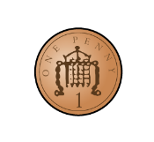




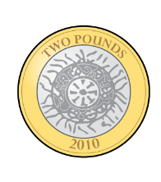
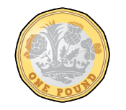
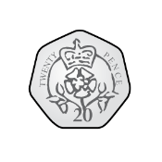
Organise the coins on your table into pence and pounds.
Can you name each coin?

Slide 3
Write down the value of each coin.

Slide 4
Match the cards with equal values.
A
A
C
D

Slide 5

Dora says:
Do you agree with Dora?
Justify your answer.
All coins are round.

Slide 6
Which is the odd one out?
Why?
20 p
8 p
10 p
2 p

Slide 7




The tooth fairy left some money for two children.
Jack has 50 pence. Mo has one pound.
Jack thinks he has more money because his coin is physically bigger.
Explain why Jack is wrong.
Jack
Mo

Slide 8



How many of each note can you see?
There are _____ 5 pound notes.
There are _____ 10 pound notes.
There are _____ 20 pound notes.

Slide 9
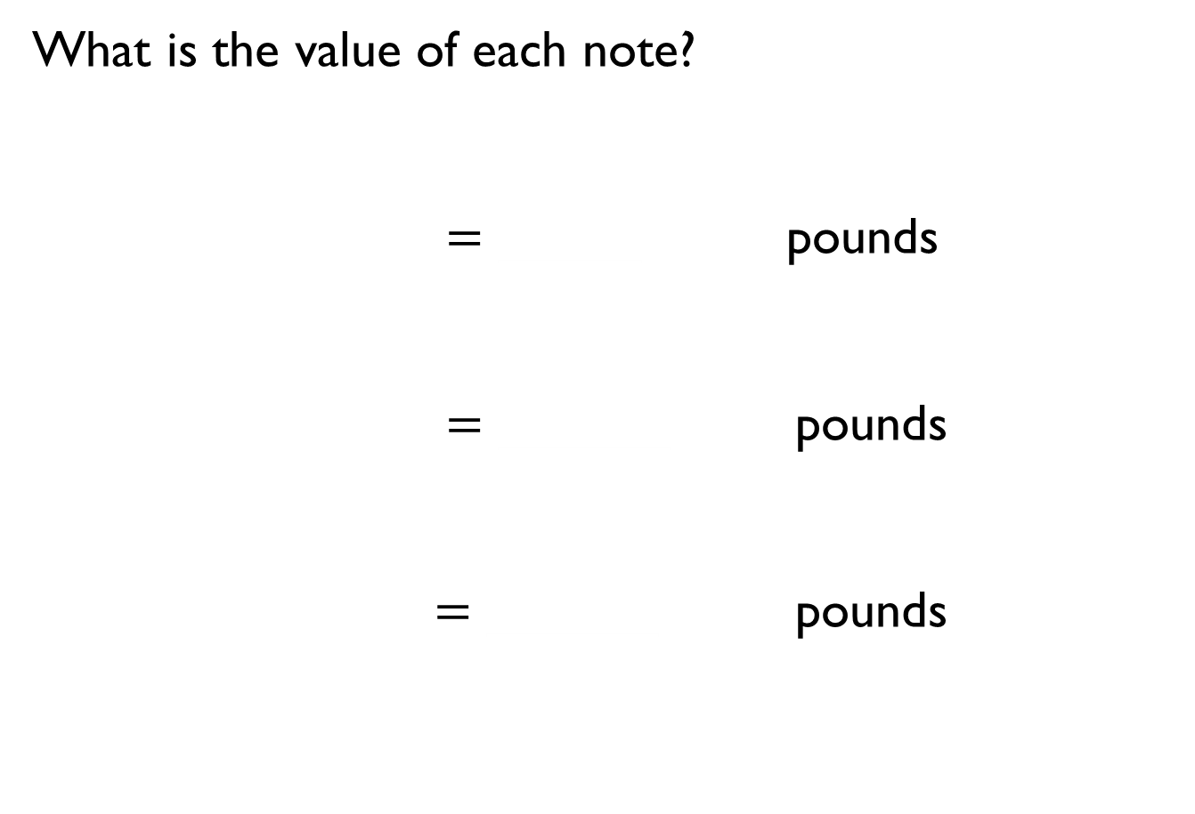
What is the value of each note?
$=$ _____ pounds
$=$ ______ pounds
$=$ ______ pounds

Slide 10


Teddy is given one for Christmas.
Eva is given two
Who is correct?
Explain your reasoning.
Eva
I got more than you did because I got two notes.
Teddy
I got more than you did because my number is bigger.

Slide 11



Jack, Rosie and Amir each have some money in their pockets. Jack and Amir both have coins and Rosie has a note.
What note could Rosie have?
I have more money than Rosie.
Amir
I have less money than Rosie.
Jack

Slide 12
Always, sometimes or never true?
Money in notes is worth more than money in coins.

Slide 13



Using coins children make links to times tables. What do they notice?

Slide 14
Use or draw coins to show the given amounts.
10p in 5p coins.
50p in 5p coins.
50p in 10p coins.
40p in 5p coins.

Slide 15





Use $<$, $>$ or $=$ to compare the amounts.
$$<$$
$$=$$
$$>$$

Slide 16




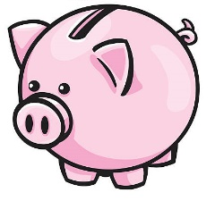
Tommy’s piggy bank is full of 2 pence pieces, 5 pence pieces and 10 pence pieces.
Using one type of coin at a time, how can he make 30 p?

Slide 17

Alex has 2 silver coins.
Teddy has 5 bronze coins.
Amir has 1 silver coin.
They all have the same amount of money.
Which coins do they each have?
Collect or draw the coins to prove it.
Are there any other amounts that this works for?

