Slide 1




Year 1 - Summer - Block 4
Place Value (to 100)

Slide 2
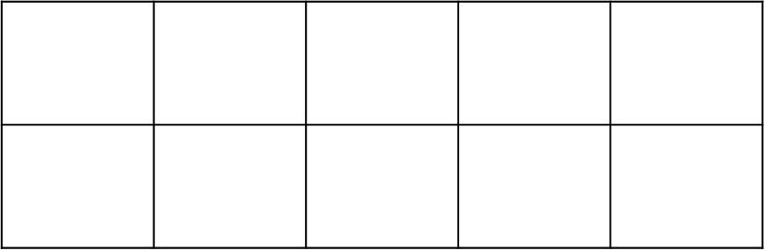





How many flowers are there altogether?
Can you represent the flowers using ten frames and counters?

Slide 3



How many straws are there?
Bundle the straws into tens to make them easier to count.

Slide 4
Use the hundred square to:
Count forwards from 80 to 92
Count backwards from 73 to 65
Write down the numbers
between 75 and 81
Find what number comes
between 46 and 48
1 | 2 | 3 | 4 | 5 | 6 | 7 | 8 | 9 | 10
11 | 12 | 13 | 14 | 15 | 16 | 17 | 18 | 19 | 20
21 | 22 | 23 | 24 | 25 | 26 | 27 | 28 | 29 | 30
31 | 32 | 33 | 34 | 35 | 36 | 37 | 38 | 39 | 40
41 | 42 | 43 | 44 | 45 | 46 | 47 | 48 | 49 | 50
51 | 52 | 53 | 54 | 55 | 56 | 57 | 58 | 59 | 60
61 | 62 | 63 | 64 | 65 | 66 | 67 | 68 | 69 | 70
71 | 72 | 73 | 74 | 75 | 76 | 77 | 78 | 79 | 80
81 | 82 | 83 | 84 | 8 | 86 | 87 | 88 | 89 | 90
91 | 92 | 93 | 94 | 95 | 96 | 97 | 98 | 99 | 100

Slide 5






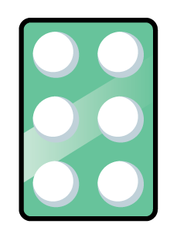






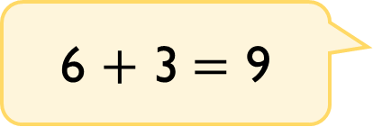
Teddy has made a number using the number shapes.
He says
What mistake has Teddy made?
6 $+$ 3$=$ 9
Teddy

Slide 6
Correct the mistake in each sequence.
34, 35, 36, 38, 39
98, 97, 96, 95, 93
78, 79, 18, 81, 82

Slide 7
Use Base 10 to make these numbers. Complete the stem sentences.
70 36 64 81 22 66 49
has tens and ones.
has tens and ones.
70
7
0

Slide 8



Complete the part-whole models.
8_
92

Slide 9


Show these numbers using a place value chart, Base 10 or straws.
Tens | Ones
73 50 88 79
91 85 62 93

Slide 10


Is Jack correct?
Prove it.
I have 9 ones.
Mo
I only have 1 ten so your number is bigger than mine.
Jack

Slide 11
Use Base 10 to make a number:
Greater than 84
Less than 70
Greater than 75 but less than 87

Slide 12
Use Base 10 to make a number.
The number has 5 tens and
fewer than 8 ones.
How many possible numbers are there?

Slide 13
Use Base 10 to make these numbers on place value charts. Write how many tens and ones are in each number.
78 and 61 90 and 89 64 and 92
Which number from each pair is the largest? Discuss how you know.
Tens | Ones
Tens | Ones
Tens | Ones

Slide 14
On the hundred square, find a number:
Less than 69
Greater than 79
Greater than 69
but less than 79
1 | 2 | 3 | 4 | 5 | 6 | 7 | 8 | 9 | 10
11 | 12 | 13 | 14 | 15 | 16 | 17 | 18 | 19 | 20
21 | 22 | 23 | 24 | 25 | 26 | 27 | 28 | 29 | 30
31 | 32 | 33 | 34 | 35 | 36 | 37 | 38 | 39 | 40
41 | 42 | 43 | 44 | 45 | 46 | 47 | 48 | 49 | 50
51 | 52 | 53 | 54 | 55 | 56 | 57 | 58 | 59 | 60
61 | 62 | 63 | 64 | 65 | 66 | 67 | 68 | 69 | 70
71 | 72 | 73 | 74 | 75 | 76 | 77 | 78 | 79 | 80
81 | 82 | 83 | 84 | 8 | 86 | 87 | 88 | 89 | 90
91 | 92 | 93 | 94 | 95 | 96 | 97 | 98 | 99 | 100

Slide 15




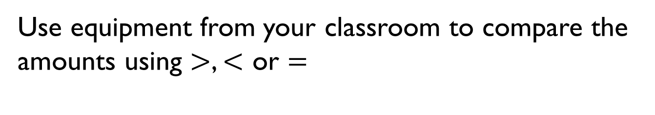
Use equipment from your classroom to compare the amounts using $>$, $<$ or $=$

Slide 16


Eva and Alex have some number cards.
They both use two of their cards to make two-digit numbers.
Eva’s number is bigger than Alex’s number.
What could their numbers be? How many answers can you find?
1
2
4
Eva
3
5
6
Alex

Slide 17



How many ways can you complete the part-whole models to make the calculation correct?
$$>$$

Slide 18



Compare the amounts using $<$,$>$or $=$
$$<$$
Tens | Ones
Tens | Ones
$$=$$
Tens | Ones
Tens | Ones
$$>$$
Tens | Ones
Tens | Ones
5 | 1

Slide 19
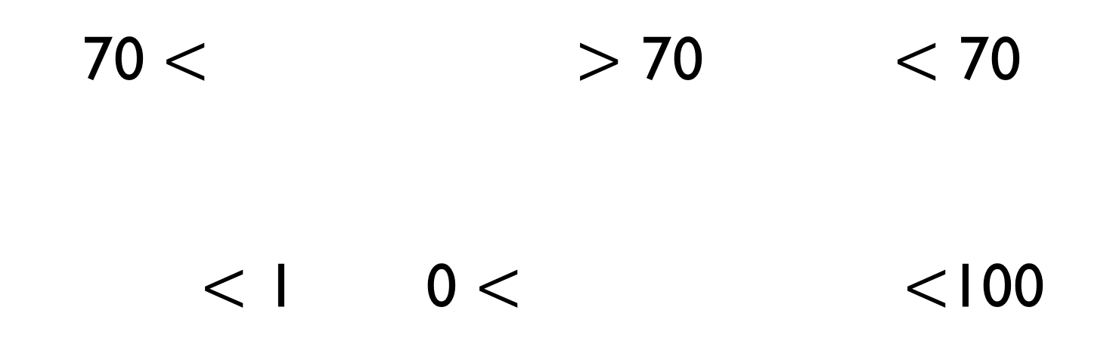
Complete the statements:
70 $<$ $>$ 70 $<$ 70
$<$ 1 0 $<$ $<$100

Slide 20




Complete the stem sentences and statements.
62 is _______ than 55 but _______ than 70
___ is greater than ____ but less than ___
the statements:
$$<$$
$$<$$
$$>$$
$$>$$

Slide 21
Tommy has marked numbers on his number lines.
Has he made any mistakes?
Explain to a friend the mistake you think he has made.
Show the numbers on your own number line.
75
34
91
57
65
56
50
60
70

Slide 22
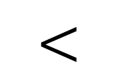
How many different ways can you complete the place value charts to make the statement correct?
Tens | Ones
5
Tens | Ones
 | 3
$$<$$

Slide 23




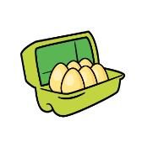
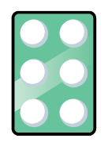






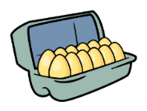




Put these objects in the correct place in the table.
 | Most |  | Least
Counters
Number Pieces
Eggs

Slide 24
In groups of 4 roll some PE equipment.
The furthest roll wins.
Give a sticker and a high-five to the person who came first, second, third and fourth.

Slide 25
Order the numbers from smallest to largest.
57 8 21 100 93 72

Slide 26




Mo creates a traffic jam using some toy cars on the carpet.
The red car is 3rd from the front.
It is also the 2nd from the back.
Use some cars or manipulatives to find out how many cars are in the traffic jam.

Slide 27
The numbers in each list are in size order.
Complete the missing numbers.
Why did you choose the numbers you did?
Are they the only numbers that could have completed the number tracks?
65 | 78 |  | 91 | 99
89 | 80 | 72
 |  | 57

Slide 28







Use manipulatives and ask children to show one more and one less than the given amounts.

Slide 29
Complete the missing numbers.
 |  | 37
 | 46 | 47
55 |  | 57
65

Slide 30
Use the number cards to make 2 digit numbers.
Now write down one more and one less than the numbers you have made.
Use equipment if needed.
7
5
9
6

Slide 31
Can you move two of the counters so Rosie has 1 more than Alex and Whitney has 1 less than Alex?
Alex
Rosie
Whitney

Slide 32
Always, Sometimes or Never True?
When finding 1 less than a number, the tens digit of the number stays the same.

Slide 33



Dora started with this number.
Has Dora shown the correct amount?
Explain how you know.
I am going to find one more.

