Slide 1




Year 1 - Spring - Block 3
Length & Height

Slide 2





Rosie, Alex and Mo are comparing the height of Mrs Rose and Jack.
Rosie
Alex
Mo
Can you improve their sentences to make them more accurate?
Mrs Rose is tall than Jack.
Jack is short than Mrs Rose.
Mrs Rose is longer than Jack.

Slide 3

Eva thinks the pencils are the same length.
How can Eva check if she is correct?

Slide 4
Using classroom equipment, can you find an object which is longer than your rubber but shorter than your pencil?
Can you find a friend who is shorter than you but taller than your other friend?

Slide 5


True or false?
The flower is 8 cubes tall.
Explain your answer.

Slide 6
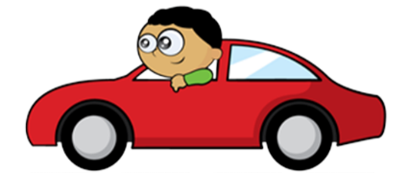
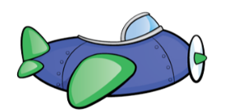



Whitney measures the length of two toys.
She says,
Do you agree with Whitney?
Explain your answer.
The toys are the same length.

Slide 7
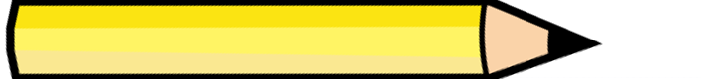
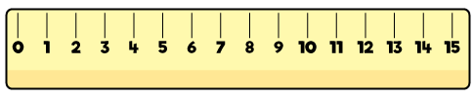

Teddy measures the length of the pencil.
He says,
Do you agree with Teddy?
Explain why.
The length of the
pencil is 10 cm.

Slide 8



Eva, Dexter and Rosie are comparing ribbons that they have.
Unfortunately, Dexter has lost his ribbon.
He says,
Eva
Rosie
Dexter
How long could Dexter’s ribbon be?
My ribbon is shorter than Rosie’s, but longer than Eva’s.

