Slide 1




Year 1 - Spring - Block 4
Weight & Volume

Slide 2

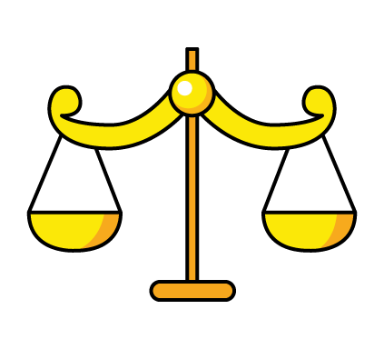

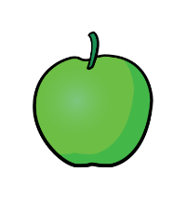


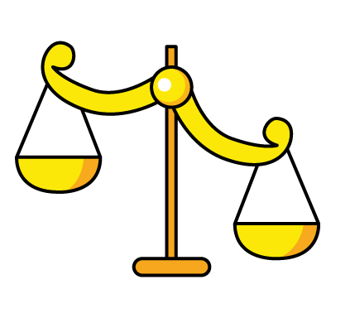


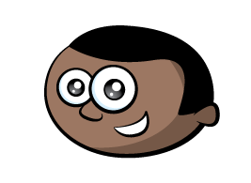
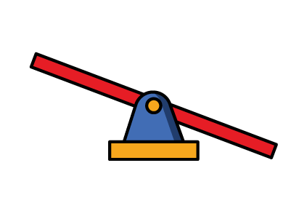

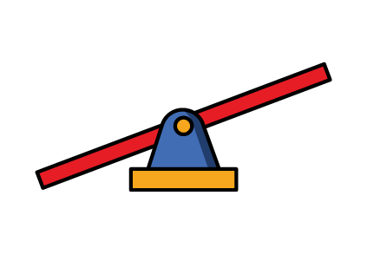
The class are seeing whether the balloon or apple will weigh more.
Eva
Whitney
Mo
Teddy
Who is correct? Explain why.
The balloon will be heavier because it is bigger than the apple.
The balance will be level because they are both red.
The apple will go down because it is lighter.
The balloon will go up because it is lighter.

Slide 3

What object could Jack be thinking of?
Prove it.
How many objects can you think of?
I’m thinking of an object. It is heavier than a pencil, but lighter than a dictionary.

Slide 4






=
Amir says,
Teddy says,
Who do you agree with?
Explain why.
The apple is heavier than the peach, because it weighs 4 cubes.
The apple and the peach weigh the same.

Slide 5
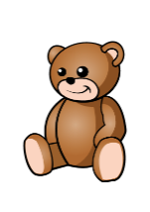
How many cubes does the teddy bear weigh?
Explain how you know.

Slide 6




Complete the sentences below:
The ________ is heavier than the .
The ________ is lighter than the .
The ________ weighs ____ pencils.
$$=$$
$$=$$

Slide 7



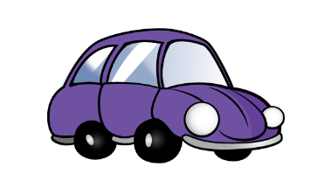

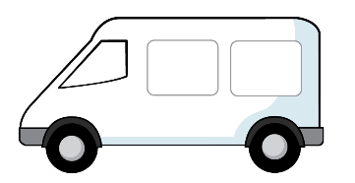
Can you match the clue to the images?
1) My object weighs more than the car.
2) My object is less than 5 cubes.
3) My object is not the heaviest or the lightest.
A
B
C

Slide 8

Look at the balance scales below.
Which statements are true?
The car is heavier than the van.
The van is heavier than the car.
The car is lighter than the van.
The van is lighter than the car.
The car and van weigh the same amount.
Can you make a problem like this for your partner?

Slide 9
Always, Sometimes, Never?
Show me.
The tallest container holds the most liquid.
Identical containers can have a different capacity.

Slide 10
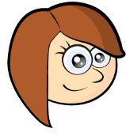



Rosie, Teddy and Amir are describing their glasses of water.
Rosie
Teddy
Amir
Can you fill in how much water could be in each of the children’s glasses?
My glass has more water than Teddy’s.
My glass is nearly full.
My glass has less water than Rosie’s.
Rosie
Teddy
Amir

Slide 11
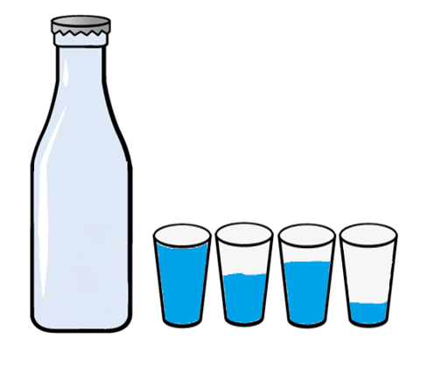
Whitney pours her cups into the bottle and they fill it exactly.
She says the bottle has a capacity of four cups. Do you agree?

Slide 12





It takes 5 to fill 1
It takes 2 to fill 1
How many will fill one ?
What else can you find out?
$$=$$
$$=$$

Slide 13
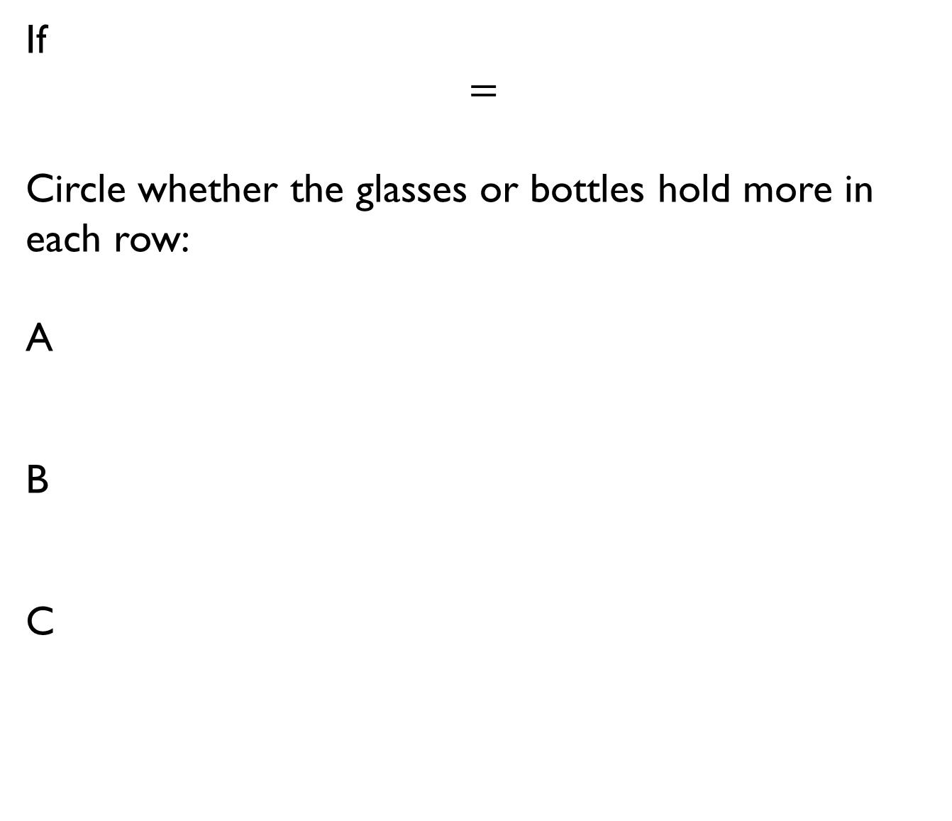
If
$$=$$
Circle whether the glasses or bottles hold more in each row:
A
B
C

Slide 14

Alex has a bottle of juice. She pours three glasses of juice.
Do you agree? Explain why.
The bottle holds exactly three glasses of juice.

Slide 15
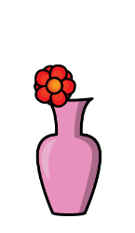

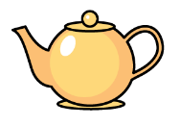
Choose three containers.
Investigate how you could compare the capacity of each one.

