Slide 1




Year 1 - Summer - Block 3
Position & Direction

Slide 2
Are these statements correct?
Is there more than one answer?
Explain how you know.
The shape has made a quarter turn.
The shape has made a half turn.
The shape has made a three-quarter turn.

Slide 3






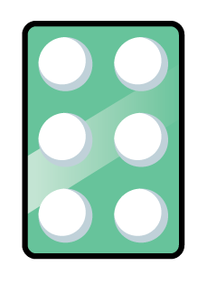
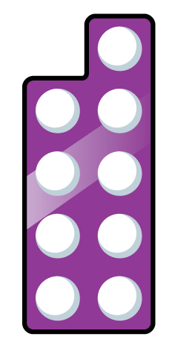
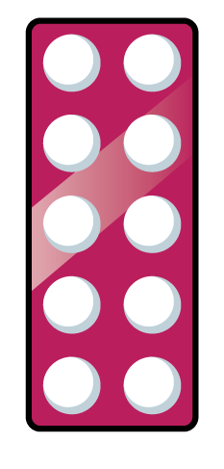
Alex turns her number shape and it finishes facing this direction.
What direction could it have started facing?
What turn could it have made?

Slide 4
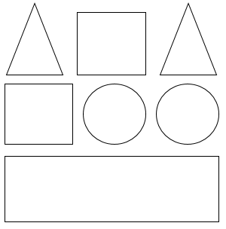
Use the clues to colour the shapes.
The circle in the middle is blue.
The circle on the right is red.
The shape up from the right circle is green.
The shape down from the circles is green.
The square to the left of the green triangle is red.
The four-sided shape up from the rectangle is blue.
The triangle on the left is red.

Slide 5

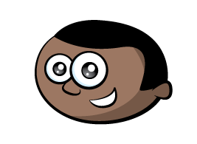

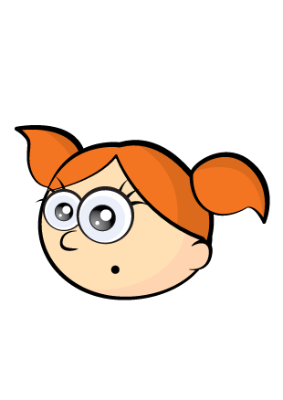


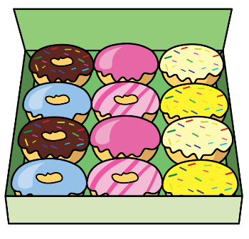


Who is correct?
Explain how you know.
The pink doughnuts are on the left.
Mo
The pink doughnuts are on the right.
Alex

Slide 6





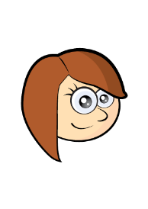



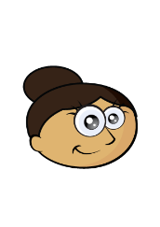



Jack is directly above Alex.
Eva is directly below Alex.
________ is to the right of Eva.
There is no-one above Amir.
What are the missing names?
Add people to complete the grid and describe where they are.
Whitney
Jack
Teddy
Jack
Alex
Annie
Rosie
Whitney
Tommy
Dora
Mo
Amir
Ron
Eva
Dora
Dexter

Slide 7



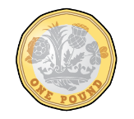
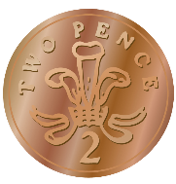



How many different ways can you describe the position of the 2p coin?

