Slide 1




Year 1 - Summer - Block 6
Time

Slide 2







Sort the activities into before and after school.
Can you think of one more activity for each group?
Can you sort the activities into three groups labelled morning, afternoon and evening?
?
?
Bedtime story
Get
dressed
Go to a party
Breakfast

Slide 3



Tommy is drinking a bottle of orange juice.
Match the words to the bottles to order them.
finally
first
next

Slide 4

Dora is describing her day.
Dora
Draw and label pictures to order Dora’s day.
First, I went to the park.
After lunch, I went to the cinema.
Before the cinema, I went to a café for lunch.
First
Then
Next

Slide 5


Draw pictures to show what could have happened before and after.
Before
After

Slide 6
Fill in the missing days of the week and complete the sentences.
    Today is Wednesday, yesterday was ______.
    Yesterday was Monday, today is _______.
    Today is Saturday, tomorrow is _______.
    Tomorrow is ________, today is Wednesday.
Sunday
Tuesday
Wednesday
Saturday

Slide 7
Use a calendar to look at the names of the months.
Discuss special dates in different children’s lives e.g. birthdays, celebrations, holidays.
Complete the sentences.
My birthday is in _____________.
In ________, I went to ______________.

Slide 8

Eva is practising chanting the months of the year.
She says,
Eva is incorrect. Correct her mistakes.
January, February, May, April, March, July, June, August, September, November, October, December.

Slide 9
The 5th June is a Wednesday.
What day is the 10th June?

Slide 10
Sort the days of the week into school days or non-school days.
Sunday
Thursday
Saturday
Friday
Wednesday
Tuesday
Monday
At school
Not at school

Slide 11
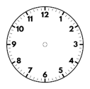
Match the times to the clocks.
9 o’clock
Two o’clock
5 o’clock

Slide 12
Complete the times.
The time is
___ o’clock
The time is
___ o’clock

Slide 13

Draw the hour hand and minute hand on clock faces to show the times:
Eight o’clock 1 o’clock Twelve o’clock

Slide 14

Can you spot Amir’s mistake?
The time is 3 o’clock.
Amir

Slide 15

Is Alex correct?
Explain your reasoning.
When it is 11 o’clock both hands point at 11

Slide 16
Match the times to the clocks.
Half past twelve
Half past 2
Half past nine

Slide 17
Complete the times.
The time is half past ___
The time is half past ___

Slide 18
Draw the hour hand and the minute hand on clock faces to show these times:
Half past 1 Half past four Half past 8

Slide 19

Tommy
Can you spot Tommy’s mistake?
The time is 6 past 1

Slide 20
Read the instructions and draw the hands on the clock.
The minute hand is pointing at the six.
The hour hand is half way between 10 and 11
What time is it?

Slide 21
Using a stopwatch, record how many times you can do these activities in 20 seconds.
Star jumps
Write your name
Hops on the spot
Can you think of any activity which takes 20 seconds?

Slide 22
Would you measure the duration of the activities in seconds, minutes or hours? Sort the activities into three groups: seconds, minutes and hours.
Brushing teeth
Reading a book
Saying the alphabet
Holiday flight
Playing outside
Sleeping at night

Slide 23
Complete the sentences using seconds, minutes or hours.
Playtime is about 20 _________ long.
The school day is about 6 _______ long.

Slide 24
Are the units of time chosen sensible for these activities?
A football match measured in seconds.
A lap around the school playground measured in minutes.
A birthday party measured in hours.
Explain your answers.

Slide 25
Dora has a clock without an hour hand.
She says,
Do you agree with Dora?
Explain your answer.
I can measure how long it takes someone to run around the playground 10 times using my clock.

Slide 26



Teddy, Mo and Whitney are running a race. Here are their times.
Use faster or slower to complete each sentence.
Teddy is _________ than Mo.
Teddy is _________ than Whitney.
Whitney is _________ than Mo.
Can you write any more sentences to describe the race using the words slower and faster?
Teddy -
52 seconds
Mo -
58 seconds
Whitney -
48 seconds

Slide 27
Three planes are flying to Paris in the morning.
Here are the times they arrive.
Use earlier and later to complete the sentences.
Plane A is _________ than Plane B.
Plane B is _________ than Plane C.
Plane C is _________ than Plane A.

Slide 28
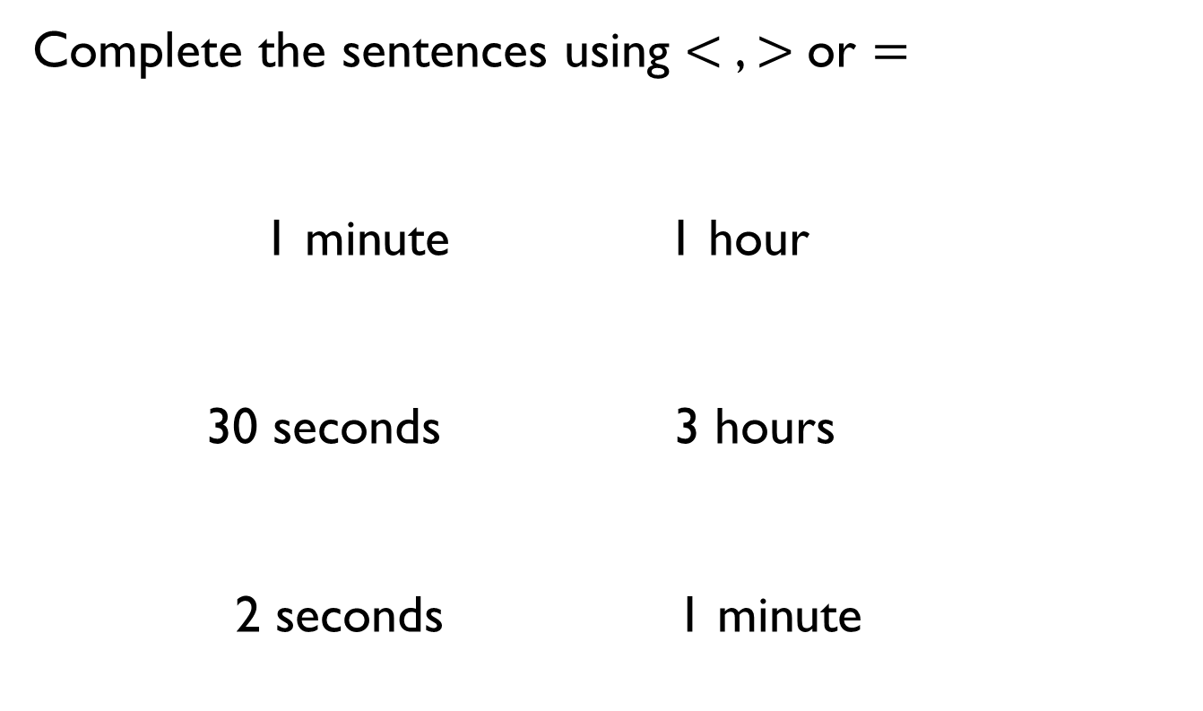



Complete the sentences using $<$, $>$or $=$
1 minute 1 hour
30 seconds 3 hours
2 seconds 1 minute
$$<$$
$$=$$
$$>$$

Slide 29
Work in small groups.
Complete the following activities and record how long it takes each person.
Build a tower of ten bricks.
Run a lap of the playground.
Write your name five times.
Write three sentences about each activity using the words slower and faster.

Slide 30
Five friends are going to a party.
Use the clues to work out when each friend arrived.
Amir arrived later
than Jack and Eva.
Rosie arrived later
than Amir but
earlier than Ron.
Eva arrived the
earliest.
1st
2nd
3rd
4th
5th

