Slide 1




Year 2 - Summer - Block 4
Measurement

Slide 2
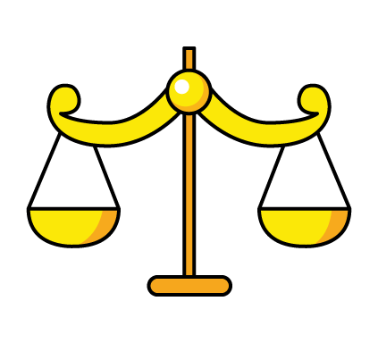




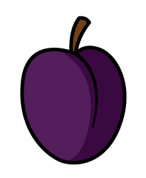

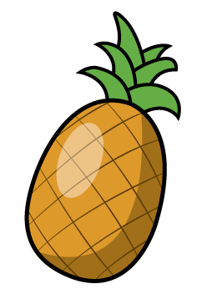

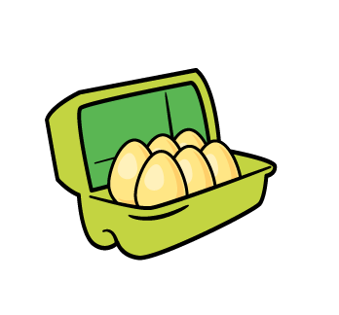
Tommy
Eva
Do you agree?
Explain why.
Apples weigh more than bananas.
Two doughnuts weigh the same as two bananas.

Slide 3



One pear weighs 10 cubes.
How many cubes will balance one pineapple?
Explain how you know.

Slide 4
Always, Sometimes or Never true?
The larger the box, the heavier it is.

Slide 5



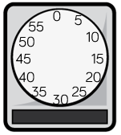
Which is heavier, the red or the green beanbag?
Explain why.

Slide 6


The weighs g.
The weighs g.

Slide 7
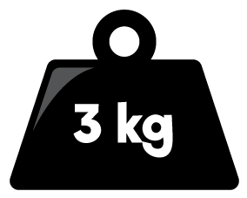
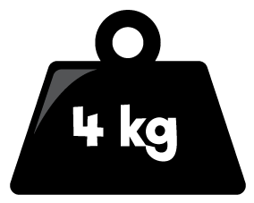
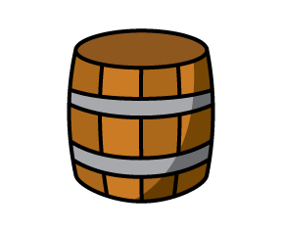

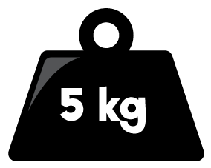


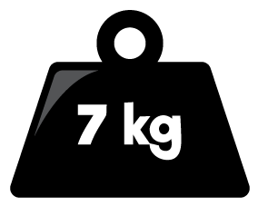
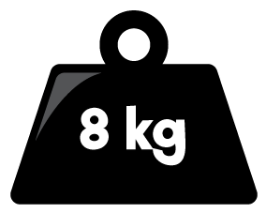
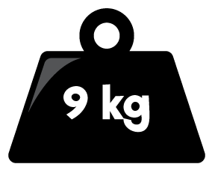
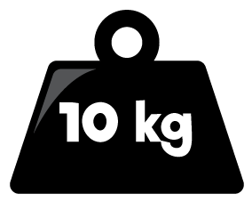

What is the mass of each barrel?
Double the mass of A
Half the mass of A
What is the difference between the mass of B and C?
A
B
C

Slide 8
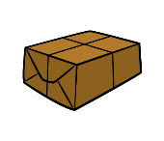
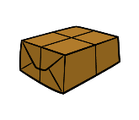

The brown parcel weighs twice as much as the blue parcel.
The green parcel weighs 2 kg more than 30 kg
The blue parcel weighs 12 kg less than the green parcel.
Draw an arrow to show where each parcel would be on the scale.
0
10
20
30
40

Slide 9
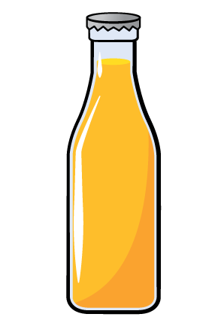
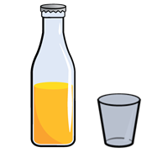
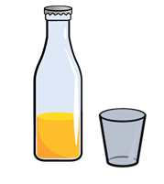
Whitney had two full bottles of juice.
She poured some juice into two glasses.
A B
Which glass has the most juice in?
Which has the least juice in?
Explain how you know.

Slide 10


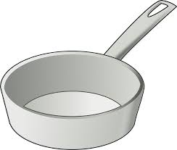
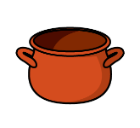
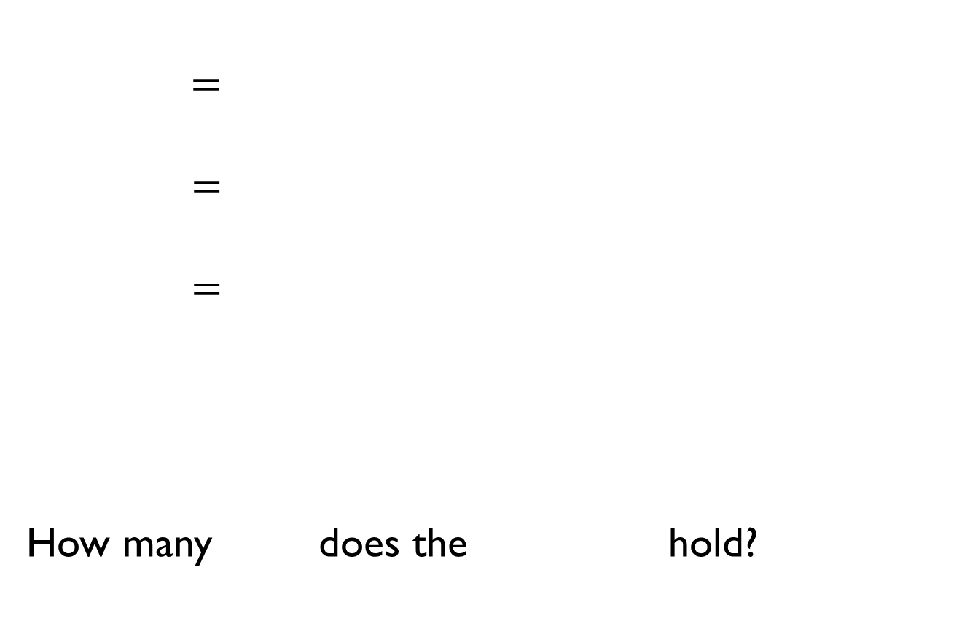
$=$
$=$
$=$
How many does the hold?

Slide 11
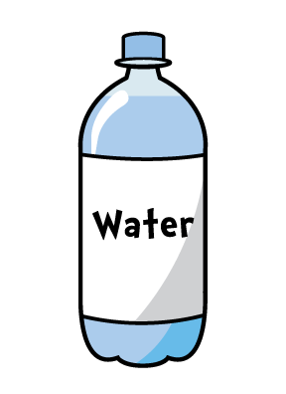
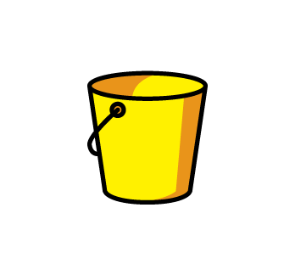
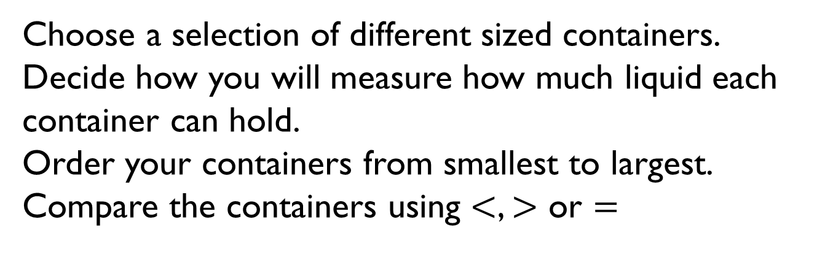
Choose a selection of different sized containers.
Decide how you will measure how much liquid each container can hold.
Order your containers from smallest to largest.
Compare the containers using $<$, $>$ or $=$

Slide 12
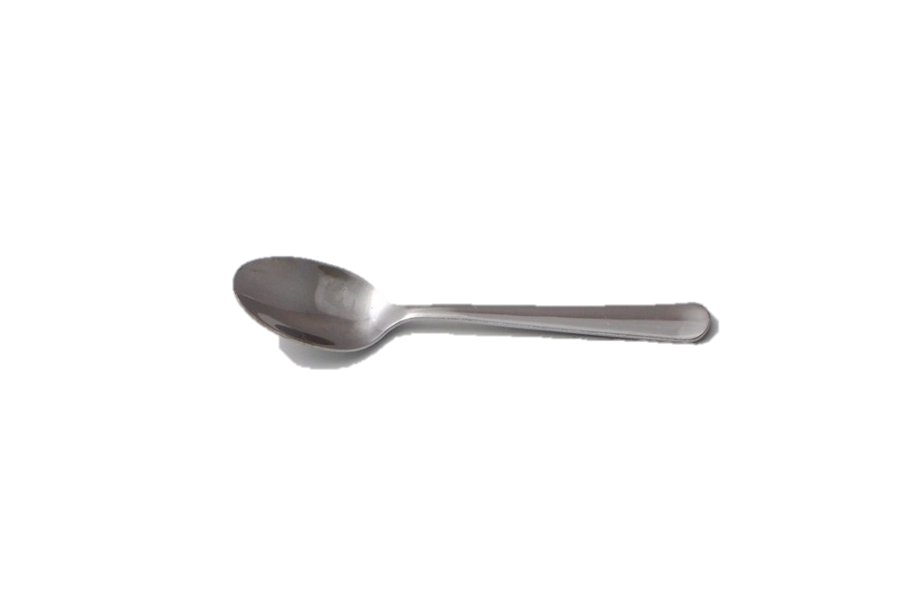
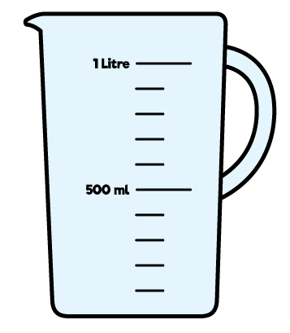
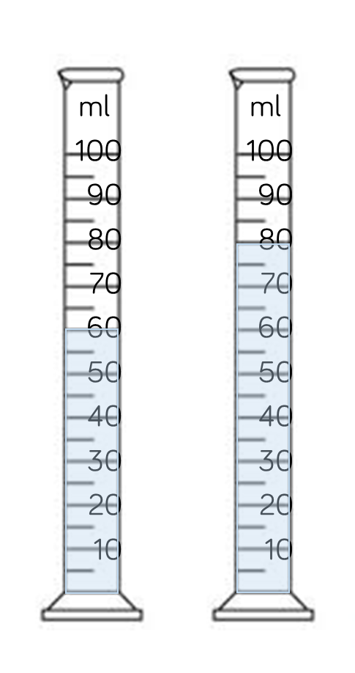
A holds 5 ml of liquid.
How many of liquid are there in each container?
A B
100 ml
100 ml
50 ml
50 ml

Slide 13
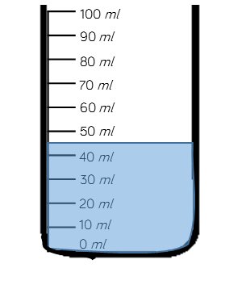
Estimate the amount of water in the container.
Explain why you have given your answer.
100 ml
100 ml
50 ml
50 ml

Slide 14
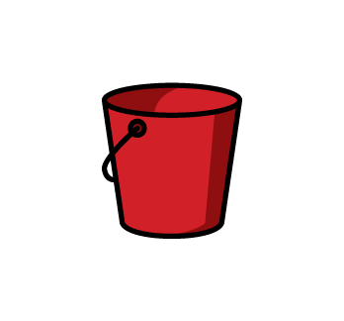
Mo puts 4 litres of water in bucket A.
He then pours 3 litres from bucket A into bucket B.
A B
Which sentence is correct?
There is more in bucket A.
There is less in bucket A.
There are equal amounts in each bucket.
Explain why.

Slide 15

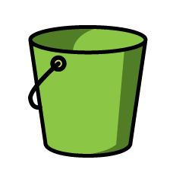
Eva wants to measure 2 litres of water into a tub. She only has a 5 litre and a 3 litre container.
How can she use both containers to measure 2 litres?
5 l
3 l

Slide 16

3 bowls each have more than 20 l of water in but less than 50 l
The green bowl has 5 l more than the red bowl.
The blue bowl has 10 l more than the green bowl.
How much could each bowl have in?

Slide 17
Mollie took the temperature at 12 p.m. and again at 5 p.m.
There was a difference of 7°C
What could the temperatures be?

Slide 18
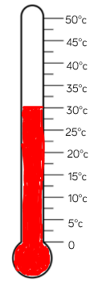
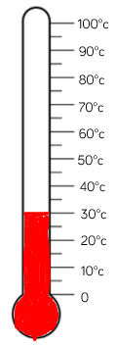
What is the same and what is different about the thermometers/temperatures?

