Slide 1




Year 2 - Spring - Block 2
Statistics

Slide 2








Dexter makes a tally chart of the animals he saw at the zoo.
Which box shows all of the animals Dexter saw? Explain why the others are incorrect.
Box 1
Box 2
Box 3
Box 4
Animal | Tally

Slide 3
Class 1 and Class 2 were each asked their favourite ice-cream flavours.
Their results are shown in the tally charts.
What is the same? What is different?
Class 1
Flavour | Total
Vanilla
Chocolate
Strawberry
Mint
Class 2
Flavour | Total
Vanilla
Chocolate
Strawberry
Mint

Slide 4
Here is a pictogram showing the number of counters each child has.
How could you improve the pictogram?
Dexter
Alex
Mo
Rosie

Slide 5

Use the clues to help you complete the pictogram.
More Caramel was sold than Bubblegum flavour, but less than Strawberry flavour.
Mint was the most popular flavour.
Vanilla was the least popular.
Can you find more than one way to complete the pictogram?
Flavour | = 1 ice cream | Total
Strawberry
Vanilla
Chocolate
Mint
Caramel
Bubblegum |  | 4

Slide 6
Teddy writes these statements about his pictogram:
There were more cows than sheep.
There were the same number of sheep and horses.
There were more chickens than any other animal.
There were less cows than goats.
There were 8 goats.
Can you draw a pictogram so that Teddy’s statements are correct?
What title would you give it?

Slide 7

Here is a pictogram.
Do you agree with Eva?
Explain why and correct any mistakes
Blue
Red
Yellow
Green
The most popular colour sweet is green.

Slide 8
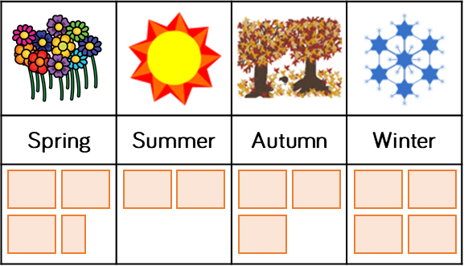

Create a pictogram to show who was born in what season in your class.
Use what you know about pictograms to help you.
Here is an example.
Key
Spring | Summer | Autumn | Winter
$=$ 2 children

Slide 9


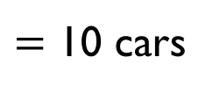

Teddy and Eva both draw a pictogram to show how many cars they counted driving past their school.
What is the same? What is different?
Whose pictogram do you prefer? Why?
Eva
Colour | Number of cars
Blue
Red
Silver
Black
Green
Teddy
Blue | Red | Silver | Black | Green
$=$ 5 cars
$=$ 10 cars

Slide 10




Jack and Whitney have carried out a traffic survey.
Who is right? Convince me.
Van
Bus
Bike
Lorry
Car
$=$ 10 vehicles
To find the total number of vehicles I need to count the symbols. There are 16 and a half vehicles.
Whitney
If I add the number of lorries and bikes together then it will be equal to the number of cars
Jack

Slide 11



Justify
If the staff needed to pick one day to have off during the week, which would be the best day and why?
Convince me
There are more ice-creams sold at the weekend than during the rest of the week
True or False (Why?)
Three ice creams were sold on Tuesday
$=$ 2 ice creams
Mon | Tues | Wed | Thur | Fri | Sat | Sun

Slide 12
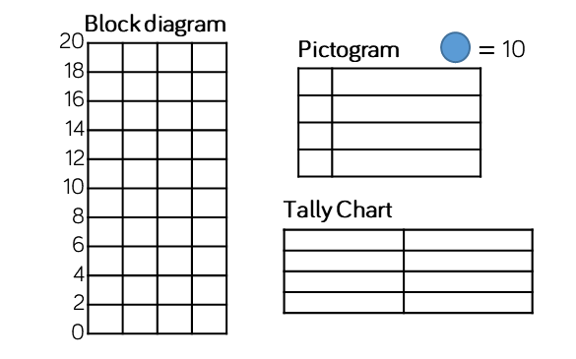
Here are three tables of data.
Which set of data could you display using the block graph?
Which could use the pictogram?
Which could use the tally chart?
Explain your reasoning.
Block diagram
Pictogram
Tally chart
Data Set 1
Data Set 2
Data Set 3
Team | Goals scored
A | 20
B | 32
C | 27
D | 16
Player | Points
1 | 20
2 | 65
3 | 80
4 | 45
Name | Score
Ron | 20
Eva | 12
Amir | 6
Mo | 16

Slide 13

Split into groups.
Everyone needs to write their name on a sticky note.
Use your sticky notes to create a block diagram to answer each question.
How many boys and how many
girls are there in your group?
Which month has the most
birthdays for your group?
What is your favourite sport?
What other information about your group could you show?

