Slide 1




Year 2 - Spring - Block 3
Properties of Shape

Slide 2
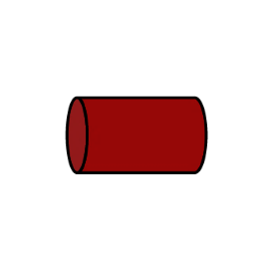
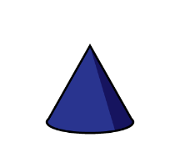

Which shape is the odd one out?
Explain why.
Which shape is the odd one out? Explain your reasoning.

Slide 3

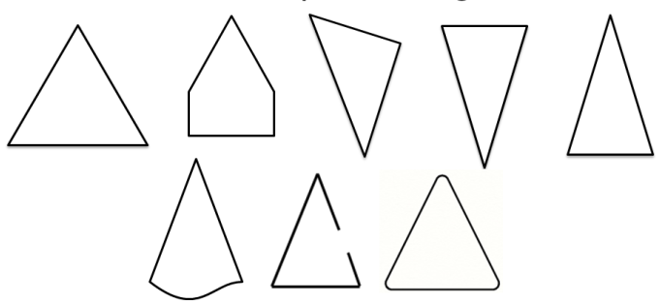
What shape could Whitney be thinking of?
Are there any other shapes it could be?
What shape is Whitney definitely not thinking about? How do you know?
Use true or false to say which shapes are triangles.
I’m thinking of a 2-D shape with more than 3 sides.

Slide 4
Here are 18 lollipop sticks.
How many hexagons can you make?
How many octagons can you make?
What other shapes can you make with 18 lollipop sticks?

Slide 5
Mo makes a rectangle using the sticks.
How many identical rectangles could he make with 18 sticks?
Make your own rectangle. How many sticks did you use? Is your rectangle the same as your friend’s?

Slide 6
If I put these shapes into order from the smallest number of sides to the largest, which shape would come third?
Where would a hexagon come in the list? Why?

Slide 7

Amir says,
What shape could he have?
My shape has half the number of vertices as an octagon.

Slide 8
Put these shapes in order based upon the number of vertices they have.

Slide 9
Jack has created a pattern using shapes.
How many vertices does each step in the pattern have?
Can you predict how many vertices the next step in the pattern will have?
Is there more than one way to continue the pattern?
Can you create your own pattern and explore how the vertices change?
1
2
3

Slide 10
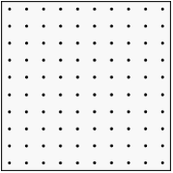
Using geoboards, how many different rectangles can you make?
What’s the same about the rectangles?
What’s different?
Has your friend made any different rectangles?

Slide 11
What shape could be hiding under the spilt paint?
Prove your answer by drawing it.

Slide 12
Can you draw more than one four-sided shape that has a vertical line of symmetry?

Slide 13

Tommy has placed a mirror on the vertical line of symmetry.
This is what he sees:
Can you complete the other half of the shape?

Slide 14
Which 2-D shapes can be made when a vertical line of symmetry is drawn on a square?

Slide 15
Ron sorted the shapes in order of the number of sides.
Has he ordered them correctly?
Explain why.

Slide 16
Which shape is in the wrong set?
Explain why.
Vertical line of symmetry | No vertical line of symmetry

Slide 17
Where should these shapes go in the Venn diagram?
Create your own labels and sort the shapes in a different way.
4 sides Orange

Slide 18
Dora says that the 12th shape in this pattern will be a triangle.
Is she correct?
How do you know?

Slide 19
How many different ways can you arrange these shapes to make a repeating pattern?

Slide 20
Can you translate this pattern using shapes?
Clap, clap, snap, clap, clap, snap, clap, clap ……

Slide 21
Teddy says my 3-D shape has 6 faces. Mo says he must have a cube.
Is Mo correct?
Explain your answer.

Slide 22


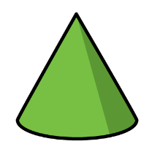
Annie has sorted these 3-D shapes.
Can you spot her mistake?
Can you add another shape to each set?
Flat faces
Curved surfaces
Both

Slide 23

Whitney says,
What shape does Whitney have?
Play this game with a friend. Describe the faces of a 3-D shape and they need to guess what it is.
I have a 3-D shape with 2 square faces and 4 rectangular faces.

Slide 24
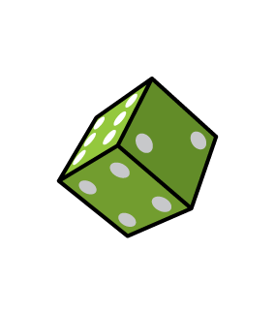
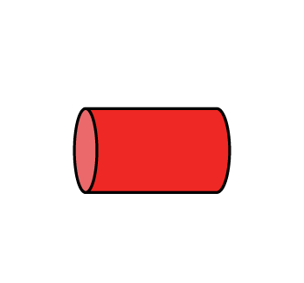
Ron has sorted these shapes according to the number of edges.
Which shape is in the wrong place?
Explain why.
1 edge
More than 1 edge

Slide 25


Is Dora correct?
Explain your answer.
My 3-D shape has 12 edges.
Eva
You could have a cube, cuboid or square-based pyramid.
Dora

Slide 26
Compare these 3-D shapes.
What is the same and what is different?

Slide 27

Jack says,
Is this true or false?
Explain why
All 3-D shapes have at least one vertex.

Slide 28

Annie is sorting 3-D shapes.
She puts a cube in the cuboid pile.
Do you agree? Why?
A cube is a type of cuboid.

Slide 29
Jack is investigating which shapes stack and which shapes roll.
He says,
Is he correct?
Sort your shapes using the Venn diagram. Explain what you notice about each set.
Do all shapes with flat surfaces stack?
Some shapes will stack and roll.
stack
roll

Slide 30
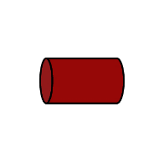
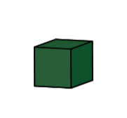

What is the same about these patterns?
What is different about these patterns?

Slide 31

Choose two 3-D shapes.
What different repeating patterns could be made?

Slide 32
Using the 3-D shapes:
- Make a repeating pattern where there are more cones than cuboids.
- Make a repeating pattern where the third shape is always a cylinder.

