Slide 1




Year 2 - Summer - Block 3
Time

Slide 2
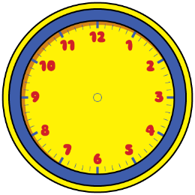



Dora
Amir
Alex
Can you spot the mistake they’ve made?
Who is telling the time correctly?
The time is half past 6
The time is half past 3
The time is half past 2

Slide 3
Alex
Is Alex correct?
Explain your reasoning
It is half past 11 so the hour hand should be on the 11

Slide 4

Oh no! The minute hand has fallen off the classroom clock!
Lunchtime is at 12:00
Have the children missed their lunchtime?

Slide 5

Do you agree with Teddy?
Explain why.
Quarter past is always later than quarter to.

Slide 6
How many quarters of an hour are between 7 o’clock and 9 o’clock.
Explain how you found the answer.

Slide 7

The train to Blackpool leaves at quarter past and quarter to every hour.
Make a list of the times of the trains Oliver can catch if he gets to the train station between 2 o’clock and half past 4

Slide 8
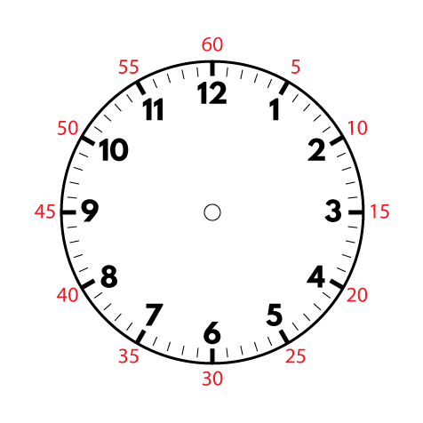
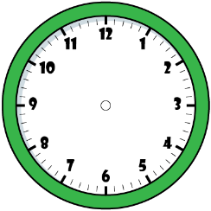

Dora
Amir
Alex
Who is correct? Explain your answer.
It is ten to one.
It is ten past ten.
It is ten to two.

Slide 9
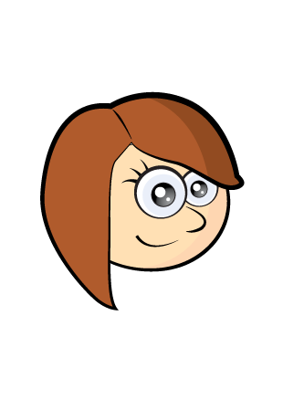
Do you agree with Rosie? Explain why.
Four lots of 5 minutes is the same as quarter of an hour.

Slide 10

Sophia starts her Maths questions at 10 past 11
Each question takes her 5 minutes to complete.
She completes 7 questions.
What time does Sophia finish her Maths questions?
Explain how you found the answer.

Slide 11

Tommy
Do you agree with Tommy? Explain why.
There must be 12 hours in a day because we start from midnight and go up to 12 o’clock then start again from 1

Slide 12
Rosie
Do you agree with Rosie? Prove it.
If you add three hours onto the current time, the amount of minutes to/past the hour do not change.

Slide 13


The day starts at 12 o’clock and ends at 12 o’clock.
Here are Eva’s calculations for working out how many hours there are in a day.
What mistake has Eva made?
12
1
2
3
4
5
6
7
8
9
10
11
12
1
2
3
4
5
6
7
8
9
10
11
12
I counted them up, and there are 25 hours in a day.

Slide 14
Oh no! The hour hand has fallen off the class clock!
Start End
The clock shows the start and end time of a film.
How long do you think the film lasted?

Slide 15
Aimee is planning her birthday. She wants to plan something to do from 9am to 5pm.
Here are the things she wants to do:
Visit the zoo (3 hours)
Go to Pizza Palace (1 hour and a half)
Have breakfast (half an hour)
Play party games (1 hour)
Watch a film (2 hours)
Create a timetable for Aimee’s day.
Compare it to your friends – is it the same?

Slide 16
The clocks show the start and end time of the film Super Dog.
The film Crazy Cat starts at quarter past 1 and ends at quarter to 3
Teddy says,
Do you agree with Teddy?
Explain why.
Super Dog must be the longest film, because it ends the latest.

Slide 17
Rosie has an hour for her lunch break.
If she takes 10 minutes to eat her lunch, does she have enough time to complete all of the playground activities?
How do you know?
Activity | Duration
Skipping | 7 minutes
Ball skills | 10 minutes
Treasure hunt | 21 minutes
Trim trail | 19 minutes

