Slide 1




Year 2 - Summer - Block 1
Position & Direction

Slide 2





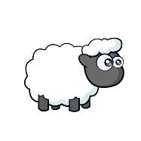
Amir
Is Amir correct?
Explain your reasoning.
The sheep has moved 2 squares forward.

Slide 3

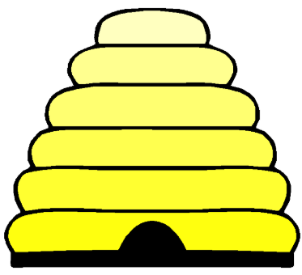
How many different routes can you write for the bee to get to the hive?
Use the words forwards, backwards, left and right.

Slide 4



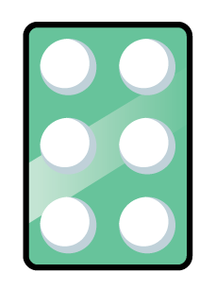


Look at the number shape below:
How could the number shape have turned?
Describe all possibilities.

Slide 5



Always, Sometimes, Never
If two objects turn in different directions they will not be facing the same way.

Slide 6
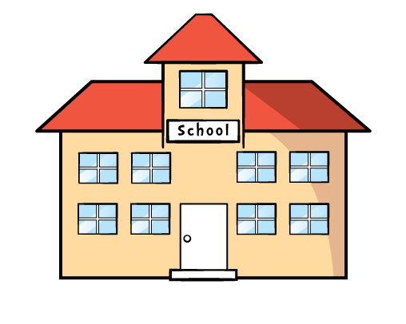
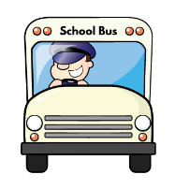
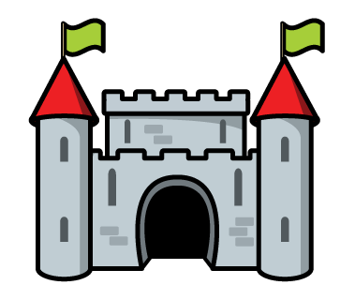
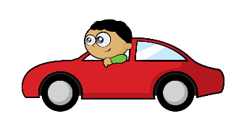
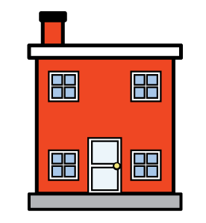

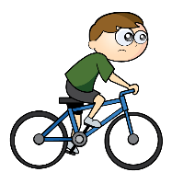
How many different routes can you find to get from start to finish.
Use the words ‘forwards’, ‘backwards’, ‘clockwise’, ‘anti-clockwise’ and ‘quarter turn’.
 |  |  | Finish
 | Start

Slide 7

Is Whitney correct?
Convince me.
A quarter turn clockwise is the same as a three-quarter turn anticlockwise.

Slide 8
How many different patterns can you create using this shape?

Slide 9

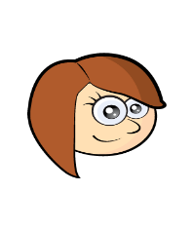
Eva
Rosie
Who is correct?
The rule is turn the shape a quarter turn.
The rule is turn the shape three quarters.

Slide 10
Spot the mistake in each pattern.
Explain why they are incorrect.

