Slide 1




Year 3 - Summer - Block 2
Time

Slide 2




4 children describe their birthdays.
Teddy
Can you work out their birthdays and order them from earliest to latest in the year?
My birthday is the first day of the second month.
Mo
I was born on the 15th of June.
I was born on the last day of the year!
Eva
I was born two days before Mo.
Dora

Slide 3



Whitney asks Rosie and Jack a question.
Who do you agree with? Explain your thinking.
Some months have 31 days, some months have 30 days. How many months have 28 days?
Only February has 28 days.
Rosie
Every month has 28 days.
Jack

Slide 4
Mo
Do you agree with Mo?
Explain your answer.
I get up at 7 o’clock in the morning and go to bed at 7 o’clock at night. This means I have been awake for a full day.

Slide 5
Su | Mo | Tu | We | Th | Fr | Sa
 | 1 | 2 | 3 | 4 | 5 | 6
7 | 8 | 9 | 10 | 11 | 12 | 13
14 | 15 | 16 | 17 | 18 | 19 | 20
21 | 22 | 23 | 24 | 25 | 26 | 27
28 | 29 | 30 | 31
In this month, there are no school holidays.
Teddy
Do you agree with Teddy?
Explain your thinking.
Which month could it be?
In this month we have to come to school for 31 days.

Slide 6
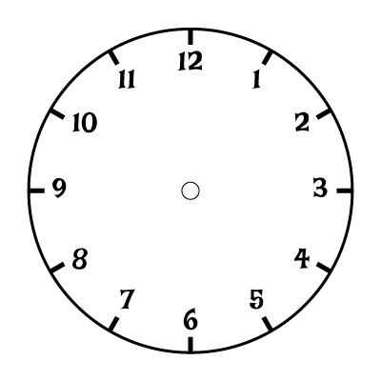


Dora
Who do you agree with?
Explain your thinking.
The clock shows ten minutes to 3
The hour hand is not quite pointing to the 3, so it must be ten to 2
Amir

Slide 7
This clock has lost its minute hand.
What time could it be?
Justify your answer.

Slide 8
This clock has lost its hour hand.
What time could it be?

Slide 9
This clock has lost its minute hand.
What time could it be?

Slide 10
Ron’s watch shows the time he
arrives at the station.
Which train could he be catching?
Explain how you know.
 | Arrives | Leaves
London | 5:50 a.m. | 6:00 a.m.
Edinburgh | 8:00 a.m. | 8:20 a.m.
Manchester | 2:33 p.m. | 2:45 p.m.
Leeds | 7:31 p.m. | 7:35 p.m.
The board shows the times of trains arriving and leaving the train station.

Slide 11

Who is more likely to be correct?
Explain how you know.
I slept from 8 p.m. to 8 a.m.
Dora
I slept from 8 a.m. to 8 p.m.
Teddy

Slide 12
Eva says the clocks are showing the same time of day.
Is she correct?
Explain how you know.
8:20

Slide 13
Is Teddy correct?
Prove it.
If the time has an 8 in it, it has to be 8 o’clock.
Teddy
8:20

Slide 14

Eva starts playing her piano at 11:30
She plays for 45 minutes before having a half an hour break.
She then plays for another 15 minutes.
What time did she finish?
8:20

Slide 15


Lunchtime begins at: Lunchtime ends at:
Teddy and Rosie are working out how long lunchtime lasts for.
Whose method is correct?
1:10
I did three quarters of an hour then added 10
Teddy
I did 1 hour take away 5 minutes
Rosie

Slide 16
Eva and Mo are having a race.
It takes Eva 3 and a half minutes to complete the race.
It takes Mo 3 minutes and 15 seconds.
Is Eva correct?
Explain how you know.
I won because I got a higher time.

Slide 17
Jack’s school starts at ten to 9 and finishes at quarter past 3
He uses the number line to calculate how long the school
day is.
Jack works out the school day is 5 hours and 35 minutes long.
Jack is incorrect.
Explain his mistake.
45 mins
4 hours
50 mins
3:15
4:00
8:00
8:50

Slide 18
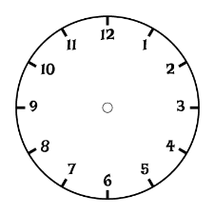


School ends in 45 minutes. What time will it be?
Amir says,
Whitney says,
Who do you agree with?
Explain why.
It’s 20 minutes to 3 o’clock, so school finishes at 3:25 p.m.
School ends at 2:85
8:20

Slide 19
Tommy is halfway through watching his favourite TV programme. He looks at his watch and it shows this time.
The show is less than 1 hour long.
What could the start and end time be?
How many different start and end times can you find?
15:45

Slide 20


Alex takes 153 seconds to skip around the playground.
Jack takes 2 minutes 23 seconds.
Who is the quickest?
Explain how you know.

Slide 21
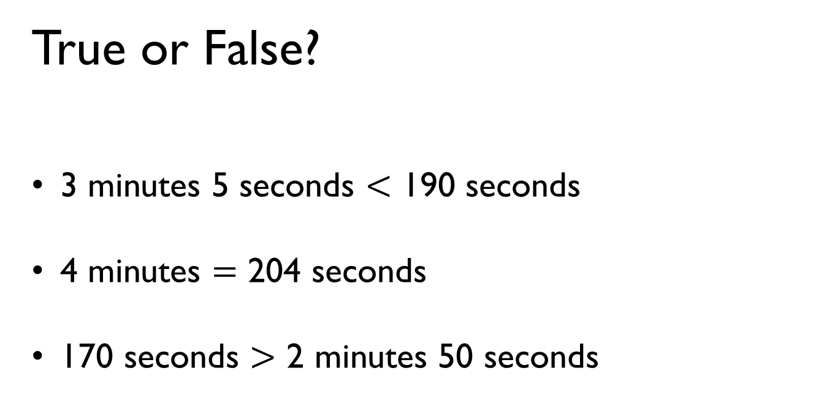
True or False?
3 minutes 5 seconds $<$ 190 seconds
4 minutes $=$ 204 seconds
170 seconds $>$ 2 minutes 50 seconds

Slide 22


Dora works out how many seconds there are in 4 minutes 15 seconds.
She says,
Dexter uses a bar model to help him.
Who is correct?
That’s easy, it is 415 seconds.
4 minutes 15 seconds
60
60
60
60
15
Each minute has 60 seconds. So it’s 4 lots of 60 plus 15.

