Slide 1




Year 3 - Summer - Block 1
Fractions

Slide 2
Explain how the diagram shows both $\frac{2}{3}$ and $\frac{4}{6}$

Slide 3

Which is the odd one out? Explain why.

Slide 4



Teddy makes this fraction:
Mo says he can make an equivalent fraction with a denominator of 9
Dora disagrees. She says it can’t have a
denominator of 9 because the
denominator would need to be double 3
Who is correct? Who is incorrect? Explain why.

Slide 5




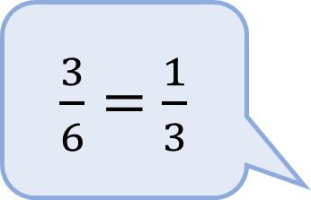
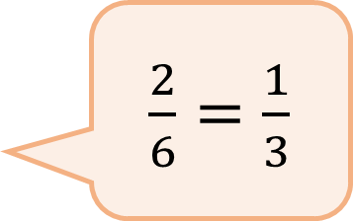


Alex and Tommy are using number lines to explore equivalent fractions.
Alex
Tommy
Who do you agree with? Explain why.
$\frac{2}{6}=\frac{1}{3}$
$$\frac{2}{6}$$
$$\frac{1}{3}$$
$$\frac{3}{6}$$
$\frac{3}{6}=$ $\frac{1}{3}$
$$\frac{1}{3}$$

Slide 6
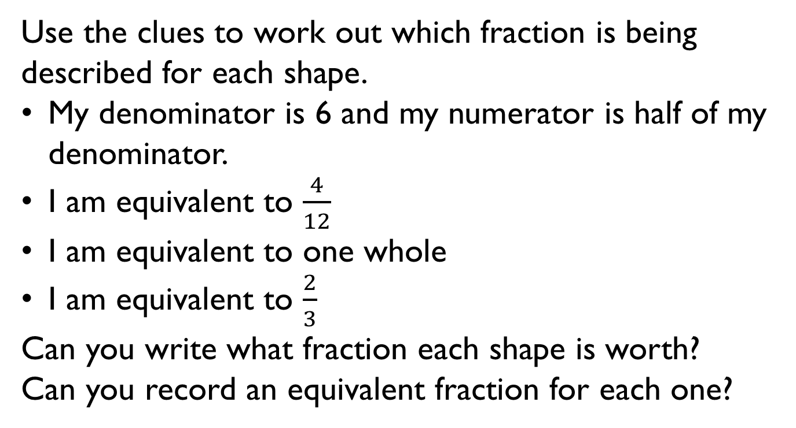
0
1
Use the clues to work out which fraction is being described for each shape.
My denominator is 6 and my numerator is half of my denominator.
I am equivalent to $\frac{4}{12}$
I am equivalent to one whole
I am equivalent to $\frac{2}{3}$
Can you write what fraction each shape is worth?
Can you record an equivalent fraction for each one?

Slide 7
Always, Sometimes, Never.
Prove it.
Can you find any relationships between the numerator and denominator for other equivalent fractions?
If a fraction is equivalent to one half, the denominator is double the numerator.

Slide 8

Dora has shaded a fraction.
She says,
Is this possible?
Explain why.
I am thinking of an equivalent fraction to the shaded fraction where the numerator is 9

Slide 9
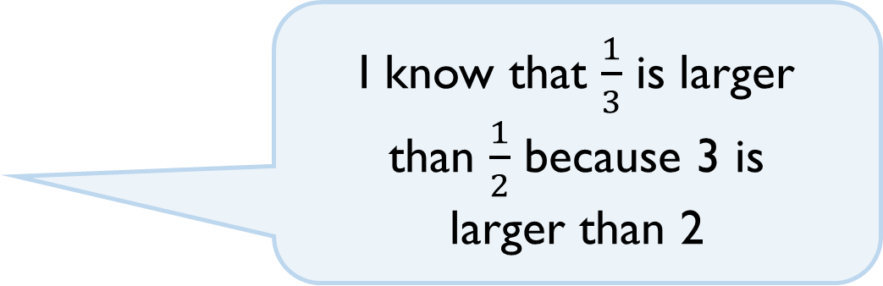
Do you agree with Dora?
Explain how you know.
I know that $\frac{1}{3}$ is larger
than $\frac{1}{2}$ because 3 is
larger than 2

Slide 10
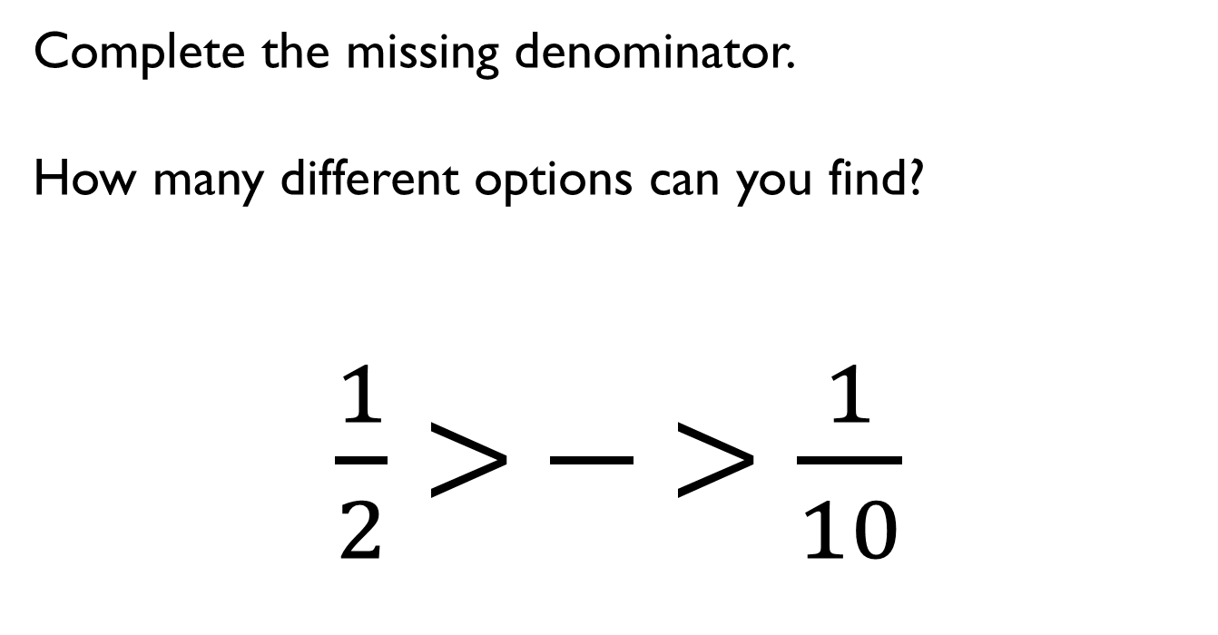

Complete the missing denominator.
How many different options can you find?
$\frac{1}{2}>$ $\frac{}{}>$ $\frac{1}{10}$
$1$

Slide 11
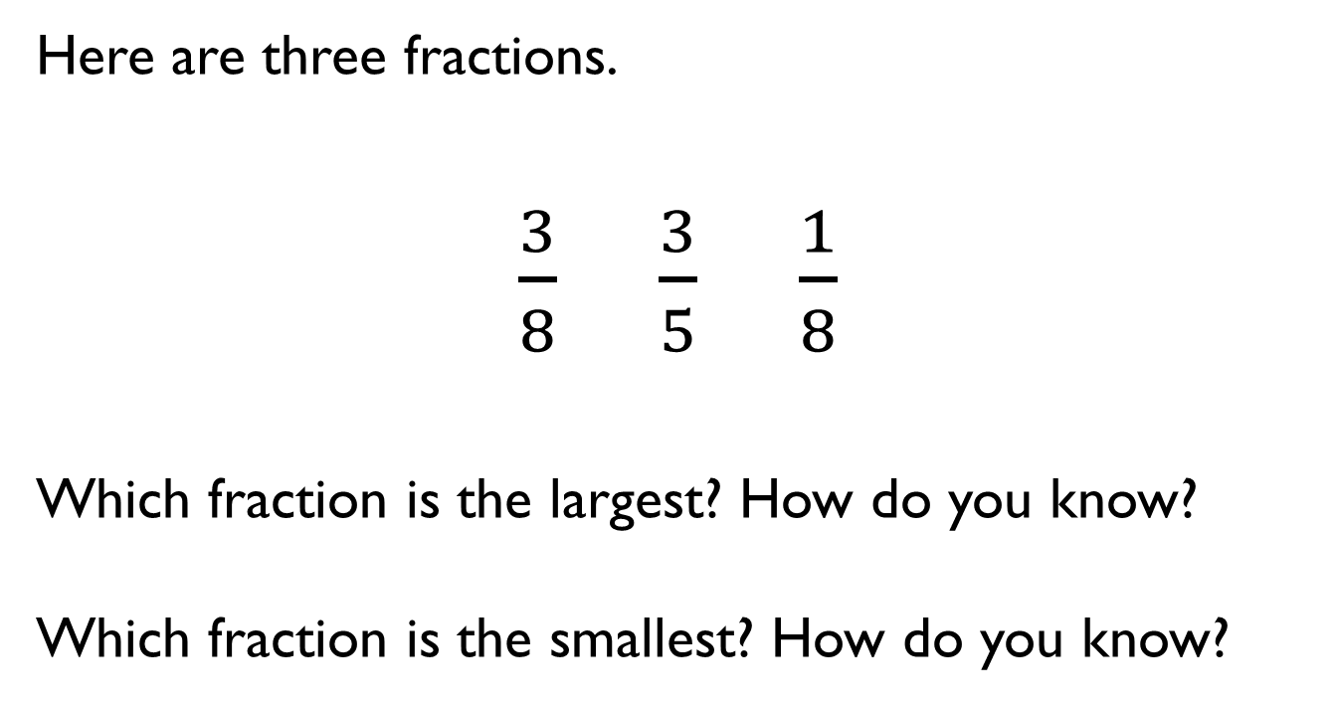
Here are three fractions.
$\frac{3}{8}$ $\frac{3}{5}$ $\frac{1}{8}$
Which fraction is the largest? How do you know?
Which fraction is the smallest? How do you know?

Slide 12

Is Jack correct?
Prove it.
When the denominators are the same, the larger the numerator, the smaller the fraction.

Slide 13
Shade the blank diagrams so the fractions are ordered correctly.
Fractions in ascending order
Fractions in descending order

Slide 14



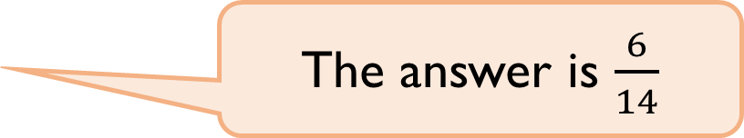
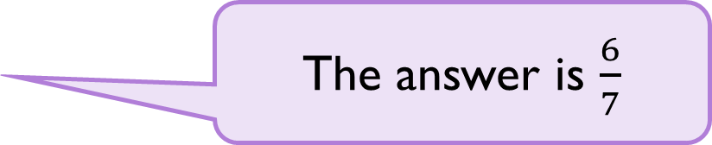
Rosie and Whitney are solving:
Rosie says,
Whitney says,
Who do you agree with?
Explain why.
$$\frac{4}{7}+\frac{2}{7}$$
The answer is $\frac{6}{7}$
The answer is $\frac{6}{14}$

Slide 15

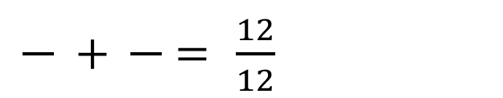
Mo and Teddy share these chocolates.
They both eat an odd number of chocolates.
Complete this number sentence to show what fraction of the chocolates they each could have eaten.
$\frac{}{} + \frac{}{}=$ $\frac{12}{12}$

Slide 16
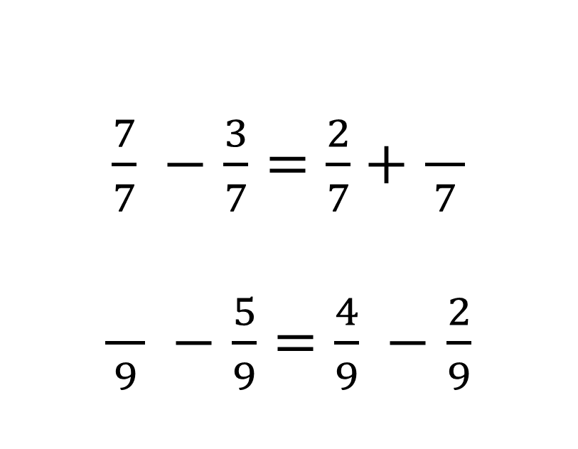
Find the missing fractions:
$\frac{7}{7} −$ $\frac{3}{7}=$ $\frac{2}{7}+$ $\frac{}{7}$
$\frac{}{9} −$ $\frac{5}{9}=$ $\frac{4}{9} −$ $\frac{2}{9}$

Slide 17
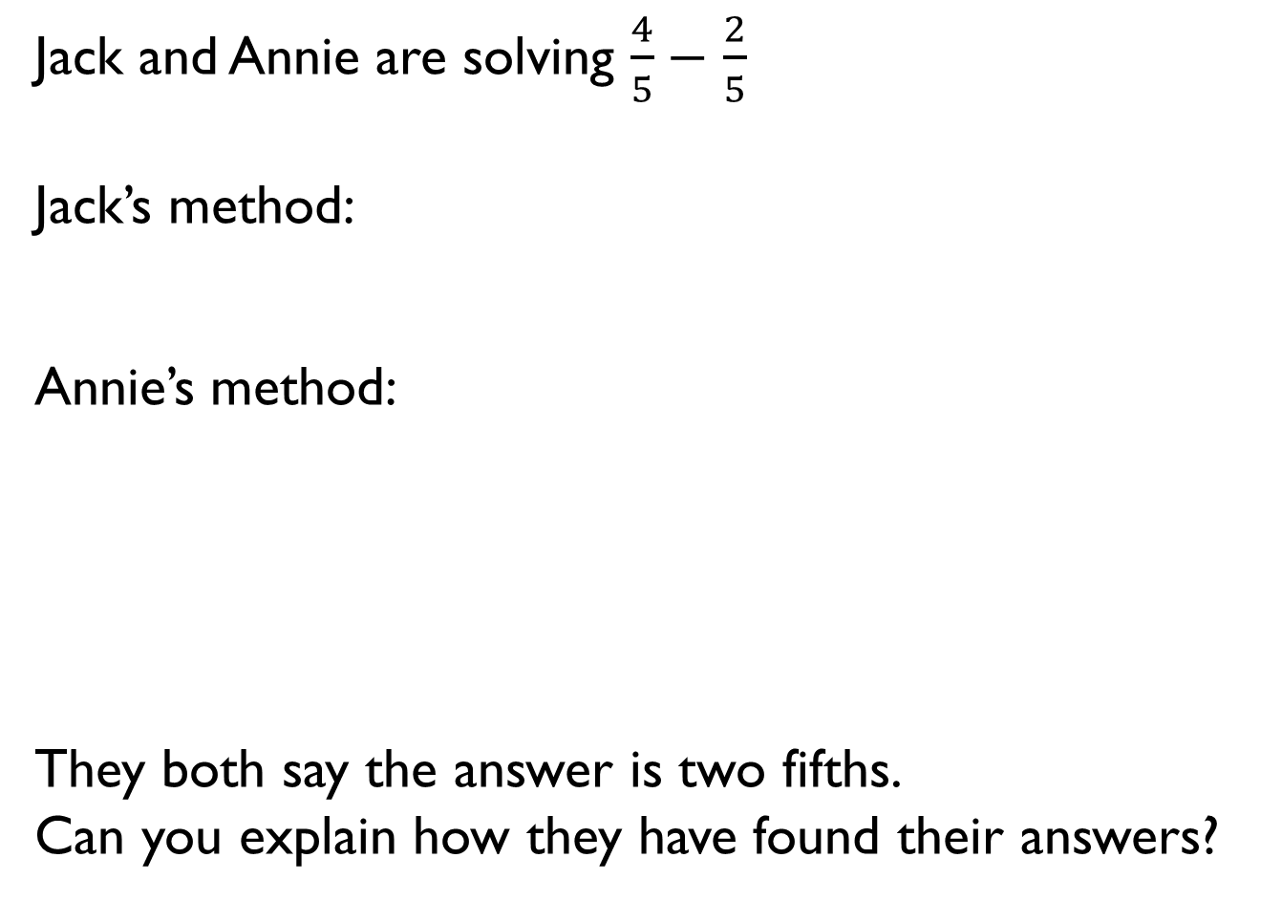
Jack and Annie are solving $\frac{4}{5}−$ $\frac{2}{5}$
Jack’s method:
Annie’s method:
They both say the answer is two fifths.
Can you explain how they have found their answers?

Slide 18
How many fraction addition and subtractions can you make from this model?

