Slide 1




Year 3 - Summer - Block 4
Mass & Capacity

Slide 2
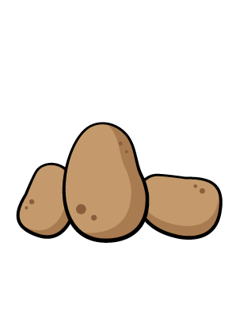
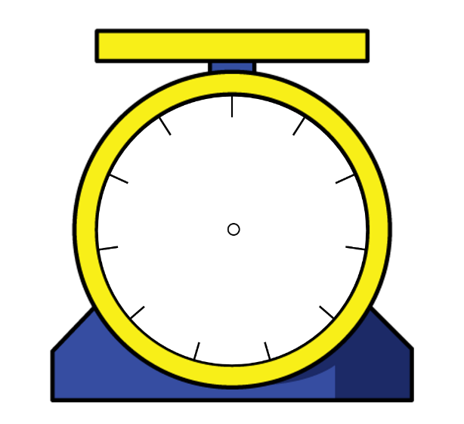

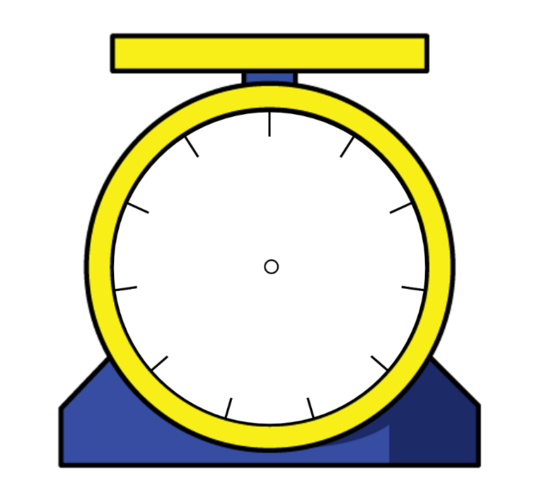




Who do you agree with? Explain why.
Amir
Jack
Rosie
Can you calculate the weight of the potatoes? Explain how you did it.
0
0
1
100
10
10
The potatoes weigh 13 kg
90
20
9
2
80
g
30
8
g
3
We don’t know how much the potatoes weigh because the number is hidden.
70
7
4
40
6
5
0
60
50
10
kg
g
0
0
1
100
0
10
10
10
The potatoes weigh more than half of 10 kg
9
2
90
20
g
8
g
3
80
g
30
7
4
70
40
6
5
60
50

Slide 3








The chocolate bar weighs 100 g.
How much does one muffin weigh?
How much does each side weigh?

Slide 4
Using only 3 objects and a weighing scale, try to get as close to 2 kg as possible.
Explain why you chose those objects.
Work out how much more or how much less is needed to make it 2 kg.

Slide 5
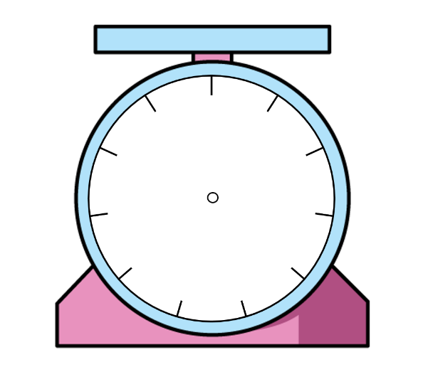

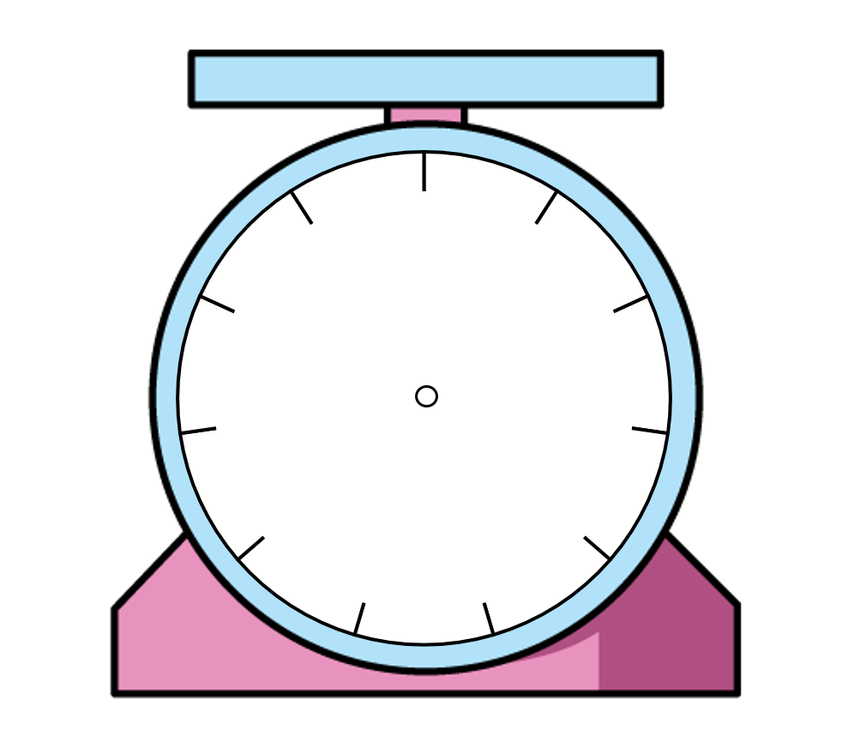



Tommy is weighing a toy car.
Use this to work out what the other children’s cars weigh.
My car weighs 1 kg more than Mo’s.
My car weighs 200 g less than Tommy’s.
0
1
10
9
2
8
kg
g
3
Alex
7
4
Mo
6
5
My car weighs 1 kg and 300 g less than Alex’s.
Dexter

Slide 6
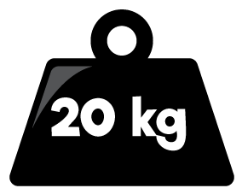
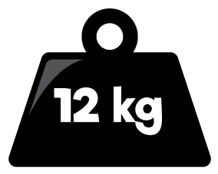
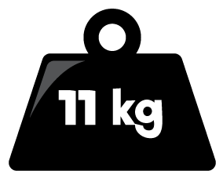

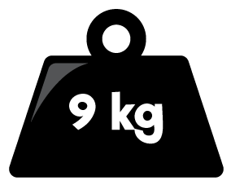
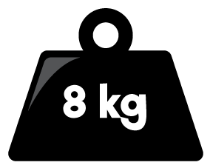

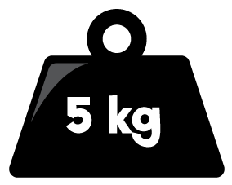
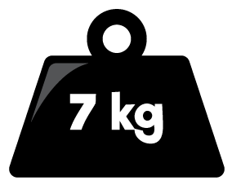
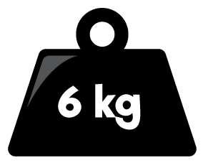
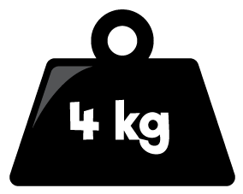
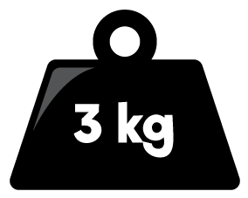
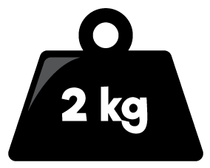





Here is a balance. Here is another.
Work out the value of
Can you create your own version for a partner?

Slide 7
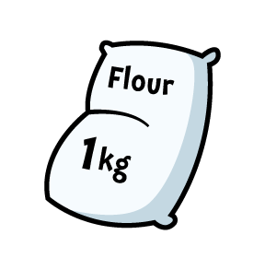


Three children are weighing potatoes and flour.
Who do you agree with? Explain your answer.
The flour weighs more because 2 kg is more than 700 g.
The flour weighs less because 2 is less than 700
1000
0
100
10
0
1
900
200
9
2
800
g
300
8
g
3
g
kg
700
400
7
4
600
500
6
5
The potatoes weigh more because the arrow is further than the arrow on the flour scale.

Slide 8




Here are three masses.
Match each mass to the correct child.
20 kg and 600 g
18 kg and 500 g
20 kg
My mass weighs more than $\frac{1}{2}$ of 40 kg.
Dora
My mass is more than Eva’s mass.
Mo
My mass weighs more than 18 kg but less than 20 kg.
Eva

Slide 9
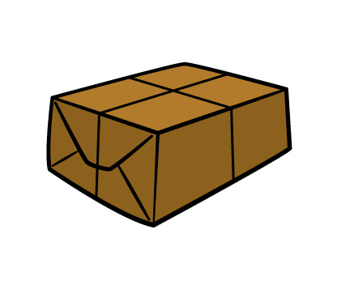
The green parcel weighs 5 kg.
Can you work out what the blue and brown parcel weigh?
How much would the green and brown parcel weigh altogether?
7 kg and 250 g
9 kg and 400 g

Slide 10









Dora buys two peaches and three pears.
One peach weighs 75 g.
Three pears weigh the same as two peaches.
How much does one pear weigh?

Slide 11
Use a variety of containers.
Can you estimate how much liquid they hold?
Check your estimates using measuring jugs and cylinders to see how accurate you were.

Slide 12
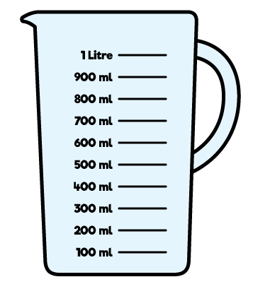
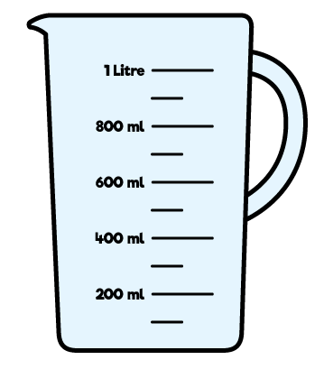
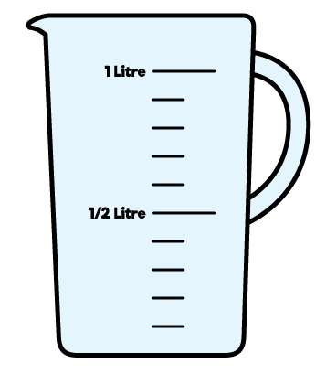
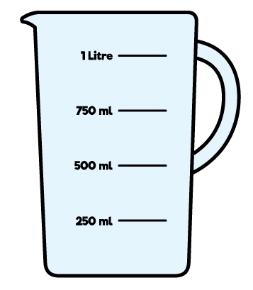

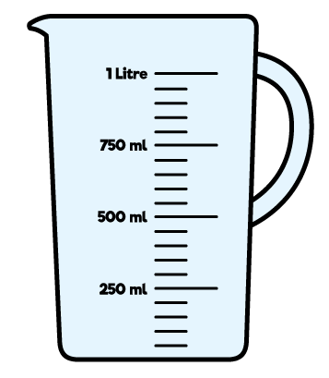

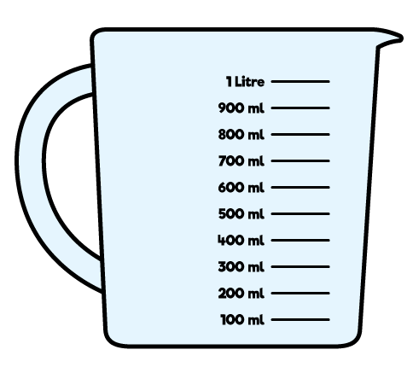
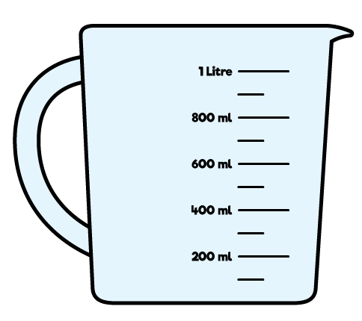
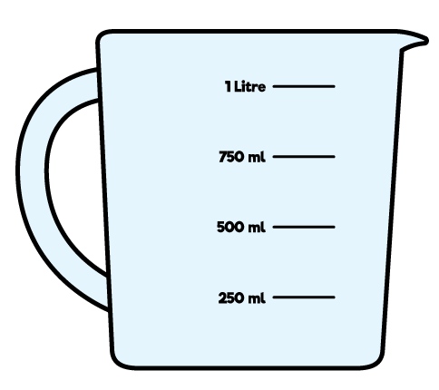

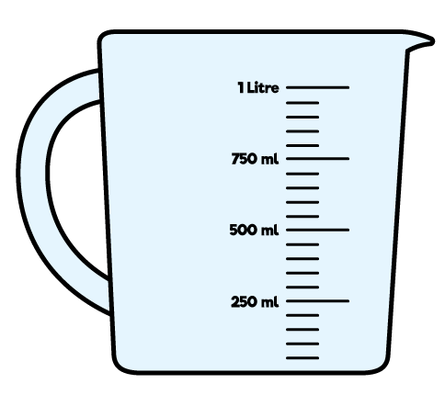
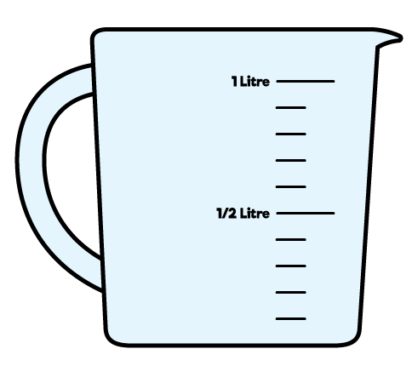


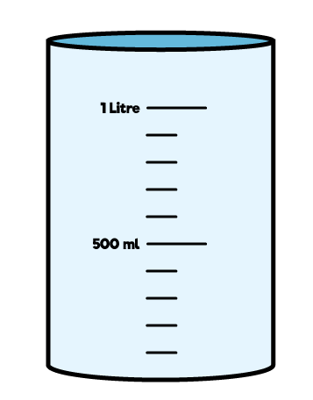
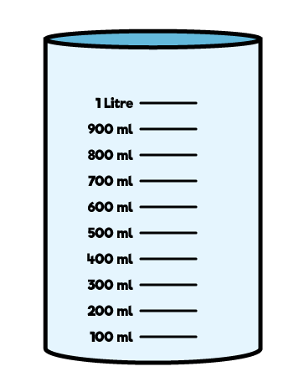
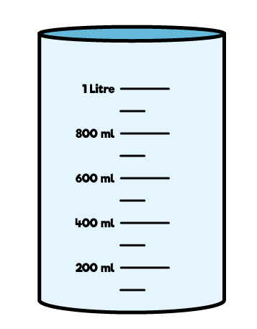
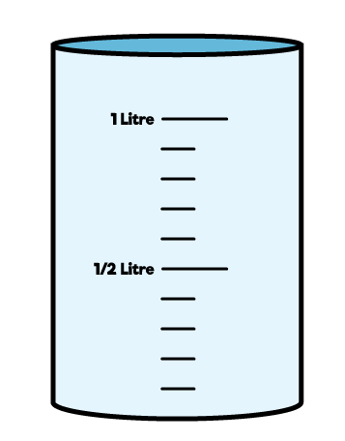

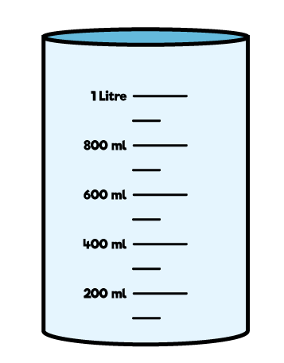
Use the clues to work out who has which container.
I have exactly half a litre
Annie
I have 1,000 ml
Ron
I have more than 300 ml but less than 400 ml
Eva
A
B
C

Slide 13
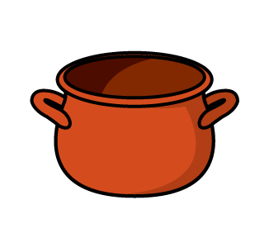

Amir and Alex work out the capacity of the pot by filling it with water, then pouring the water into the measuring cylinders.
Who do you agree with? Explain why.
The capacity of the pot is 302 ml
Amir
The capacity of the pot is 2 l and 300 ml.
Alex

Slide 14
True or False?
The tallest container has the largest capacity.
Use containers to decide whether the statement is true or false.
Record the capacity of the different containers in a table.

Slide 15


Rosie has a litre bottle of water.
She pours a drink for herself and two friends.
Their glasses can hold up to 250 ml.
Teddy has more than Amir.
Rosie has the most.
How much could each child have in their glass?
How much would be left in the bottle?

Slide 16

Is Eva correct? Explain your answer.
I know container 1 has more than container 2 in it because the water goes further up the side.
Eva
Container 1
Container 2

Slide 17

Tommy is pouring drinks using these jugs.
A drink is 125 ml.
Is Tommy correct?
If not, how much juice will be left in jug 2?
If I pour three more drinks using jug 2, both jugs will have the same amount of juice in.
Tommy
Jug 1
Jug 2

Slide 18
Here are some measuring cylinders.
The total liquid in all three cylinders is 400 ml.
Cylinder A has half of the total amount in it. Cylinder B has 67 ml less than Cylinder A.
How much liquid does each cylinder contain?
A
B
C

