Slide 1
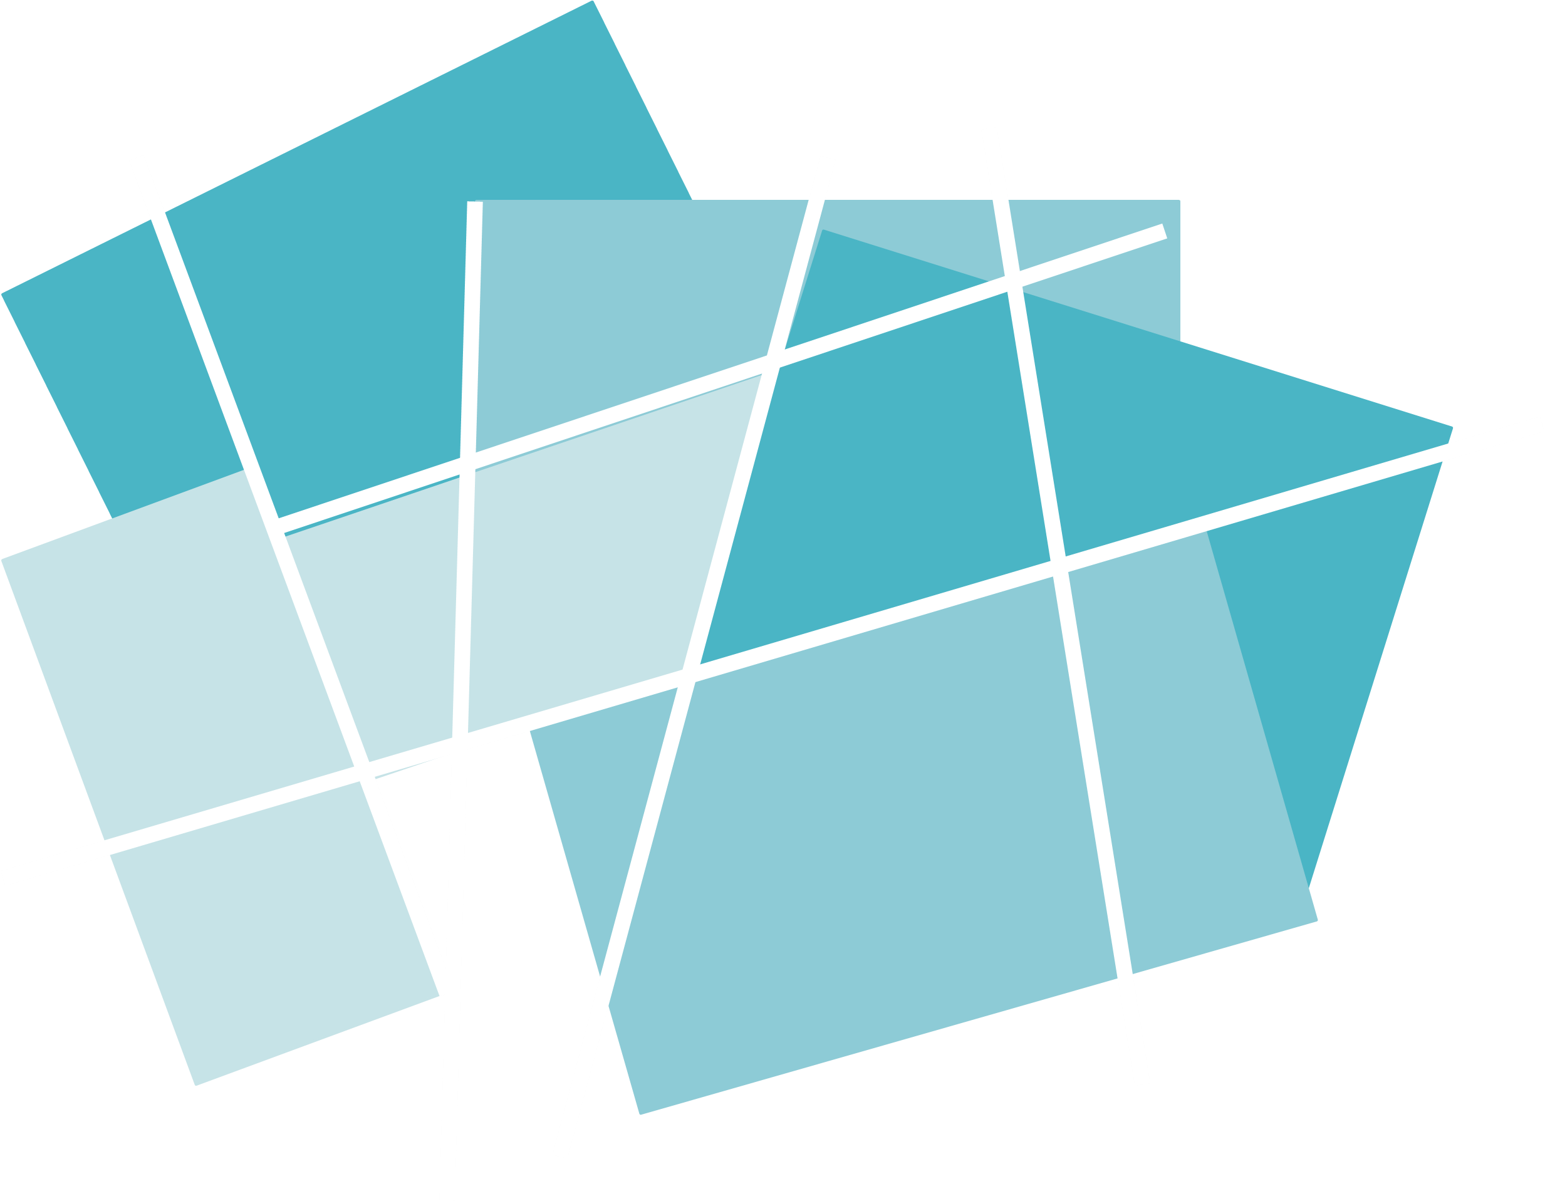



Year 4 - Summer - Block 1
Decimals

Slide 2
Which part-whole model does not match the hundred square?
Explain your answer.
1
1
1
0.3
0.7
0.03
0.07
0.2
0.3
0.5

Slide 3
Three bead strings are 0.84 m long altogether.
Would four bead strings be longer or shorter than a metre?
Explain how you know.

Slide 4
Annie thinks the number shown is 2.2
Do you agree with Annie?
Explain your answer.
Ones | Tenths | Hundredths

Slide 5
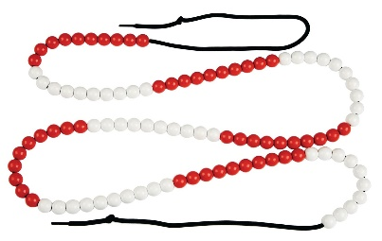
Mo is told that this bead string represents one whole.
He thinks that each individual bead represents one tenth.
Do you agree with Mo?
Explain your answer.

Slide 6


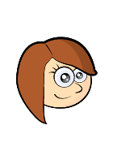
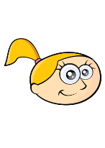
Match each description to the correct number.
Teddy
Amir
Rosie
Eva
My number has the same amount of tens as tenths.
46.02
My number has one decimal place.
2.64
My number has two hundredths.
46.2
40.46
My number has six tenths.

Slide 7
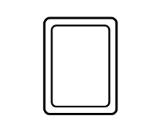

Use each digit card once to make the statement correct.
Can you find eight different possible solutions?
5
0
1
2
4
5
3
$$>$$

Slide 8
Use three digit cards to make the greatest possible number.
Use three digit cards to make the smallest possible number.
5
7
0
4
5

Slide 9
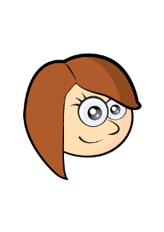
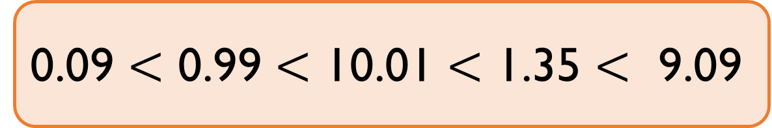
Spot the Mistake
Rosie is ordering some numbers in ascending order:
Can you explain her mistake?
0.09 $<$ 0.99 $<$ 10.01 $<$ 1.35 $<$ 9.09

Slide 10

Some children have planted sunflowers and have measured their heights.
Order the children based on the heights of their sunflowers in both ascending and descending order.
Child | Height
Beth | 1.23 m
Tony | 0.95 m
Rachel | 1.02 m
Kate | 1.2 m
Faye | 99 cm
Emma | 0.97 m

Slide 11

Mo says 0.4 rounded to the nearest whole number is zero.
Whitney says 0.4 rounded to the nearest whole number is one.
Who is correct? Why?

Slide 12
A number with one decimal place rounded to the nearest whole number is 45
What could the number be?

Slide 13
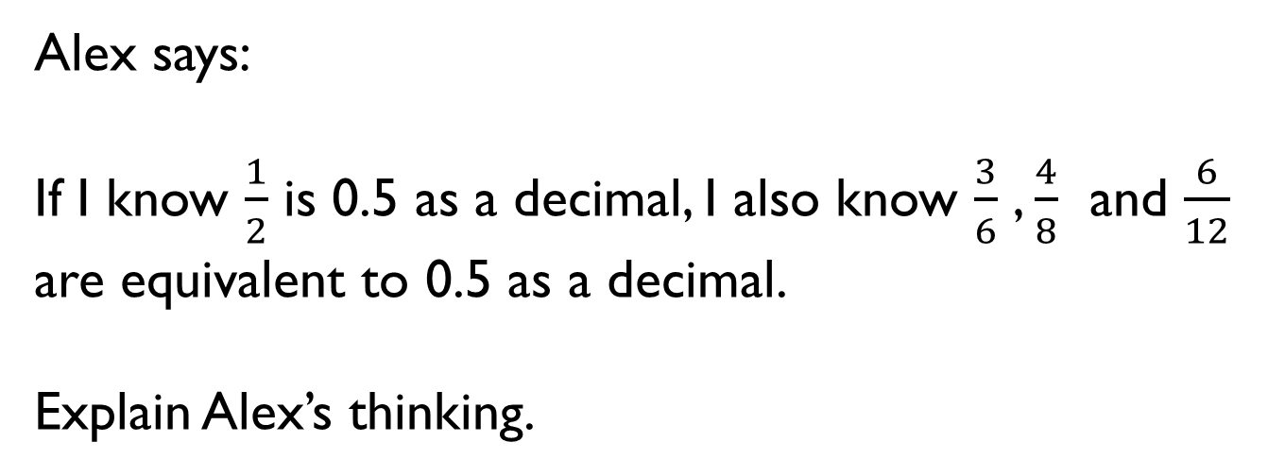
Alex says:
If I know $\frac{1}{2}$ is 0.5 as a decimal, I also know $\frac{3}{6}$ , $\frac{4}{8}$ and $\frac{6}{12}$ are equivalent to 0.5 as a decimal.
Explain Alex’s thinking.

Slide 14
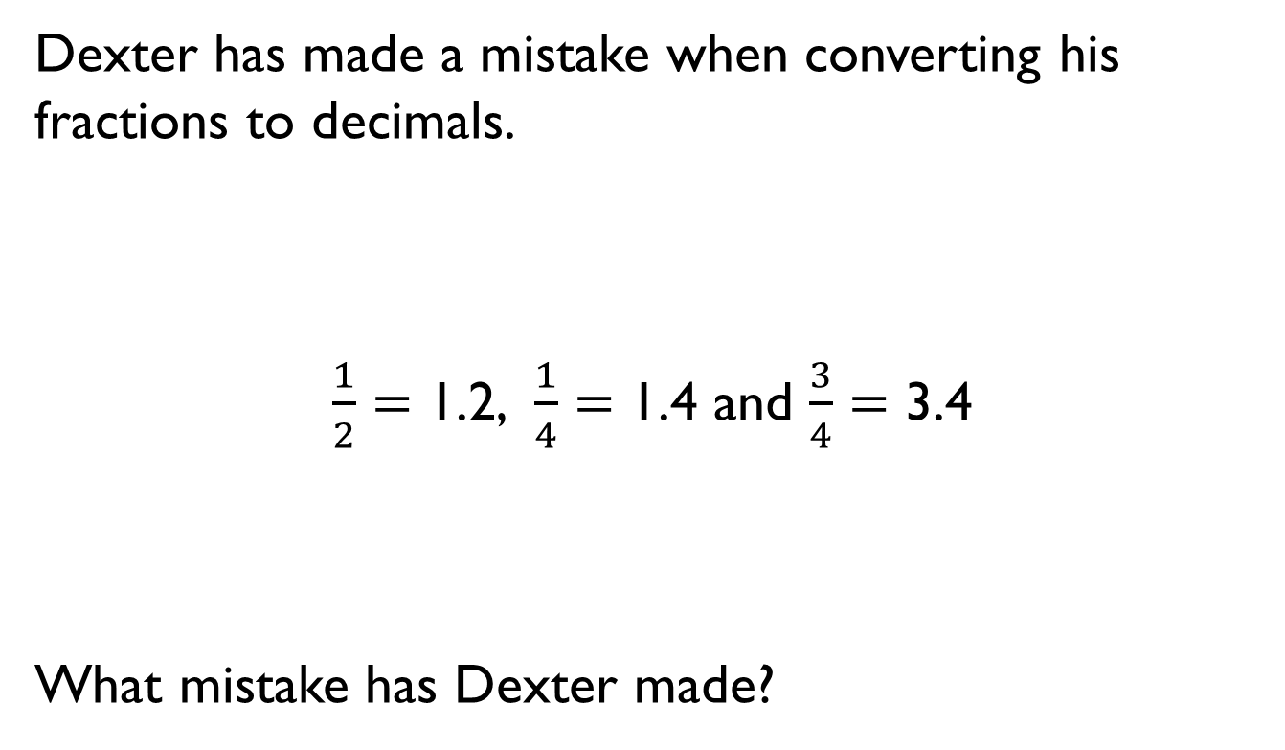
Dexter has made a mistake when converting his fractions to decimals.
$\frac{1}{2}$ $=$ 1.2, $\frac{1}{4}$ $=$ 1.4 and $\frac{3}{4}$ $=$ 3.4
What mistake has Dexter made?

