Slide 1




Year 4 - Spring - Block 1
Multiplication & Division

Slide 2
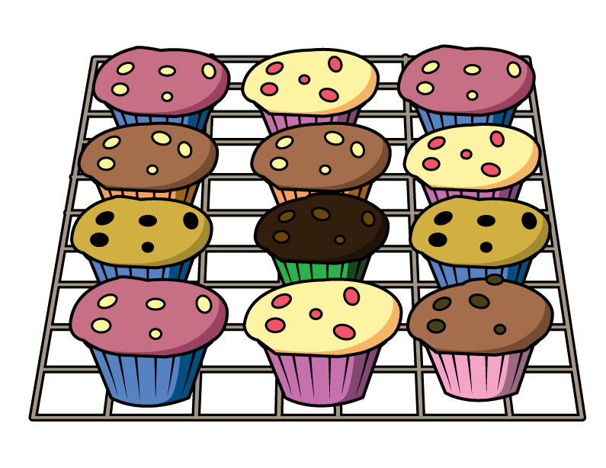
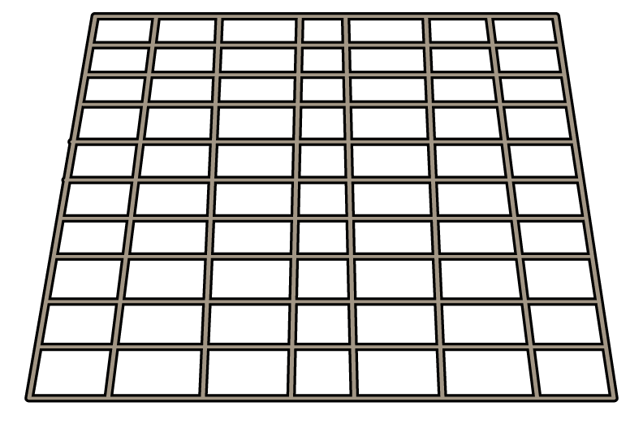






Here is one batch of muffins.
Teddy bakes 11 batches of muffins.
How many muffins does he have altogether?
In each batch there are 3 strawberry, 3 vanilla, 4 chocolate and 2 toffee muffins.
How many of each type of muffin does Teddy have in 11 batches?
Teddy sells 5 batches of muffins.
How many muffins does he have left?

Slide 3


Rosie uses a bar model to represent 88 divided by 11
Explain Rosie’s mistake.
Can you draw a bar model to represent 88 divided by 11 correctly?
88
11 | 11 | 11 | 11 | 11 | 11 | 11 | 11 | 11 | 11 | 11

Slide 4


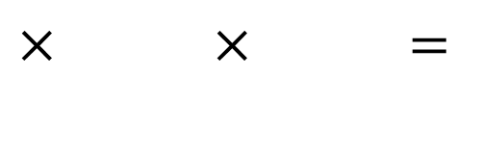
Choose three digit cards.
Arrange them in the calculation.
How many different calculations can you make using your three digit cards?
Which order do you find it the most efficient to calculate the product?
How have you grouped the numbers?
$×$ $×$ $=$
0
1
2
3
4
5
6
7
8
9

Slide 5

Make the target number of 84 using three of the digits below.
Multiply the remaining three digits together, what is the product of the three numbers?
Is the product smaller or larger than 84?
Can you complete this problem in more than one way?
7 | 5 | 3 | 4 | 6 | 2
× × $=$ 84

Slide 6

Tommy says,
Is Tommy correct?
Use arrays to explain your answer.
The greater the number, the more factors it will have.

Slide 7
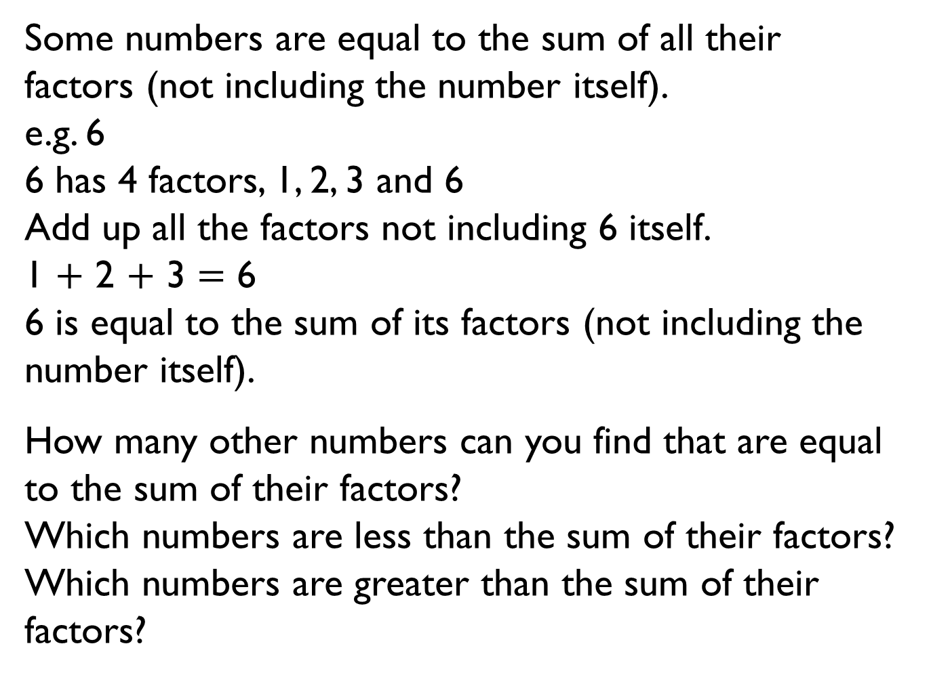
Some numbers are equal to the sum of all their factors (not including the number itself).
e.g. 6
6 has 4 factors, 1, 2, 3 and 6
Add up all the factors not including 6 itself.
1 $+$ 2 $+$ 3 $=$ 6
6 is equal to the sum of its factors (not including the number itself).
How many other numbers can you find that are equal to the sum of their factors?
Which numbers are less than the sum of their factors?
Which numbers are greater than the sum of their factors?

Slide 8
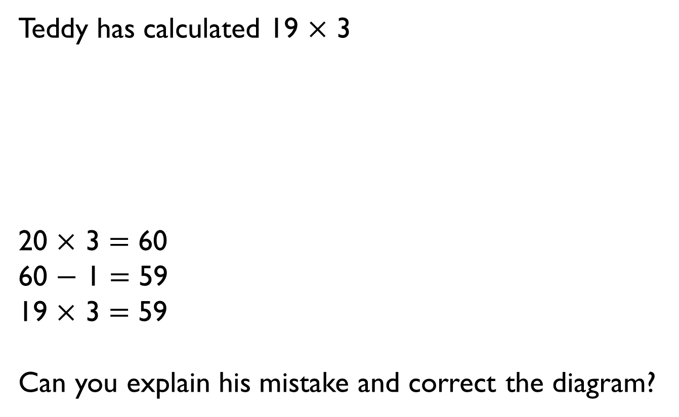
Teddy has calculated 19 $×$ 3
20 $×$ 3 $=$ 60
60 $−$ 1 $=$ 59
19 $×$ 3 $=$ 59
Can you explain his mistake and correct the diagram?

Slide 9





Here are three number cards.
Dora, Annie and Eva choose one of the number cards each. They multiply their number by 5
Dora says,
Annie says,
Eva says,
Which number card did each child have? Would you have used a different method to multiply the numbers by 5?
21
42
38
I did 40 $×$ 5 and then subtracted 2 lots of five.
I multiplied my number by 10 and then divided 210 by 2
I halved my 2-digit number and doubled 5 so I calculated 21 $×$ 10

Slide 10
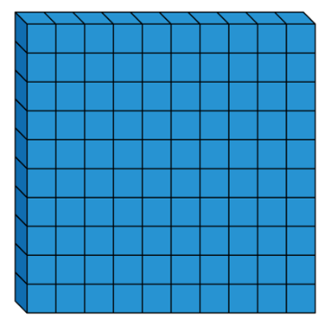


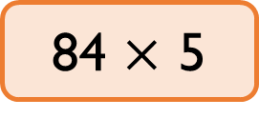
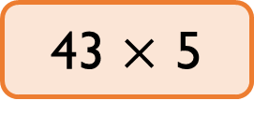
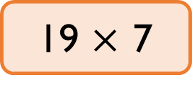
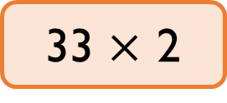
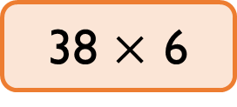
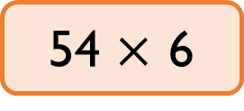
Here are 6 multiplications.
Which of the multiplications would you calculate mentally?
Which of the multiplications would you use a written method for?
Explain your choices to a partner.
Did your partner choose the same methods as you?
43 $×$ 5
54 $×$ 6
38 $×$ 6
33 $×$ 2
19 $×$ 7
84 $×$ 5

Slide 11
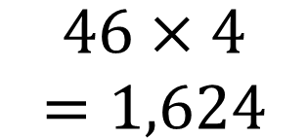
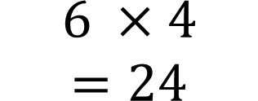
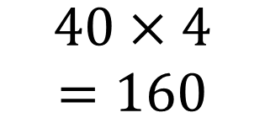
Ron is calculating 46 multiplied by 4 using the part-whole model.
Can you explain Ron’s mistake?
$$46×4=1,624$$
$$40×4=160$$
$$6 ×4=24$$

Slide 12



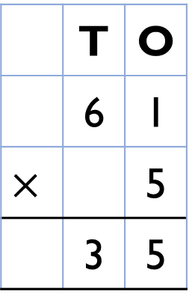
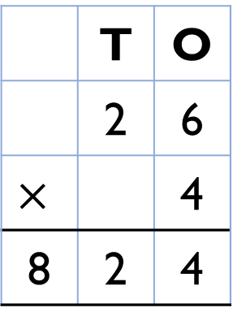
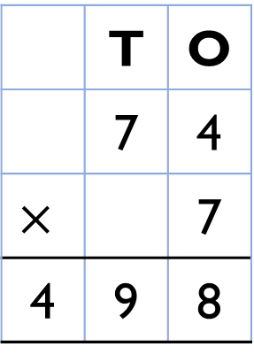
Here are three incorrect multiplications.
Correct the multiplications.
 | T | O
 | 6 | 1
$$×$$ |  | 5
 | 3 | 5
 | T | O
 | 7 | 4
$$×$$ |  | 7
4 | 9 | 8
 | T | O
 | 2 | 6
$$×$$ |  | 4
8 | 2 | 4

Slide 13


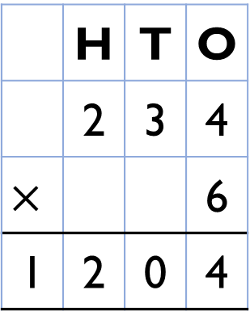
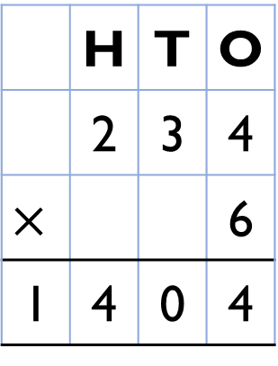
Spot the mistake
Alex and Dexter have both completed the same multiplication.
Who has the correct answer?
What mistake has been made by one of the children?
 | H | T | O
 | 2 | 3 | 4
$$×$$ |  |  | 6
1 | 2 | 0 | 4
 | H | T | O
 | 2 | 3 | 4
$$×$$ |  |  | 6
1 | 4 | 0 | 4
2
2
2
2

Slide 14

Teddy and his mum were having a reading competition.
In one month, Teddy read 814 pages.
His mum read 4 times as many pages as Teddy.
How many pages did they read altogether?
How many fewer pages did Teddy read?
Use the bar model to help.
Teddy
814
Mum
814
814
814
814

Slide 15
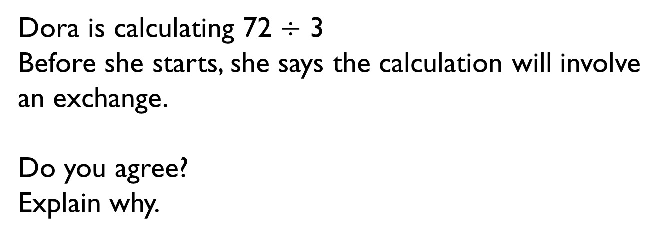
Dora is calculating 72 $÷$ 3
Before she starts, she says the calculation will involve an exchange.
Do you agree?
Explain why.

Slide 16
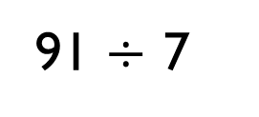
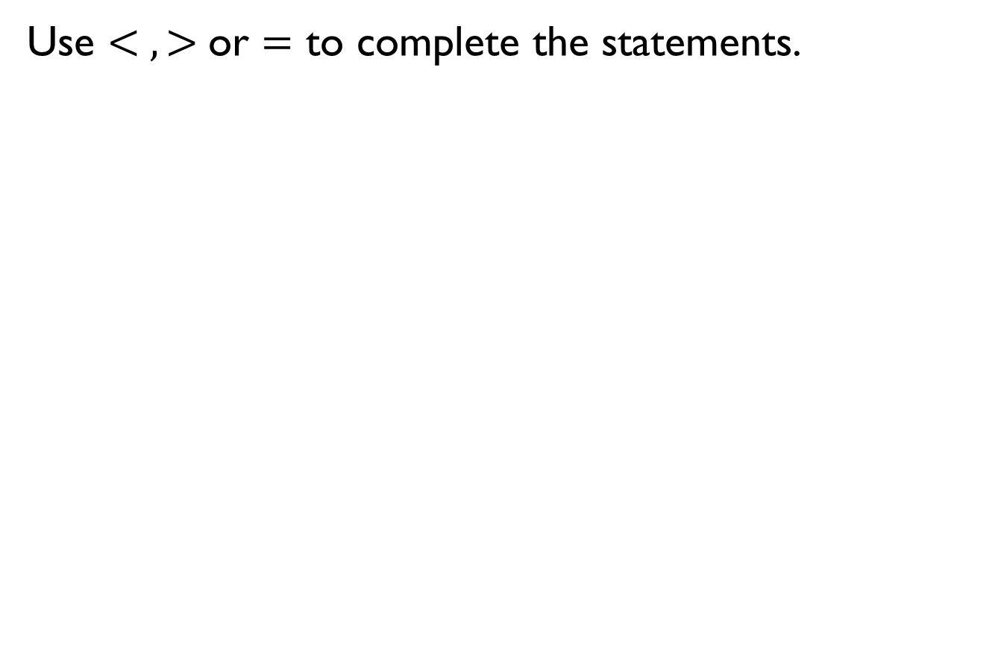
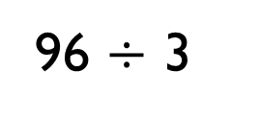
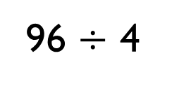
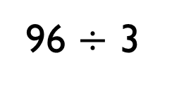
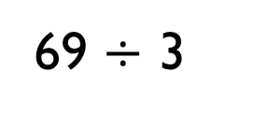
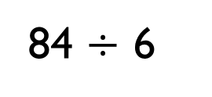
Use $< , >$or $=$ to complete the statements.
69 $÷$ 3
96 $÷$ 3
96 $÷$ 4
96 $÷$ 3
91 $÷$ 7
84 $÷$ 6

Slide 17
Eva has 96 sweets.
She shares them into equal groups.
She has no sweets left over.
How many groups could Eva have shared her sweets into?

Slide 18
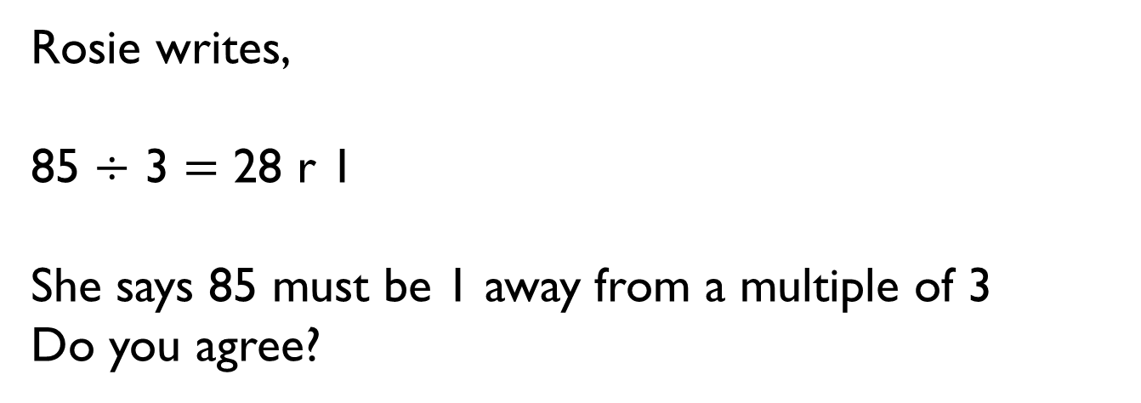
Rosie writes,
85 $÷$ 3 $=$ 28 r 1
She says 85 must be 1 away from a multiple of 3
Do you agree?

Slide 19
37 sweets are shared between 4 friends. How many sweets are left over?
Four children attempt to solve this problem.
• Alex says it’s 1
• Mo says it’s 9
• Eva says it’s 9 r 1
• Jack says it’s 8 r 5
Can you explain who is correct and the mistakes other people have made?

Slide 20
Whitney is thinking of a 2-digit number that is less than 50
When it is divided by 2, there is no remainder.
When it is divided by 3, there is a remainder of 1
When it is divided by 5, there is a remainder of 3
What number is Whitney thinking of?

Slide 21
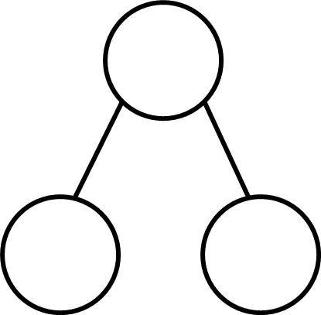
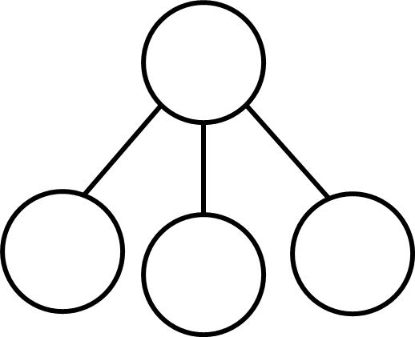
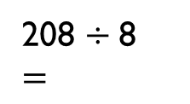
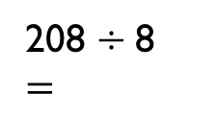
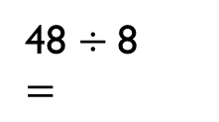
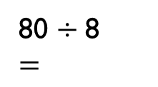
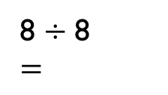
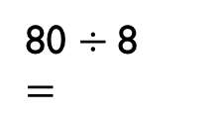
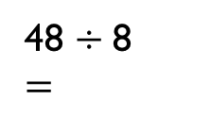
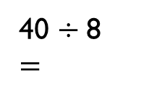
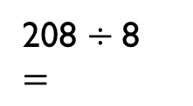
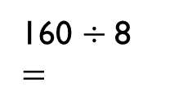
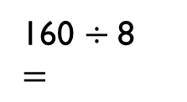
Dexter is calculating 184 ÷ 8 using part-whole models. Can you complete each model?
How many part-whole models can you make to calculate 132 ÷ 4?
208 ÷ 8
$$=$$
208 ÷ 8
$$=$$
208 ÷ 8
$$=$$
160 ÷ 8
$=$
48 ÷ 8
$=$
80 ÷ 8
$=$
48 ÷ 8
$=$
160 ÷ 8
$=$
8 ÷ 8
$=$
80 ÷ 8
$=$
40 ÷ 8
$=$

Slide 22

You have 12 counters and the place value grid. You must use all 12 counters to complete the following.
Create a 3-digit number divisible by 2
Create a 3-digit number divisible by 3
Create a 3-digit number divisible by 4
Create a 3-digit number divisible by 5
Can you find a 3-digit number divisible by 6, 7, 8 or 9?
Hundreds | Tens | Ones

Slide 23
Here are the meal choices in the school canteen.
There are 2 choices of starter, 4 choices of main and 3 choices of dessert.
How many meal combinations can you find? Can you use a systematic approach?
Can you represent the combinations in a multiplication?
If there were 20 meal combinations, how many starters, mains and desserts might there be?
Starter | Main | Dessert
Soup Garlic Bread | Pasta Chicken Beef Salad | Cake Ice-cream Fruit Salad

Slide 24
Alex has 6 T-shirts and 4 pairs of shorts.
Dexter has 12 T-shirts and 2 pairs of shorts.
Who has the most combinations of T-shirts and shorts?
Explain your answer.

