Slide 1




Year 4 - Summer - Block 3
Time

Slide 2

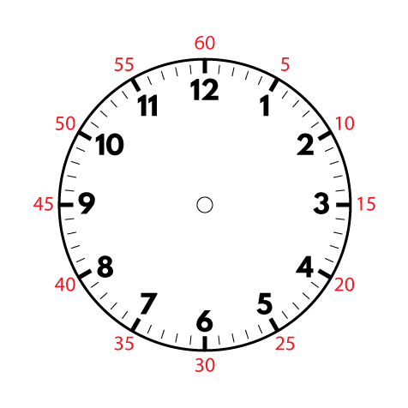

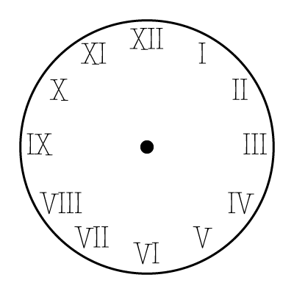
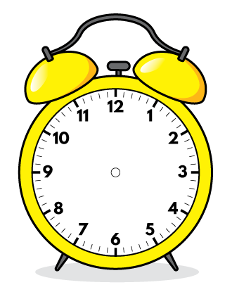
Jack takes part in a sponsored silence.
He says,
Do you agree with Jack?
Explain why you agree or disagree.
Explain your answer.
If I am silent for five hours at 10p per minute, I will raise £50

Slide 3

Dora says,
Is she correct? Can you explain why?
To convert hours to minutes, I multiply the number of hours by 60

Slide 4
Five friends run a race.
Their times are
shown in the table.
Which child finished the race the closest to two minutes?
What was the difference between the fastest time and the slowest time?
Give your answer in minutes and seconds.
Name | Time
Eva | 114 seconds
Dexter | 199 seconds
Teddy | 100 seconds
Whitney | 202 seconds
Ron | 119 seconds

Slide 5



Amir, Rosie and Jack describe when their birthdays are.
Amir says,
Rosie says,
Jack says,
Use the clues to work out when their birthdays are if today is the 8th June.
My birthday is in exactly two weeks.
My birthday is in exactly 2 months.
My birthday is in 35 days.

Slide 6
Always, sometimes, never?
There are 730 days in two years.

Slide 7
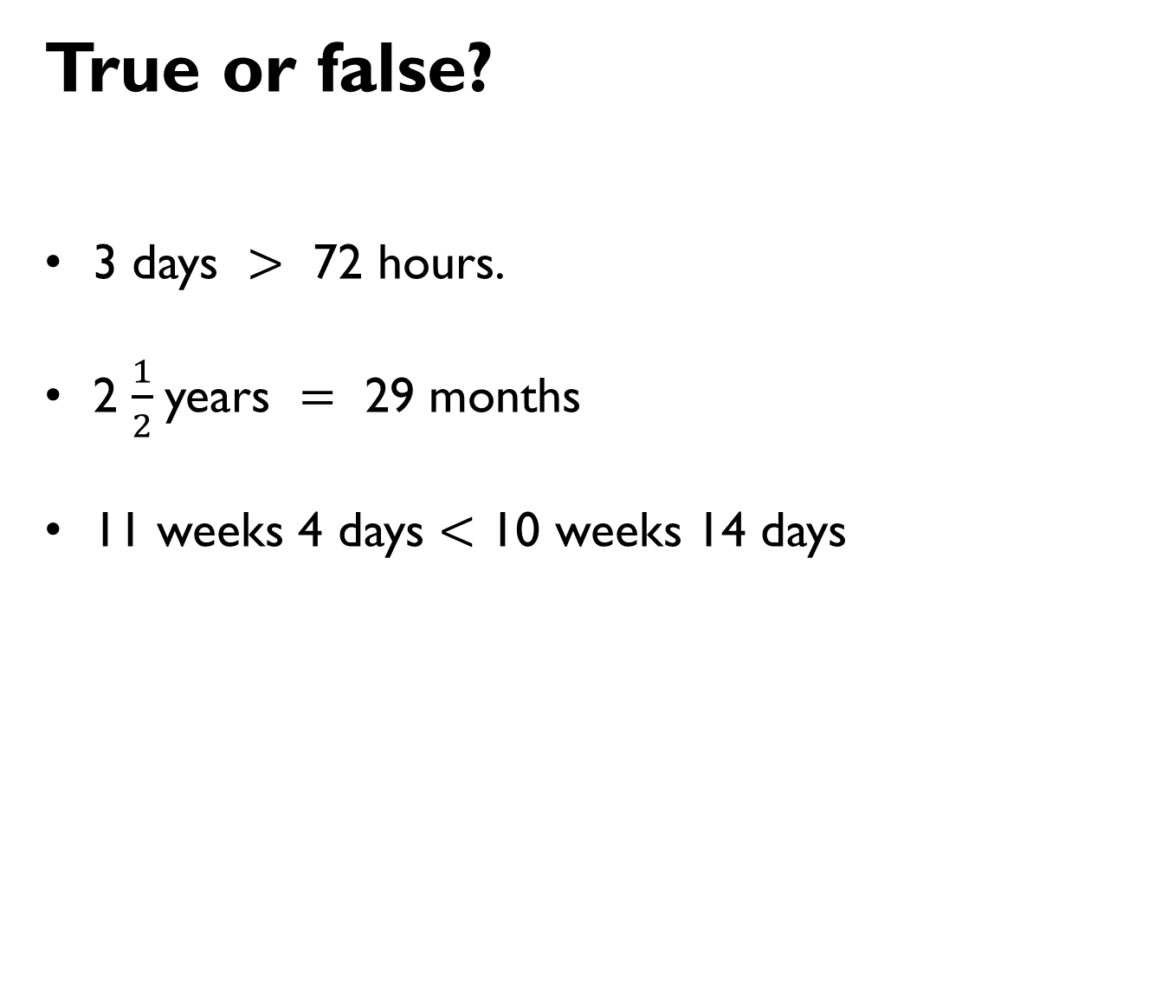
True or false?
3 days $>$ 72 hours.
2 $\frac{1}{2}$years $=$ 29 months
11 weeks 4 days $<$ 10 weeks 14 days

Slide 8
Annie converts the analogue time to digital format.
Here is her answer.
22 : 02
Explain what Annie has done wrong.
What should the digital time be?

Slide 9
On a 12 hour digital clock, how many times will the time be read the same forwards and backwards?
12 : 21

Slide 10

Jack arrives at the train station at the time shown in the morning.
Which trains could he catch?
How long will Jack have to wait for each train?
Destination | Departs
York | 07 : 10 a.m.
New Pudsey | 09 : 25 a.m.
Bramley | 09 : 42 a.m.
Leeds | 10 : 03 a.m.

Slide 11



Three children are meeting in the park.
Rosie says,
Teddy says,
Eva says,
Will all the children meet at the same time?
Explain your answer.
We are meeting at
14:10.
We are meeting at ten to two.
We are meeting at
02:10 p.m.

Slide 12
Jack says,
Will this always be true?
Are there any examples where this isn’t the case?
To change any time after midday from 12 hours to 24 hours digital time just add 12 to the hours

Slide 13
Can you match the time dominoes together so that the touching times are the same?
Can you create your own version for your partner?
20:55
_____
Ten to two
13:50
_____
Five to ten
09:55
_____
Ten to three
15:05
_____
Ten past 4
02:50
_____
Five past 3
16:10
_____
Five to nine

