Slide 1




Year 4 - Spring - Block 4
Decimals

Slide 2


Who is correct?
Dora
Amir
Explain why.
5 hundredths is equivalent to 50 tenths.
50 hundredths is equivalent to 5 tenths.

Slide 3

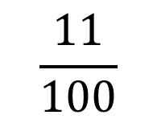
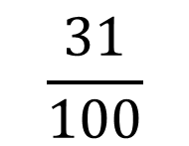
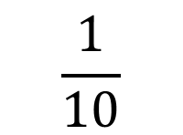
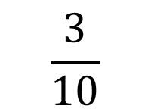
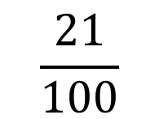
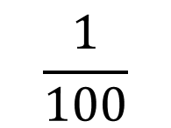
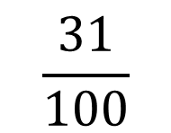
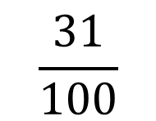
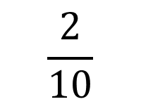
Ron says he can partition tenths and hundredths in more than one way.
Use Ron’s method to partition 42 hundredths in more than one way.
$$\frac{31}{100}$$
$$\frac{31}{100}$$
$$\frac{31}{100}$$
$$\frac{3}{10}$$
$$\frac{1}{100}$$
$$\frac{2}{10}$$
$$\frac{11}{100}$$
$$\frac{1}{10}$$
$$\frac{21}{100}$$

Slide 4


Who is correct?
Annie
Dexter
Explain why.
1.2 is equivalent to 1 whole and 2 tenths.
1.2 is equivalent to 12 tenths.

Slide 5
What is the same? What’s different?
Show me.
Six tens
Six tenths

Slide 6
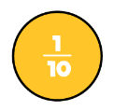

Which ten frame is the odd one out?
Explain your answer.

Slide 7
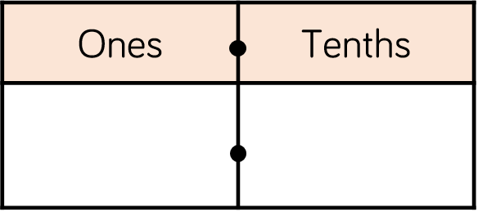
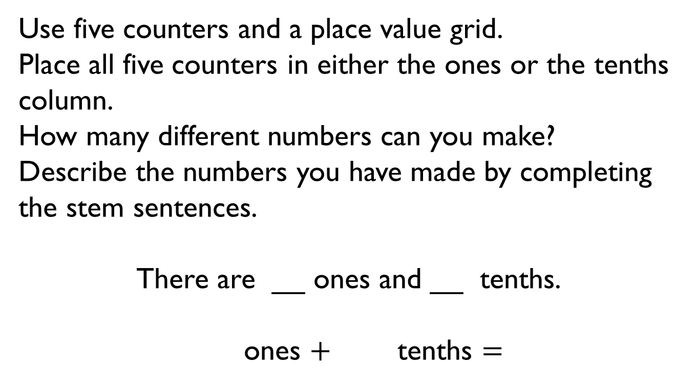
Use five counters and a place value grid.
Place all five counters in either the ones or the tenths column.
How many different numbers can you make?
Describe the numbers you have made by completing the stem sentences.
There are __ ones and __ tenths.
        ones $+$ tenths $=$

Slide 8

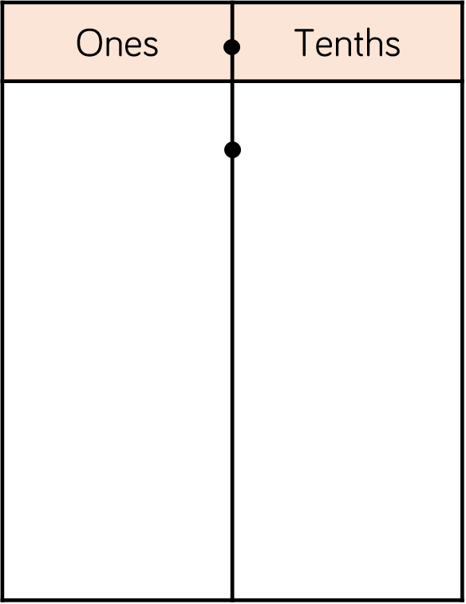



Two children are making eleven tenths.
Who has made it correctly?
Explain your answer.
Rosie
Amir

Slide 9

What could the start and end numbers on the number line be?
Explain your reasons.
6.4

Slide 10

Place the decimals on the number line.
Which order did you place your numbers on the number line?
2.3
2.7
2
3
1.9
2.5
2.7 2.3 1.9 2.5 2.9 3.2
2.9
3.2

Slide 11

Choose a digit card from 1 – 9 and place a counter over the top of that number on the Gattegno chart.
Ron says,
Do you agree? Use the Gattegno chart to explain your reason.
100 | 200 | 300 | 400 | 500 | 600 | 700 | 800 | 900
10 | 20 | 30 | 40 | 50 | 60 | 70 | 80 | 90
1 | 2 | 3 | 4 | 5 | 6 | 7 | 8 | 9
0.1 | 0.2 | 0.3 | 0.4 | 0.5 | 0.6 | 0.7 | 0.8 | 0.9
0.01 | 0.02 | 0.03 | 0.04 | 0.05 | 0.06 | 0.07 | 0.08 | 0.09
To divide by 10, you need to move the counters to the right.

Slide 12
100 | 200 | 300 | 400 | 500 | 600 | 700 | 800 | 900
10 | 20 | 30 | 40 | 50 | 60 | 70 | 80 | 90
1 | 2 | 3 | 4 | 5 | 6 | 7 | 8 | 9
0.1 | 0.2 | 0.3 | 0.4 | 0.5 | 0.6 | 0.7 | 0.8 | 0.9
0.01 | 0.02 | 0.03 | 0.04 | 0.05 | 0.06 | 0.07 | 0.08 | 0.09

Slide 13
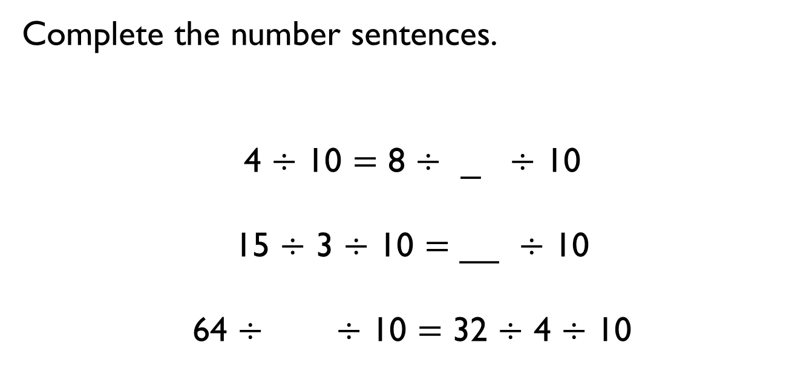
Complete the number sentences.
4 $÷$ 10 $=$ 8 $÷$ _ $÷$ 10
15 $÷$ 3 $÷$ 10 $=$ __ $÷$ 10
64 $÷$ $÷$ 10 $=$ 32 $÷$ 4 $÷$ 10

Slide 14
Jack has used a Gattegno chart to divide a 2-digit number by 10
He has placed counters over the numbers in his answer.
What was Jack’s original number?
How can you use the chart to help you?
100 | 200 | 300 | 400 | 500 | 600 | 700 | 800 | 900
10 | 20 | 30 | 40 | 50 | 60 | 70 | 80 | 90
1 | 2 | 3 | 4 | 5 | 6 | 7 | 8 | 9
0.1 | 0.2 | 0.3 | 0.4 | 0.5 | 0.6 | 0.7 | 0.8 | 0.9
0.01 | 0.02 | 0.03 | 0.04 | 0.05 | 0.06 | 0.07 | 0.08 | 0.09

Slide 15

Dexter says,
Show that Dexter is incorrect.
When I divide a 2-digit number by 10, my answer will always have digits in the ones and tenths columns.

Slide 16
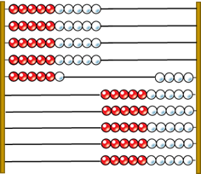
Here is a Rekenrek made from 100 beads.
If the Rekenrek represents one whole, what fractions have been made on the left and on the right?
Can you partition both of the fractions into tenths and hundredths?

Slide 17
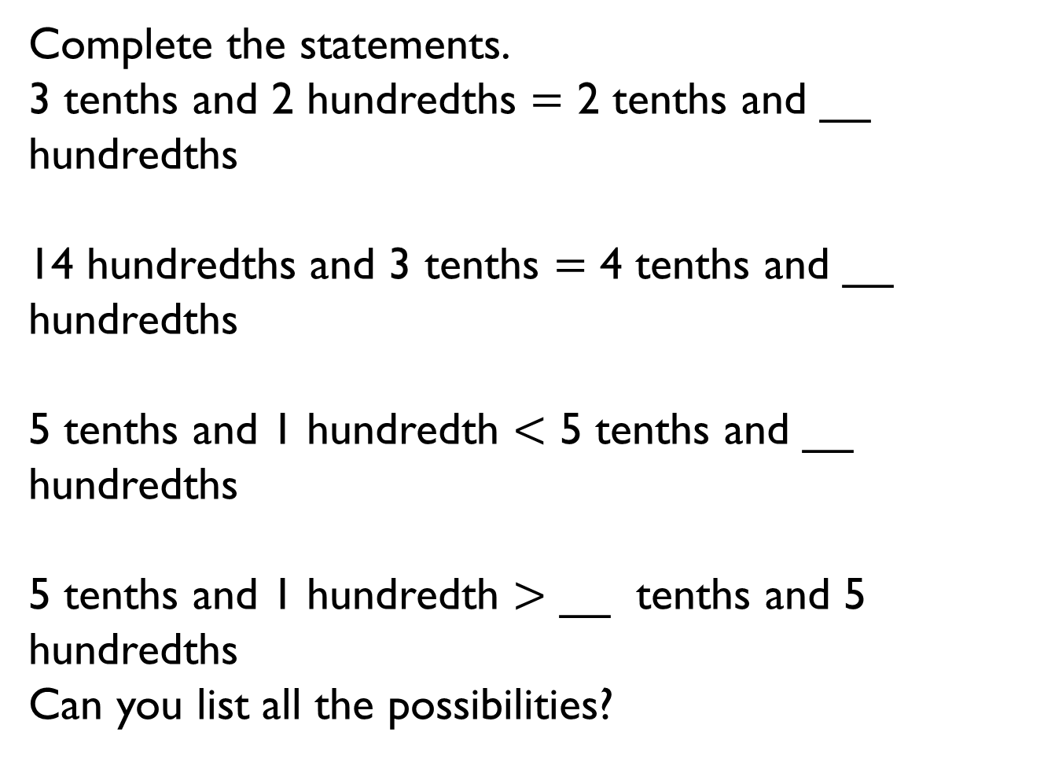
Complete the statements.
3 tenths and 2 hundredths $=$ 2 tenths and __ hundredths
14 hundredths and 3 tenths $=$ 4 tenths and __ hundredths
5 tenths and 1 hundredth $<$ 5 tenths and __ hundredths
5 tenths and 1 hundredth $>$ __ tenths and 5 hundredths
Can you list all the possibilities?

Slide 18

Dora says,
Is she correct?
Explain your answer.
17 hundredths is the same as 1,700

Slide 19
Alex and Eva have been asked to write the decimal shaded on the 100 grid.
Alex says the grid shows 0.70
Eva says the grid shows 0.7
Who do you agree with?
Explain your answer.

Slide 20
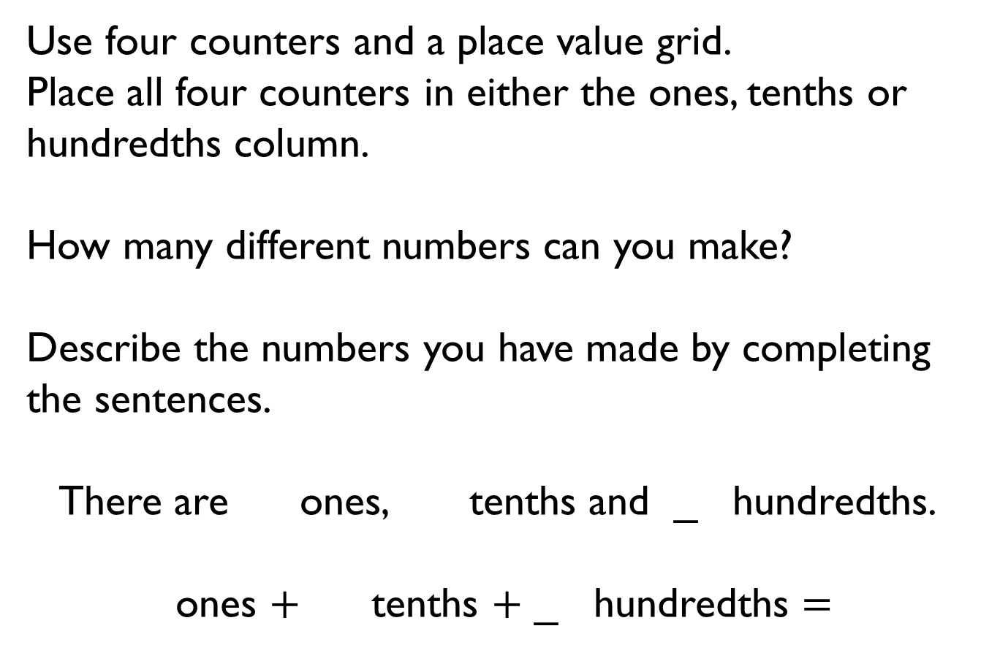
Use four counters and a place value grid.
Place all four counters in either the ones, tenths or hundredths column.
How many different numbers can you make?
Describe the numbers you have made by completing the sentences.
There are ones, tenths and _ hundredths.
        ones $+$ tenths $+$ _ hundredths $=$

Slide 21
Ron says he can partition 0.34 in more than one way.
Use Ron’s method to partition 0.45 in more than one way.
0.34
0.34
0.34
0.3
0.24
0.14

Slide 22
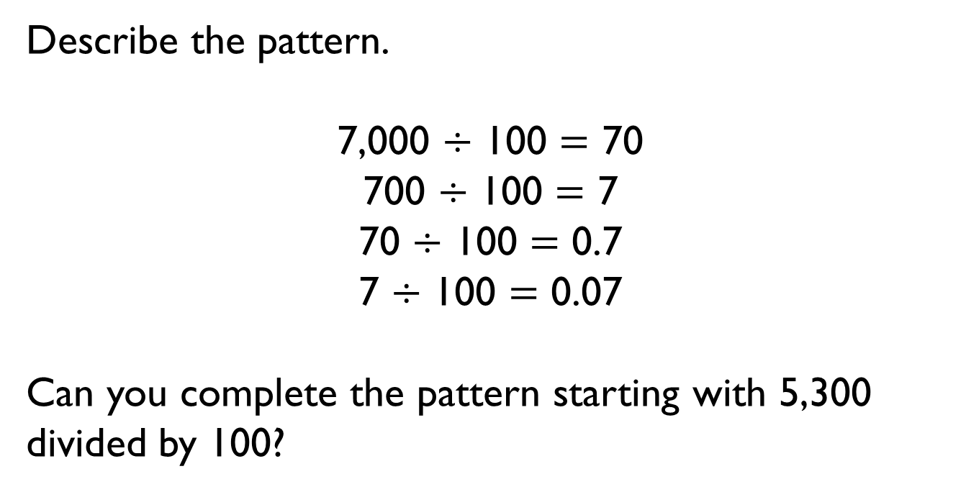
Describe the pattern.
7,000 $÷$ 100 $=$ 70
700 $÷$ 100 $=$ 7
70 $÷$ 100 $=$ 0.7
7 $÷$ 100 $=$ 0.07
Can you complete the pattern starting with 5,300 divided by 100?

Slide 23


Teddy says,
Mo says,
Who is correct?
Explain your answer.
45 divided by 100 is 0.45 so I know 0.45 is 100 times smaller than 45
45 divided by 100 is 0.45 so I know 45 is 100 times bigger than 0.45

