Slide 1




Year 5 - Autumn - Block 1
Place Value

Slide 2
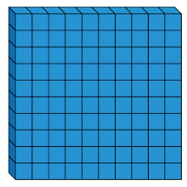


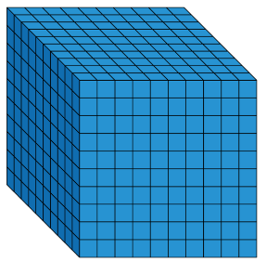





Dora has made five numbers, using the digits 1, 2, 3, 4
She has changed each number into a letter.
Her numbers are
aabcd
acdbc
dcaba
cdadc
bdaab
Here are three clues to work out her numbers:
The first number in her list is the greatest number.
The digits in the fourth number total 12
The third number in the list is the smallest number.

Slide 3
Tommy says he can order the following numbers by only looking at the first three digits.
Is he correct?
Explain your answer.
12,516
12,832
12,679
12,538
12,794

Slide 4
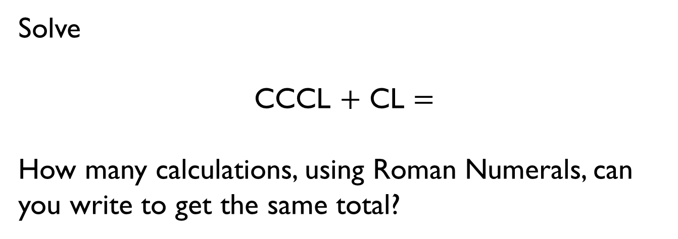
Solve
CCCL $+$ CL $=$
How many calculations, using Roman Numerals, can you write to get the same total?

Slide 5
Here is part of a Roman Numerals hundred square.
Complete the missing values.
What patterns do you notice?
XLIV | XLV |  | XLVII
 |  | LVI | LVII
LXIV |  | LXVI | LXVII

Slide 6

Jack
What could Jack’s number be?
Can you find all of the possibilities?
My number rounded to the nearest 10 is 1,150
Rounded to the nearest 100 it is 1,200
Rounded to the nearest 1,000 it is 1,000

Slide 7

Whitney
Do you agree with Whitney?
Explain why.
2,567 to the nearest 100 is 2,500

Slide 8

Teddy
Explain the mistake Teddy has made.
4,725 to the nearest 1,000 is 5,025

Slide 9
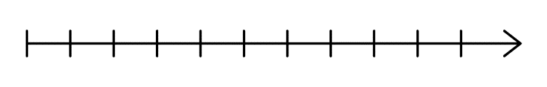
Here is a number line.
What is the value of A?
B is 40 less than A.
What is the value of B?
C is 500 less than B.
Add C to the number line.
A
2000
3000
B

Slide 10
Here are three ways of partitioning 27,650
27 thousands and 650 ones
27 thousands, 5 hundreds and 150 ones
27 thousands and 65 tens
Write three more ways.

Slide 11
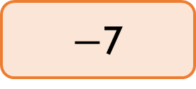
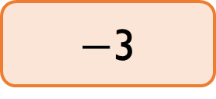
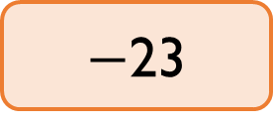
Rosie counts forwards and backwards in 10s from 317
Circle the numbers Rosie will count.
Explain why Rosie will not say the other numbers.
427
997
$−$7
1,666
3,210
5,627
$−$23
7
$−$3

Slide 12
Place the digits cards 0 to 9 face down and select five of them.
Make the greatest number possible and the smallest number possible.
How do you know which is the greatest or smallest?
0
1
2
3
4
5
6
7
8
9

Slide 13
Using the digit cards 0 to 9, create three different 5-digit numbers that fit the following clues:
The digit in the hundreds column and the ones column have a difference of 2
The digit in the hundreds column and the ten thousands column has a difference of 2
The sum of all the digits totals 19
0
1
2
3
4
5
6
7
8
9

Slide 14
Round 59,996 to the nearest 1,000
Round 59,996 to the nearest 10,000
What do you notice about the answers?
Can you think of three more numbers where the same thing could happen?

Slide 15
Two 5-digit numbers have a difference of five.
When they are both rounded to the nearest thousand, the difference is 1,000
What could the numbers be?

Slide 16
Describe the value of the digit 7 in each of the following numbers.
How do you know?
407,338
700,491
25,571

Slide 17
The bar models are showing a pattern.
Draw the next three.
Create your own pattern of bar models for a partner to continue.
40,000
25,000 | 15,000
40,000
20,000 | 20,000
40,000
15,000 | 25,000

Slide 18

Amir writes the first five numbers of a sequence.
They are:
3,666, 4,666, 5,666, 6,666, 7,666
Amir
Is he correct?
Explain why.
The 10th term will be 15,322 because I will double the 5th term.

Slide 19



I am counting up in 10s from 184
I will include 224
Mo
Rosie
Jack
Who has made a mistake?
Identify anyone who has made a mistake and explain how you know.
I am counting up in 100s from 604
I will include 1,040
I am counting up in 1,000s from 13
I will include 130,000

Slide 20
The missing number is an odd number.
When rounded to the nearest 10,000 it is 440,000
The sum of the digits is 23
Greatest Smallest
What could the number be?
Can you find three possibilities?
475,000
?
407,500

Slide 21




Here are four number cards.
Four children take one each and say a clue.
Which card did each child have?
42,350
56,995
43,385
56,963
My number is 57,000 when rounded to the nearest 100
My number has exactly three hundreds in it
My number is 43,000 when rounded to the nearest thousand
My number is exactly 100 less then 57,063

Slide 22
The difference between two 3-digit numbers is two.
When each number is rounded to the nearest 1,000 the difference between them is 1,000
What could the two numbers be?

Slide 23
When the difference between A and B is rounded to the nearest 100, the answer is 700
When the difference between B and C is rounded to the nearest 100, the answer is 400
A, B and C are not multiples of 10
What could A, B and C be?

Slide 24
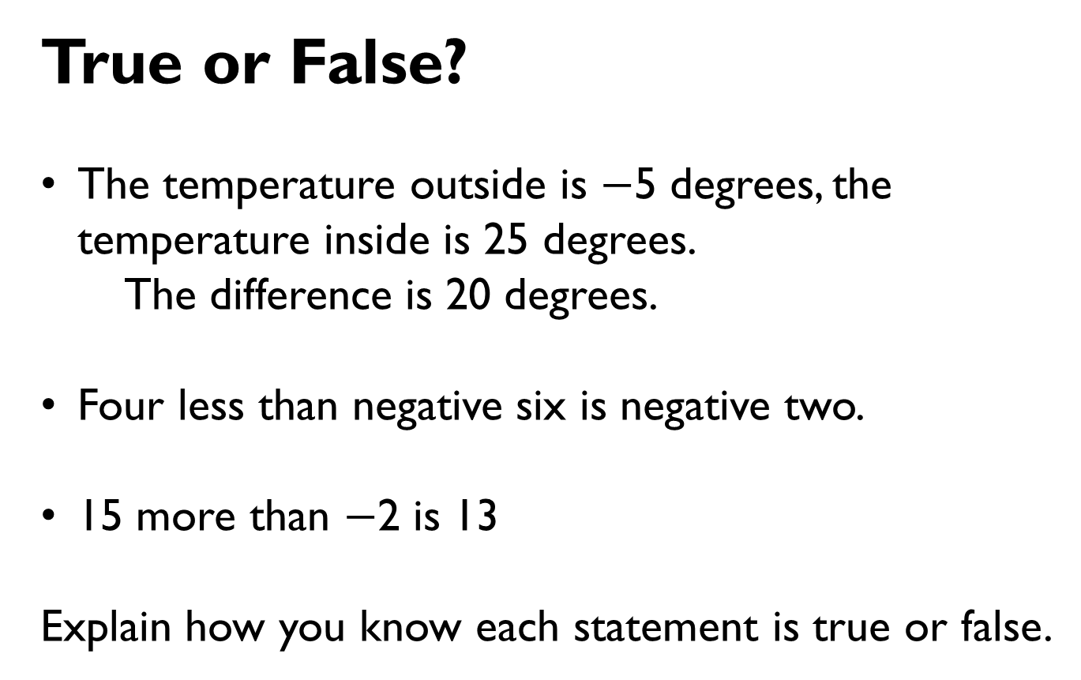
True or False?
The temperature outside is $−$5 degrees, the temperature inside is 25 degrees.
The difference is 20 degrees.
Four less than negative six is negative two.
15 more than $−$2 is 13
Explain how you know each statement is true or false.

Slide 25
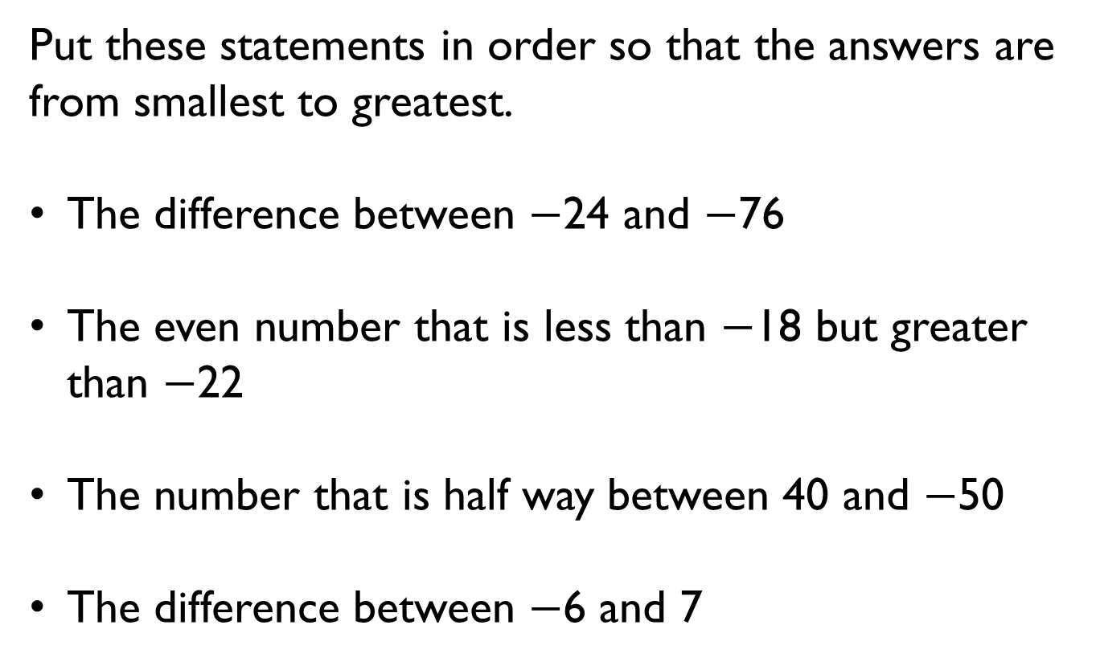
Put these statements in order so that the answers are from smallest to greatest.
The difference between $−$24 and $−$76
The even number that is less than $−$18 but greater than $−$22
The number that is half way between 40 and $−$50
The difference between $−$6 and 7

