Slide 1




Year 5 - Autumn - Block 2
Addition and Subtraction

Slide 2
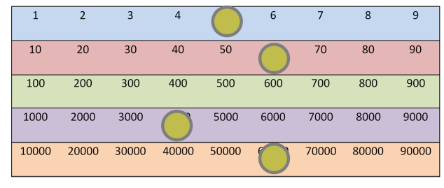
Amir is discovering numbers on a Gattegno chart.
He makes this number.
Amir moves one counter three spaces on a horizontal line to create a new number.
When he adds this to his original number he gets 131,130
Which counter did he move?

Slide 3
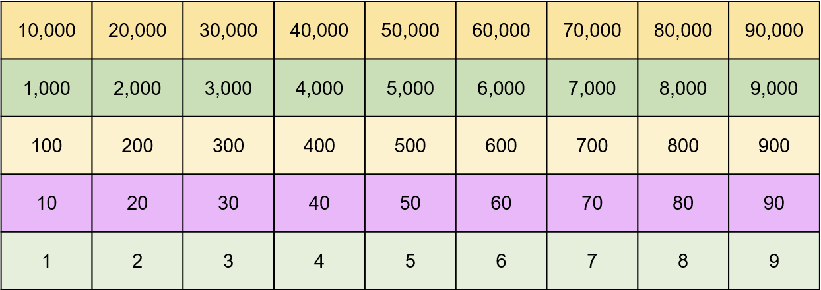

Slide 4






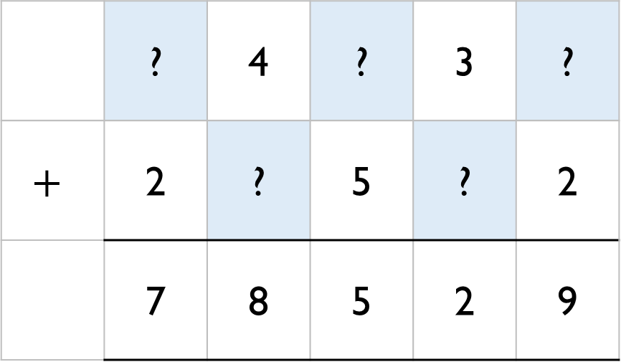
Work out the missing numbers.
 | ? | 4 | ? | 3 | ?
$$+$$ | 2 | ? | 5 | ? | 2
 | 7 | 8 | 5 | 2 | 9

Slide 5
Eva makes a 5-digit number.
Mo makes a 4-digit number.
The difference between their numbers is 3,465
What could their numbers be?

Slide 6
Rosie completes this subtraction incorrectly.
Explain the mistake to Rosie and correct it for her.
2 8 7 0 1
7 6 2 1
2 1 1 8 0

Slide 7

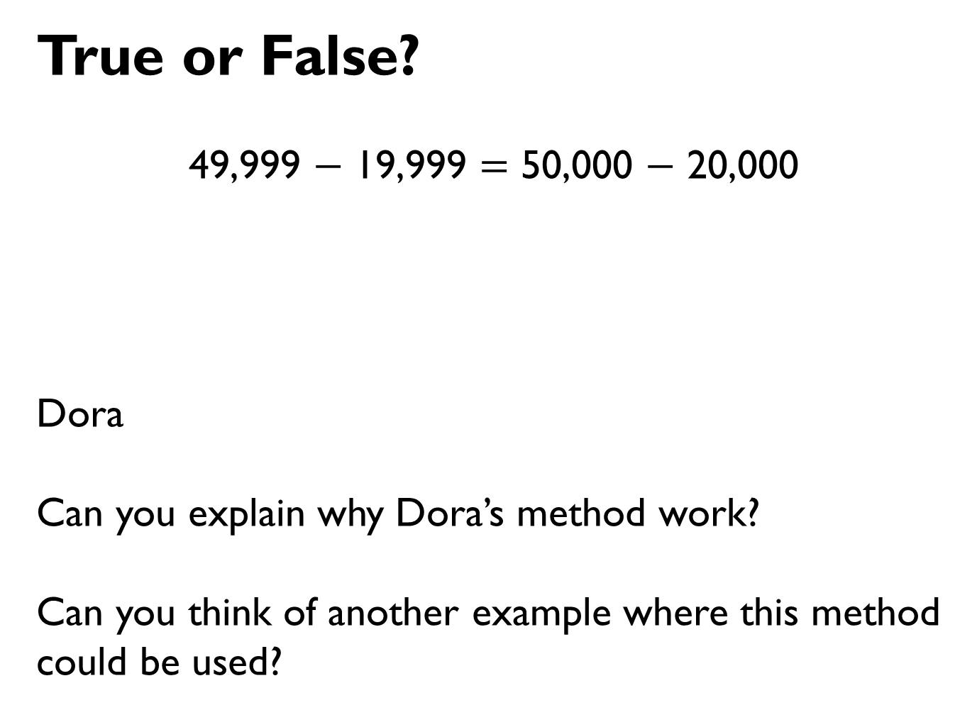
True or False?
49,999 $−$ 19,999 $=$ 50,000 $−$ 20,000
Dora
Can you explain why Dora’s method work?
Can you think of another example where this method could be used?
I did not need to use a written method to work this out.

Slide 8
Which estimate is inaccurate?
a)
b)
c)
Explain how you know.
25,000
0
100,000
25,000
10,000
90,000
25,000
0
50,000

Slide 9
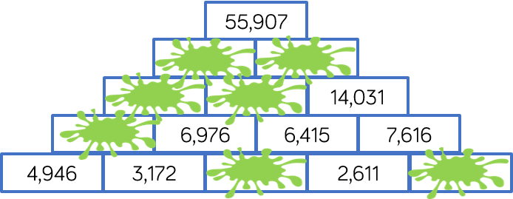
Complete the pyramid using addition and subtraction.

Slide 11



Mo, Whitney, Teddy and Eva collect marbles.
Mo
Whitney
Teddy
In total they have 8,524 marbles between them.
How many does Eva have?
I have 1,648 marbles.
I have double the amount of marbles Mo has.
I have half the amount of marbles Mo has.

Slide 12

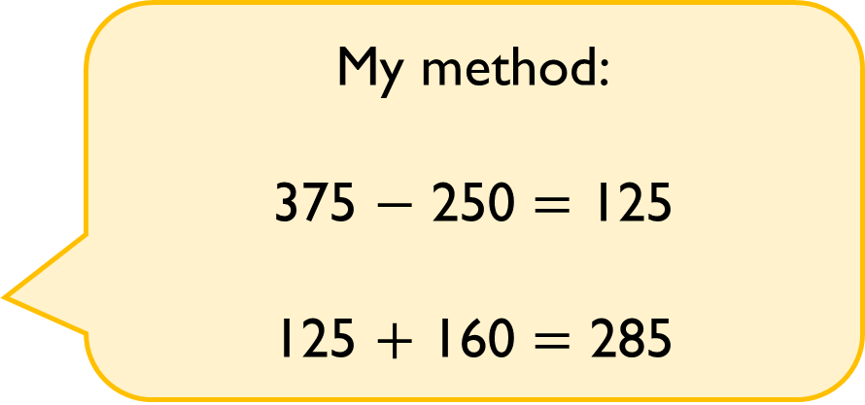
A milkman has 250 bottles of milk.
He collects another 160 from the dairy, and delivers 375 during the day.
How many does he have left?
Tommy
Do you agree with Tommy?
Explain why.
My method:
375 $−$ 250 $=$ 125
125 $+$ 160 $=$ 285

Slide 13
On Monday, Whitney was paid £114
On Tuesday, she was paid £27 more than on Monday.
On Wednesday, she was paid £27 less than on Monday.
How much was Whitney paid in total?
How many calculations did you do?
Is there a more efficient method?

