Slide 1




Year 5 - Autumn - Block 4
Multiplication & Division

Slide 2
Use 0 – 9 digit cards. Choose 2 cards and multiply the digits shown.
What is your number a multiple of?
Is it a multiple of more than one number?
Find all the numbers you can make using the digit cards.
Use the table to help.
 | 0 | 1 | 2 | 3 | 4 | 5 | 6 | 7 | 8 | 9
0
1
2
3
4
5
6
7
8
9

Slide 3
 | 0 | 1 | 2 | 3 | 4 | 5 | 6 | 7 | 8 | 9
0
1
2
3
4
5
6
7
8
9

Slide 4
Always, Sometimes, Never
The product of two even numbers is a multiple of an odd number.
The product of two odd numbers is a multiple of an even number.

Slide 5
Eva’s age is a multiple of 7 and is 3 less than a multiple of 8
She is younger than 40
How old is Eva?

Slide 6
Here is Annie’s method for finding factor pairs of 36
When do you put a cross next to a number?
How many factors does 36 have?
Use Annie’s method to find all the factors of 64
1 | 36
2 | 18
3 | 12
4 | 9
5 | X
6 | 6

Slide 7
Always, Sometimes, Never
An even number has an even amount of factors.
An odd number has an odd amount of factors.

Slide 8
True or False?
The bigger the number, the more factors it has.

Slide 9
True or False?
1 is a factor of every number.
1 is a multiple of every number.
0 is a factor of every number.
0 is a multiple of every number.

Slide 10
I am thinking of two 2-digit numbers.
Both of the numbers have a digit total of six.
Their common factors are:
1, 2, 3, 4, 6, and 12
What are the numbers?

Slide 11
Find all the prime numbers between 10 and 100, sort them in the table below.
Why do no two-digit prime numbers end in an even digit?
Why do no two-digit prime numbers end in a 5?
End in a 1 | End in a 3 | End in a 7 | End in a 9

Slide 12


Dora says all prime numbers have to be odd.
Her friend Amir says that means all odd numbers are prime, so 9, 27 and 45 are prime numbers.
Explain Amir’s and Dora’s mistakes and correct them.

Slide 13

Teddy says,
Do you agree?
Explain your reasoning.
Factors come in pairs so all numbers must have an even number of factors.

Slide 14
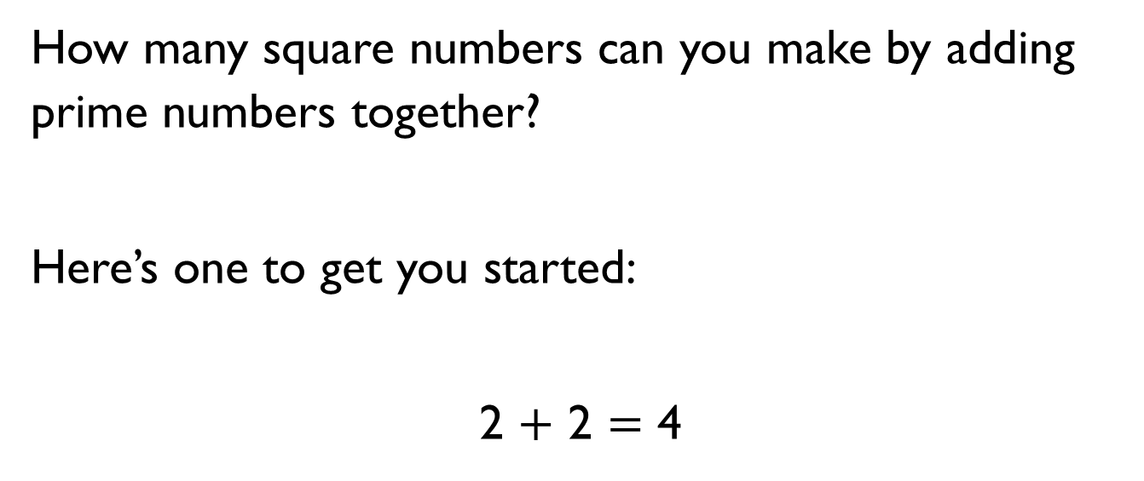
How many square numbers can you make by adding prime numbers together?
Here’s one to get you started:
2 $+$ 2 $=$ 4

Slide 15

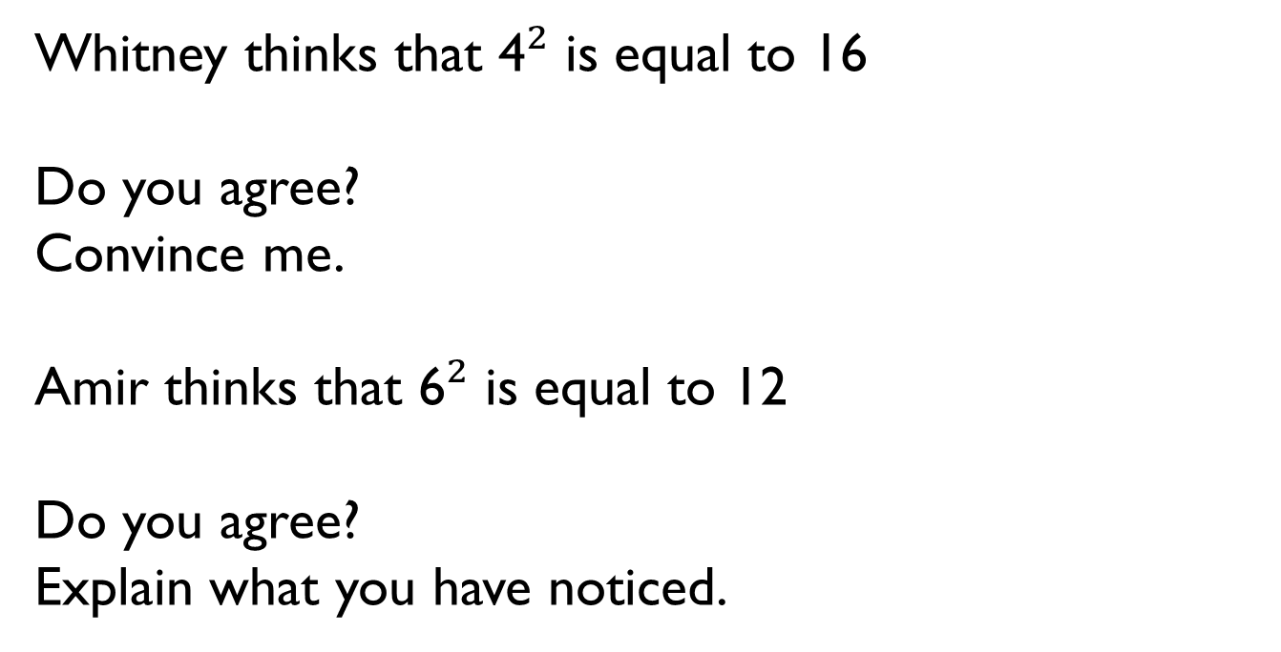
Whitney thinks that 4$²$ is equal to 16
Do you agree?
Convince me.
Amir thinks that 6$²$ is equal to 12
Do you agree?
Explain what you have noticed.

Slide 16
Always, Sometimes, Never
A square number has an even number of factors.

Slide 17


Rosie says,
Do you agree?
Explain your answer.
5$3$ is equal to 15

Slide 18
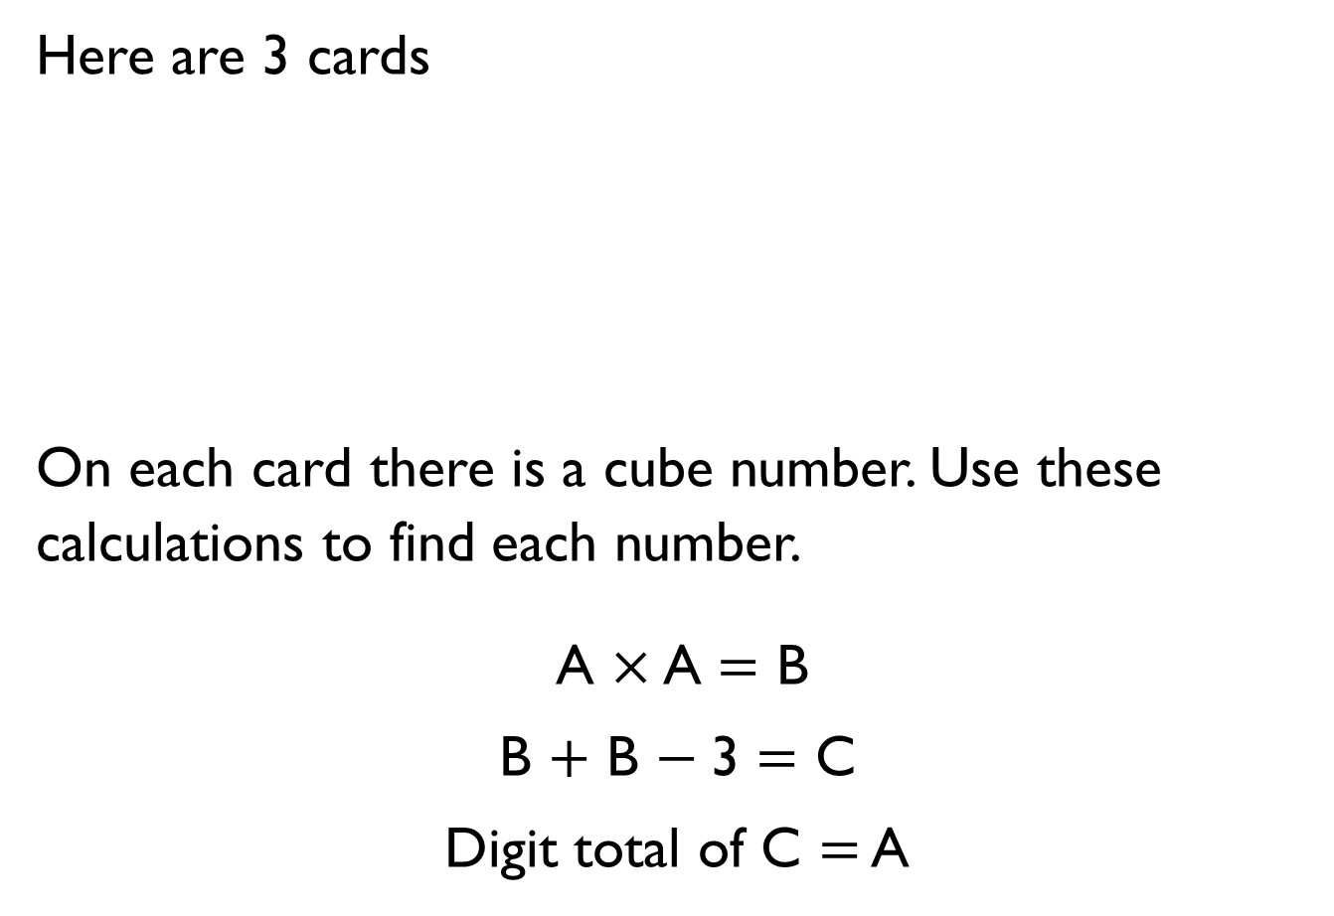
Here are 3 cards
On each card there is a cube number. Use these calculations to find each number.
A $×$ A $=$ B
B $+$ B $−$3 $=$ C
Digit total of C $=$ A
A
B
C

Slide 19
Dora is thinking of a two-digit number that is both a square and a cube number.
What number is she thinking of?

Slide 20
Teddy’s age is a cube number.
Next year his age will be a square number.
How old is he now?

Slide 21
The sum of a cube number and a square number is 150
What are the two numbers?

Slide 22
Rosie has £300 in her bank account.
Tommy has 100 times more than Rosie in his bank account.
How much more money does Tommy have than Rosie?

Slide 23

Whitney has £1,020 in her bank account.
Tommy has £120 in his bank account.
Whitney says,
Is Whitney correct? Explain your reasoning.
I have ten times more money than you

Slide 24
Jack is thinking of a 3-digit number.
When he multiplies his number by 100, the ten thousands and hundreds digit are the same.
The sum of the digits is 10
What number could Jack be thinking of?

Slide 25
Mo has £357,000 in his bank.
He divides the amount by 1,000 and takes that much money out of the bank.
Using the money he has taken out, he buys some furniture costing two hundred and sixty-nine pounds.
How much money does Mo have left from the money he took out?
Show your working out.

Slide 26
Here are the answers to some problems:
5,700 405 397 6,203
Can you write at least two questions for each answer involving dividing by 10, 100 or 1,000?

Slide 27
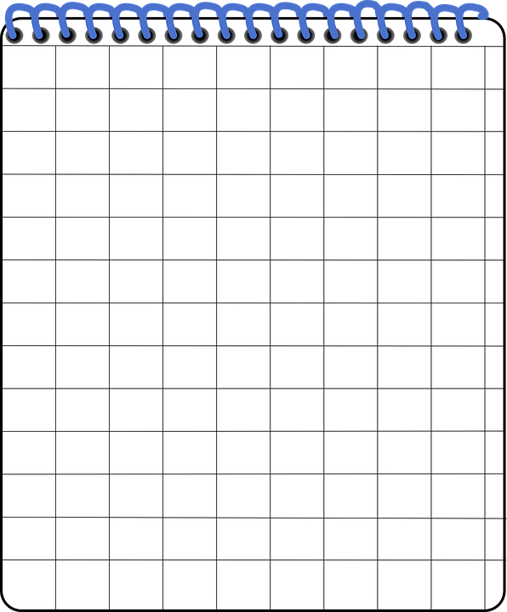
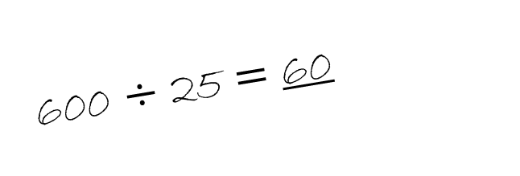
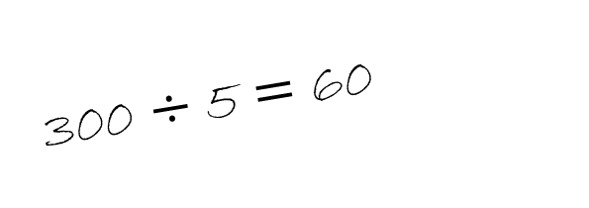
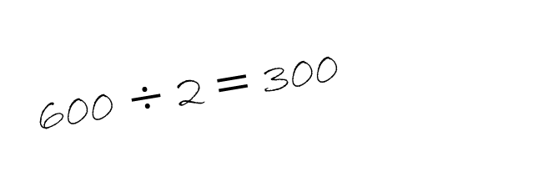
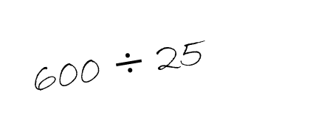
Tommy has answered a question.
Here is his working out.
Is he correct?
Explain your answer.
600 $÷$ 25
600 $÷$ 2 $=$ 300
300 $÷$ 5 $=$ 60
600 $÷$ 25 $=$ 60

Slide 28

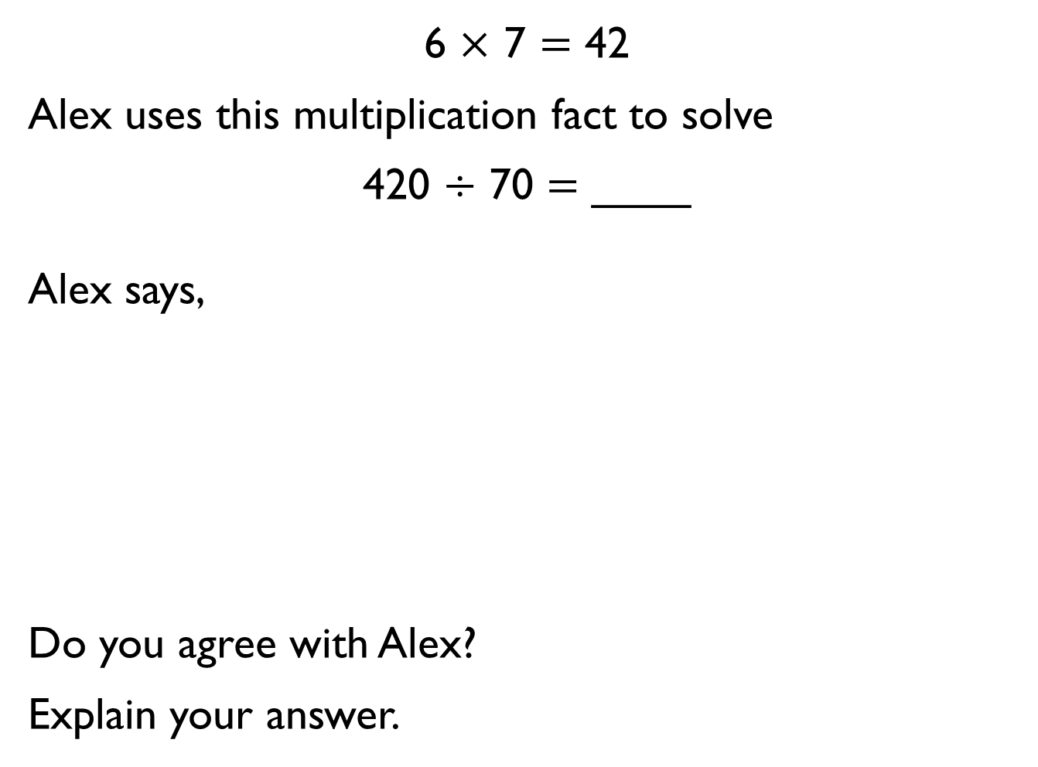
6 $×$ 7 $=$ 42
Alex uses this multiplication fact to solve
420 $÷$ 70 $=$ ____
Alex says,
Do you agree with Alex?
Explain your answer.
The answer is 60 because all of the numbers are 10 times bigger.

