Slide 1
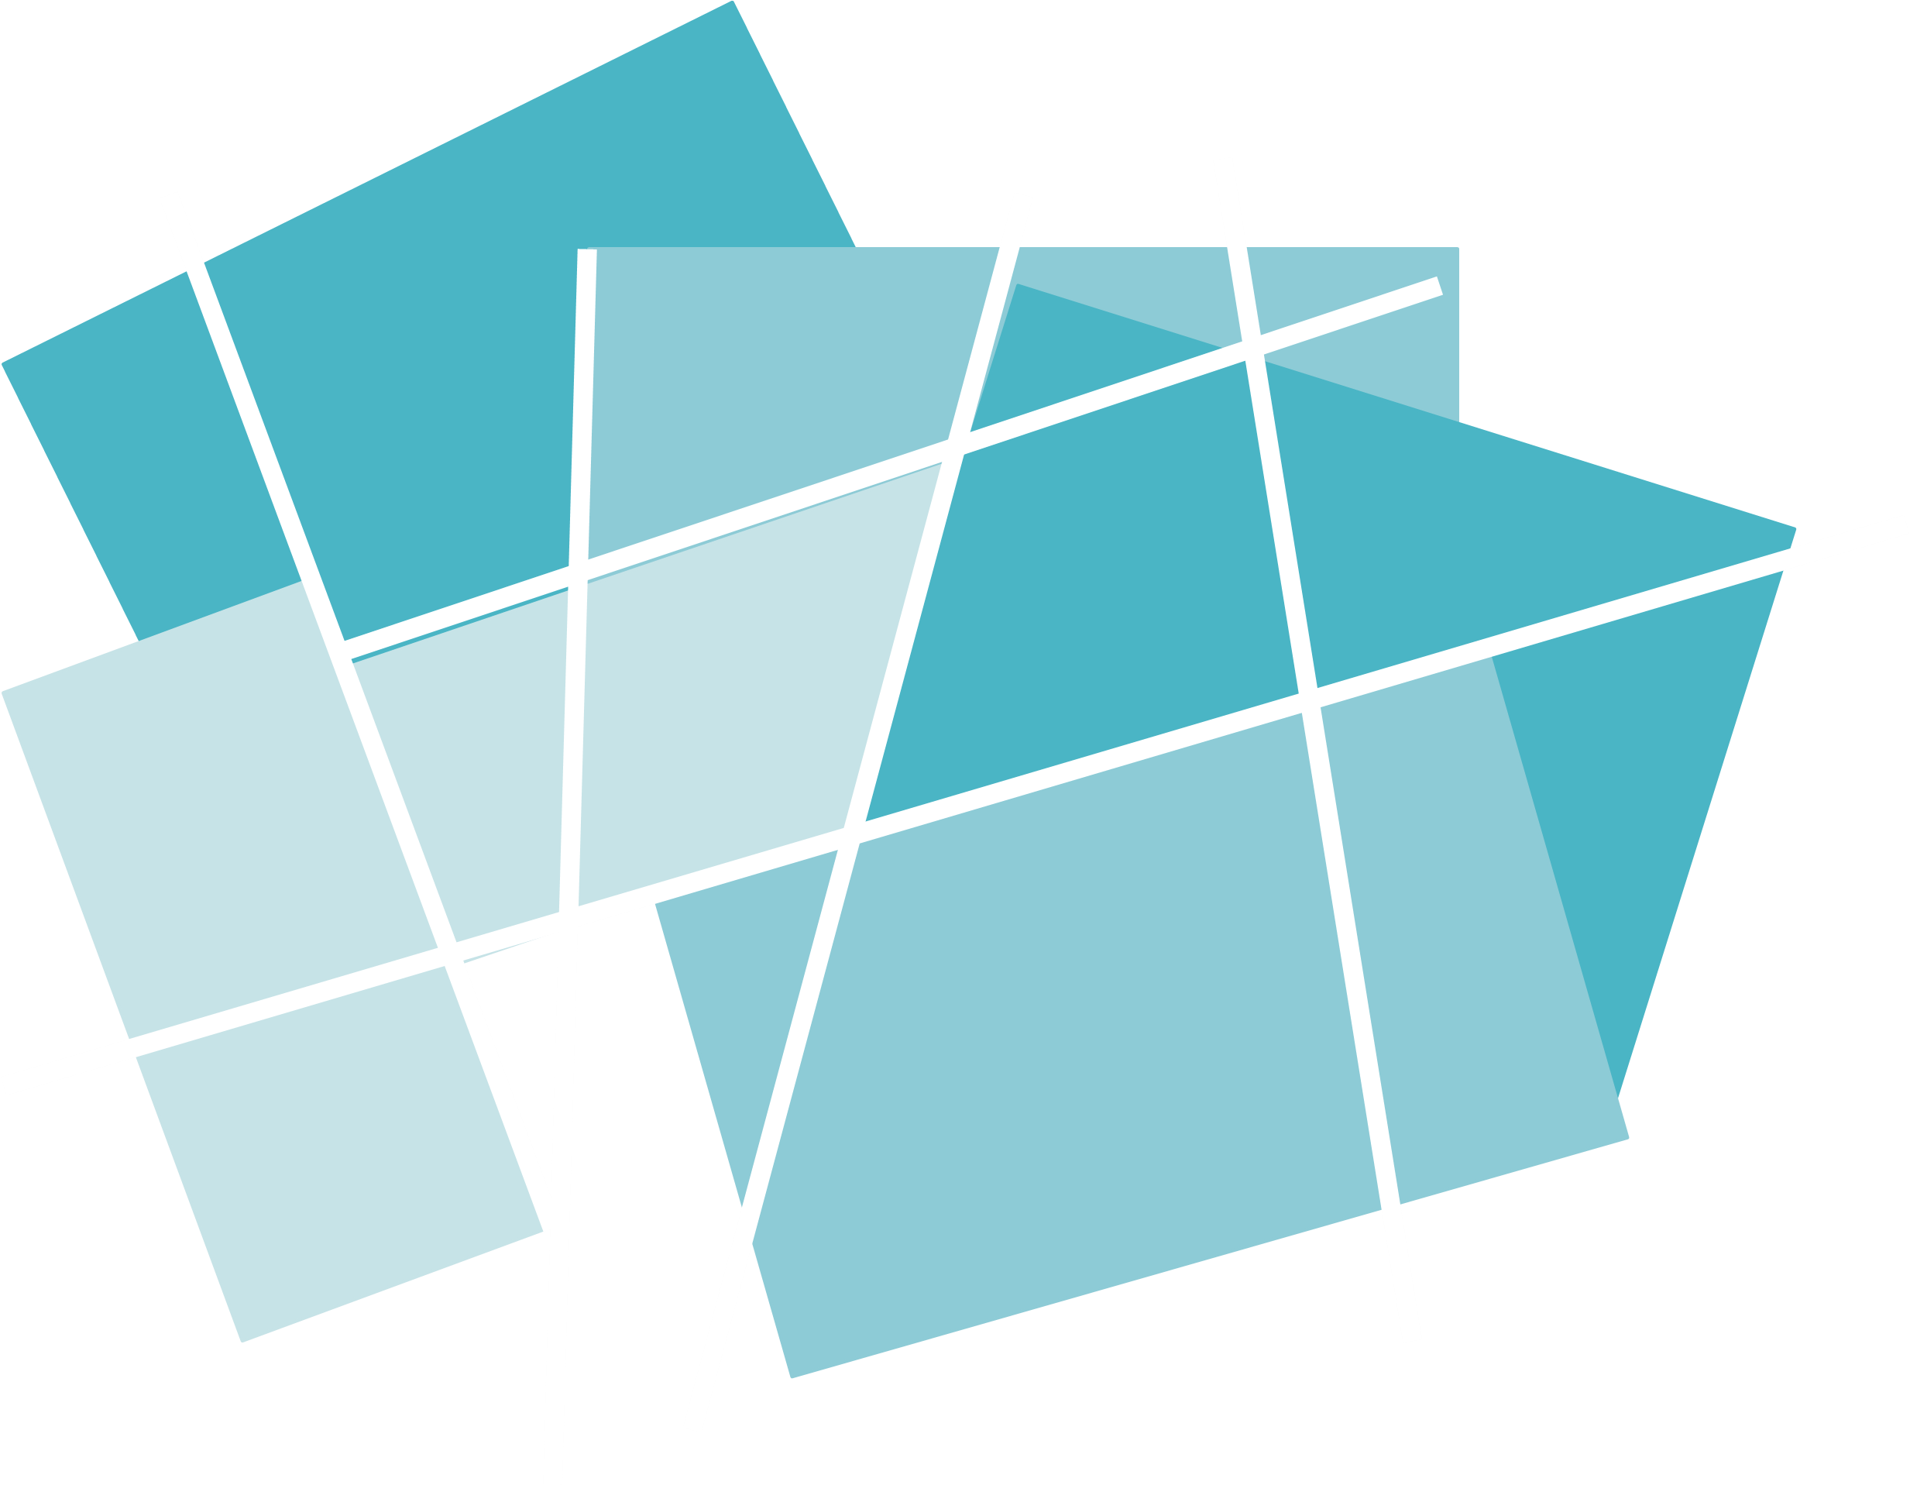



Year 5 - Autumn - Block 5
Perimeter & Area

Slide 2
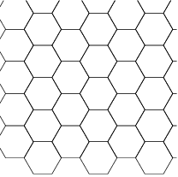
Each regular hexagon has a side length of 2 cm
Can you construct a shape with a perimeter of 44 cm?

Slide 3
Activity
Investigate different ways you can make composite rectilinear shapes with a perimeter of 54 cm.

Slide 4
Here is a square inside another square.
The perimeter of the inner square is 16 cm
The outer square’s perimeter is four times the size of
the inner square.
What is the length of one side of the outer square?
How do you know? What do you notice?

Slide 5
The value of c is 14 m.
What is the total perimeter of the shape?
4c
c

Slide 6
The blue rectangle has a perimeter of
38 cm.
What is the value of a?
a
4.8 cm

Slide 7
Investigate how many ways you can make different squares and rectangles with the same area of 84 cm²
What strategy did you use?

Slide 8
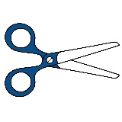
True or False?
If you cut off a piece from a shape, you reduce its area and perimeter.
Draw 2 examples to prove your thinking.

Slide 9
Estimate the area of each shape and then order from largest to smallest.
6.8 cm
2.8 cm
3.4 cm
19.1 cm
7.75 cm

Slide 10
      Each orange square has an area of 24 cm².
      Calculate the total orange area.
      Calculate the blue area.
      Calculate the green area.
      What is the total area of the whole shape?

Slide 11
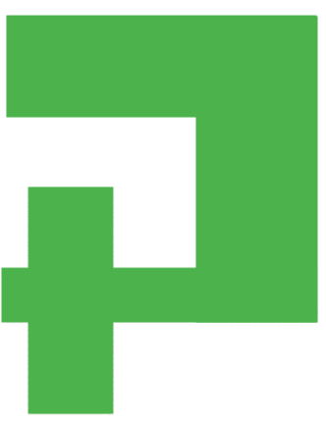
How many different ways can you split this shape to find the area?
Add more values and work out the area.
2 m
6 m

Slide 12
Jack says this shape has an area of 34 cm².
Show that Jack is correct.
Find three more possible compound shapes that have an area of 34 cm².
2 cm
5 cm
8 cm
6 cm
4 cm
2 cm

Slide 13
Draw a circle on 1 cm² paper. What is the estimated area?
Can you draw a circle that has area approximately 20 cm²?

Slide 14
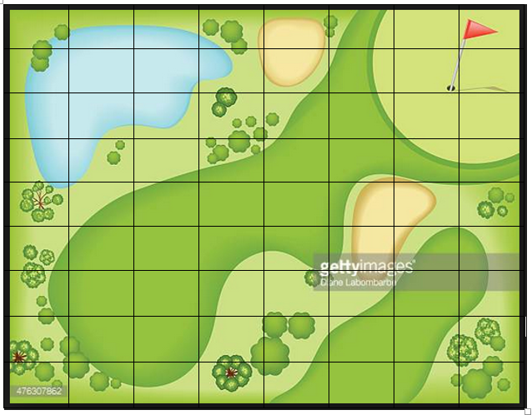
If each square represents 3 m², what is the approximate area of:
The lake
The bunkers
The fairway
The rough
Tree/forest area

Slide 15
Can you construct a ‘Pirate Island’ to be used as part of a treasure map for a new game? Each square represents 4 m².
The island must include the following features and be of the given approximate measure:
Circular Island 180 m²
Oval Lake 58 m²
Forests with a total area of 63 m² (can be split over more than one space)
Beaches with a total area of 92 m² (can be split over more than one space)
Mountains with a total area of 57 m²
Rocky coastline with total area of 25 m²

