Slide 1




Year 5 – Summer - Block 2
Properties of Shapes

Slide 2
Which angle is the odd one out?
Could another angle be the odd one out for a different reason?
180˚
45˚
79˚
270˚

Slide 3
Always, sometimes or never true?
If I turn from North-East to North-West, I have turned 90˚
If I turn from East to North-West, I will have turned through an obtuse angle.
If I turn from South-West to South, my turn will be larger than 350˚

Slide 4
Pick a starting point on the compass and describe a turn to your partner. Use the mathematical words to describe your turns:
Clockwise
Anti-clockwise
Degrees
Acute
Obtuse
Reflex
Right angle
Can your partner identify where you will finish?

Slide 5
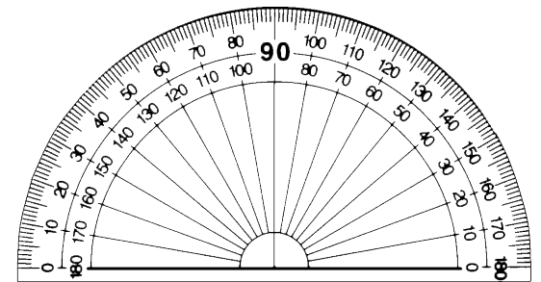


I have measured the angle correctly because my protractor is the right way round.
Teddy
Whitney
Who do you agree with?
Explain why.
I have measured the angle correctly because my protractor is on the line accurately.

Slide 6



Three children are measuring angles. Can you spot and explain their mistake?
Mo
Dora
Alex
My angle measures 135˚
My angle measures 55˚
My angle measures 35˚

Slide 7
Rosie is measuring an obtuse angle.
What’s her mistake?

Slide 8
How many ways can you find the value of the angle?

Slide 9
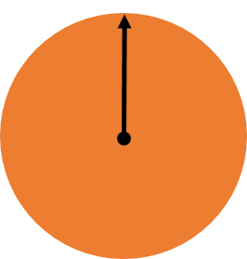
Use a cut out of a circle and place a spinner in the centre.
Point the arrow in the starting position above.
Move the spinner to try to make the angles shown on the cards below.
Check how close you are with a protractor.
40°
72°
154°

Slide 10
Draw a range of angles for a friend.
Estimate the sizes of the angles to order them from smallest to largest.
Measure the angles to see how close you were.

Slide 11
Always, sometimes or never true?
Two acute angles next to each other make an obtuse angle.
Half an obtuse angle is an acute angle.
180˚ is an obtuse angle

Slide 12
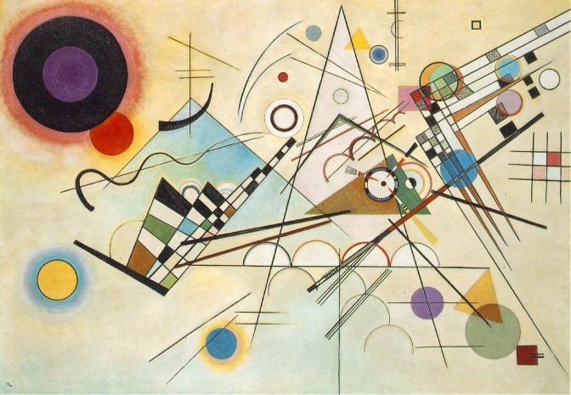
Use Kandinsky’s artwork to practice measuring lines and angles.
Create clues for your partner to work out which line or angle you have measured.

Slide 13
Here are two angles.
Angle b is a prime number between 40 and 50
Use the clue to calculate what the missing angles could be.
a
b

Slide 14

Jack is measuring two angles on a straight line.
Explain why at least one of Jack’s angles must be wrong.
My angles measure 73˚and 108˚

Slide 15
The total of angle f and g are the same as angle e
Angle e is 9˚ more than the size of the given angle.
Angle f is 11˚ more than angle g
Calculate the size of the angles.
Create your own straight line problem like this one for your partner.
54°
f
e
g

Slide 16
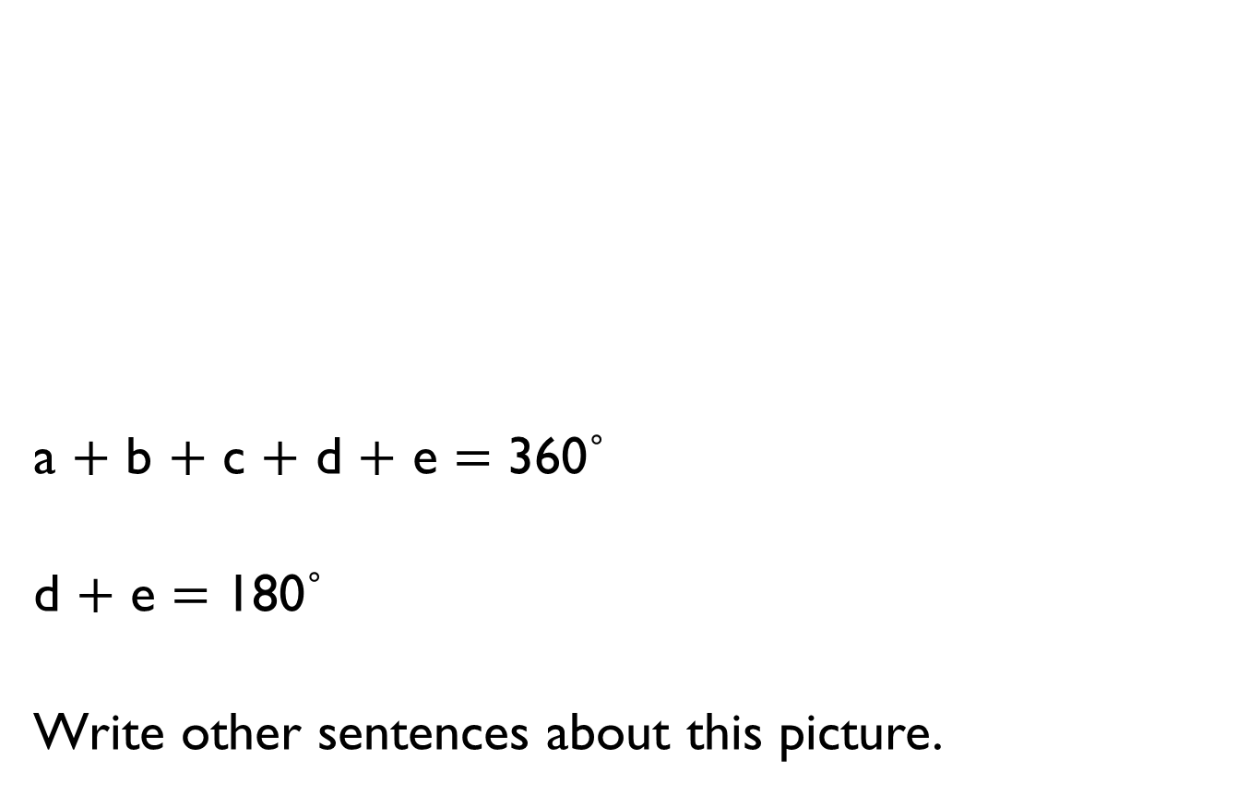
a $+$ b $+$ c $+$ d $+$ e $=$ 360˚
d $+$ e $=$ 180˚
Write other sentences about this picture.
b
c
a
d
e

Slide 17
Two sticks are on a table.
Without measuring, find the three missing angles.
a
b
66°
c

Slide 18


Eva says,
Rosie says,
Use Rosie’s method to draw angles:
300˚
200˚
280˚
My protractor only goes to 180 degrees, so I can’t draw reflex angles like 250 degrees.
I know a full turn is 360 degrees so I can draw 110 degrees instead and have an angle of 250 degrees as well.
110°
250°

Slide 19
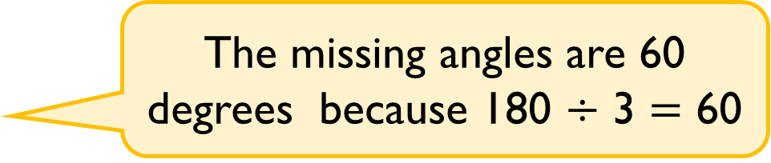
Whitney is calculating the missing angles in the shape.
She says,
Do you agree?
Explain why.
The missing angles are 60 degrees because 180 $÷$ 3 $=$ 60

Slide 20
Alex has this triangle.
She makes this composite shape using identical triangles to the one above.
Calculate the perimeter of the shape.
Calculate the missing angles.
Use your own triangle, square or rectangle to make a similar problem?
60°
57 mm
57 mm
60°
60°
57 mm
a
b
c

Slide 21
Always, sometimes or never true?
A regular polygon has equal sides but not equal angles.
A triangle is a regular polygon.
A rhombus is a regular polygon.
The number of angles is the same as the number of sides in any polygon.

Slide 22
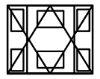
How many regular and irregular polygons can you find in this picture?

Slide 23
Cut out lots of different regular and irregular shapes. Ask children to work in pairs and sort them into groups. Once they have sorted them, can they find a different way to sort them again?
Children could use Venn diagrams and Carroll diagrams to deepen their understanding, for example:
Quadrilaterals
 | Regular polygon | Irregular polygon
Has at least one right angle
Has no right angles
Kites
Parallelograms
Rhombi
Rectangles
Squares
Trapeziums

Slide 24

Amir says,
Do you agree?
Explain why.
If two 3-D shapes have the same number of edges, then they also have the same number of vertices.

Slide 25
Create cubes and cuboids by using multilink cubes.
Draw these on isometric paper.
Would it be harder if you had to draw something other than squares or rectangles?

Slide 26
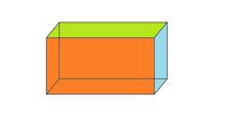
Using different 3-D solids, how can you represent them from different views?
Work out which representation goes with which solid.
For example,
Front view
Side view Plan view

