Slide 1




Year 5 – Summer - Block 3
Position & Direction

Slide 2
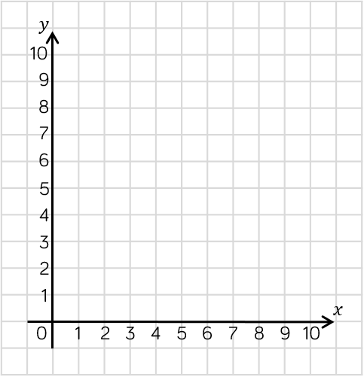


Who do you agree with? Can you spot the mistake the other child has made?
The point is at (8, 3)
Mo
The point is at (3, 8)
Alex

Slide 3
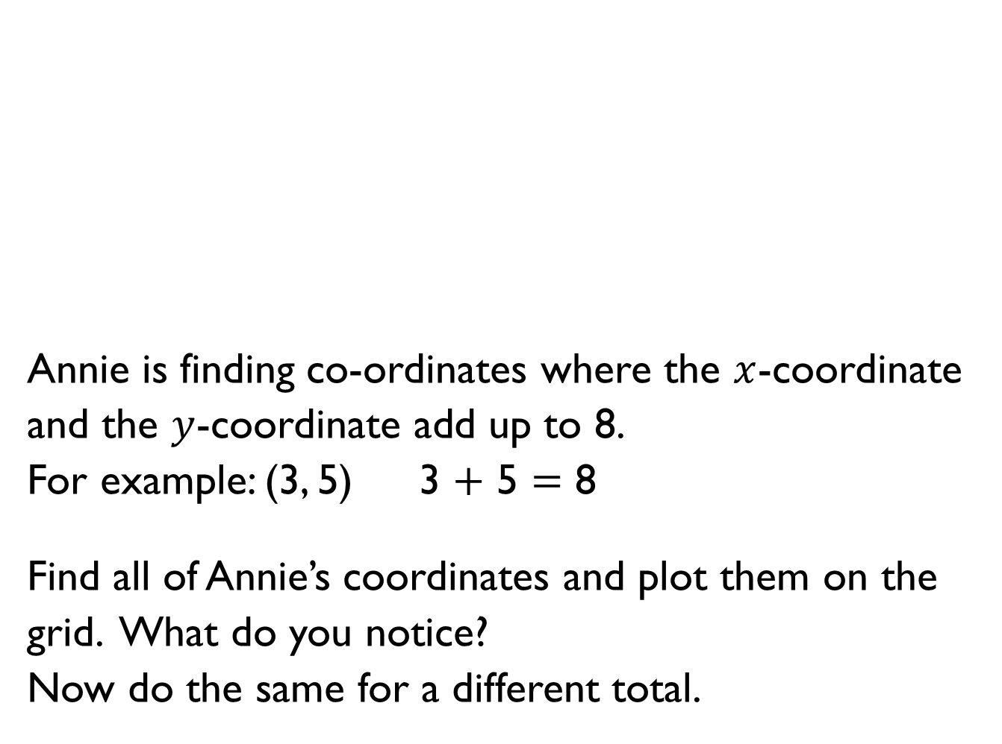
Annie is finding co-ordinates where the $x$-coordinate and the $y$-coordinate add up to 8.
For example: (3, 5) 3 $+$ 5 $=$ 8
Find all of Annie’s coordinates and plot them on the grid. What do you notice?
Now do the same for a different total.

Slide 4

Do you agree with Dora?
Explain your thinking.
When you reflect a shape, its dimensions change.
Dora

Slide 5
The rectangle is pink and green.
The rectangle is reflected in the mirror line.
What would its reflection look like?

Slide 6


$$y$$
10
Eva reflects the shape in the mirror line.
She thinks that the coordinates of the vertices for the reflected shape are:
Is Eva is correct?
Explain why.
9
8
7
6
5
4
3
2
1
$$x$$
0
1
2
3
4
5
6
7
8
9
10
(5, 5)
(2, 5)
(2, 9)

Slide 7

$$y$$
10
This is a shape after it has been reflected. This is called the image.
Use the grid and the marked mirror lines to show where the original object was positioned.
Is there more than one possibility?
9
8
7
6
5
4
3
2
1
$$x$$
0
1
2
3
4
5
6
7
8
9
10

Slide 8



Triangle ABC is translated so that point B translates to point D
Amir
Do you agree with Amir?
Explain your thinking.
$$y$$
8
A
7
6
5
B
C
4
3
2
D
1
0
1
2
3
4
5
6
7
8
$$x$$
It won’t fit on this grid!

Slide 9

A triangle is drawn on the grid.
It is translated so that point A translates to point B.
What would be the coordinates of the other vertices of the translated triangle?
$$y$$
8
7
A
6
5
B
4
3
2
1
0
1
2
3
4
5
6
7
8
$$x$$

Slide 10
These three coordinates have all been translated in the same way.
Can you work out the missing coordinates?
Describe the translation.
( _ , _ )
( 3 , 1 )
( _ , 5)
( 4 , 3 )
( 4 , _ )
( 6 , 1 )

Slide 11
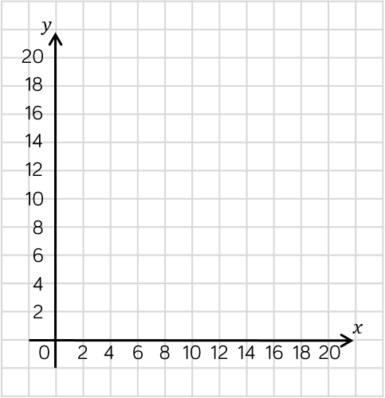
A rectangle is translated two to the left and 4 up.
Three of the coordinates of the translated rectangle are: (6, 8) (10, 14) and (10, 8).
What are the coordinates of the original rectangle?

