Slide 1




Year 6 - Spring - Block 5
Perimeter, Area & Volume

Slide 2


Rosie and Dexter are drawing shapes with an area of 30cm²
Who is correct?
Explain your reasoning.
Dexter’s shape
Rosie’s shape
0.5 cm
2 cm
60 cm
10 cm
5 cm
4 cm

Slide 3
Three children are given the same rectilinear shape to draw.
Amir says, “The smallest length is 2 cm.”
Alex says, “The area is less than 30 cm².”
Annie says, “The perimeter is 22 cm.”
What could the shape be?
How many possibilities can you find?

Slide 4
Always, Sometimes, Never?
If the area of a rectangle is odd then all of the lengths are odd.

Slide 5
True or False?
Two rectangles with the same perimeter can have different areas.
Explain your answer.

Slide 6
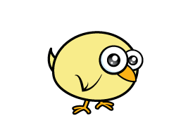
A farmer has 60 metres of perimeter fencing.
For every 1 m² he can
keep 1 chicken.
How can he arrange his fence so that the enclosed area gives him the greatest area?

Slide 7
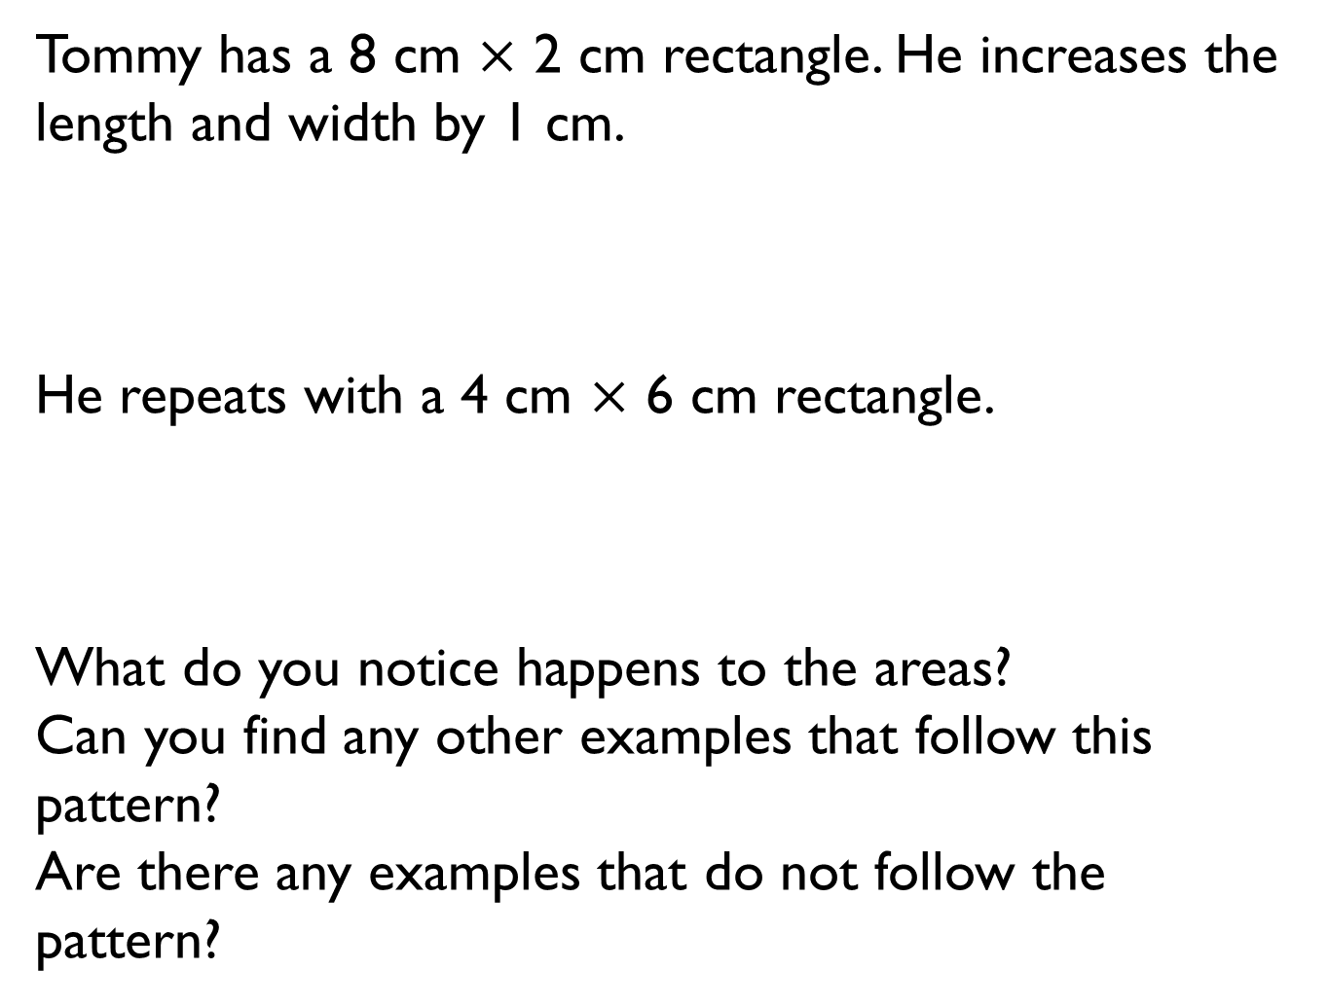
Tommy has a 8 cm $×$ 2 cm rectangle. He increases the length and width by 1 cm.
He repeats with a 4 cm $×$ 6 cm rectangle.
What do you notice happens to the areas?
Can you find any other examples that follow this pattern?
Are there any examples that do not follow the pattern?
Length | Width | Area
8 | 2
9 | 3
Length | Width | Area
4 | 6

Slide 8
Mo says the area of this triangle is 15cm²
Is Mo correct? If not, explain his mistake.

Slide 9
Part of a triangle has been covered.
Estimate the area of the whole triangle.

Slide 10
What is the same about these two triangles?
What is different?
Can you create a different right angled triangle with the same area?

Slide 11

Annie is calculating the area of a right-angled triangle.
Do you agree with Annie? Explain your answer.
I only need to know the length of any two sides to calculate the area of a triangle.

Slide 12
What could the length and the height of the triangle be?
How many different integer possibilities can you find?
Area = 54 cm²

Slide 13

Calculate the area of the shaded triangle.
Mo says,
Do you agree with Mo?
If not, can you spot his mistake?
24 cm
6 cm
I got an answer of 72 cm²

Slide 14
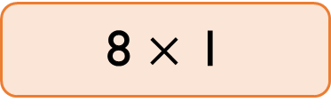
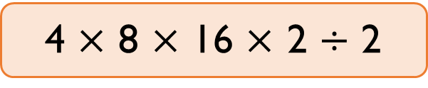
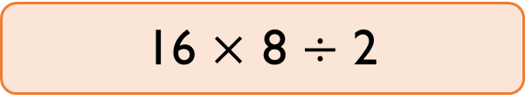
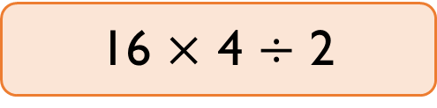
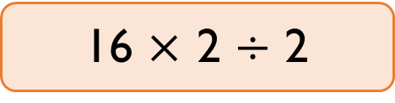
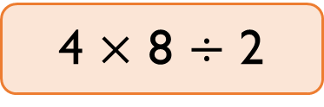
Class 6 are calculating the area of this triangle.
Here are some of their methods.
Tick the correct methods.
Explain any mistakes.
2 cm
8 cm
4 cm
16 cm
4 $×$ 8 $×$ 16 $×$ 2 $÷$ 2
4 $×$ 8 $÷$ 2
16 $×$ 2 $÷$ 2
16 $×$ 4 $÷$ 2
16 $×$ 8 $÷$ 2
8 $×$ 1

Slide 15
The shape is made of three identical triangles.
What is the area of the shape?
12 cm
22 cm

Slide 16
Teddy has drawn a parallelogram.
The area is greater than 44 m² but less than 48 m².
What could the base length and the perpendicular height of Teddy’s parallelogram be?

Slide 17
Dexter thinks the area of the parallelogram is 84 cm².
What mistake has Dexter made?
What is the correct area?
4 cm
14 cm
6 cm

Slide 18
Dora and Eva are creating a mosaic.
They are filling a sheet of paper this size.
Dora is using tiles that are rectangular.
Eva’s tiles are parallelograms.
Dora thinks that she will use fewer tiles than Eva to fill the page because her tiles are bigger.
Do you agree? Explain your answer.
15 cm
19 cm
3 cm
5 cm
3 cm
5 cm

Slide 19
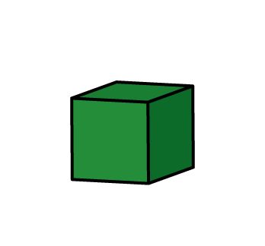
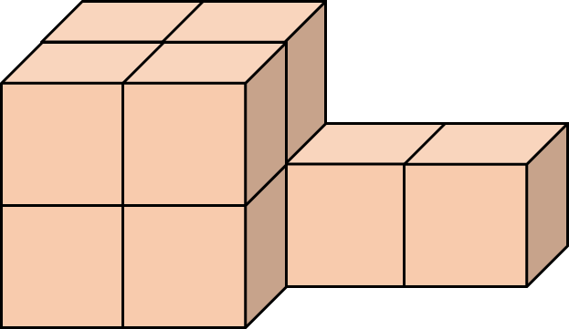

Amir says he will need 8 cm³ to build this shape.
Dora says she will need 10 cm³.
Who do you agree with?
Explain why.

Slide 20

Tommy is making cubes using multilink.
He has 64 multilink cubes altogether.
How many different sized cubes could he make?
He says,
How many other combinations can Tommy make where he uses all the cubes?
If I use all of my multilink to make 8 larger cubes, then each of these will be 2 by 2 by 2.

Slide 21
Rosie says,
Do you agree?
Explain why.
You can’t calculate the volume of the cube because you don’t know the width or the height.
2 cm

Slide 22
Calculate the volume of the shape.
2 cm
9 cm
7 cm
4 cm
12 cm

Slide 23
How many different ways can you make a cuboid with a volume of 48 cm³?

