Slide 1




Year 6 - Summer - Block 1
Properties of Shapes

Slide 2
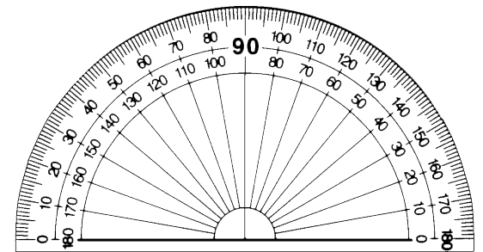
Cut out a circle and draw a line from the centre to the edge. Add a spinner in the centre.
Put the arrow in the starting position as shown above. Turn over a flash card with an angle on.
Estimate the given angle by moving the spinner.
Check how close you are using a protractor.
45°
185°

Slide 3

Alex measures this angle:
She says it is 130º
Explain what she has done wrong.

Slide 4


Dora and Eva are asked how many degrees there are between North-West and South-West.
Dora says,
Eva says,
Who do you agree with?
Explain why.
There are 90 degrees between NW and SW.
There are 270˚ between NW and SW.

Slide 5
If it takes 60 minutes for the minute hand to travel all the way around the clock, how many degrees does the minute hand travel in:
7 minutes
12 minutes
How many minutes have passed if the minute hand has moved 162°?

Slide 6
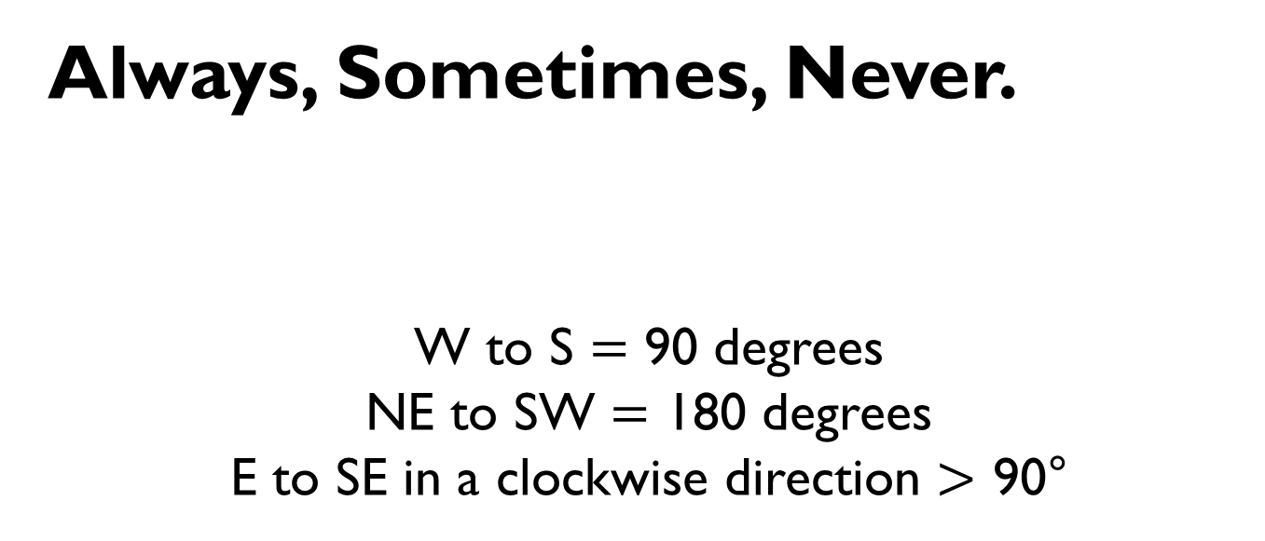
Always, Sometimes, Never.
W to S $=$ 90 degrees
NE to SW $=$ 180 degrees
E to SE in a clockwise direction $>$ 90°

Slide 7
There are five equal angles around a point.
What is the size of each angle?
Explain how you know.
a
b
c
a
b
d
c
a
b°

Slide 8
Four angles are at a point on a straight line.
One angle is 81°
The other three angles are equal.
What size are the other three angles?
Draw a diagram to prove your answer.

Slide 9
Here is a pie chart showing the colour of cars sold by a car dealer.
The number of blue cars sold is equal to the total number of red and green cars sold.
The number of red cars sold is twice the number of green cars sold.
Work out the size of the angle for each section of the pie chart.

Slide 10
The diagram below is drawn using three straight lines.
Whitney says that it’s not possible to calculate all of the missing angles.
Do you agree? Explain why.
b
a
c
157°
d
a
c
b

Slide 11

Amir says that angle g is equal to 30° because vertically opposite angles are equal.
Do you agree? Explain your answer.
Find the size of all missing angles.
Is there more than one way to find the size of each angle?
30°
e
g
f

Slide 12

Amir says,
Can Amir be correct? Can you demonstrate this?
b°
My triangle has two 90° angles.
a°
b°
b°
c°
a°
e°
f°
g°

Slide 13

Eva says,
Work out the size of each of the angles in the triangle.
My triangle is a scalene triangle.
One angle is obtuse.
One of the angles measures 56°
The obtuse angle is three times the smallest angle.

Slide 14
True or False?
A triangle can never have
3 acute angles.

Slide 15
I have an isosceles triangle.
One angle measures 42 degrees.
What could the other angles measure?

Slide 16



Alex
Mo
Eva
What type of triangle is each person describing?
Explain how you know.
My angles are 70°, 70° and 40°
My angles are 45°, 45° and 90°
My angles are 60°, 60° and 60°

Slide 17
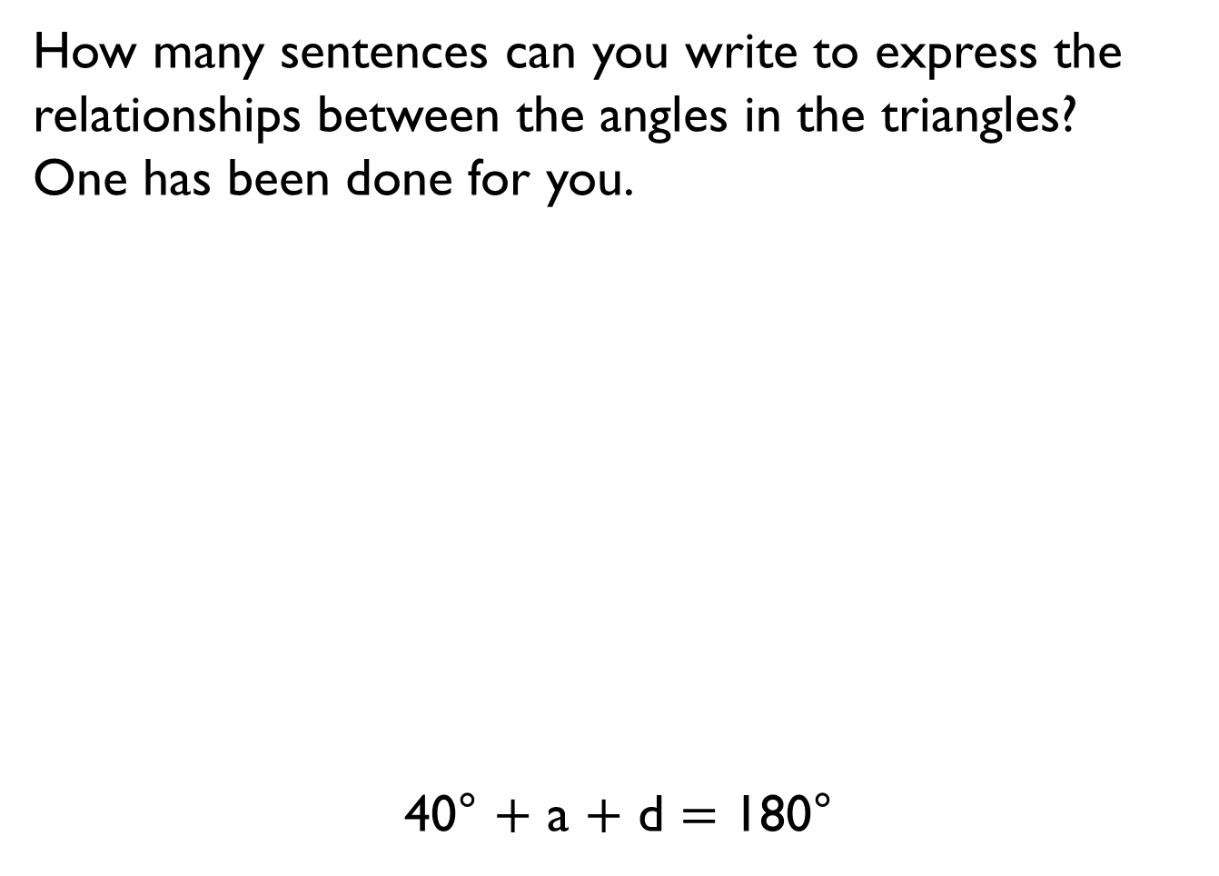
How many sentences can you write to express the relationships between the angles in the triangles?
One has been done for you.
40° $+$ a $+$ d $=$ 180°
316°
y°
40°
92°
39°
x°
g°
a
b
c
d
152°
39°

Slide 18
Calculate the size of the reflex angle b
b
33°
82°
132°
a
e
21°
d
c

Slide 19
Calculate the size of angles a, b and c?
Give reasons for all of your answers.
b
58°
a
c
123°

Slide 20

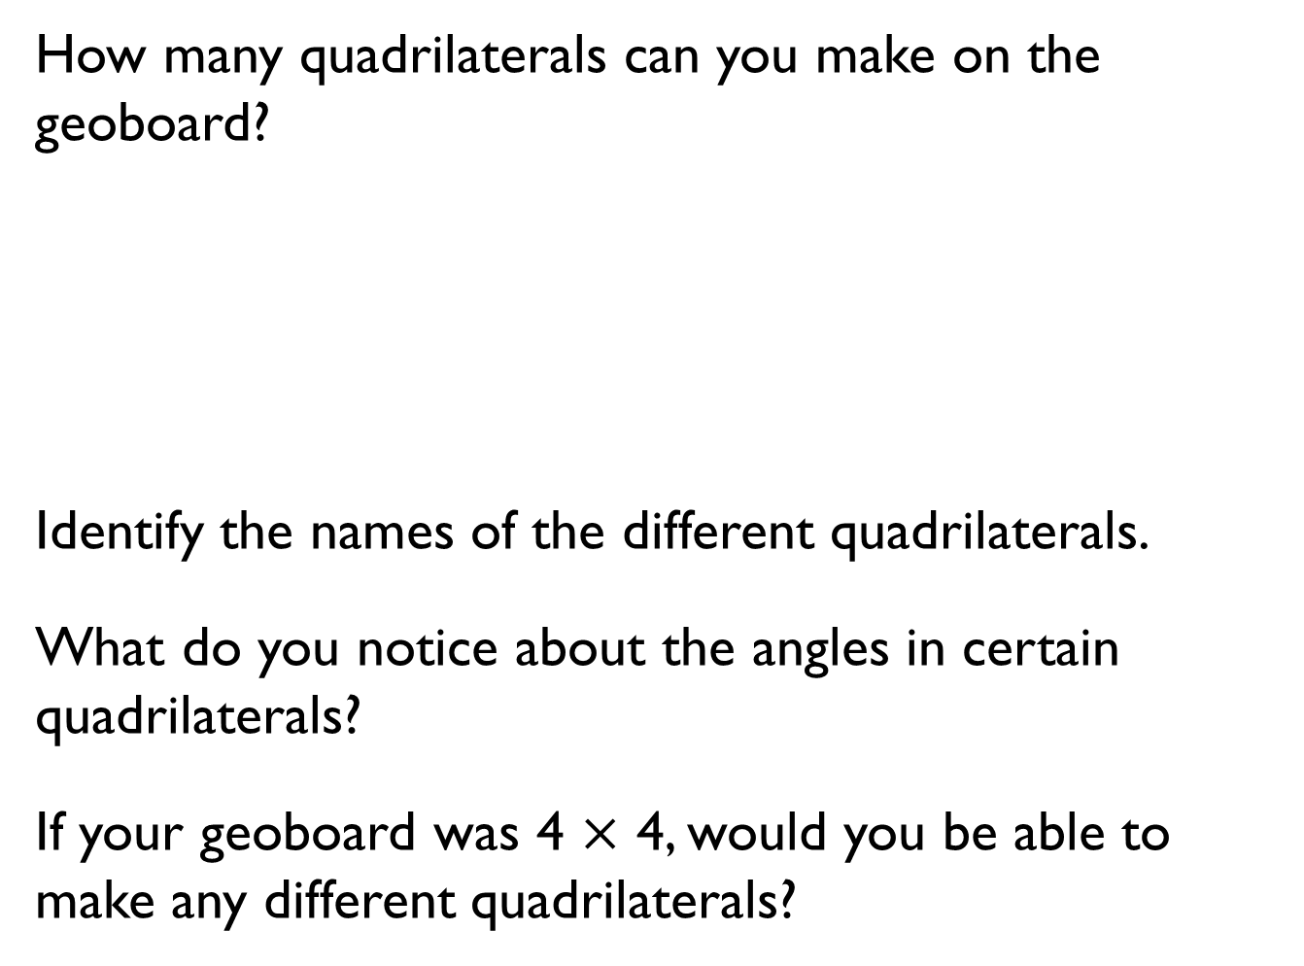
How many quadrilaterals can you make on the geoboard?
Identify the names of the different quadrilaterals.
What do you notice about the angles in certain quadrilaterals?
If your geoboard was 4 $×$ 4, would you be able to make any different quadrilaterals?
a
63°
y
105°
105°
85°
49°
115°

Slide 21

Jack says,
Draw two different shapes to prove Jack wrong. Measure and mark on the angles.
All quadrilaterals have at least one right angle.

Slide 22
This quadrilateral is split into two triangles.
Use your knowledge of angles in a triangle to find the sum of angles in a quadrilateral.
Split other quadrilaterals into triangles too. What do you notice?
b
c
r
a
q
p

Slide 23



Use the clues to work out what shape each person has.
Dora
Tommy
Alex
What is the sum of the interior angles of each shape?
My polygon is made up of 5 triangles.
The sum of my angles is more than 540° but less than 900°
The sum of my angles is equivalent to the sum of angles in 3 triangles.

Slide 24
Here are two regular hexagons.
The interior angles of a hexagon sum to 720°
Use this fact to work out angle a in the diagram.
a

Slide 25
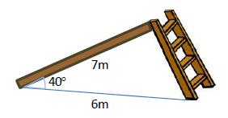
Mr Harrison is designing a slide for the playground.
Use a scale of 1 cm to represent 1 m.
Draw a scale diagram.
Use the diagram to find out how long Mr Harrison needs the ladder to be.
7 m
40°
6 m

Slide 26

What is the size of an interior angle of the regular shape below.
Accurately draw a regular pentagon with side length 5 cm.

Slide 27
Eva has drawn a scalene triangle.
Angle A is the biggest angle.
Angle B is 20° larger than angle C.
Angle C is the smallest angle, and it is 70° smaller than angle A.
Use a bar model to help you calculate the size of each angle, then construct Eva’s triangle.
Is there more than one way to construct the triangle?

Slide 28
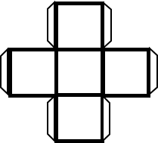
Dora thinks that this net will fold to create a cube.
Do you agree with Dora?
Explain your answer.

Slide 29
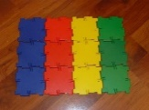
Use Polydron to investigate
how many different nets can
be made for a cube.
Is there a rule you need to follow?
Can you spot an arrangement that won’t work before you build it?
How do you know why it will or won’t work?
Can you record your investigation systematically?

Slide 30
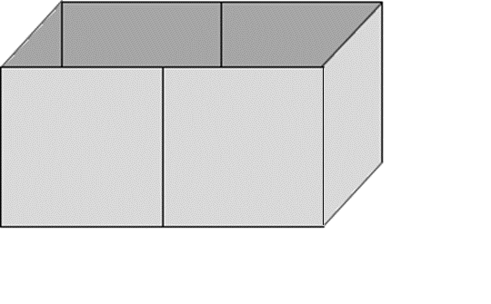
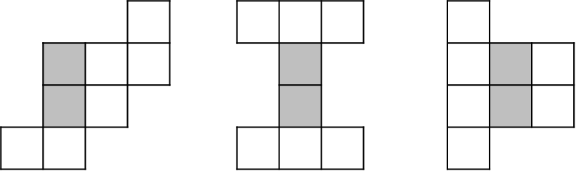
Here is an open box.
Which of the nets will fold together to make the box?
The grey squares show the base.
A B C

