Slide 1




Year 6 - Summer - Block 3
Statistics

Slide 2
Eva has created a graph to track the growth of a plant in her house.
Plant Growth in July
30
30
25
20
Height (cm)
15
10
5
0
1st
3rd
5th
7th
9th
11th
13th
15th
17th
19th
21st
23rd
25th
27th
29th
31st
Date

Slide 3
Eva recorded the following facts about the graph.
On the 9th of July the plant was about 9 cm tall.
b) Between the 11th and 19th July the plant grew about 5 cm.
c) At the end of the month the plant was twice as tall as it had been on the 13th.
Can you spot and correct Eva’s mistakes?

Slide 4
Write a story and 3 questions for each of the 3 graphs below.
a
b
c

Slide 5
This graph shows the distance a car travelled.
Rosie and Jack were asked to complete the graph to show the car had stopped.
35
30
25
20
Distance travelled in miles
15
10
5
0
0
5
10
15
20
25
30
35
40
45
50
55
Time in minutes

Slide 6
Here are their completed graphs.
Rosie:
Jack:
Who has completed the graph correctly?
Explain how you know.

Slide 7
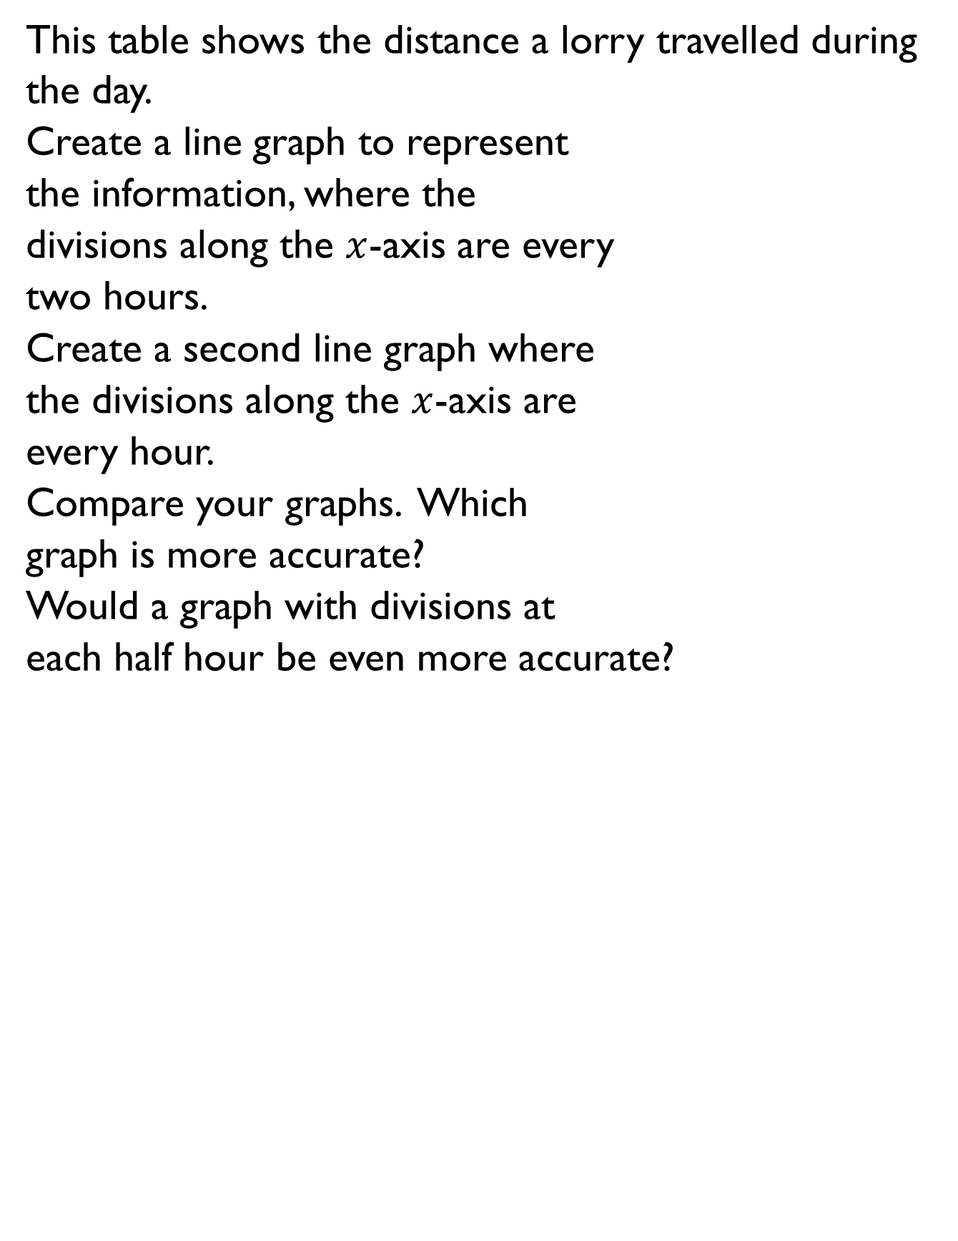
This table shows the distance a lorry travelled during the day.
Create a line graph to represent
the information, where the
divisions along the $x$-axis are every
two hours.
Create a second line graph where
the divisions along the $x$-axis are
every hour.
Compare your graphs. Which
graph is more accurate?
Would a graph with divisions at
each half hour be even more accurate?
Time | Distance in miles
7.00 a.m. | 10
8.00 a.m. | 28
9.00 a.m. | 42
10.00 a.m. | 58
11.00 a.m. | 70
12.00 a.m. | 95
1.00 p.m. | 95
2.00 p.m. | 118

Slide 8
What could this graph be showing?
Label the horizontal and vertical axes to show this.
Is there more than one way to label the axes?
60
50
40
30
20
10
0
0
10
20
30
40
50
60
70
80
90

Slide 9
The graph below shows some of Mr Woolley’s journeys.
What is the same and what is different about each of these journeys?
What might have happened during the green journey?
Distance of journey (km)
Time of journey (hours)

Slide 10

Alex says:
Do you agree? Explain your reasoning.
The bigger the radius of a circle, the bigger the diameter.

Slide 11
Spot the mistake!
Tommy has measured and labelled the diameter of the circle below.
He thinks that the radius of this circle will be 3.5 cm.
Is Tommy right? Explain why.
7 cm

Slide 12
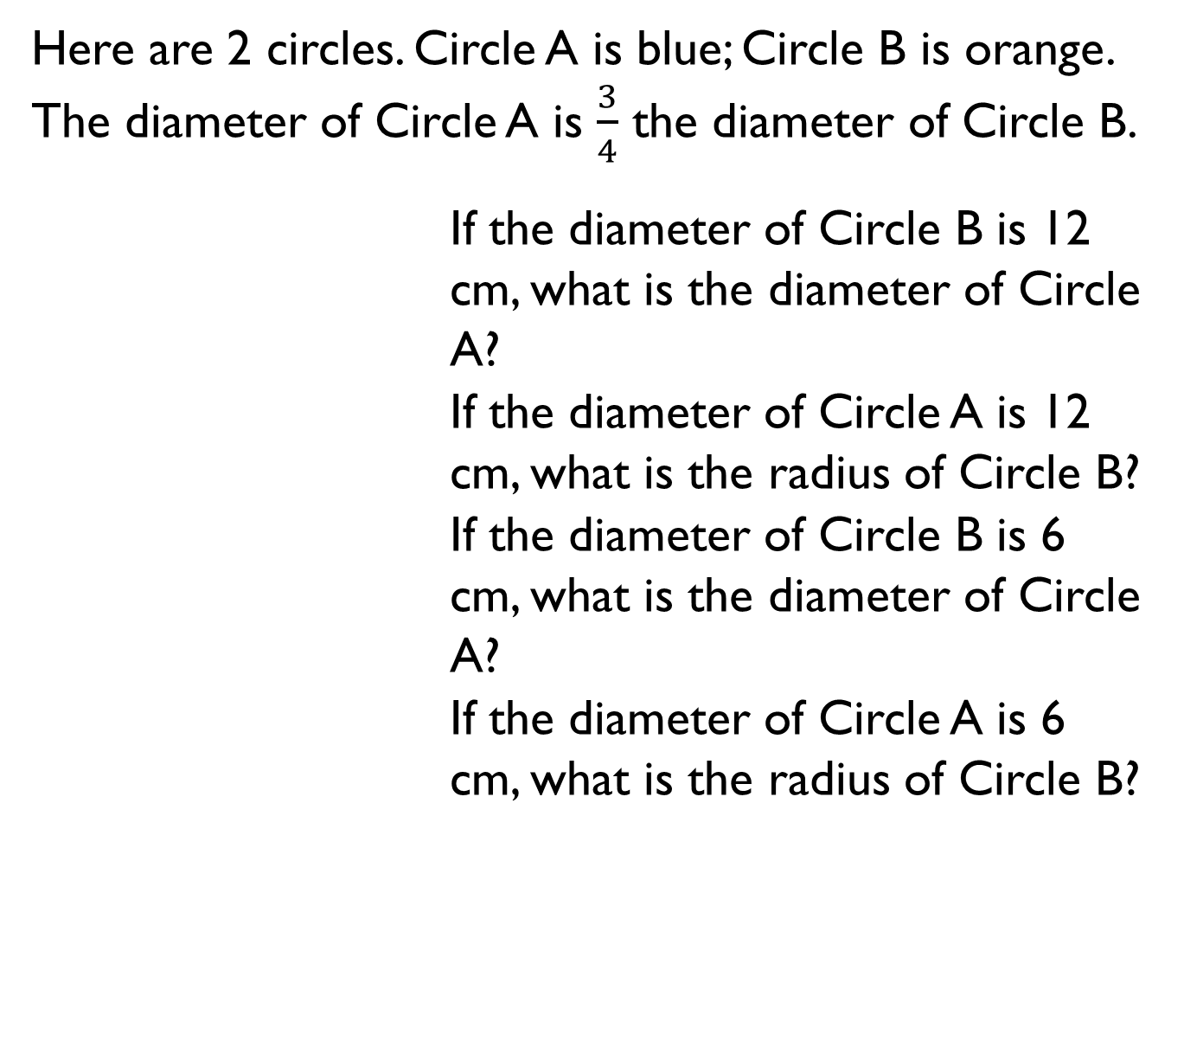
Here are 2 circles. Circle A is blue; Circle B is orange. The diameter of Circle A is $\frac{3}{4}$ the diameter of Circle B.
If the diameter of Circle B is 12 cm, what is the diameter of Circle A?
If the diameter of Circle A is 12 cm, what is the radius of Circle B?
If the diameter of Circle B is 6 cm, what is the diameter of Circle A?
If the diameter of Circle A is 6 cm, what is the radius of Circle B?

Slide 13
In a survey people were asked what their favourite season of the year was. The results are shown in the pie chart below.
If 48 people voted summer, how many people took part in the survey?
Explain your method.
Our favourite time of year
Spring
Summer
Autumn
Winter

Slide 14
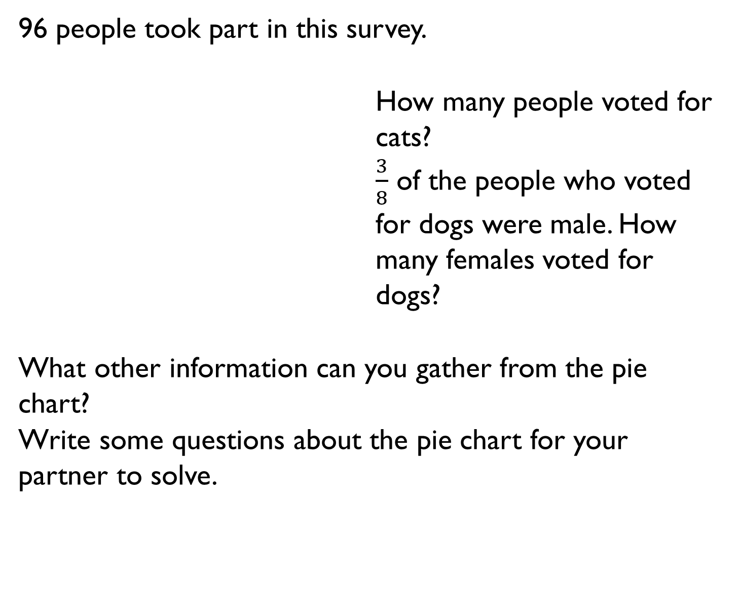
96 people took part in this survey.
How many people voted for cats?
$\frac{3}{8}$ of the people who voted for dogs were male. How many females voted for dogs?
What other information can you gather from the pie chart?
Write some questions about the pie chart for your partner to solve.
Our favourite pets
Hamsters
Horses
Dogs
Cats

Slide 15
15 people in this survey have no siblings. Use this information to work out how many people took part in the survey altogether.
Now work out how many people each segment of the pie chart is worth.
Can you represent the information in a table?
Number of siblings
5%
9%
No siblings
1 siblings
2 siblings
3 siblings
4 siblings
5 siblings
31%
10%
17%
28%

Slide 16

120 boys and 100 girls were asked which was their favourite subject. Here are the results:
Jack says:
Do you agree? Explain why.
Boys Favourite Subjects
Girls Favourite Subjects
20 %
35 %
50 %
Maths
English
Science
Maths
English
Science
20 %
50 %
15 %
More girls prefer Maths than boys because 60 % is bigger than 50 %.

Slide 17
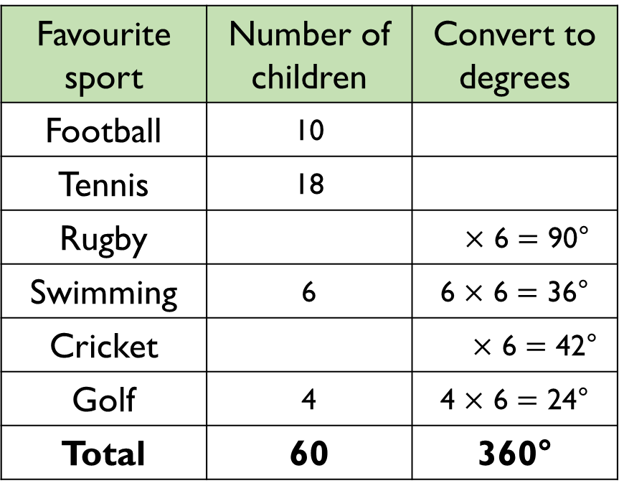
A survey was conducted to work out Year 6’s favourite sport. Work out the missing information and then construct a pie chart.
Favourite sport | Number of children | Convert to degrees
Football | 10
Tennis | 18
Rugby |  | $×$ 6 $=$ 90°
Swimming | 6 | 6 $×$ 6 $=$ 36°
Cricket |  | $×$ 6 $=$ 42°
Golf | 4 | 4 $×$ 6 $=$ 24°
Total | 60 | 360°

Slide 18
A restaurant was working out which Sunday dinner was the most popular. Use the data to construct a pie chart.
Dinner choice | Frequency | Convert to degrees
Chicken | 11
Pork | 8
Lamb | 6
Beef | 9
Vegetarian | 6
Total | 40

Slide 19
Miss Jones is carrying out a survey in class about favourite crisp flavours. 15 pupils chose salt and vinegar.
How many fewer people chose ready salted?
Ready Salted
72°
Prawn
Cocktail
Salt & Vinegar
180°
Cheese
& Onion

Slide 20
The mean number of goals scored in 6 football matches was 4
Use this information to calculate how many goals were scored in the 6th match:
Match number | Number of goals
1 | 8
2 | 4
3 | 6
4 | 2
5 | 1
6

Slide 21
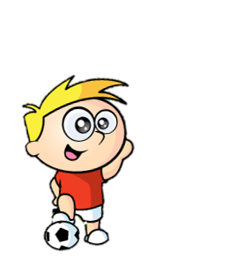
Three football teams each play 10 matches over a season.
The mean number of goals scored by each team was 2
How many goals might the teams have scored in each match?
How many solutions can you find?

Slide 22






Work out the age of each member of the family if:
Mum is 48 years old.
Teddy is 4 years older than Jack and 7 years older than Alex.
Calculate the mean age of the whole family.
Mum
Mean age of 50
Dad
Teddy
Mean age of 13
Jack
Alex
Mean age of 6
Eva

