Slide 1




Year 6 - Autumn - Block 1
Place Value

Slide 2
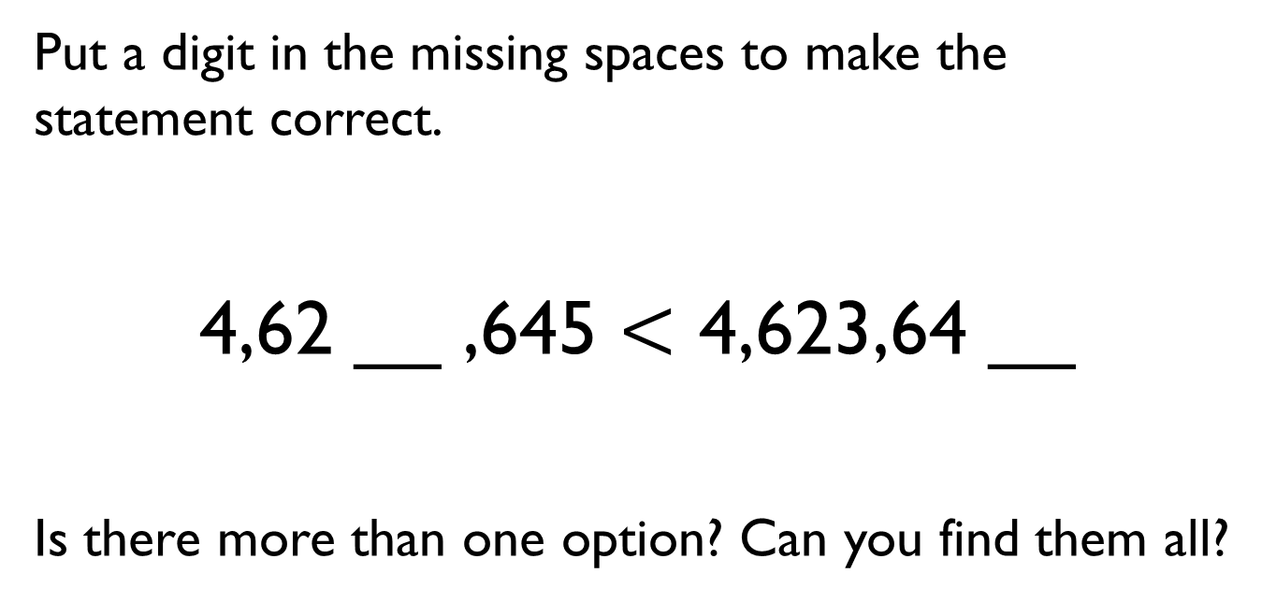
Put a digit in the missing spaces to make the statement correct.
4,62 __ ,645 $<$ 4,623,64 __
Is there more than one option? Can you find them all?
M | HTh | TTh | Th | H | T | O

Slide 3
Dora has the number 824,650
She subtracts forty thousand from her number.
She thinks her new number is 820,650
Is she correct?
Explain how you know.

Slide 4
Use the digit cards and statements to work out my number.
The ten thousands and hundreds have the same digit.
The hundred thousand digit is double the tens digit.
It is a six-digit number.
It is less than six hundred and fifty-five thousand.
Is this the only possible solution?
0
3
3
5
5
6
7

Slide 5
Eva has ordered eight 6-digit numbers.
The smallest number is 345,900
The greatest number is 347,000
All the other numbers have a digit total of 20 and have no repeating digits.
What are the other six numbers?
Can you place all eight numbers in ascending order?

Slide 6
Jack draws bar model A.
His teacher asks him to draw another where the total is 30,000
A
B
Explain how you know bar B is inaccurate.
50,000
10,000
30,000

Slide 7
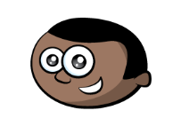

My number is 1,350 when rounded to the nearest 10
Mo
Rosie
Both numbers are whole numbers.
What is the greatest possible difference between the two numbers?
My number is 1,400 when rounded to the nearest 100

Slide 8
Whitney rounded 2,215,678 to the nearest million and wrote 2,215,000
Can you explain to Whitney what mistake she has made?

Slide 9
15,987 15,813 15,101 16,101
Tommy says, “My number rounds to 16,000 to the nearest 1,000”
Alex says, “My number has one hundred.”
Jack says, “ My number is 15,990 when rounded to the nearest 10”
Dora says, “My number is 15,000 when rounded to the nearest 1,000”
Can you work out which child has which card?

Slide 10


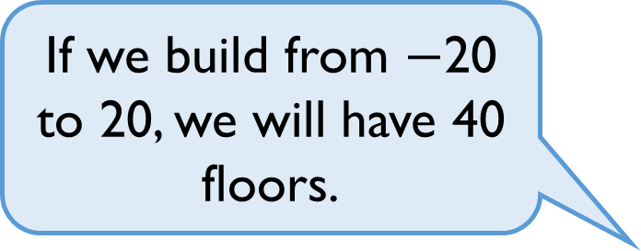
A company decided to build offices over ground and underground.
Do you agree? Explain why.
If we build from $−$20 to 20, we will have 40 floors.

Slide 11
When counting forwards in tens from any positive one-digit number, the last digit never changes.
When counting backwards in tens from any positive one-digit number, the last digit does change.
Can you find examples to show this?
Explain why this happens.

