Slide 1




Year 6 - Autumn - Block 4
Position & Direction

Slide 2



Eva is drawing a trapezium.
She wants her final shape to look like this:
Eva uses the coordinates (2, 4), (4, 5), (1, 6) and (5, 6).
Will she draw the shape that she wants to?
If not, can you correct her coordinates?
$$y$$
10
9
8
7
6
5
4
3
2
1
$$x$$
0
1
2
3
4
5
6
7
8
9
10

Slide 3


Mo has written the coordinates of points A, B and C.
A (1, 1) B (2, 7) C (3, 0)
Mark Mo’s work and correct his mistakes.
Explain why Mo could not make the same mistake for point A as he made for points B and C.
$$y$$
10
9
8
7
$$y$$
6
10
5
9
4
8
3
7
2
1
$$x$$
6
0
1
2
3
4
5
6
7
8
9
10
5
4
C
3
2
B
1
A
0
$$x$$
1 2 3 4 5 6 7 8 9 10

Slide 4


The diagram shows two identical triangles.
The coordinates of three points are shown.
Find the coordinates of point A.
$$y$$
10
9
8
7
6
5
4
$$y$$
3
A
2
1
$$x$$
0
1
2
3
4
5
6
7
8
9
10
(-1, 3)
$$x$$
(-1, 0)
(6, 0)

Slide 5
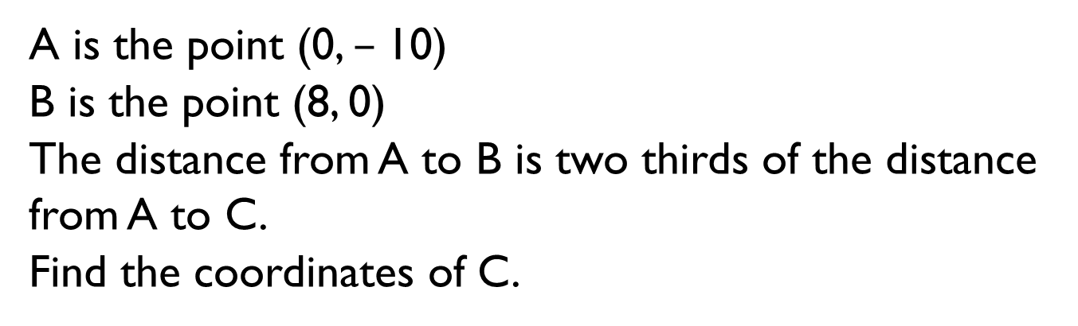


A is the point (0, $–$10)
B is the point (8, 0)
The distance from A to B is two thirds of the distance from A to C.
Find the coordinates of C.
$$y$$
10
9
8
7
6
5
4
3
$$y$$
2
1
$$x$$
C
0
1
2
3
4
5
6
7
8
9
10
B
$$x$$
A

Slide 6
True or False?
Dexter has translated the rectangle ABCD 6 units down and 1 unit to the right to get to the yellow rectangle.
Explain your reasoning.
$$y$$
10
9
8
7
6
5
A
B
4
6
3
5
2
4
1
$$x$$
3
0
1
2
3
4
5
6
7
8
9
10
2
C
D
1
0
-6 -5 -4 -3 -2 -1 1 2 3 4 5 6
-1
-2
-3
-4
-5
-6

Slide 7
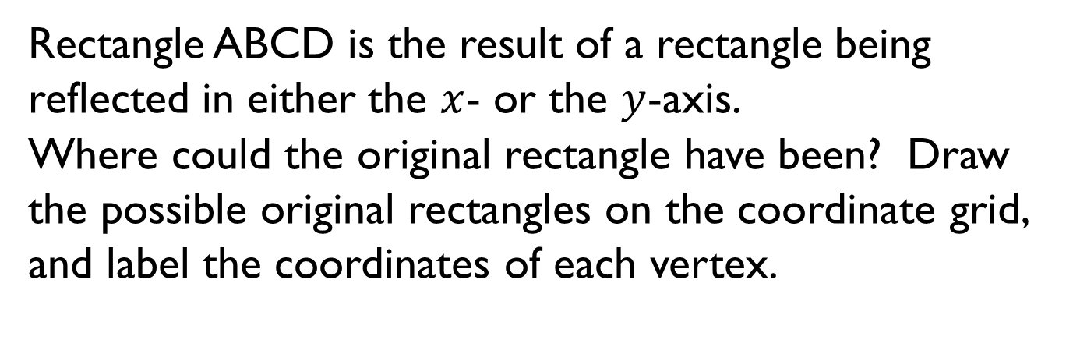
Rectangle ABCD is the result of a rectangle being reflected in either the $x$- or the $y$-axis.
Where could the original rectangle have been? Draw the possible original rectangles on the coordinate grid, and label the coordinates of each vertex.
$$y$$
10
9
8
7
6
5
4
3
6
2
5
1
$$x$$
4
0
1
2
3
4
5
6
7
8
9
10
3
2
1
0
-6 -5 -4 -3 -2 -1 1 2 3 4 5 6
-1
A
B
-2
-3
-4
-5
C
D
-6

Slide 8
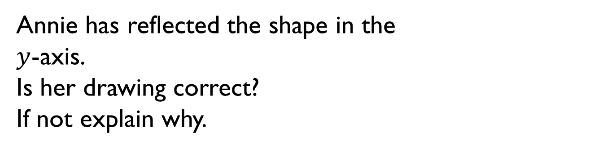
Annie has reflected the shape in the
$y$-axis.
Is her drawing correct?
If not explain why.
$$y$$
10
9
8
7
6
5
4
6
3
5
2
4
1
$$x$$
3
0
1
2
3
4
5
6
7
8
9
10
2
1
0
-6 -5 -4 -3 -2 -1 1 2 3 4 5 6
-1
-2
-3
-4
-5
-6

