Slide 1




Year 6 - Autumn - Block 2
Four Operations

Slide 2


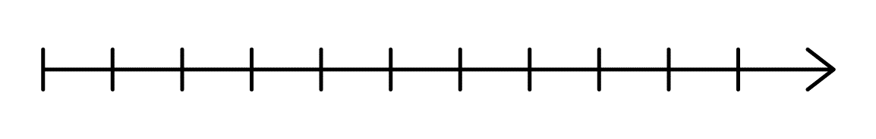



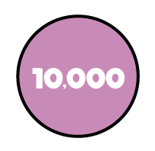
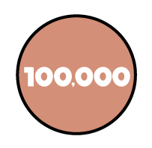
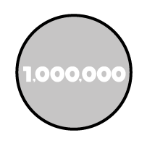
Find the difference between A and B.
A
20,000
26,000
B
32,500
42,500

Slide 3
Here is a bar model.
A is an odd number which rounds to 100,000 to the nearest ten thousand. It has a digit total of 30
B is an even number which rounds to 500,000 to the nearest hundred thousand.
It has a digit total of 10
A and B are multiples of 5
What are possible values of A and B?
A | B
631,255

Slide 4
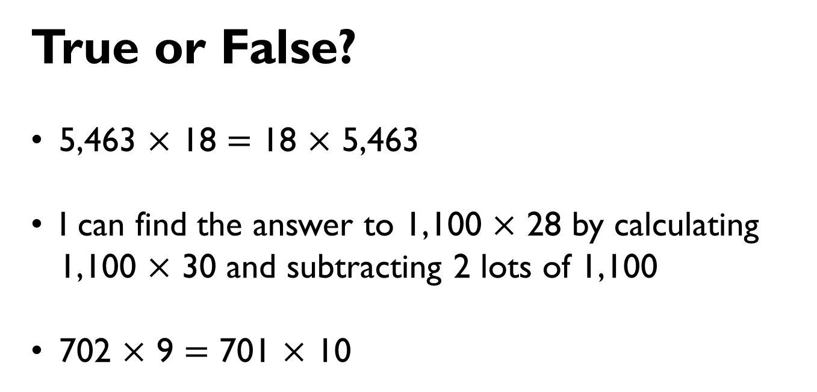
True or False?
5,463 $×$ 18 $=$ 18 $×$ 5,463
I can find the answer to 1,100 $×$ 28 by calculating 1,100 $×$ 30 and subtracting 2 lots of 1,100
702 $×$ 9 $=$ 701 $×$ 10

Slide 5
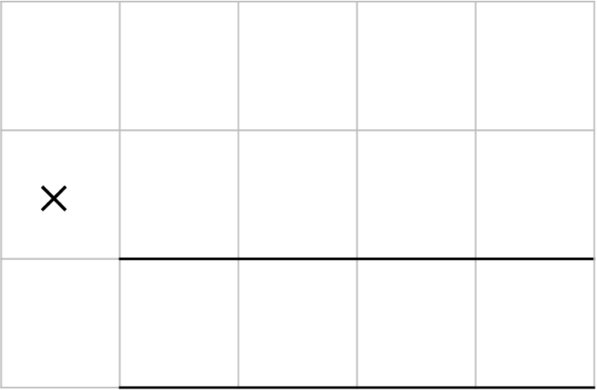
Place the digits in the boxes to make the largest product.
2
3
4
5
7
8
$$×$$

Slide 6
Find the missing digits.
0 4 1 r 3
4
1 5 9

Slide 7
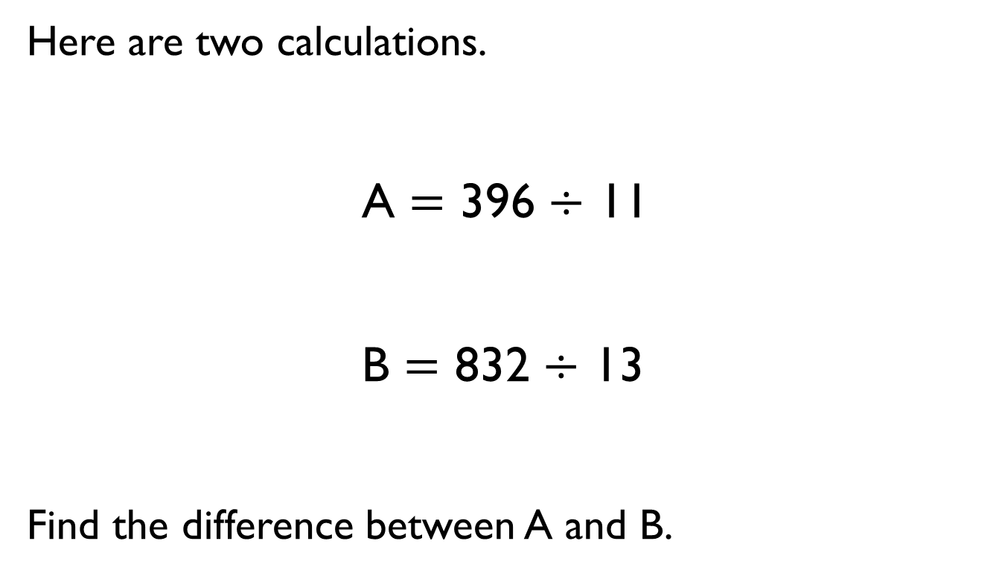
Here are two calculations.
A $=$ 396 $÷$ 11
B $=$ 832 $÷$ 13
Find the difference between A and B.

Slide 8
Work out the value of C.
(The bar models are not drawn to scale)
4,950
A | A | A
A
B | B | B
B
C | C | C | C | C

Slide 9
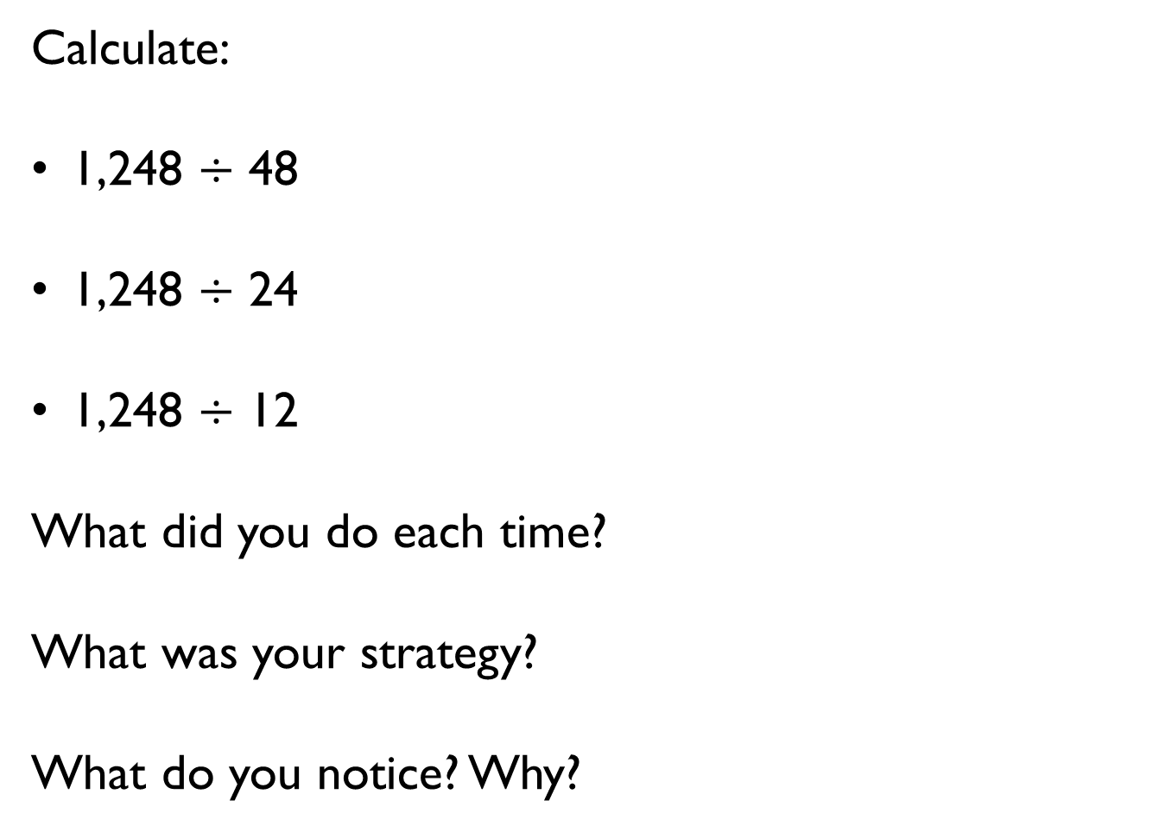
Calculate:
1,248 $÷$ 48
1,248 $÷$ 24
1,248 $÷$ 12
What did you do each time?
What was your strategy?
What do you notice? Why?

Slide 10

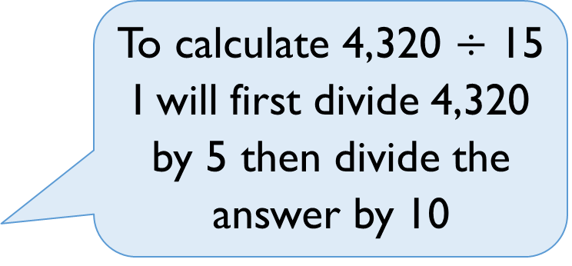
Tommy says,
Do you agree?
Explain why.
To calculate 4,320 $÷$ 15 I will first divide 4,320 by 5 then divide the answer by 10

Slide 11
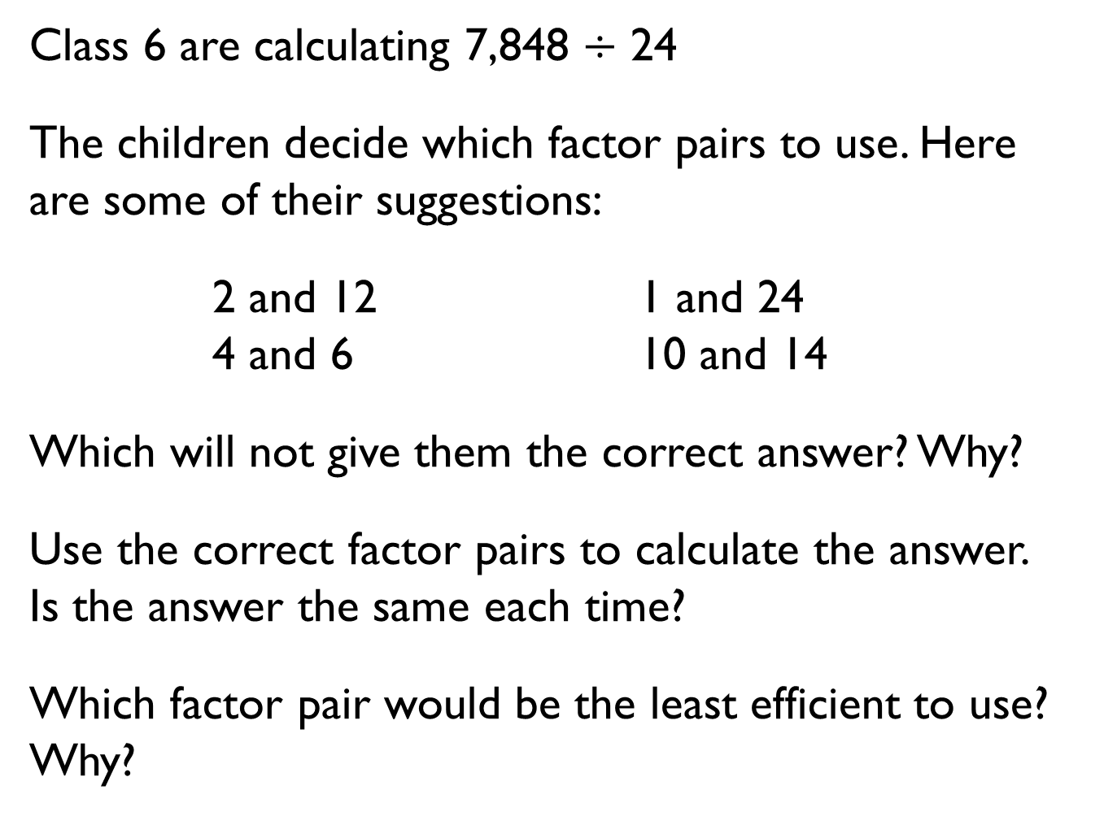
Class 6 are calculating 7,848 $÷$ 24
The children decide which factor pairs to use. Here are some of their suggestions:
2 and 12 1 and 24
4 and 6 10 and 14
Which will not give them the correct answer? Why?
Use the correct factor pairs to calculate the answer.
Is the answer the same each time?
Which factor pair would be the least efficient to use? Why?

Slide 12
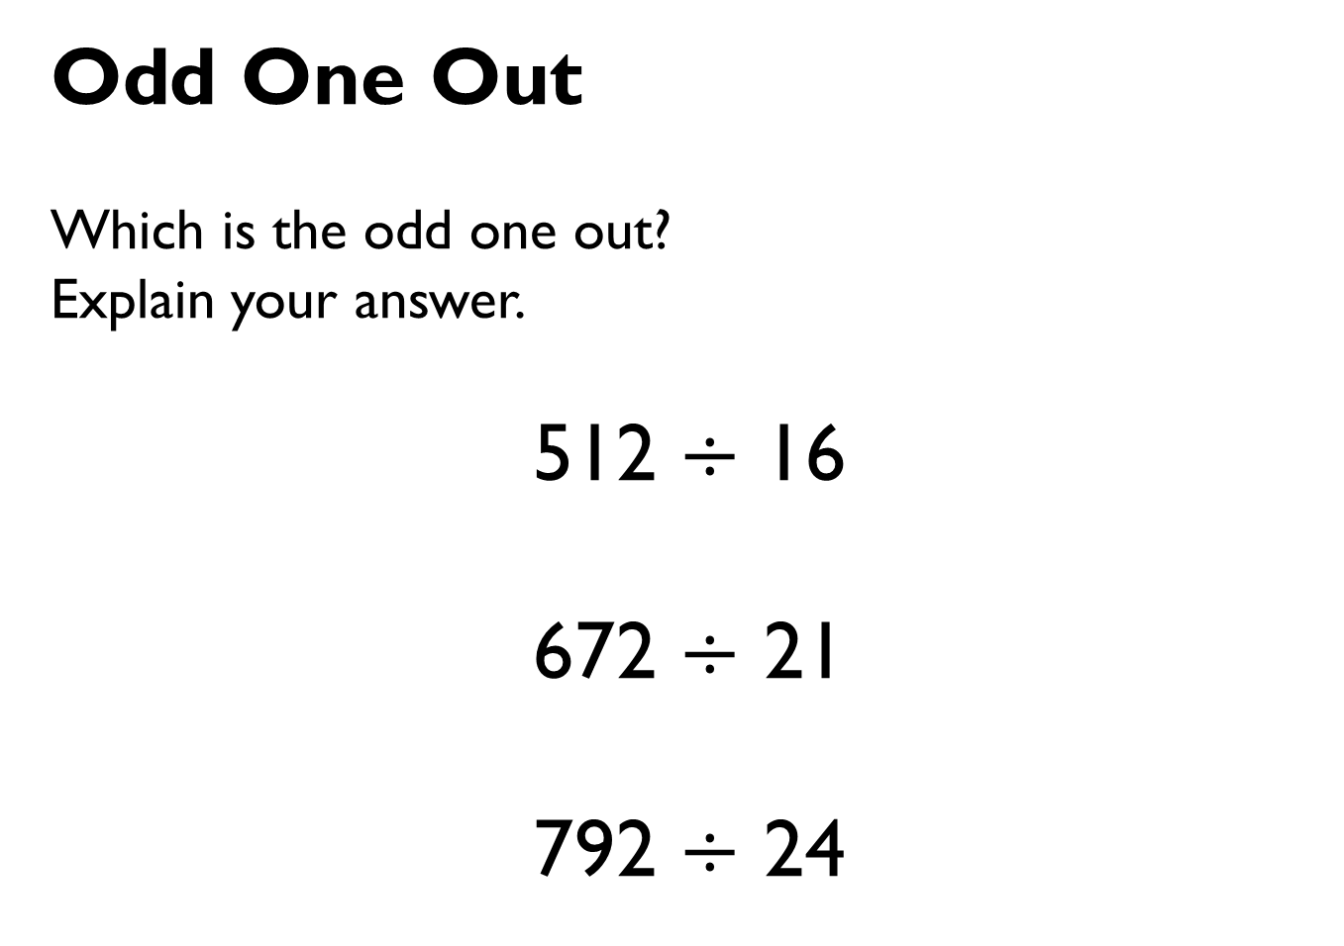
Odd One Out
Which is the odd one out?
Explain your answer.
512 $÷$ 16
672 $÷$ 21
792 $÷$ 24

Slide 13
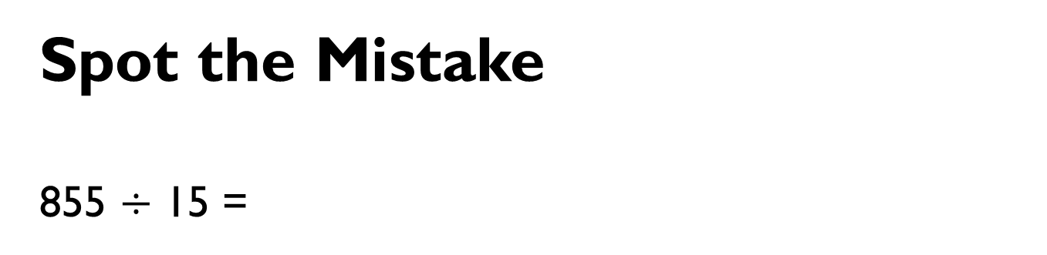
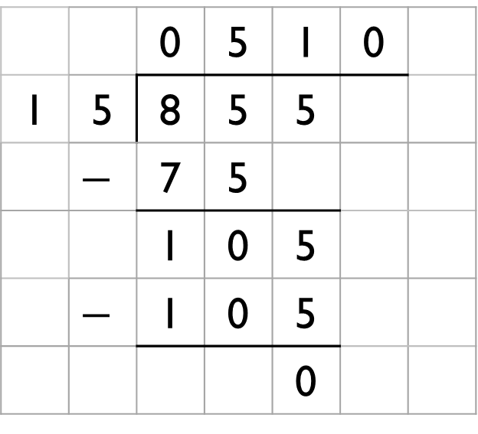
Spot the Mistake
855 $÷$ 15 =
 |  | 0 | 5 | 1 | 0
1 | 5 | 8 | 5 | 5
 | $$−$$ | 7 | 5
 |  | 1 | 0 | 5
 | $$−$$ | 1 | 0 | 5
 |  |  |  | 0

Slide 14
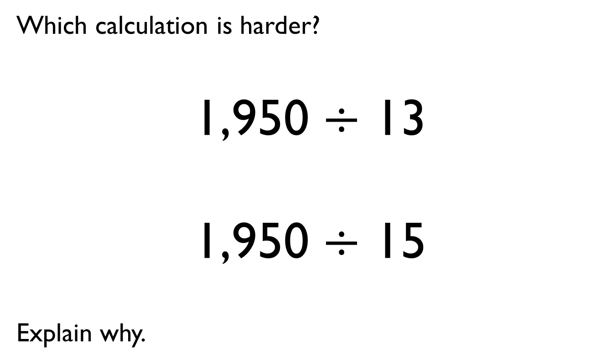
Which calculation is harder?
1,950 $÷$ 13
1,950 $÷$ 15
Explain why.

Slide 15
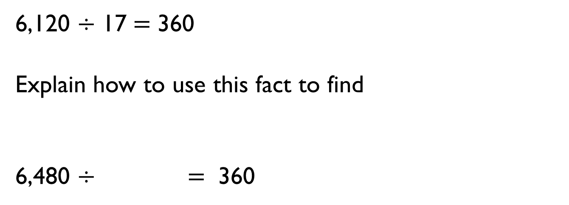
6,120 $÷$ 17 $=$ 360
Explain how to use this fact to find
6,480 $÷$ $=$ 360

Slide 16
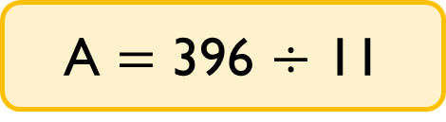
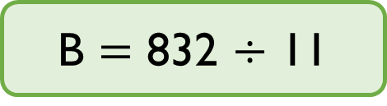
Here are two calculation cards.
Whitney thinks there won’t be a remainder for either calculation because 396 and 832 are both multiples of 11
Rosie disagrees, she has done the written calculations and says one of them has a remainder.
Who is correct? Explain your answer.
A $=$ 396 $÷$ 11
B $=$ 832 $÷$ 11

Slide 17



576 children and 32 adults need transport for a school trip. A coach holds 55 people.
Dora
Eva
Alex
Who is correct? Explain how you know.
How many spare seats will there be?
We need 10 coaches.
We need 11 coaches.
We need 12 coaches.

Slide 18
Class 6 are calculating three thousand, six hundred and thirty-three divided by twelve.
Rosie says that she knows there will be a remainder without calculating.
Is she correct?
Explain your answer.
What is the remainder?

Slide 19
Which numbers up to 20 can 4,236 be divided by without having a remainder?
What do you notice about all the numbers?

Slide 20




There are 49 pears and 56 oranges.
They need to be put into baskets of pears and baskets of oranges with an equal number of fruit in each basket.
Amir says,
Jack says,
Who is correct? Explain how you know.
There will be 8 pieces of fruit in each basket.
There will be 7 pieces of fruit in each basket.

Slide 21
Tommy has two pieces of string.
One is 160 cm long and the other is 200 cm long.
He cuts them into pieces of equal length.
What are the possible lengths the pieces of string could be?

Slide 22
Dora has 32 football cards that she is giving away to his friends.
She shares them equally between her friends.
How many friends could Dora have?

Slide 23
Work out the headings for the Venn diagram.
Add in one more number to each section.
Can you find a square number that will go in the middle section of the Venn diagram?
12
18
4
84
42
28
48

Slide 24
Annie is double her sister’s age.
They are both older than 20 but younger than 50
Their ages are both multiples of 7
What are their ages?

Slide 25
A train starts running from Leeds to York at 7am.
The last train leaves at midnight.
Platform 1 has a train leaving from it every 12 minutes.
Platform 2 has one leaving from it every 5 minutes.
How many times in the day would there be a train leaving from both platforms at the same time?

Slide 26
Use the clues to work out the number.
It is greater than 10
It is an odd number
It is not a prime number
It is less than 25
It is a factor of 60

Slide 27

Shade in the multiples of 6 on a 100 square.
What do you notice about the numbers either side of every multiple of 6?
Eva says,
Is she correct?
1 | 2 | 3 | 4 | 5 | 6 | 7 | 8 | 9 | 10
11 | 12 | 13 | 14 | 15 | 16 | 17 | 18 | 19 | 20
21 | 22 | 23 | 24 | 25 | 26 | 27 | 28 | 29 | 30
31 | 32 | 33 | 34 | 35 | 36 | 37 | 38 | 39 | 40
41 | 42 | 43 | 44 | 45 | 46 | 47 | 48 | 49 | 50
51 | 52 | 53 | 54 | 55 | 56 | 57 | 58 | 59 | 60
61 | 62 | 63 | 64 | 65 | 66 | 67 | 68 | 69 | 70
71 | 72 | 73 | 74 | 75 | 76 | 77 | 78 | 79 | 80
81 | 82 | 83 | 84 | 85 | 86 | 87 | 88 | 89 | 90
91 | 92 | 93 | 94 | 95 | 96 | 97 | 98 | 99 | 100
I noticed there is always a prime number next to a multiple of 6

Slide 28
Place 5 odd and 5 even numbers in the table.
 | Not Cubed | Cubed
Over 100
100 or less

Slide 29

Jack says,
Do you agree with Jack? Explain why you agree or disagree.
The smallest number that is both a square number and a cube number is 64

Slide 30
Shade in all the square numbers on a 100 square.
Now shade in multiples of 4
What do you notice?
1 | 2 | 3 | 4 | 5 | 6 | 7 | 8 | 9 | 10
11 | 12 | 13 | 14 | 15 | 16 | 17 | 18 | 19 | 20
21 | 22 | 23 | 24 | 25 | 26 | 27 | 28 | 29 | 30
31 | 32 | 33 | 34 | 35 | 36 | 37 | 38 | 39 | 40
41 | 42 | 43 | 44 | 45 | 46 | 47 | 48 | 49 | 50
51 | 52 | 53 | 54 | 55 | 56 | 57 | 58 | 59 | 60
61 | 62 | 63 | 64 | 65 | 66 | 67 | 68 | 69 | 70
71 | 72 | 73 | 74 | 75 | 76 | 77 | 78 | 79 | 80
81 | 82 | 83 | 84 | 85 | 86 | 87 | 88 | 89 | 90
91 | 92 | 93 | 94 | 95 | 96 | 97 | 98 | 99 | 100

Slide 31
Countdown
Children randomly select 6 numbers.
Reveal a target number.
Children aim to make the target number ensuring they can write it as a single calculation using order of operations.
25
50
75
100
1
2
3
4
5
6
7
8
9
10

Slide 32
Write different number sentences using the digits 3, 4, 5 and 8 before the equals sign that use:
One operation
Two operations with no brackets
Two operations with brackets
3
4
5
8

Slide 33
Class 6 are calculating the total of 3,912 and 3,888
Alex says,
Is Alex correct? Explain.
We can just double 3,900

Slide 34



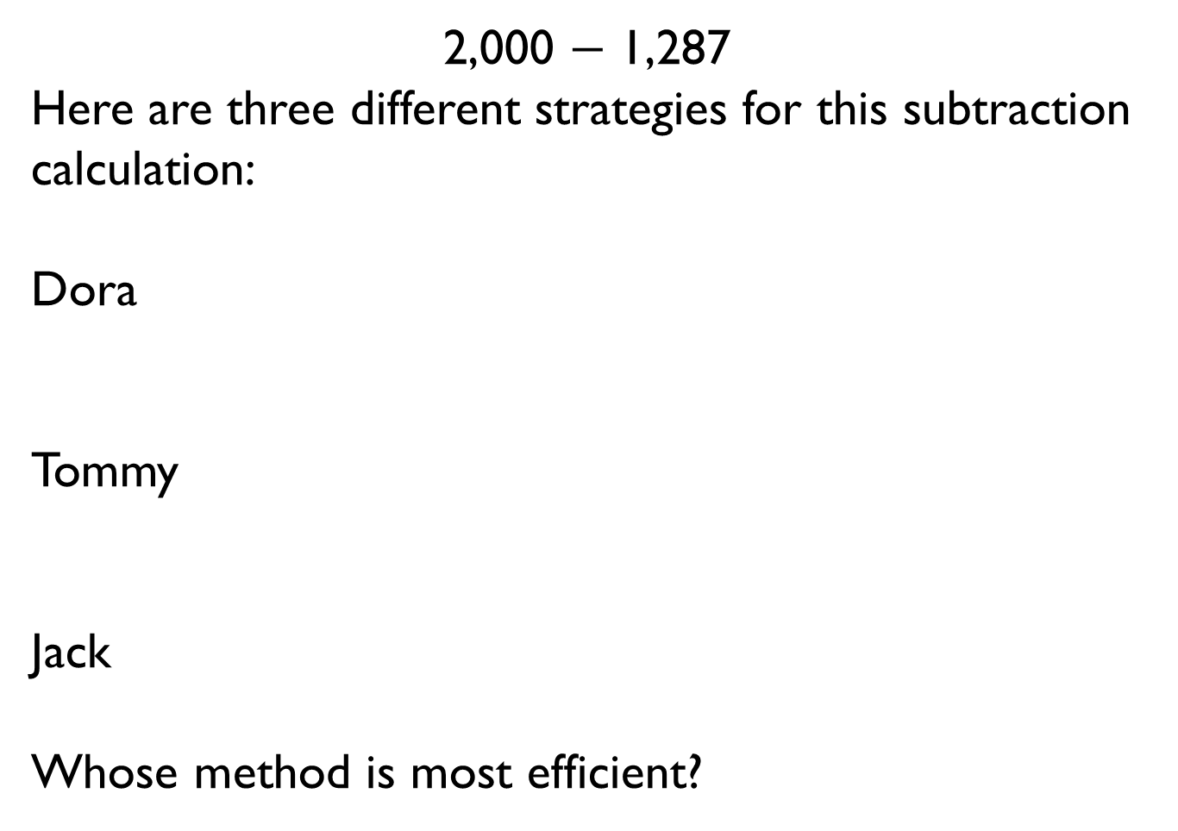
2,000 $−$ 1,287
Here are three different strategies for this subtraction calculation:
Dora
Tommy
Jack
Whose method is most efficient?
I used the column method.
I used my number bonds from 87 to 100 then from 1,300 to 2,000
I subtracted one from each number and then used the column method.

Slide 35
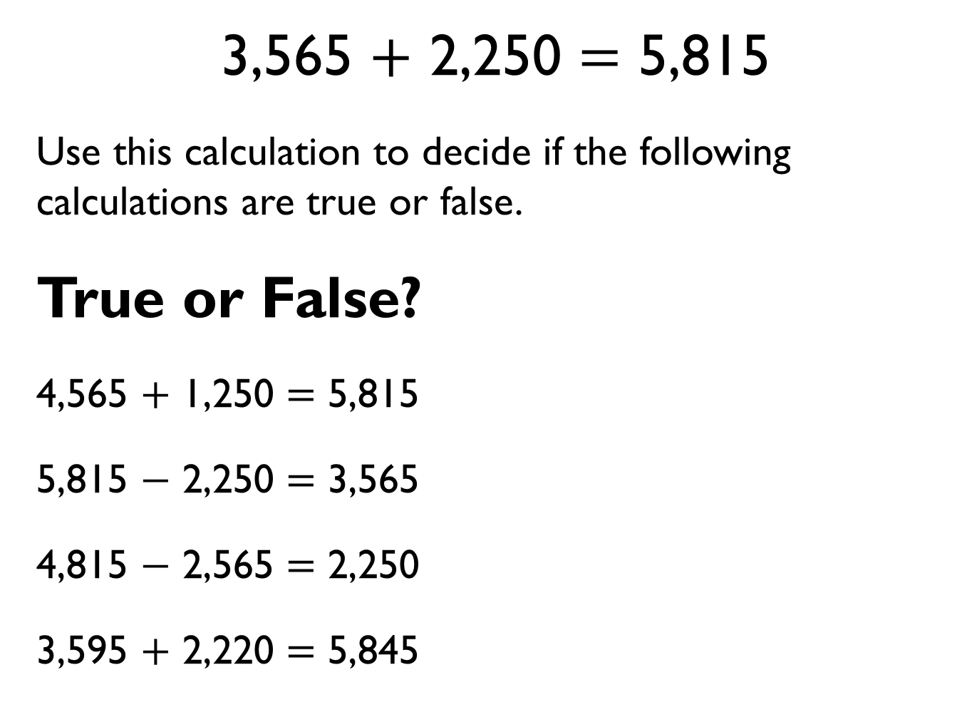
3,565 $+$ 2,250 $=$ 5,815
Use this calculation to decide if the following calculations are true or false.
True or False?
4,565 $+$ 1,250 $=$ 5,815
5,815 $−$ 2,250 $=$ 3,565
4,815 $−$ 2,565 $=$ 2,250
3,595 $+$ 2,220 $=$ 5,845

Slide 36
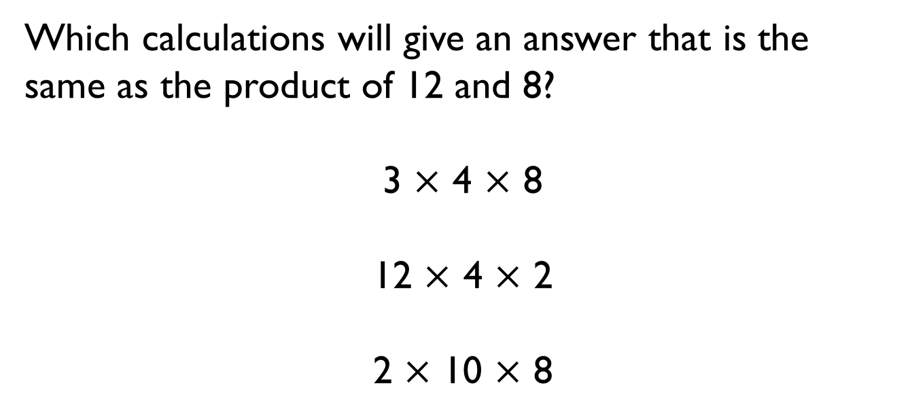

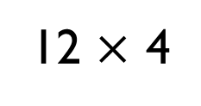
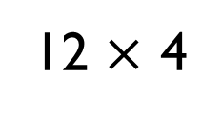
Which calculations will give an answer that is the same as the product of 12 and 8?
3 $×$ 4 $×$ 8
12 $×$ 4 $×$ 2
2 $×$ 10 $×$ 8
12 $×$ 4
$$+$$
12 $×$ 4
12 | 12 | 12 | 12
12 | 12 | 12 | 12

