Slide 1




Year 6 - Autumn - Block 3
Fractions

Slide 2
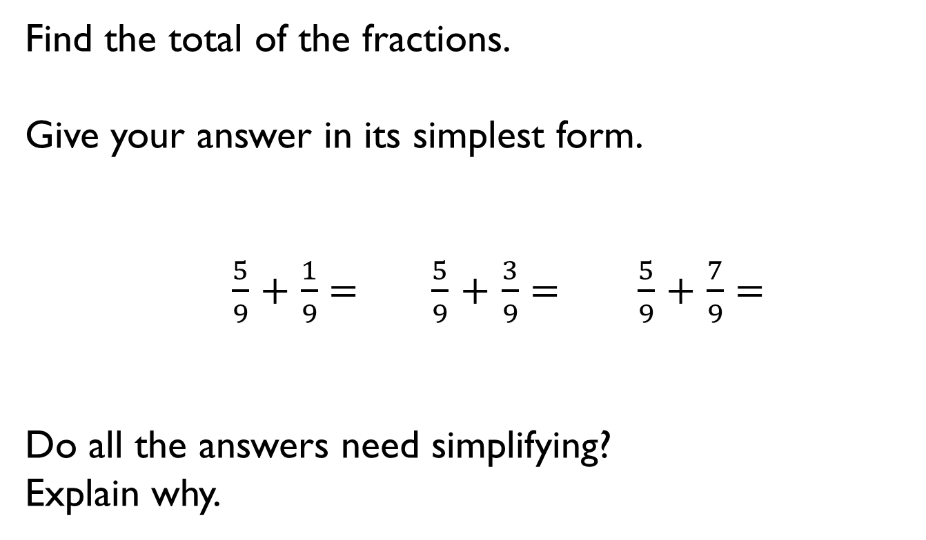
Find the total of the fractions.
Give your answer in its simplest form.
$\frac{5}{9}$ $+$ $\frac{1}{9}= \frac{5}{9}$ $+$ $\frac{3}{9}$ $=$ $\frac{5}{9}$ $+$ $\frac{7}{9}$ $=$
Do all the answers need simplifying?
Explain why.

Slide 3
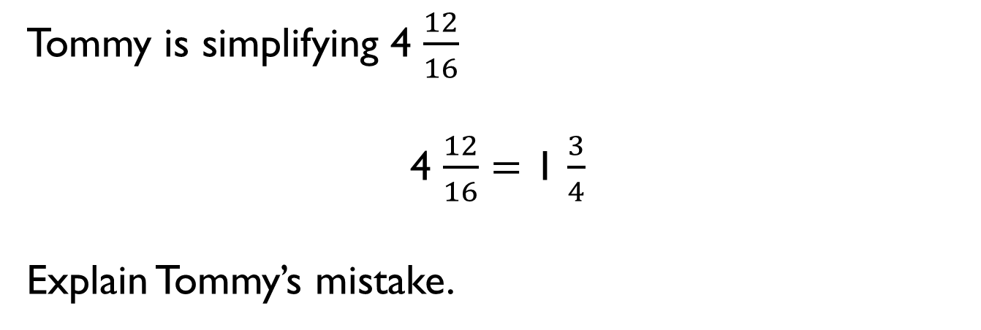
Tommy is simplifying 4 $\frac{12}{16}$
4 $\frac{12}{16}$ $=$ 1 $\frac{3}{4}$
Explain Tommy’s mistake.

Slide 4

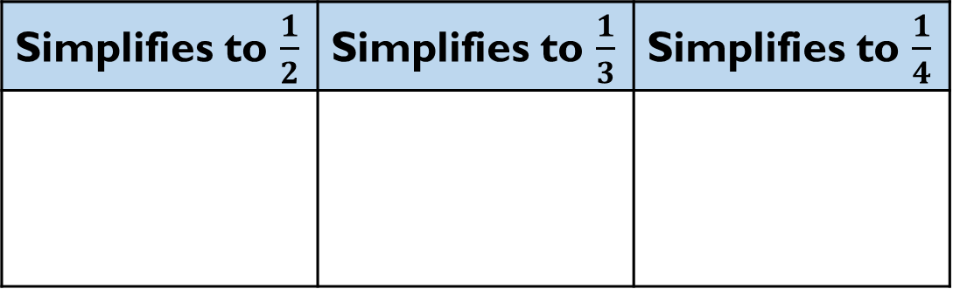







Sort the fractions into the table.
Can you see any patterns between the numbers in each column?
What is the relationship between the numerators and denominators?
Can you add three more fractions to each column?
When a fraction is equivalent to _____,
the numerator is _______ the denominator.
Simplifies to $\frac{1}{2}$ | Simplifies to $\frac{1}{3}$ | Simplifies to $\frac{1}{4}$
$\frac{5}{15}$
$\frac{2}{4}$
$\frac{4}{16}$
$\frac{8}{16}$
$\frac{2}{8}$
$\frac{3}{9}$
$\frac{6}{12}$
$\frac{5}{10}$

Slide 5

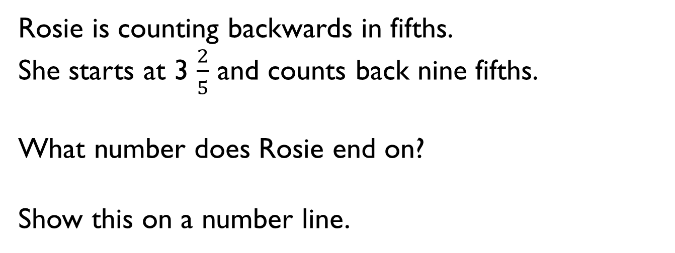
Rosie is counting backwards in fifths.
She starts at 3 $\frac{2}{5}$ and counts back nine fifths.
What number does Rosie end on?
Show this on a number line.

Slide 6
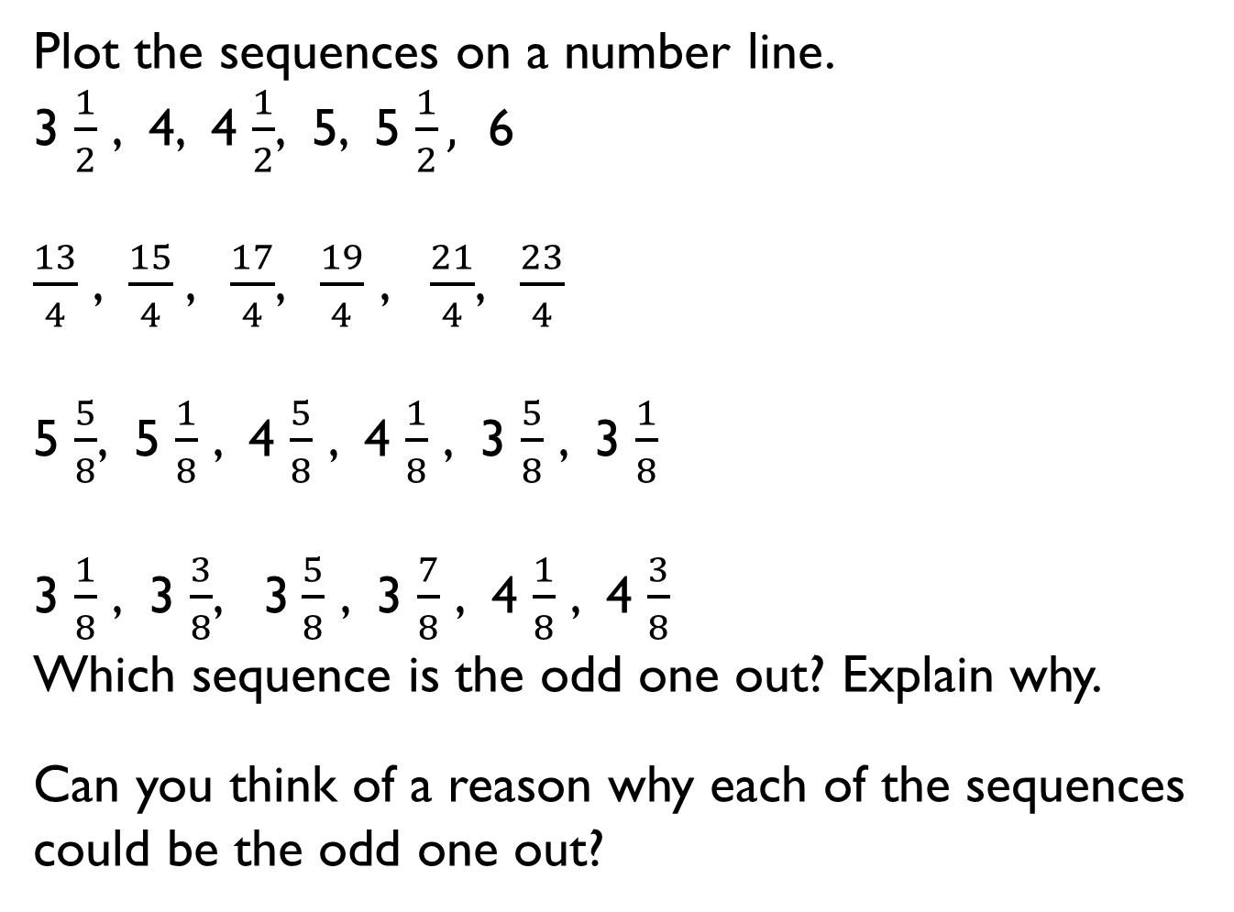
Plot the sequences on a number line.
3 $\frac{1}{2}$ , 4, 4 $\frac{1}{2}$, 5, 5 $\frac{1}{2},$ 6
$\frac{13}{4}$ , $\frac{15}{4}$, $\frac{17}{4}$, $\frac{19}{4}$ , $\frac{21}{4}$, $\frac{23}{4}$
5 $\frac{5}{8}$, 5 $\frac{1}{8}$ , 4 $\frac{5}{8}$ , 4 $\frac{1}{8}$ , 3 $\frac{5}{8}$ , 3 $\frac{1}{8}$
3 $\frac{1}{8}$ , 3 $\frac{3}{8}$, 3$\frac{5}{8}$ , 3 $\frac{7}{8}$ , 4 $\frac{1}{8}$ , 4 $\frac{3}{8}$
Which sequence is the odd one out? Explain why.
Can you think of a reason why each of the sequences could be the odd one out?

Slide 7
Use the digit cards to complete the statements.
Find three examples of ways you could complete the statement.
Can one of your ways include an improper fraction?
5
6
3
4
6
6
$$>$$
$$<$$
4
4
$$<$$

Slide 8

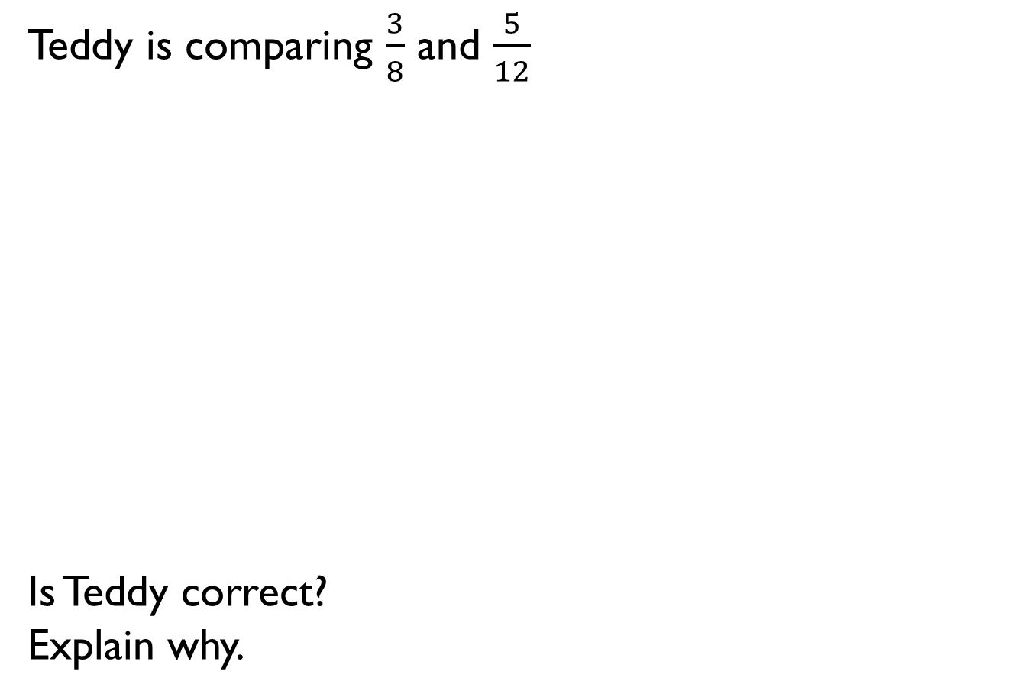
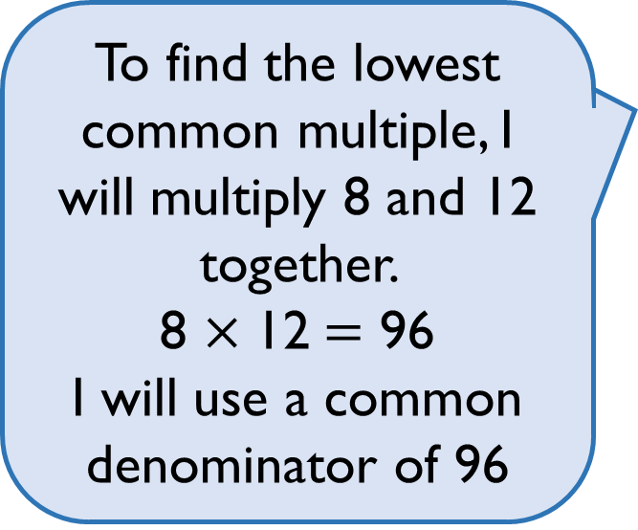
Teddy is comparing $\frac{3}{8}$ and $\frac{5}{12}$
Is Teddy correct?
Explain why.
To find the lowest common multiple, I will multiply 8 and 12 together.
8 $×$ 12 $=$ 96
I will use a common denominator of 96

Slide 9
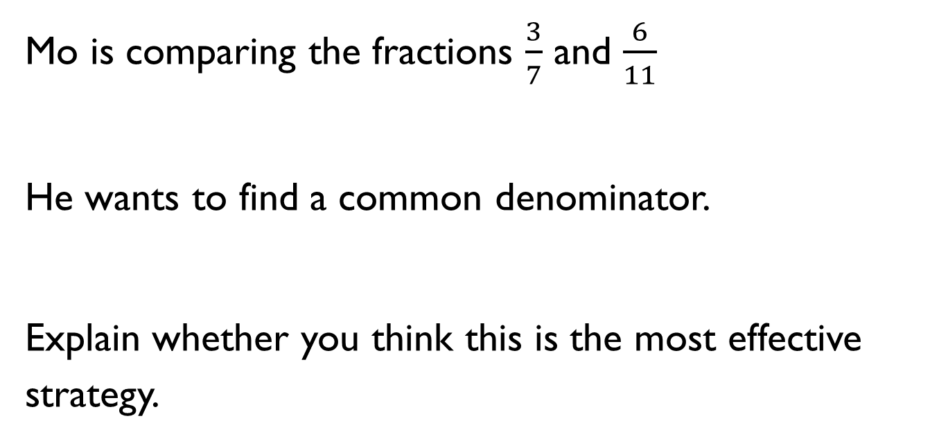
Mo is comparing the fractions $\frac{3}{7}$ and $\frac{6}{11}$
He wants to find a common denominator.
Explain whether you think this is the most effective strategy.

Slide 10
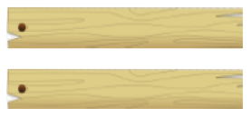
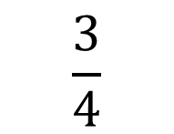
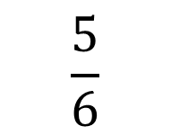
Two different pieces of wood have had a fraction chopped off.
Here are the pieces now, with the fraction that is left.
Which piece of wood was the longest to begin with?
Explain your answer.
Can you explain your method?
$$\frac{5}{6}$$
$$\frac{3}{4}$$

Slide 11
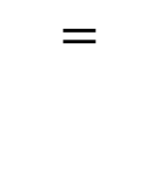
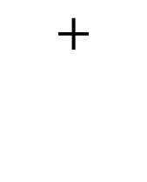
Use the same digit in both boxes to complete the calculation.
Is there more than one way to do it?
1
9
$$+$$
$$=$$
20
20

Slide 12
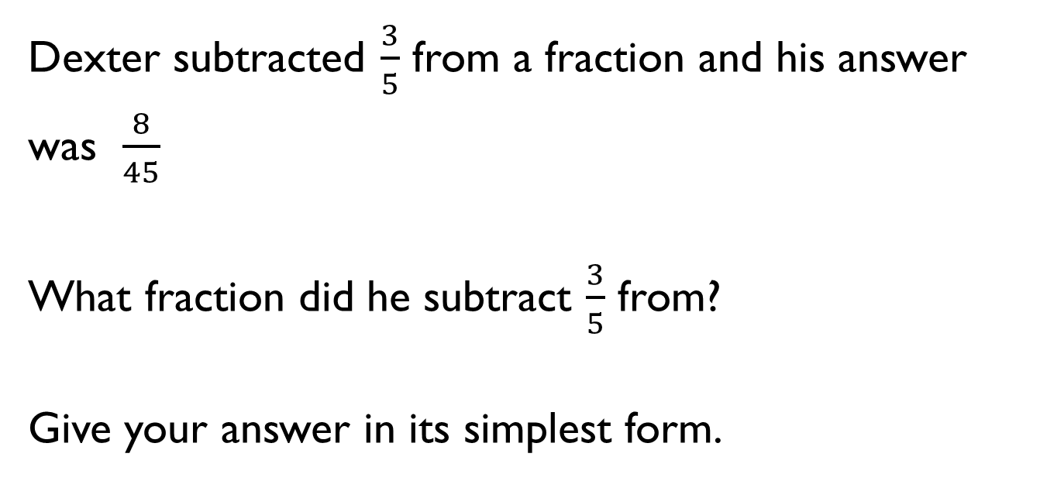
Dexter subtracted $\frac{3}{5}$ from a fraction and his answer was $\frac{8}{45}$
What fraction did he subtract $\frac{3}{5}$ from?
Give your answer in its simplest form.

Slide 13
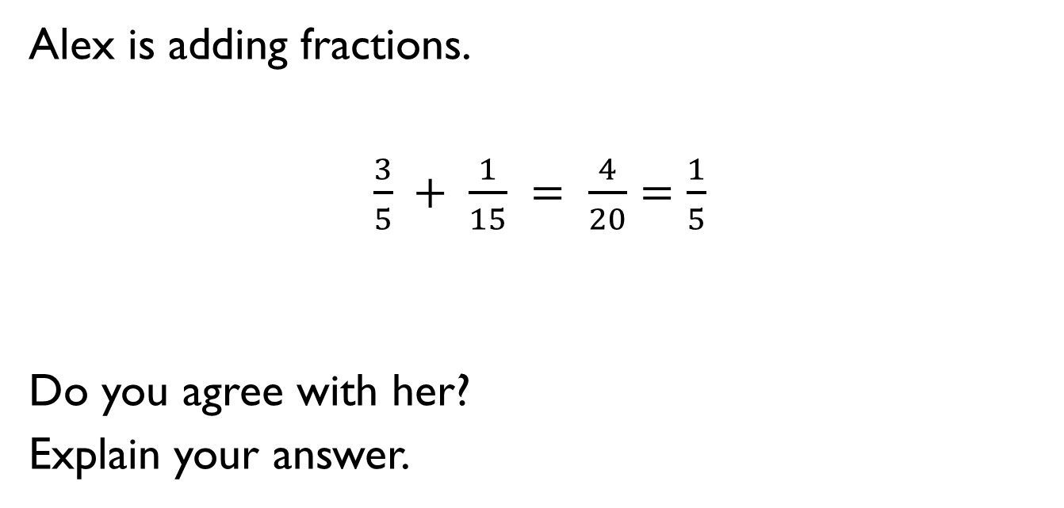
Alex is adding fractions.
$\frac{3}{5} + \frac{1}{15} = \frac{4}{20}$ $=$ $\frac{1}{5}$
Do you agree with her?
Explain your answer.

Slide 14
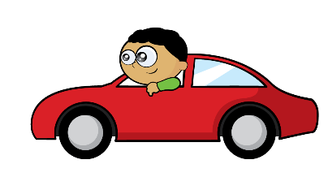
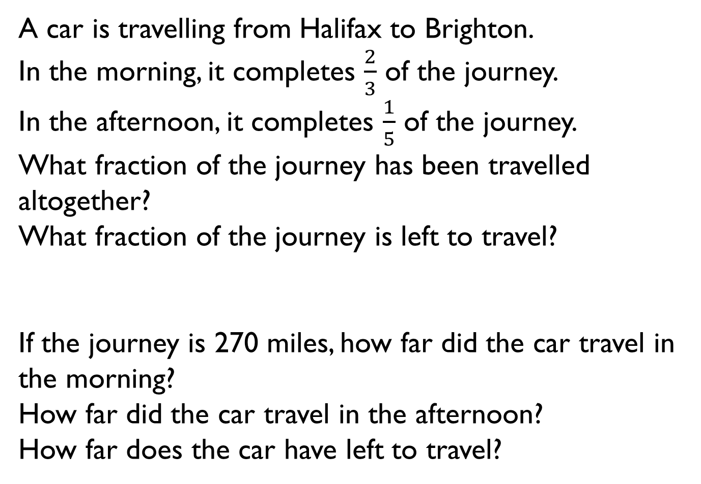
A car is travelling from Halifax to Brighton.
In the morning, it completes $\frac{2}{3}$ of the journey.
In the afternoon, it completes $\frac{1}{5}$ of the journey.
What fraction of the journey has been travelled altogether?
What fraction of the journey is left to travel?
If the journey is 270 miles, how far did the car travel in the morning?
How far did the car travel in the afternoon?
How far does the car have left to travel?

Slide 15
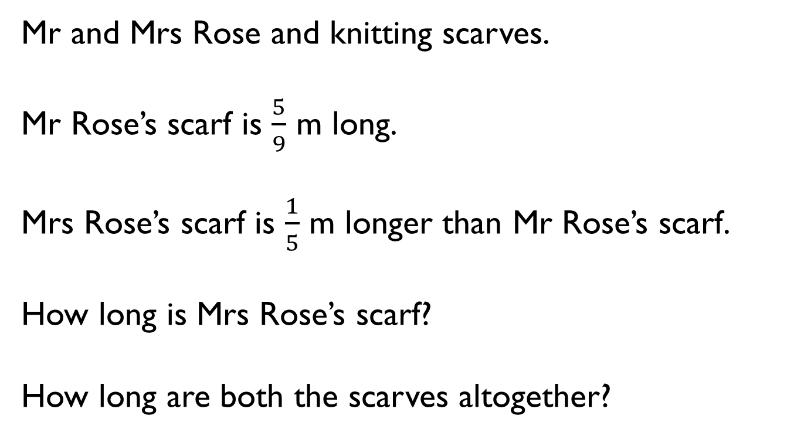
Mr and Mrs Rose and knitting scarves.
Mr Rose’s scarf is $\frac{5}{9}$ m long.
Mrs Rose’s scarf is $\frac{1}{5}$ m longer than Mr Rose’s scarf.
How long is Mrs Rose’s scarf?
How long are both the scarves altogether?

Slide 16
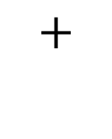
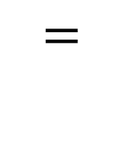
Fill in the boxes to make the calculation correct.
3
1
$$=$$
$$+$$
10
10

Slide 17
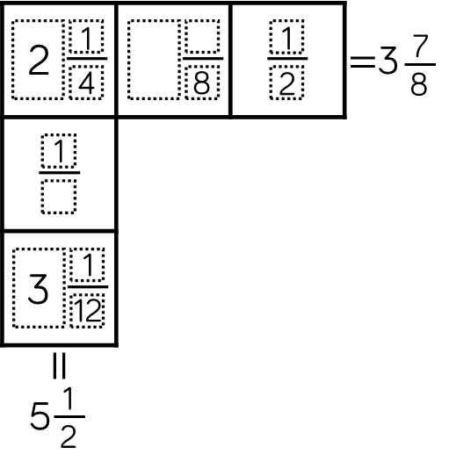
Each row and column adds up to make the total at the end.
Use this information to complete the diagram.

Slide 18
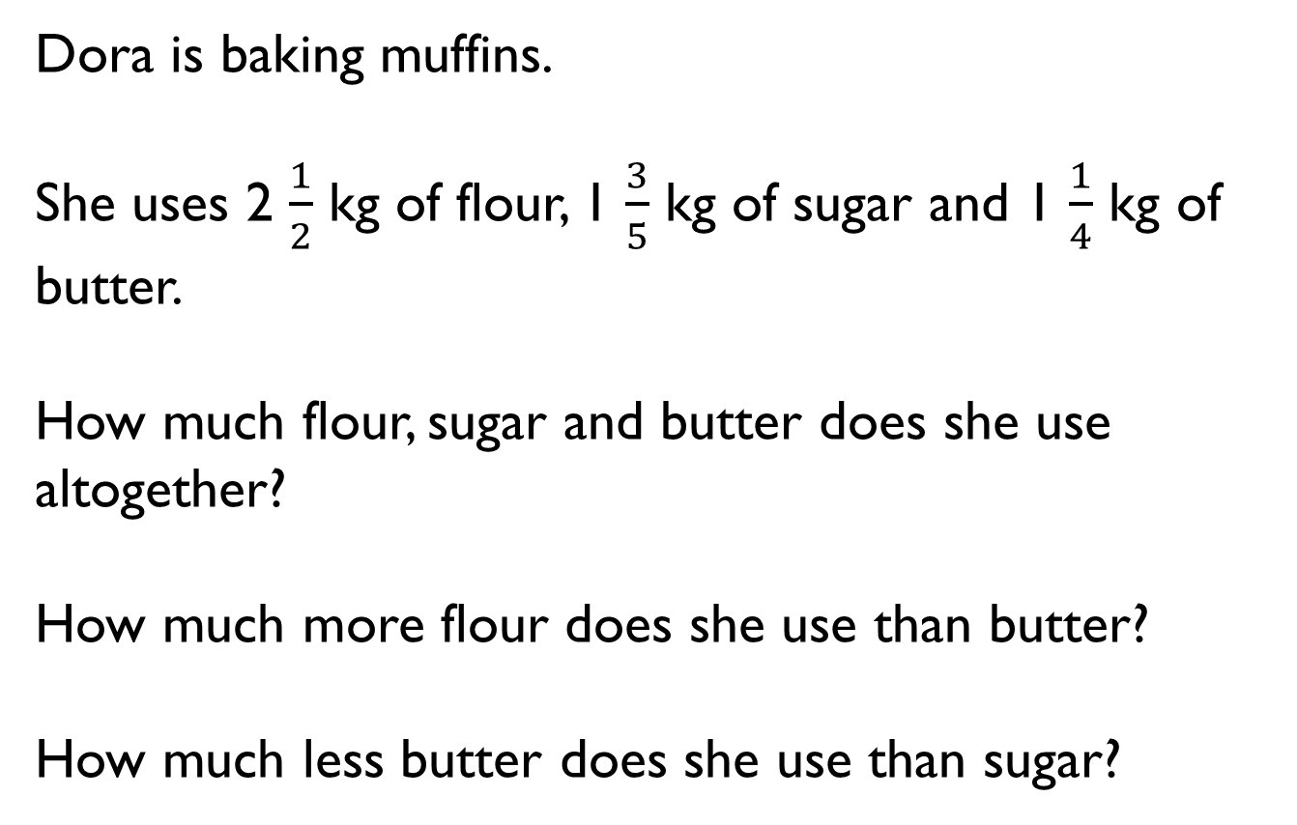
Dora is baking muffins.
She uses 2 $\frac{1}{2}$ kg of flour, 1 $\frac{3}{5}$ kg of sugar and 1 $\frac{1}{4}$ kg of butter.
How much flour, sugar and butter does she use altogether?
How much more flour does she use than butter?
How much less butter does she use than sugar?

Slide 19
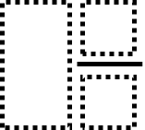

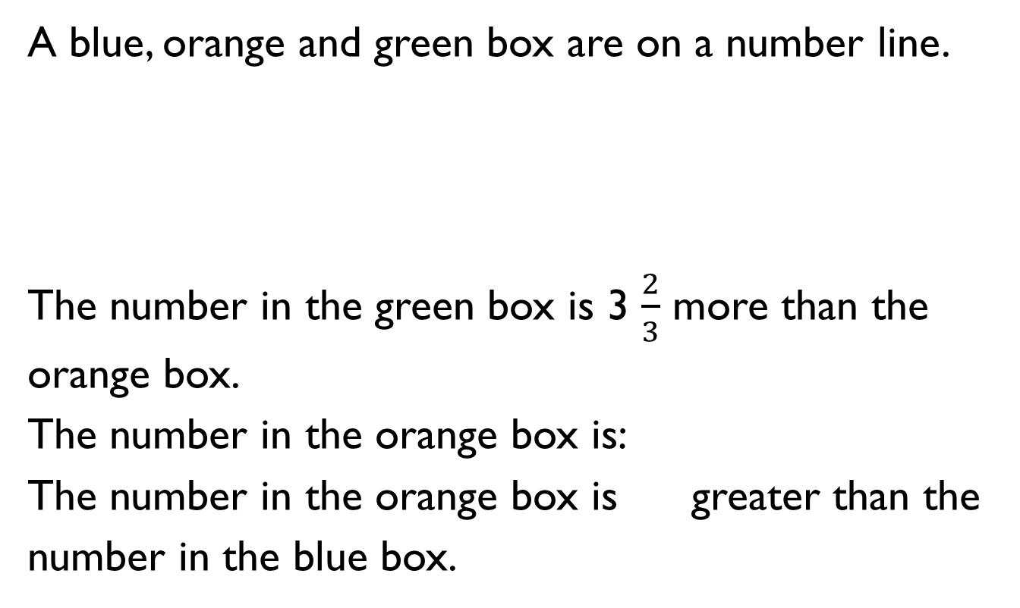
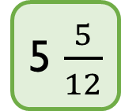
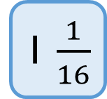
A blue, orange and green box are on a number line.
The number in the green box is 3 $\frac{2}{3}$ more than the orange box.
The number in the orange box is:
The number in the orange box is greater than the number in the blue box.
1 $\frac{1}{16}$
5 $\frac{5}{12}$

Slide 20
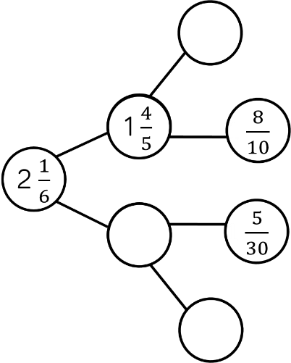
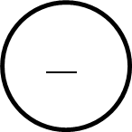
Complete the part-whole model.

Slide 21

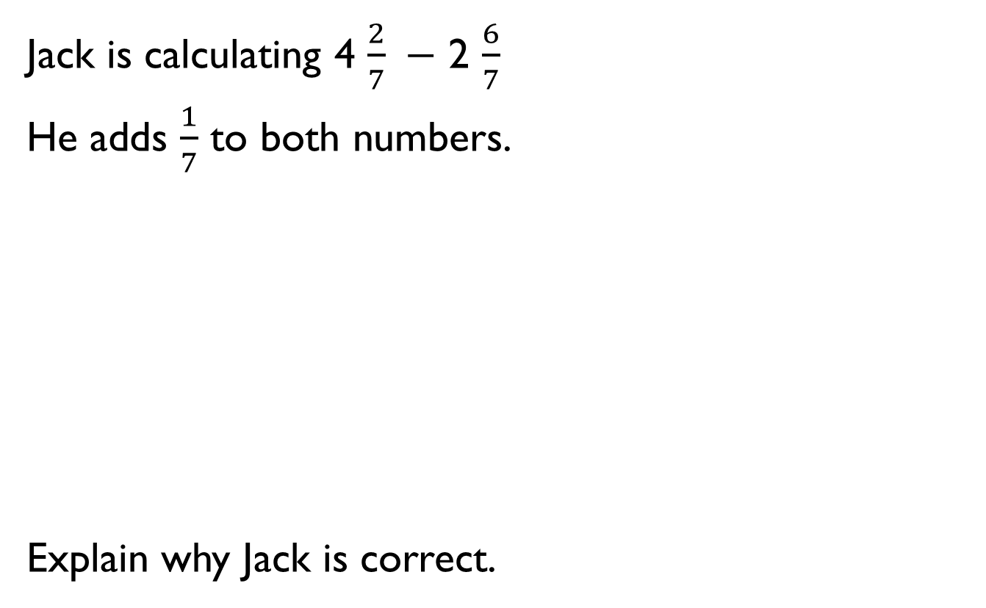
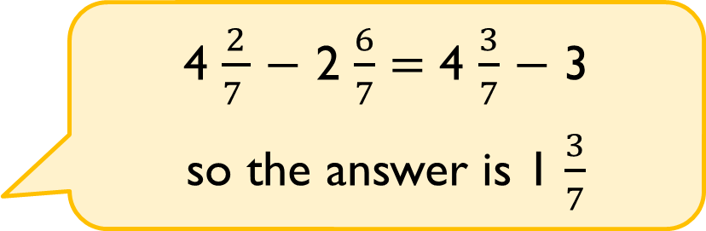
Jack is calculating 4 $\frac{2}{7} −$ 2 $\frac{6}{7}$
He adds $\frac{1}{7}$ to both numbers.
Explain why Jack is correct.
4 $\frac{2}{7 }$ $−$ 2 $\frac{6}{7}$ $=$ 4 $\frac{3}{7}$ $−$ 3
so the answer is 1 $\frac{3}{7}$

Slide 22

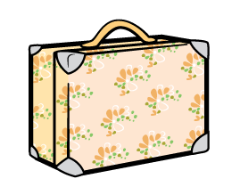
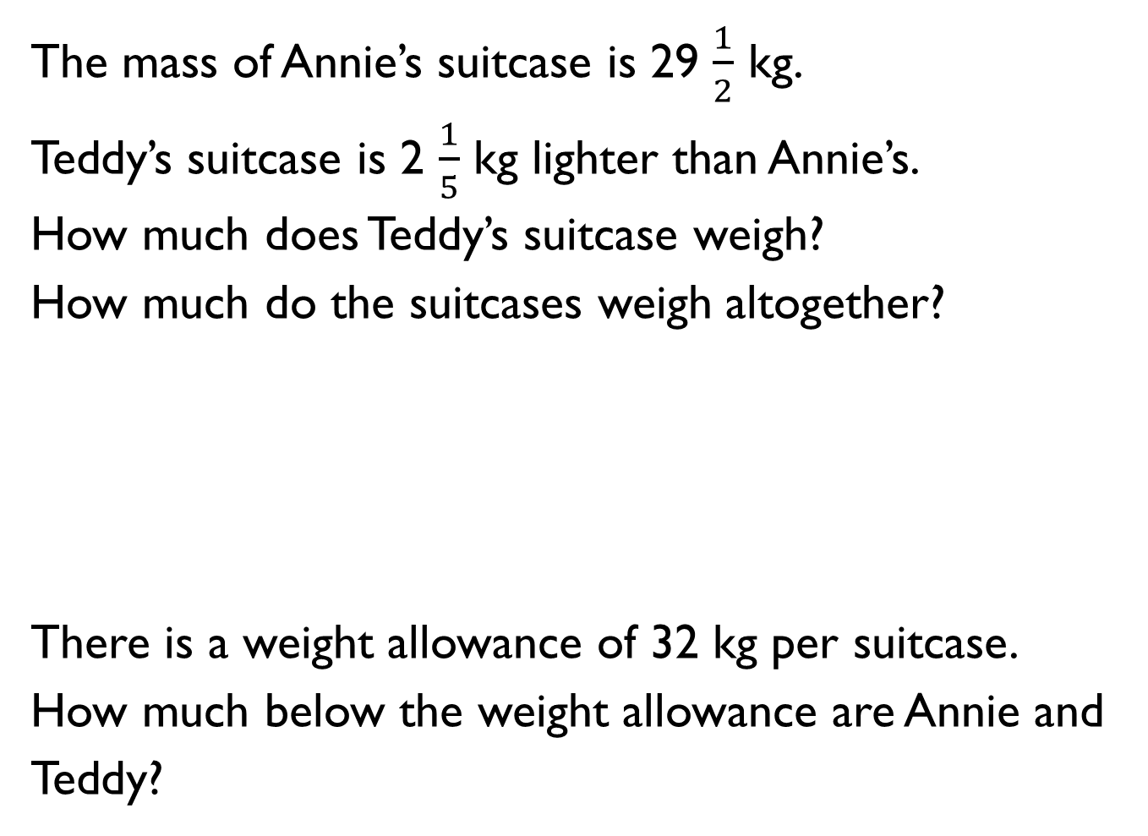
The mass of Annie’s suitcase is 29 $\frac{1}{2}$ kg.
Teddy’s suitcase is 2 $\frac{1}{5}$ kg lighter than Annie’s.
How much does Teddy’s suitcase weigh?
How much do the suitcases weigh altogether?
There is a weight allowance of 32 kg per suitcase.
How much below the weight allowance are Annie and Teddy?

Slide 23
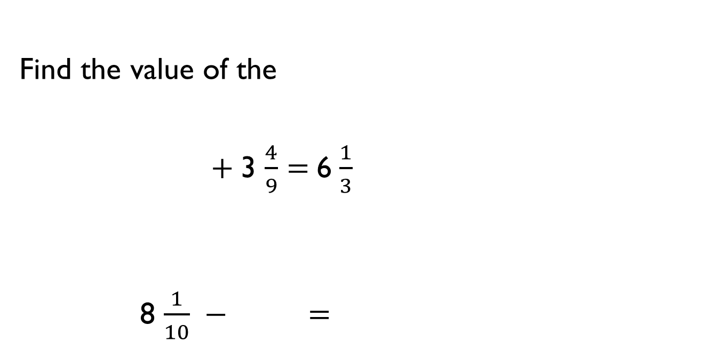
Find the value of the
$+$3 $\frac{4}{9}=$ 6 $\frac{1}{3}$
8 $\frac{1}{10} −$ $=$

Slide 24
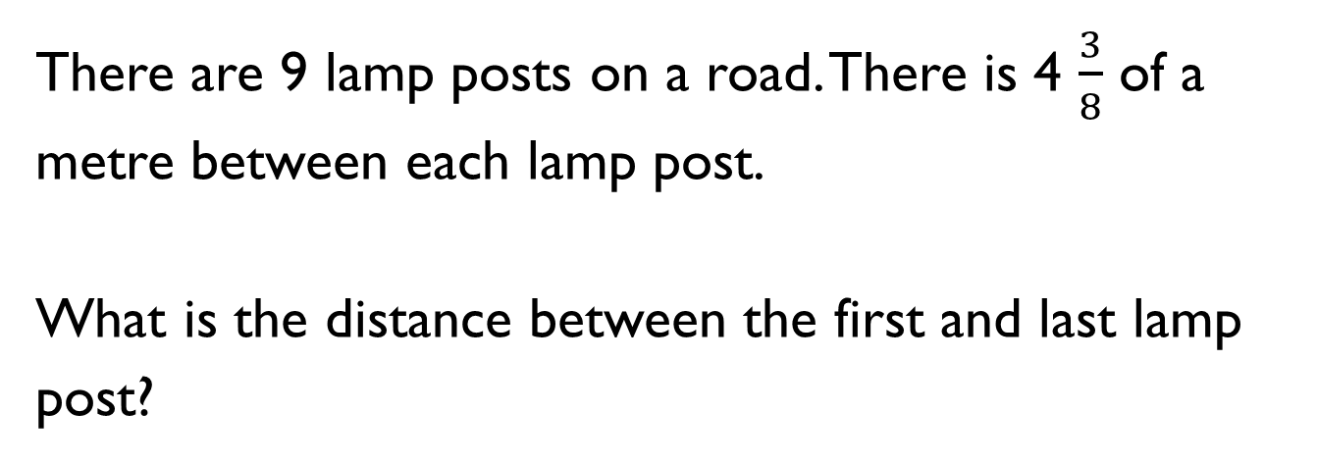
There are 9 lamp posts on a road. There is 4 $\frac{3}{8}$ of a metre between each lamp post.
What is the distance between the first and last lamp post?

Slide 25
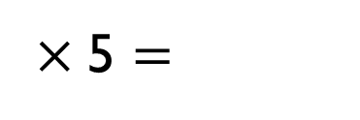
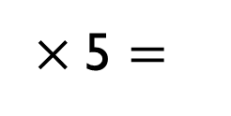
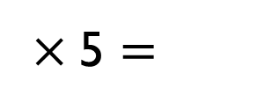
Use pattern blocks, if is equal to 1 whole, work out what fraction the other shapes represent.
Use this to calculate the multiplications.
Give your answers in their simplest form.
× 5 $=$
× 5 $=$
× 5 $=$

Slide 26


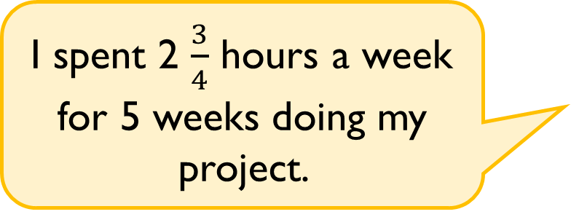
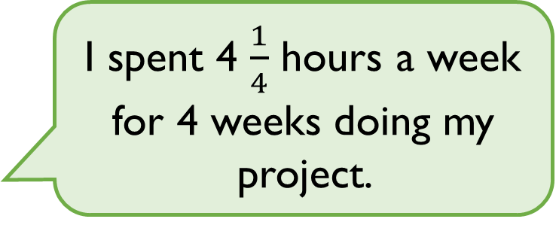
Eva and Amir both work on a homework project.
Eva
Amir
Who spent the most time on their project?
Explain your reasoning.
I spent 4 $\frac{1}{4}$ hours a week for 4 weeks doing my project.
I spent 2 $\frac{3}{4}$ hours a week for 5 weeks doing my project.

Slide 27
The shaded square in the grid below is the answer to a multiplying fractions question.
What was the question?

Slide 28
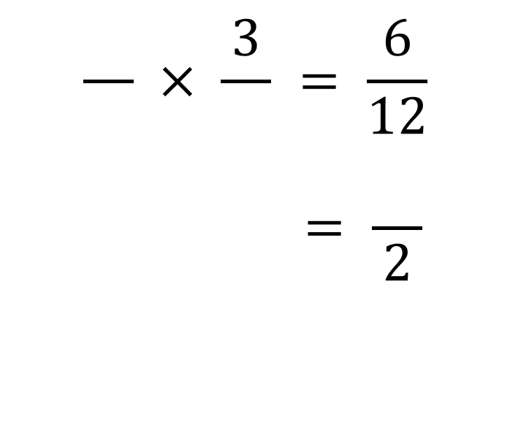
How many ways can you complete the missing digits?
$$\frac{}{} × \frac{3}{} = \frac{6}{12}$$
$$\frac{}{} × \frac{}{} = \frac{}{2}$$

Slide 29


Find the area of the shaded part of the shape.
Not drawn accurately
1 m
$\frac{5}{7}$ m
$\frac{2}{3}$ m
1 m

Slide 30

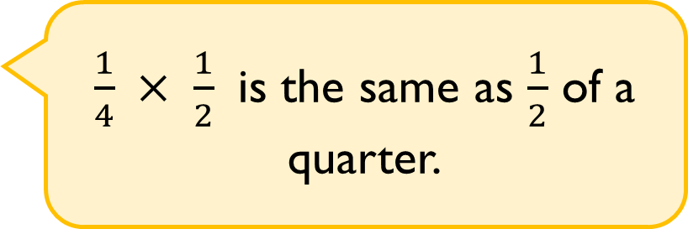
Alex says,
Do you agree?
Explain why.
$\frac{1}{4} × \frac{1}{2}$ is the same as $\frac{1}{2}$ of a quarter.

Slide 31

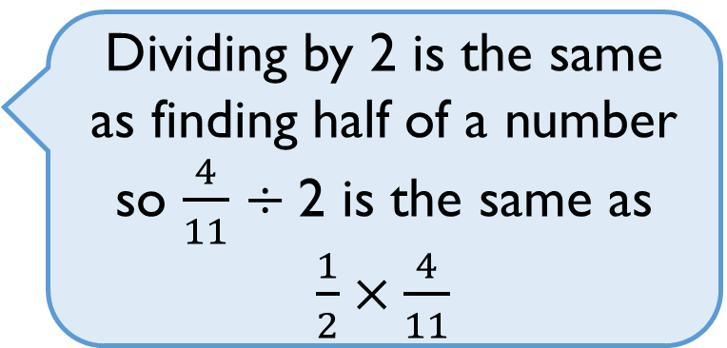
Tommy says,
Do you agree?
Explain why.
Dividing by 2 is the same as finding half of a number so $\frac{4}{11}$ ÷ 2 is the same as $\frac{1}{2}×\frac{4}{11}$

Slide 32
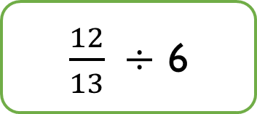
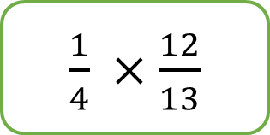
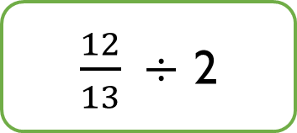
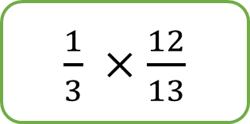
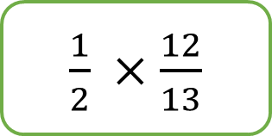
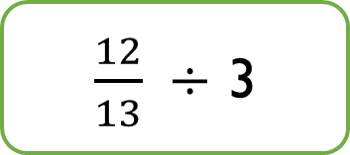
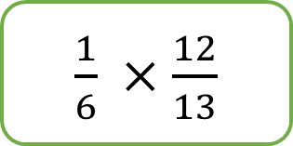
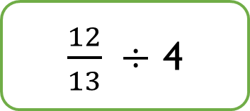
Match the equivalent calculations.
$\frac{1}{4} ×\frac{12}{13}$
$\frac{12}{13} ÷$ 2
$\frac{1}{6} ×\frac{12}{13}$
$\frac{12}{13} ÷$ 6
$\frac{1}{2} ×\frac{12}{13}$
$\frac{12}{13} ÷$ 4
$\frac{1}{3} ×\frac{12}{13}$
$\frac{12}{13} ÷$ 3

Slide 33

Complete the missing integers.
$\frac{15}{16} ÷$ $=$ $\frac{5}{16}$
$\frac{15}{16} ÷$ $=$ $\frac{3}{16}$
$\frac{20}{23} ÷$ $=$ $\frac{4}{23}$
$\frac{20}{23} ÷$ $=$ $\frac{5}{23}$

Slide 34

Rosie walks for $\frac{3}{4}$ of an hour over 3 days.
She walks for the same amount of time each day.
How many minutes does Rosie walk each day?

Slide 35

Alex says,
Do you agree?
Explain why.
I can only divide a fraction by an integer if the numerator is a multiple of the divisor.

Slide 36










Calculate the missing fractions and integers.
Is there more than one possibility?
$$\frac{7}{36}$$
$$÷$$
4
$$=$$
$$\frac{3}{20}$$
$$\frac{3}{80}$$
$$÷$$
$$=$$
$$\frac{2}{5}$$
$$÷$$
$$=$$

Slide 37

Add two sets of brackets to make the following calculation correct:
$\frac{1}{2}$ $+$ $\frac{1}{4}$ $×$ 8 $+ \frac{1}{6}$ $÷$ 3 = 6$\frac{1}{18}$
Explain where the brackets go and why.
Did you find any difficulties?

Slide 38

Match each calculation to the correct answer.
$( \frac{2}{3}+\frac{2}{9} )÷$ 4 $\frac{5}{9}$
$\frac{2}{3}−\frac{1}{3}÷$ 3 $\frac{2}{9}$
$\frac{1}{3}×$ 2 $− ($1 $\frac{1}{9}÷$2$)$ $\frac{1}{9}$

Slide 39
What is the value of A?
What is the value of B?
864
A
B

Slide 40


Two fashion designers receive $\frac{3}{8}$ of 208 metres of material.
One of them says:
Is she correct?
Explain your reasoning.
We each receive 26 m

Slide 41

Calculate the missing digits.
$\frac{3}{8}$ of 40 $=$ $\frac{?}{10}$ of 150
$\frac{1}{5}$ of 315 $=$ $\frac{?}{8}$ of 72

Slide 42


Eva lit a candle while she had a bath.
After her bath, $\frac{2}{5}$ of the candle was left.
It measured 13 cm.
Eva says:
Is she correct?
Explain your reasoning.
Before my bath the candle measured 33 cm

Slide 43
Write a problem which this bar model could represent.

Slide 44





Rosie and Jack are making juice.
They use $\frac{6}{7}$ of the water in a jug and are left with this amount of water:
Who is correct?
Explain your reasoning.
To work out how much we had originally, we should divide 300 by 6 then multiply by 7
No, we know that 300ml is $\frac{1}{7}$ so we need to multiply it by 7

