Slide 1




Year 4 - Autumn - Block 3
Length & Perimeter

Slide 2
Dexter and Rosie walk 15 kilometres altogether for charity.
Rosie walks double the distance that Dexter walks.
How far does Dexter walk?
Dexter and Rosie each raise £1 for every 500 metres they walk.
How much money do they each make?

Slide 3
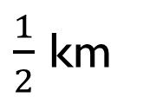
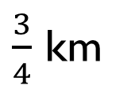
Complete the missing measurements so that each line of three gives a total distance of 2 km.
1,600 m
____ m
____ m
1,250 m
____ km
$\frac{1}{2}$ km
$\frac{3}{4}$ km

Slide 4
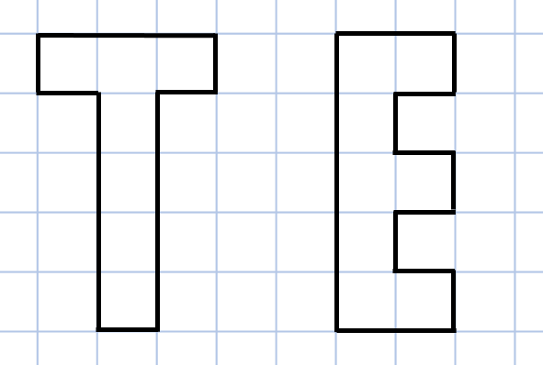
Which of these shapes has the longest perimeter?
Explore other letters which could be drawn as rectilinear shapes.
Put them in order of shortest to longest perimeter.
Can you make a word?

Slide 5
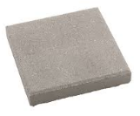
You have 10 paving stones to design a patio. The stones are one metre square.
The stones must be joined to each other so that at least one edge is joined corner to corner.
Use squared paper to show which design would give the longest perimeter and which would give the shortest.

Slide 6
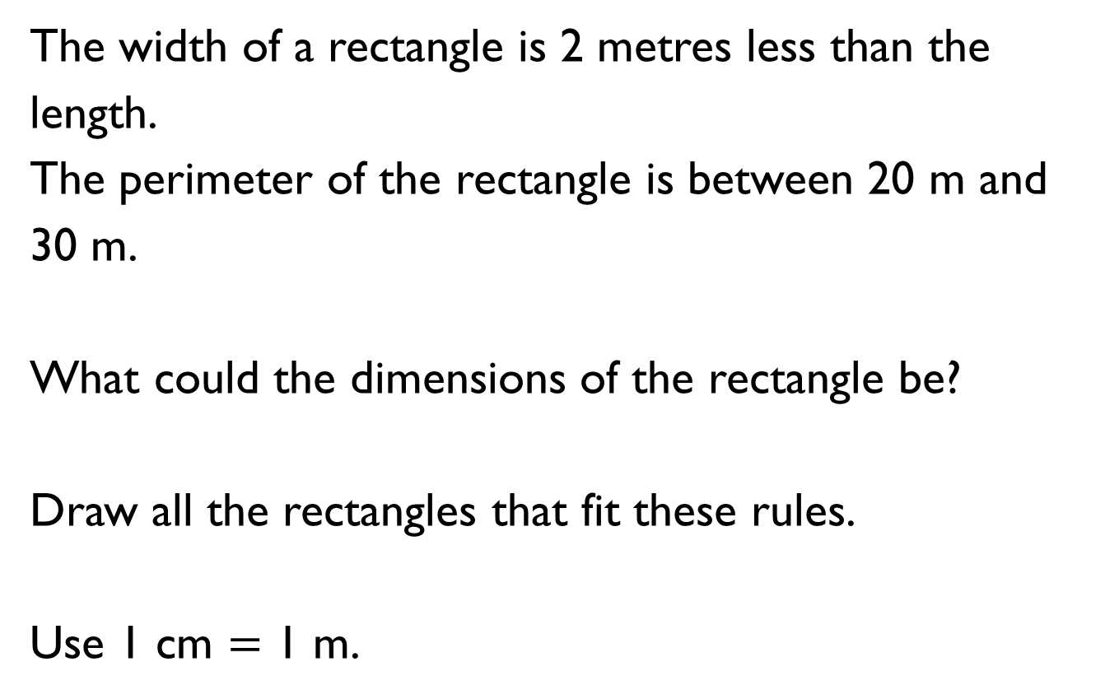
The width of a rectangle is 2 metres less than the length.
The perimeter of the rectangle is between 20 m and 30 m.
What could the dimensions of the rectangle be?
Draw all the rectangles that fit these rules.
Use 1 cm $=$ 1 m.

Slide 7
Each of the shapes have a perimeter of 16 cm.
Calculate the lengths of the missing sides.
? cm
? cm
2 cm
4 cm

Slide 8
Always, Sometimes, Never
When all the sides of a rectangle are odd numbers, the perimeter is even.
Prove your answer.

Slide 9
Here is a square. Each of the sides is a whole number of metres.
Which of these lengths could be the perimeter of the shape?
24 m, 34 m, 44 m, 54 m, 64 m, 74 m
Why could the other values not be the perimeter?

Slide 10
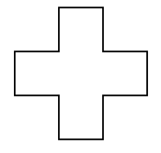
Here is a rectilinear shape. All the sides are the same length and are a whole number of centimetres.
Which of these lengths could be the perimeter of the shape?
48 cm, 36 cm, 80 cm, 120 cm, 66 cm
Can you think of any other answers which could be correct?

Slide 11
Amir has some rectangles all the same size.
He makes this shape using his rectangles. What is the perimeter?
He makes another shape using the same rectangles. Calculate the perimeter of this shape.
3 cm
8 cm

