Slide 1




Year 4 - Autumn - Block 1
Place Value

Slide 2
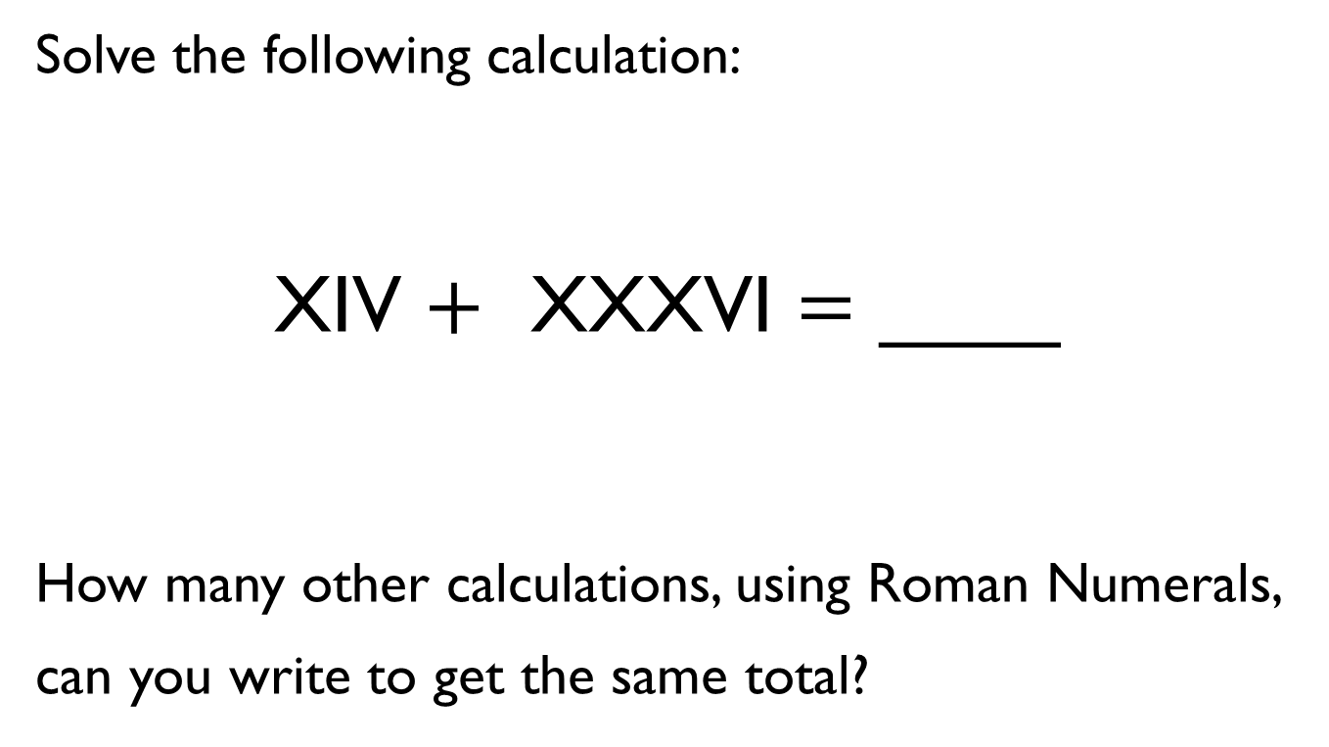
Solve the following calculation:
XIV $+$ XXXVI $=$ ____
How many other calculations, using Roman Numerals, can you write to get the same total?

Slide 3

Mo says,
Research and give examples to prove whether or not Mo is correct.
In the 10 times table, all the numbers have a zero. Therefore, in Roman Numerals all multiples of 10 have an X

Slide 4
A whole number is rounded to 370
What could the number be?
Write down all the possible answers.
370

Slide 5
Two different two-digit numbers both round to 40 when rounded to the nearest 10
The sum of the two numbers is 79
What could the two numbers be?
Is there more than one possibility?

Slide 6

Whitney says:
Do you agree with Whitney?
Explain why.
847 to the nearest 10 is 840

Slide 7
Always, Sometimes, Never
Explain your reasons for each statement.
A number with a five in the tens column rounds up to the nearest hundred.
A number with a five in the ones column rounds up to the nearest hundred.
A number with a five in the hundreds column rounds up to the nearest hundred.

Slide 8
When a whole number is rounded to the nearest 100, the answer is 200
When the same number is rounded to the nearest 10, the answer is 250
What could the number be?
Is there more than one possibility?

Slide 9
Using the digit cards 0 to 9, can you make whole numbers that fit the following rules?
You can only use each digit once.
When rounded to the nearest 10, I round to 20
When rounded to the nearest 10, I round to 10
3. When rounded to the nearest 100, I round to 700
0
1
2
3
4
5
6
7
8
9

Slide 10
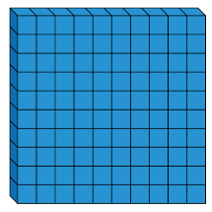


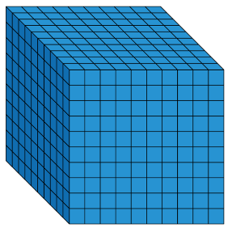




Always, Sometimes, Never
When counting in hundreds, the ones digit changes.
The thousands column changes every time you count in thousands.
To count in thousands, we use 4- digit numbers.

Slide 11

Rosie says,
True or false?
Explain how you know.
If I count in thousands from zero, I will always have an even answer.

Slide 12
Create four 4-digit numbers to fit the following rules:
The tens digit is 3
The hundreds digit is two more than the ones digit
The four digits have a total of 12

Slide 13
Use the clues to find the missing digits.
The thousands and tens digit multiply together to make 36
The hundreds and tens digit have a digit total of 9
The ones digit is double the thousands digit.
The whole number has a digit total of 21

Slide 14
Which is the odd one out?
3,500
3,500 ones
2 thousands and 15 hundreds
35 tens
Explain how you know.

Slide 15


Jack says:
Amir says:
Who has the largest number?
Explain.
My number has five thousands, three hundreds and 64 ones.
My number has fifty three hundreds, 6 tens and 4 ones.

Slide 16





Some place value counters are hidden.
The total is six thousand, four hundred and thirty two.
Which place value counters could be hidden?
Think of at least three solutions.

Slide 17
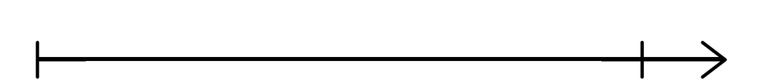
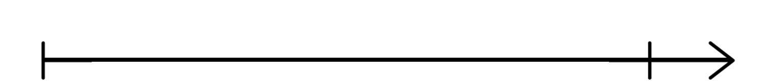
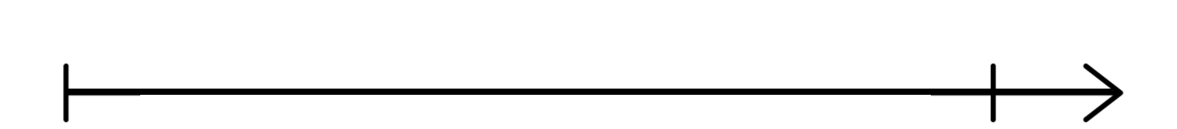
Place 6,750 on each of the number lines.
Are they in the same place on each line? Why?
6,000
7,000
6,500
8,000
0
10,000

Slide 18
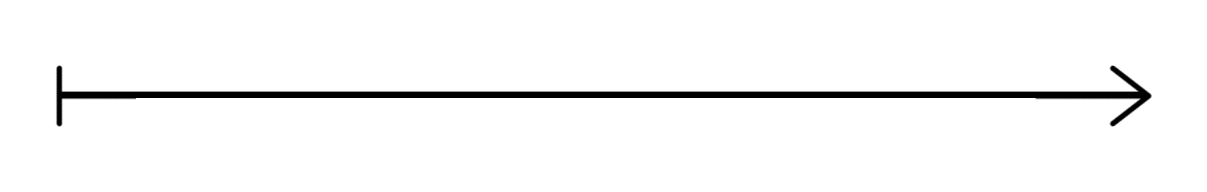
If the number on the number line is 9,200, what could the start and end numbers be?
Find three different possible answers

Slide 19
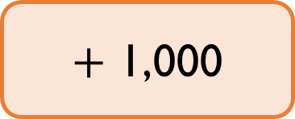
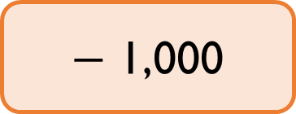
Complete the missing boxes:
4,896
$+$ 1,000
3,784
2,784
$−$ 1,000
986

Slide 20
10 less than my number is 1,000 more than 5,300.
What is my number?
Can you write your own problem similar to this?

Slide 21

Jack says,
Is he correct?
Which digit does he need to change?
When I add 1,000 to 4,325, I only have to change 1 digit.

Slide 22
Fill in the boxes by finding the patterns:
3,210
1,210
3,110
6,010

Slide 23
I am thinking of a number. It is greater than 3,000, but smaller than 5,000
The digits add up to 15
What could the number be?
Write down as many possibilities as you can.
The difference between the largest and smallest digit is 6. How many numbers do you now have?

Slide 24
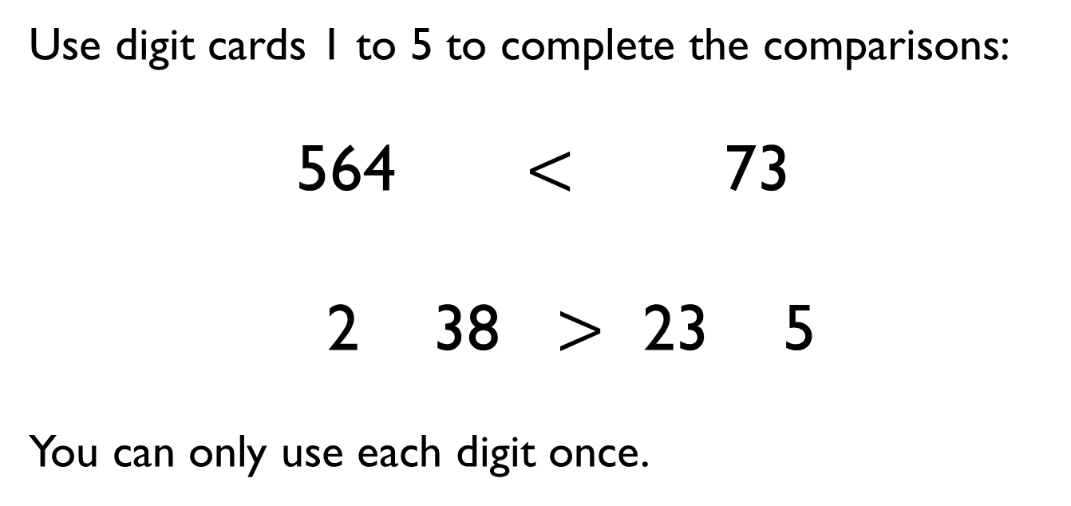
Use digit cards 1 to 5 to complete the comparisons:
564 $<$ 73
2 38 $>$ 23 5
You can only use each digit once.
1
2
3
4
5

Slide 25
Alex has ordered five 4-digit numbers.
The smallest number is 3,450, and the largest number is 3,650
All the other numbers have digit totals of 20
What could the other three numbers be?
What mistake has been made?
1,354
3,273
3,314
989
9,993
smallest
greatest

Slide 26




Put these amounts in ascending order.
Half of 2,400
LXXXVI

Slide 27
Put one number in each box so that the list of numbers is ordered smallest to largest.
Can you find more than one way?
1000s | 100s | 10s | 1s
1 | 1 |  | 3
1 |  | 2 | 7
1 | 2 | 5
1 |  | 5 | 9
1 | 3 | 8
1 |  | 1 | 5

Slide 28

David’s mum and dad are buying a car.
They look at the following cars:
Are all of the cars correctly advertised?
Explain your reasoning.
Car A
Car B
Car C
9,869
8,501
7,869
Approximately 10,000 miles
Approximately 8,000 miles
Approximately 8,000 miles

Slide 29
A number is rounded to the nearest thousand.
The answer is 7,000
What could the original number have been?
Give five possibilities.
What is the greatest number possible?
What is the smallest number possible?

Slide 30
Whitney is counting in 25s and 1,000s.
She says:
Multiples of 1,000 are also multiples of 25
Multiples of 25 are therefore multiples of 1,000
Do you agree with Whitney?
Explain why.

Slide 31
Ron is counting down in 25s from 790
Will he say 725?
Explain your answer.

Slide 32
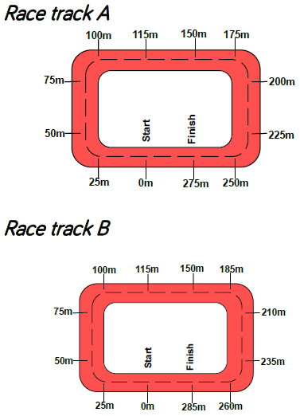
Two race tracks have been split into 25m intervals.
What errors have been made?

Slide 33

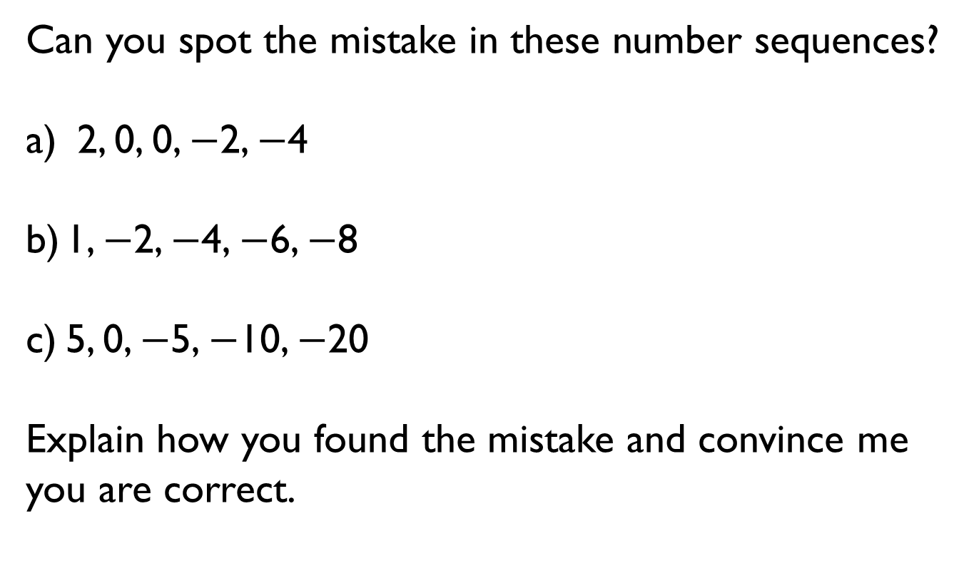
Can you spot the mistake in these number sequences?
2, 0, 0, $−$2, $−$4
1, $−$2, $−$4, $−$6, $−$8
5, 0, $−$5, $−$10, $−$20
Explain how you found the mistake and convince me you are correct.

Slide 34
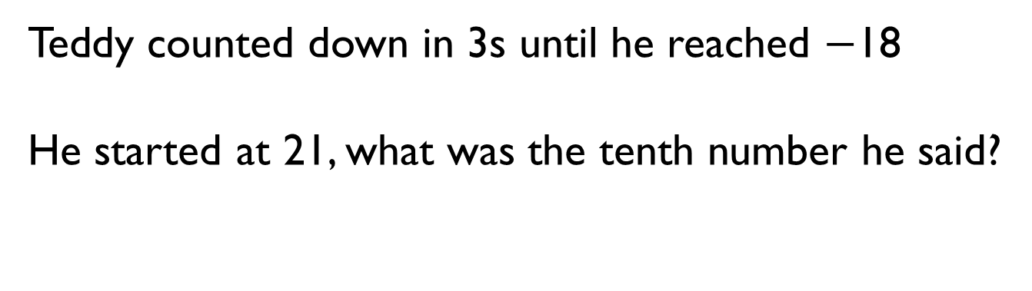
Teddy counted down in 3s until he reached $−$18
He started at 21, what was the tenth number he said?

