Slide 1




Year 4 - Autumn - Block 4
Multiplication & Division

Slide 2
Always, Sometimes, Never
If you write a whole number in a place value grid and multiply it by 10, all the digits move one column to the left.

Slide 3
Annie has multiplied a whole number by 10
Her answer is between 440 and 540
What could her original calculation be?
How many possibilities can you find?

Slide 4






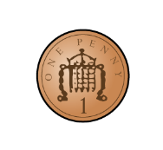




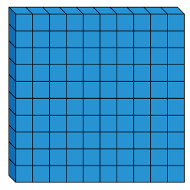

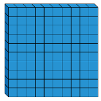

Which representation does not show multiplying by 100? Explain your answer.
100
300
3

Slide 5
The perimeter of the rectangle is 26 m.
Find the length of the missing side.
Give your answer in cm.
7 m
?

Slide 6
Four children are in a race. The numbers on their vests are:
Use the clues to match each vest number to a child.
Jack's number is ten times smaller than Mo's.
Alex's number is not ten times smaller than Jack's or Dora's or Mo's.
Dora's number is ten times smaller than Jack's.
350
35
3,500
53

Slide 7
While in Wonderland, Alice drank a potion and everything shrank. All the items around her became ten times smaller! Are these measurements correct?
Can you fill in the missing measurement?
Can you explain what Alice did wrong?
Write a calculation to help you explain each item.
Item | Original measurement | After shrinking
Height of a door | 220 cm | 2,200 cm
Her height | 160 cm | 16 cm
Length of a book | 340 mm | 43 mm
Height of a mug | 220 mm | ?

Slide 8


Eva and Whitney are dividing numbers by 10 and 100
They both start with the same 4-digit number.
They give some clues about their answer.
Eva
Whitney
What number did they both start with?
Who divided by what?
My answer has 8 ones and 2 tens.
My answer has 2 hundreds, 8 tens and 0 ones.

Slide 9
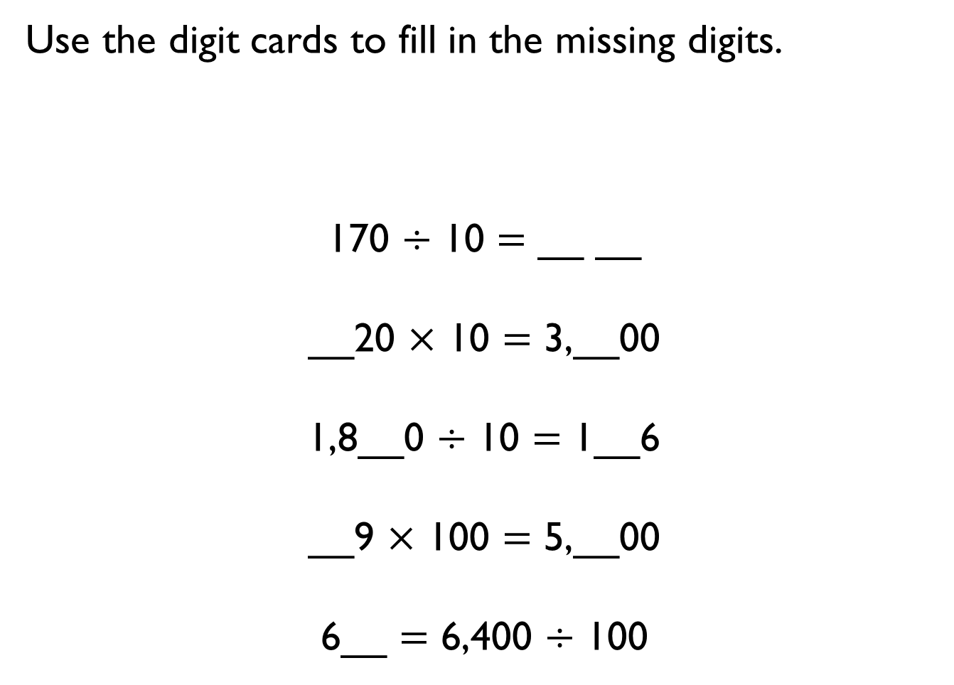
Use the digit cards to fill in the missing digits.
170 $÷$ 10 $=$ __ __
__20 $×$ 10 $=$ 3,__00
1,8__0 $÷$ 10 $=$ 1__6
__9 $×$ 100 $=$ 5,__00
6__ $=$ 6,400 $÷$ 100
1
2
3
4
5
6
7
8
9

Slide 10
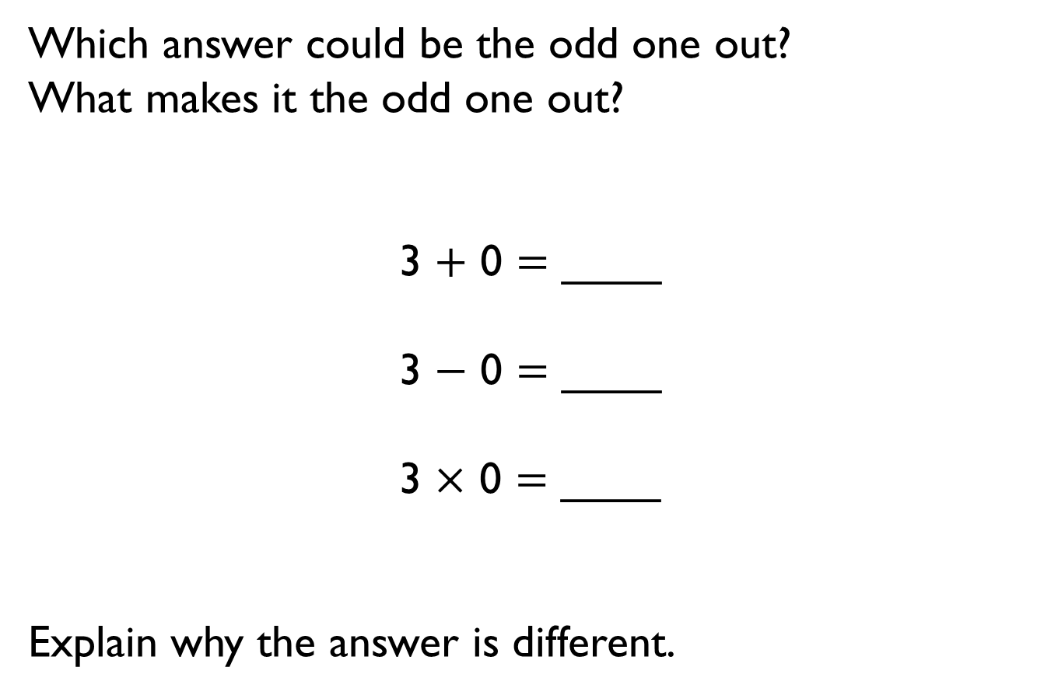
Which answer could be the odd one out?
What makes it the odd one out?
3 $+$ 0 $=$ ____
3 $−$ 0 $=$ ____
3 $×$ 0 $=$ ____
Explain why the answer is different.

Slide 11
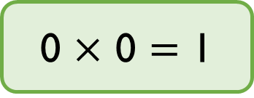
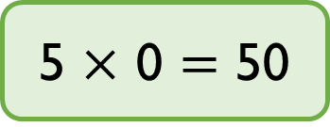
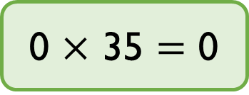
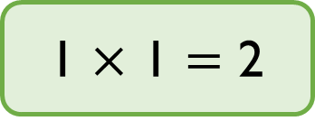
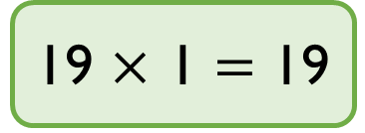
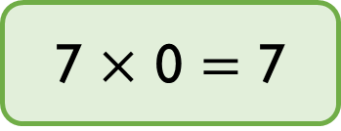
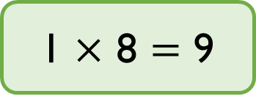
Circle the incorrect calculations and write them correctly.
Choose one calculation and create a drawing to show it.
5 $×$ 0 $=$ 50
19 $×$ 1 $=$ 19
7 $×$ 0 $=$ 7
1 $×$ 1 $=$ 2
0 $×$ 35 $=$ 0
0 $×$ 0 $=$ 1
1 $×$ 8 $=$ 9

Slide 12
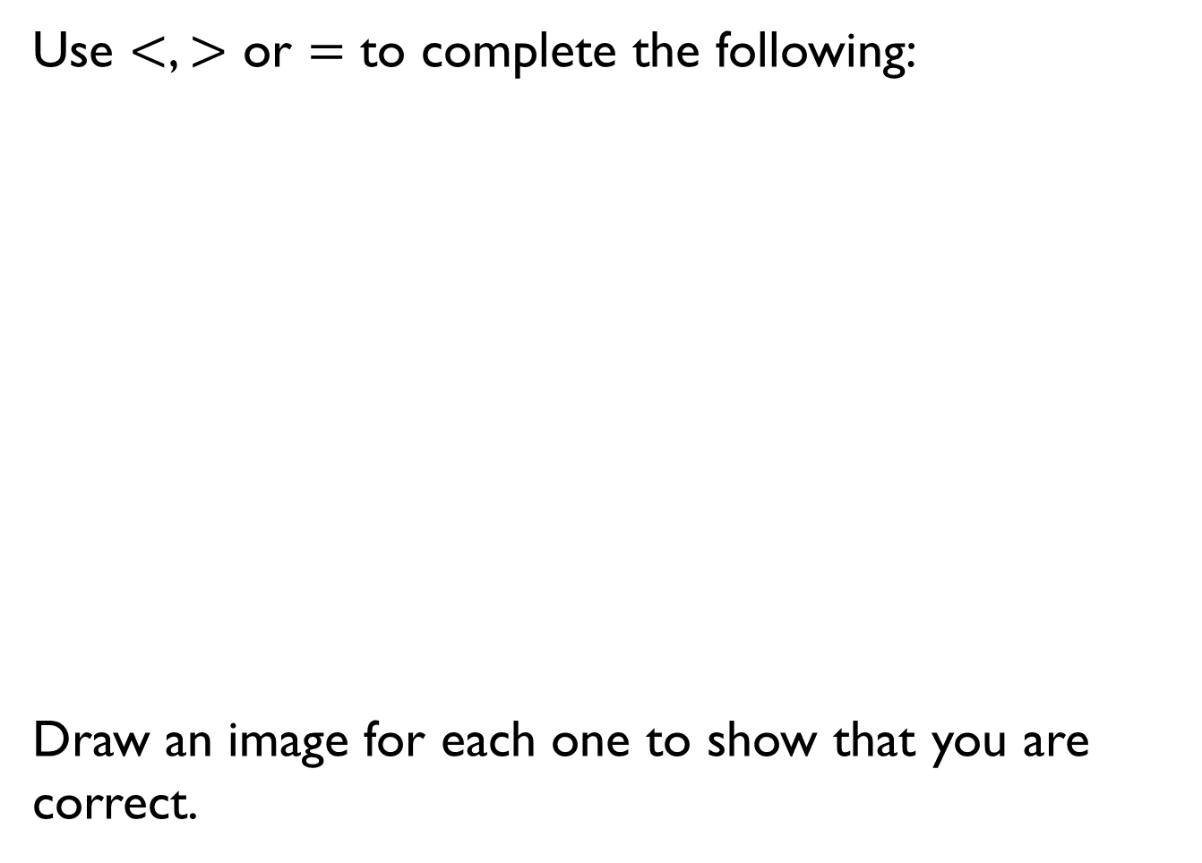
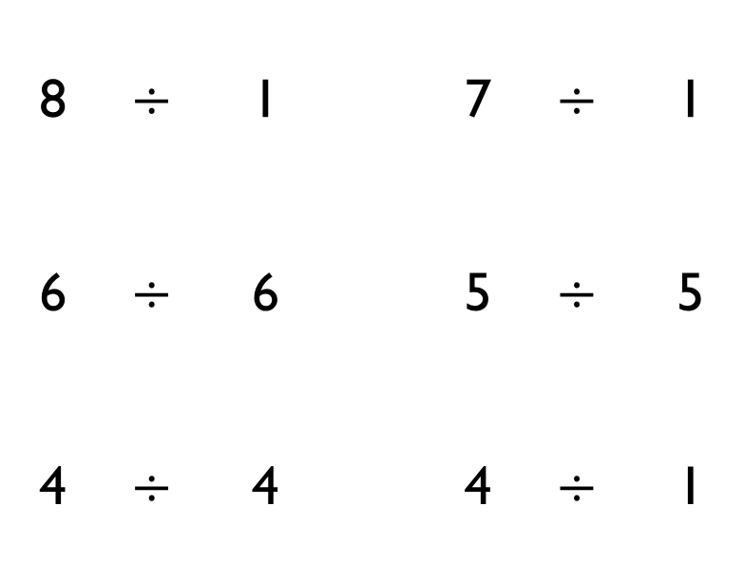
Use $<$, $>$ or $=$ to complete the following:
Draw an image for each one to show that you are correct.
8 | $$÷$$ | 1 |  | 7 | $$÷$$ | 1
6 | $$÷$$ | 6 |  | 5 | $$÷$$ | 5
4 | $$÷$$ | 4 |  | 4 | $$÷$$ | 1

Slide 13

Mo says,
Do you agree?
Explain your answer.
25 divided by 1 is equal to 1 divided by 25

Slide 14
Always, Sometimes, Never
When you multiply any whole number by 6 it will always be an even number.
Explain your answer.

Slide 15

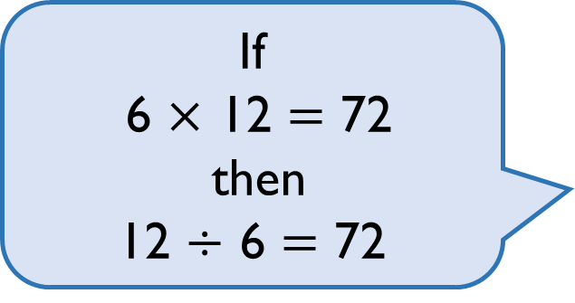
Teddy says,
Is Teddy correct?
Explain your answer.
If
6 $×$ 12 $=$ 72
then
12 $÷$ 6 $=$ 72

Slide 16
I am thinking of 2 numbers where the sum of the numbers is 15 and the product is 54
What are my numbers?
Think of your own problem for a friend to solve?

Slide 17
Always, Sometimes, Never
If a number is a multiple of 3 it is also a multiple of 6
Explain why you think this.

Slide 18
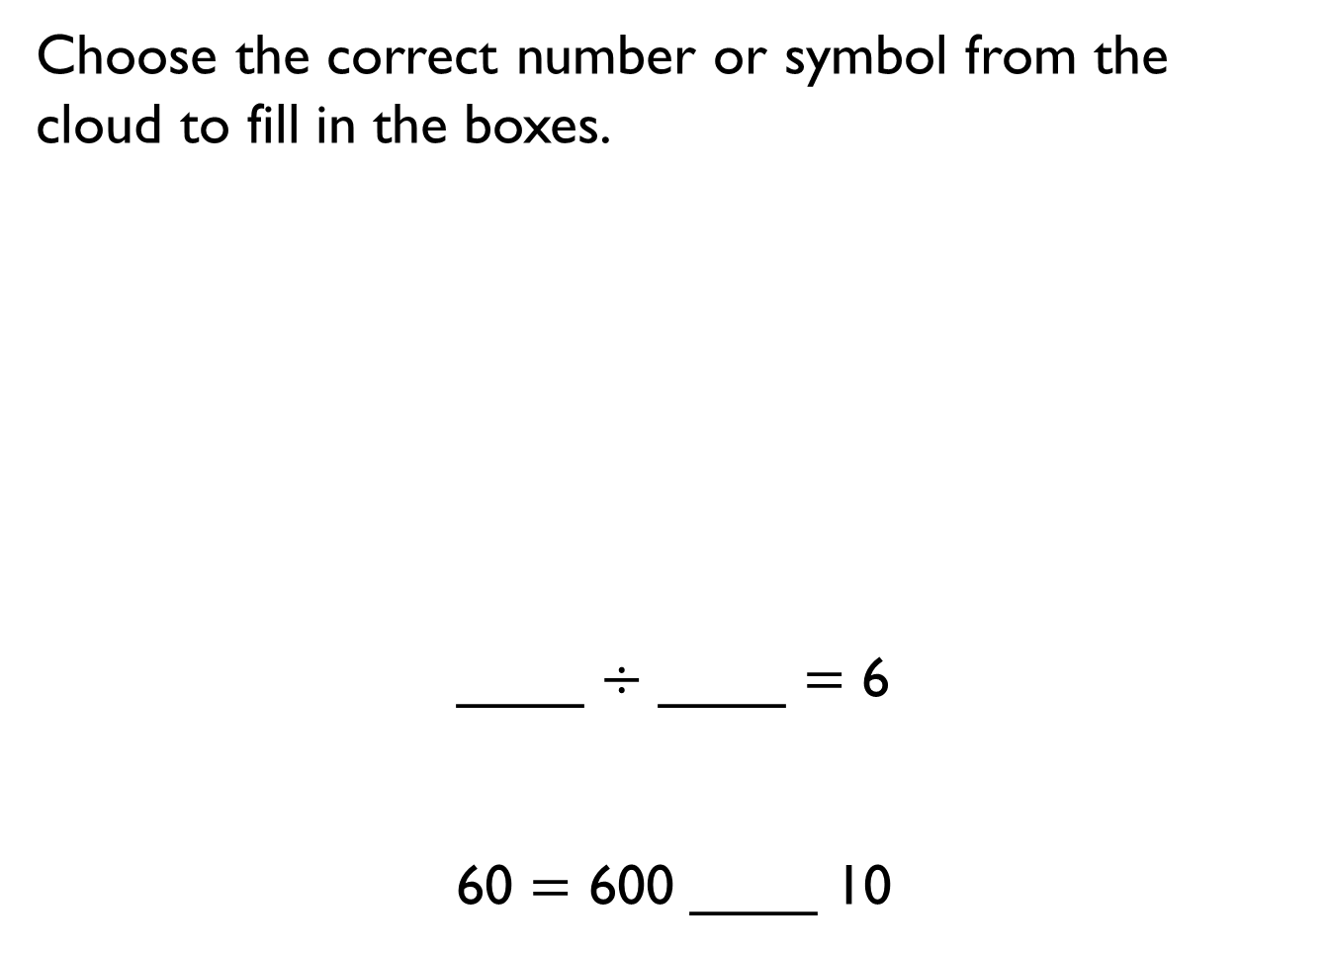



Choose the correct number or symbol from the cloud to fill in the boxes.
____ $÷$ ____ $=$ 6
60 $=$ 600 ____ 10
$$×$$
600
100
$$=$$
$$÷$$
6
10

Slide 19
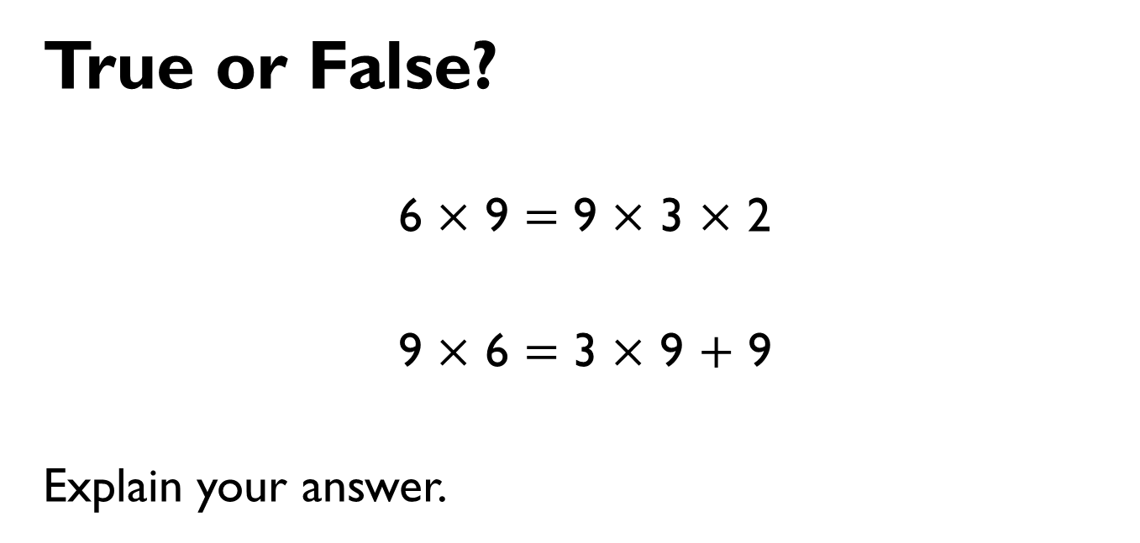
True or False?
6 $×$ 9 $=$ 9 $×$ 3 $×$ 2
9 $×$ 6 $=$ 3 $×$ 9 $+$ 9
Explain your answer.

Slide 20






Amir and Whitney both receive some sweets.
Amir
Whitney
Who has more sweets? Explain your reasoning.
I have more sweets because I have more rows.
I have more sweets because I have more in each row.

Slide 21
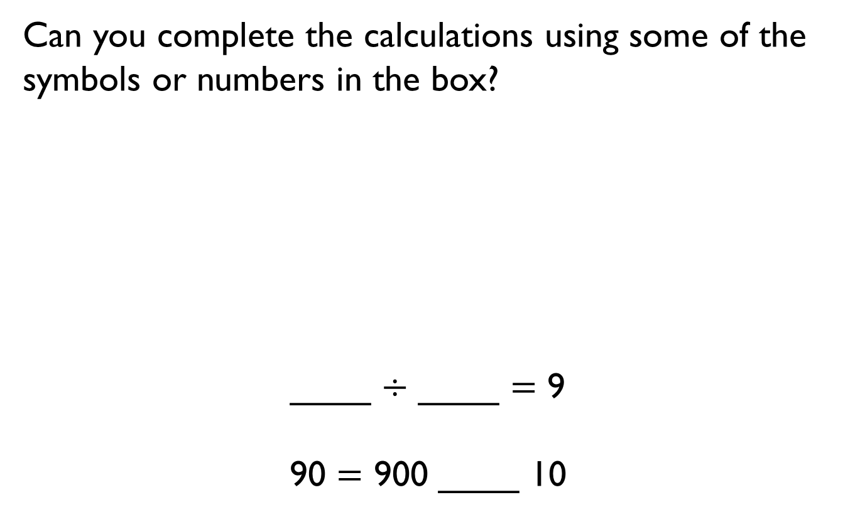


Can you complete the calculations using some of the symbols or numbers in the box?
____ $÷$ ____ $=$ 9
90 $=$ 900 ____ 10
9
100
$$÷$$
10
900
$$=$$

Slide 22
Mrs White’s class are selling tickets at £2 each for the school play.
The class can sell one ticket for each chair in the hall.
There are 7 rows of chairs in the hall. Each row contains 9 chairs.
How much money will they make?

Slide 23
What do you notice about the pattern when counting in 7s from 0?
Does this continue beyond 7 times 12?
Can you explain why?
In which other times tables will you see the same pattern?

Slide 24
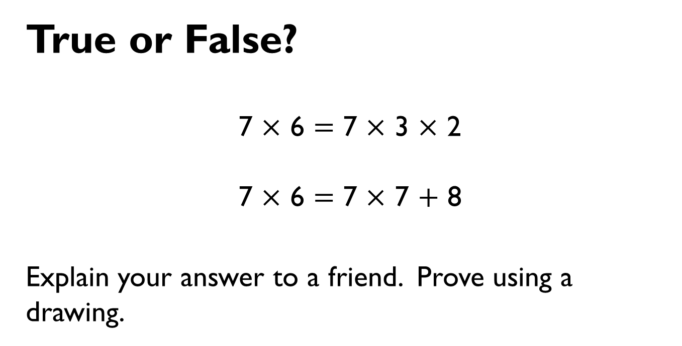
True or False?
7 $×$ 6 $=$ 7 $×$ 3 $×$ 2
7 $×$ 6 $=$ 7 $×$ 7 $+$ 8
Explain your answer to a friend. Prove using a drawing.

Slide 25

Children were arranged into rows of seven.
There were 5 girls and 2 boys in each row.
Use your times table knowledge to show how many girls would be in 10 rows and in 100 rows.
Show as many number sentences using multiplication and division as you can which are linked to this picture.
How many children in total are there in 200 rows? How many girls? How many boys?

