Slide 1




Year 3 - Autumn - Block 1
Place Value

Slide 2
True or False?
If I count in 100s from zero, all of the numbers will be even.
Convince me.

Slide 3
Always, Sometimes, Never?
When counting in hundreds, the ones column changes.
When counting in hundreds, the hundreds column changes.
To count in hundreds we use 3-digit numbers.

Slide 4
Whitney thinks the place value grid is showing the number eight.
Do you agree? Explain why.
Using all of the counters, what is the smallest number you can make?
What other numbers could you make?
Hundreds | Tens | Ones

Slide 5


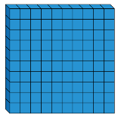
Teddy has used Base 10 to represent the number 420. He has covered some of them up.
Work out the amount he has covered up.
How many different ways can you make the missing amount using Base 10?

Slide 6
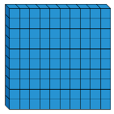
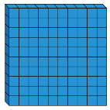
Which child has made the number 315?
Dora
Mo
Explain how you know.

Slide 7
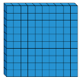

Hundreds | Tens | Ones
Is Eva correct? Explain your reasoning.
What do you notice about the number shown?
The place value grid shows the number 467

Slide 8
Using each digit card, which numbers can you make?
Use the place value grid to help.
Compare your answers with a partner.
5
0
3
Hundreds | Tens | Ones

Slide 9



Using place value counters, how many different ways can you make four hundred and fifty?
Show your solutions as a calculations.

Slide 10
Eva
Do you agree? Explain your answer.
The number in the place value grid is the greatest number you can make with 8 counters.
100s | 10s | 1s

Slide 11


100s | 10s | 1s
Dora
Jack
Who is correct? Explain your reasoning.
The place value chart shows 607
I think it shows 670

Slide 12
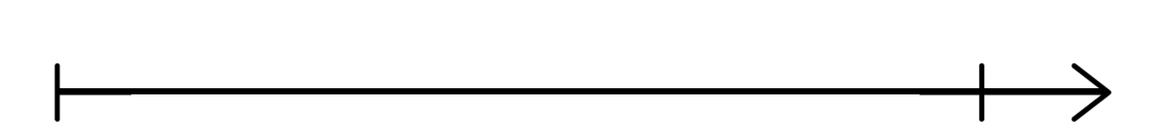
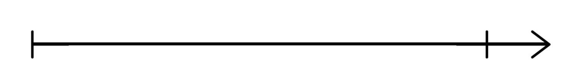
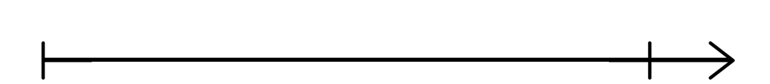
Estimate where seven hundred and twenty-five will go on each of the number lines.
Explain why it is not in the same place on each number line.
0
1,000
700
800
720
730

Slide 13
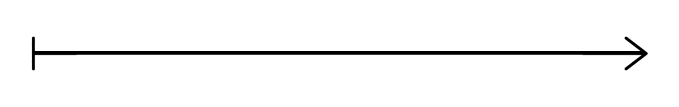
If the arrow is pointing to 780, what could the start and end numbers be?
Find three different ways and explain your reasoning.

Slide 14
10 more than my number is the same as 100 less than 320
What is my number?
Explain how you know.
Write your own similar problem to describe the original number.

Slide 15
I think of a number, add ten, subtract one hundred and then add one.
My answer is 256
What number did I start with?
Explain how you know.
What can you do to check?

Slide 16
A counter is missing on the place value chart.
What number could it have been?
Hundreds | Tens | Ones

Slide 17




Which image is the odd one out?
Explain why.
How else can you represent the number?
539 | 540 | 541 | 542 | 543 | 544
500
140
3

Slide 18
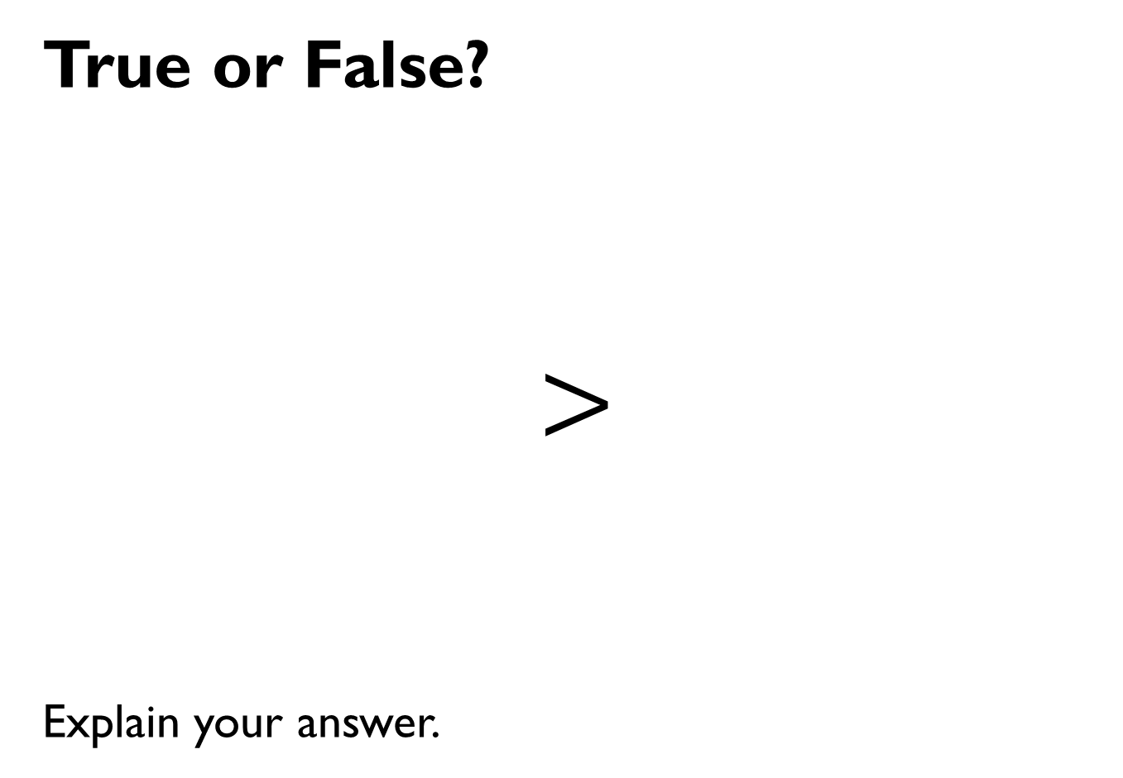
True or False?
$$>$$
Explain your answer.

Slide 19


Amir has 3 jars of sweets.
A B C
Jar A contains 235 sweets.
Jar C contains 175 sweets.
How many sweets could be in jar B?
Explain how you know.
Jar A has the most sweets in. Jar C has the least sweets in.

Slide 20
I am thinking of a number.
It is between 300 and 500
The digits add up to 14
The difference between the greatest digit and the smallest digit is 2
What could my number be?
Is there only one option?
Explain each step of your working.

Slide 21

Whitney has six different numbers.
She put them in ascending order then accidentally spilt some ink onto her page. Two of her numbers are now covered in ink.
214, 123, 243, 256, 123, 289
What could the hidden numbers be?
Explain how you know.

Slide 22
True or False?
When ordering numbers you only need to look at the place value column with the highest value.

Slide 23
Odd One Out
100, 150, 200, 215, 300
Which is the odd one out? Explain how you know.

Slide 24
Which is quicker: counting to 50 in 10s or counting to 150 in 50s?
Explain your answer.

Slide 25
Always, Sometimes, Never
When counting in 50s starting from 0, the numbers are all even.
There are only two digits in a multiple of 50
Only the hundreds and tens column changes when counting in 50s.

