Slide 1




Year 3 - Autumn - Block 2
Addition & Subtraction

Slide 2

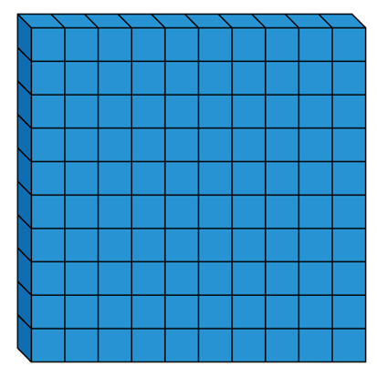
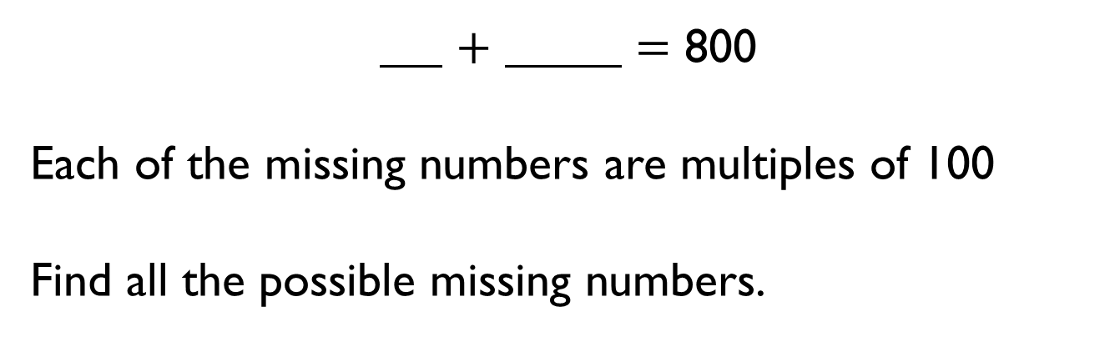
$+$ $=$ 800
Each of the missing numbers are multiples of 100
Find all the possible missing numbers.

Slide 3


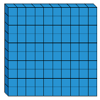
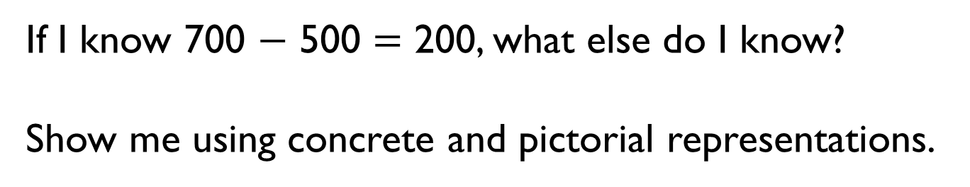
If I know 700 $−$ 500 $=$ 200, what else do I know?
Show me using concrete and pictorial representations.

Slide 4
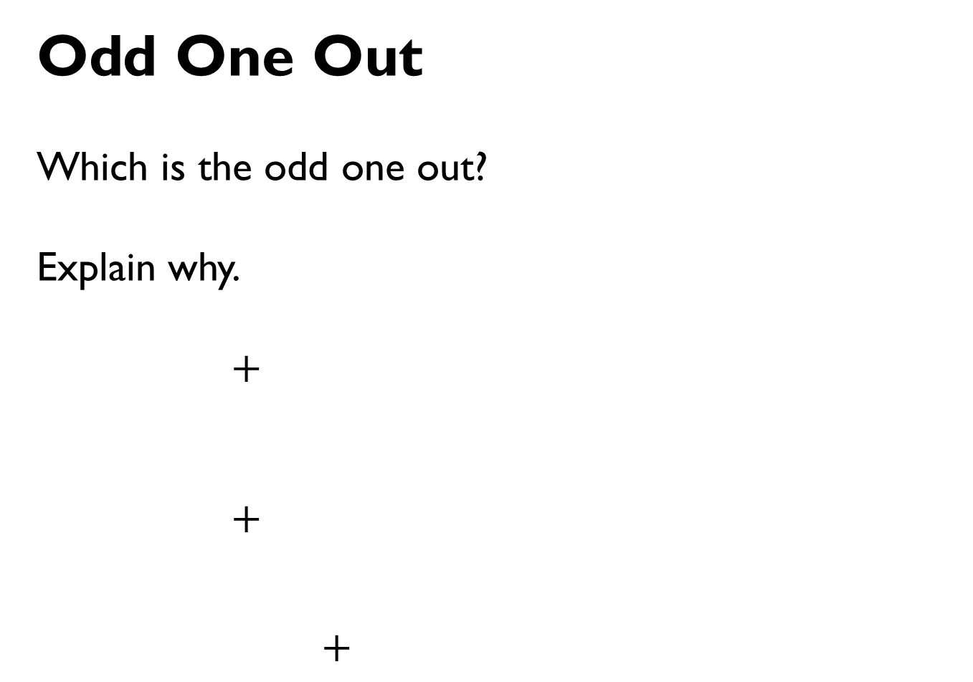
Odd One Out
Which is the odd one out?
Explain why.
$+$
$+$
$+$

Slide 5
Rosie has added or subtracted ones to get this answer.
What could her calculation have been?
Her starting numbers are between and include 340 and 350
Did you use a strategy?
Do you see a pattern?
Hundreds | Tens | Ones

Slide 6
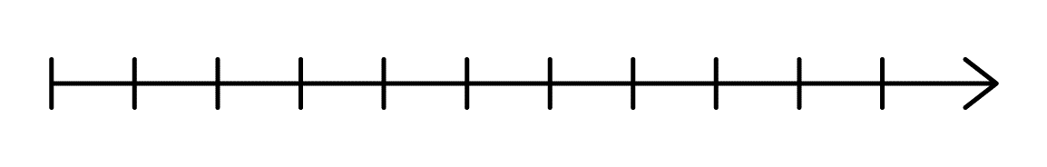


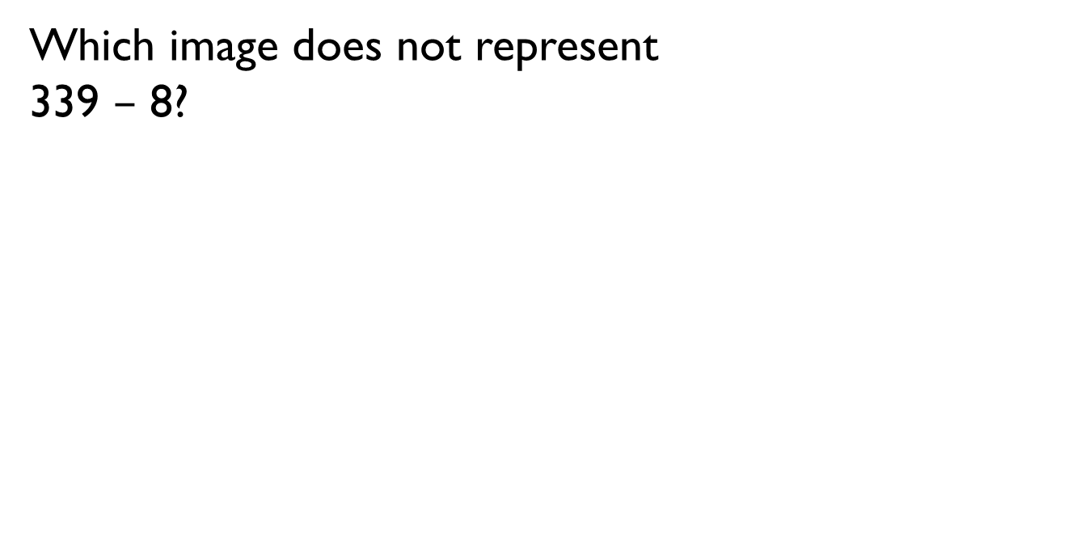
Which image does not represent
339 $–$ 8?
330
340

Slide 7
Alex thinks the chart shows 456 – 4
Do you agree?
Explain why.
Hundreds | Tens | Ones

Slide 8
Always, Sometimes, Never
When 7 and 5 are added together in the ones column, the digit in the ones column of the answer will always be 2
What other digits would always give a 2 in the ones column? Prove it.

Slide 9
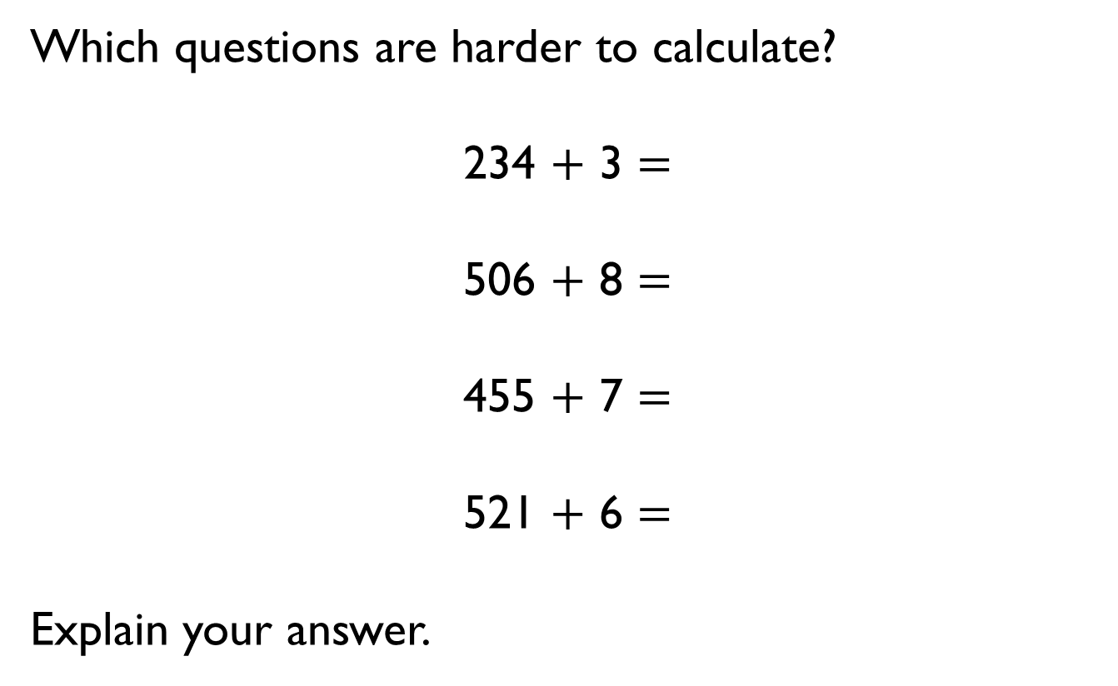
Which questions are harder to calculate?
234 $+$ 3 $=$
506 $+$ 8 $=$
455 $+$ 7 $=$
521 $+$ 6 $=$
Explain your answer.

Slide 10



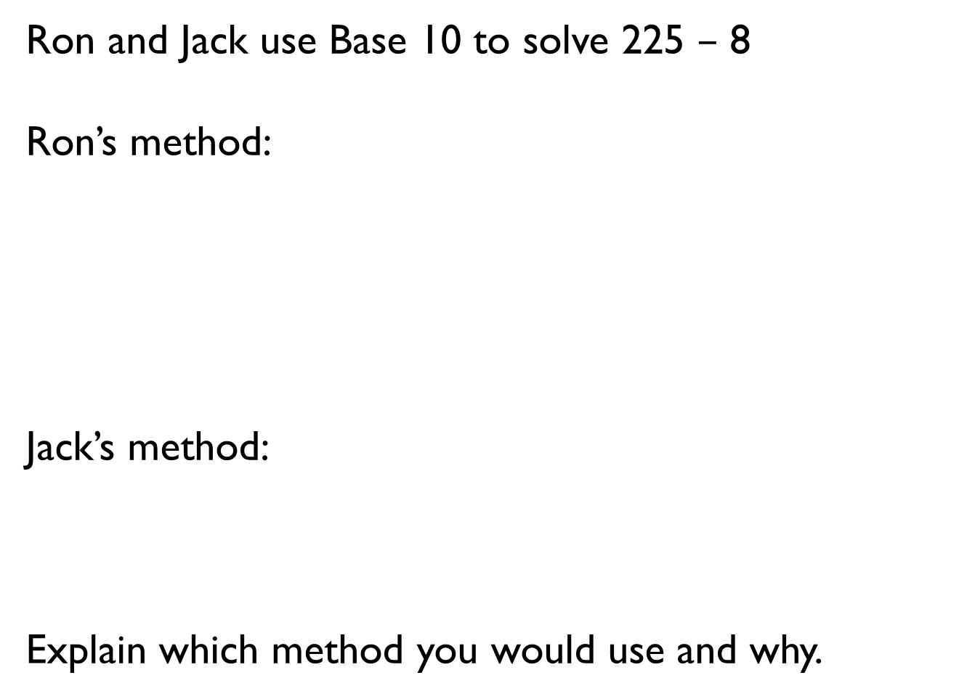
Ron and Jack use Base 10 to solve 225 $–$ 8
Ron’s method:
Jack’s method:
Explain which method you would use and why.

Slide 11
Whitney has 125 stickers.
She gives less than 10 stickers to Eva.
She has an odd number of stickers left.
How many stickers might Whitney have given away?
What do you notice is the same about your answers?
If Whitney had an even number of stickers left, how many might she have given away?

Slide 12
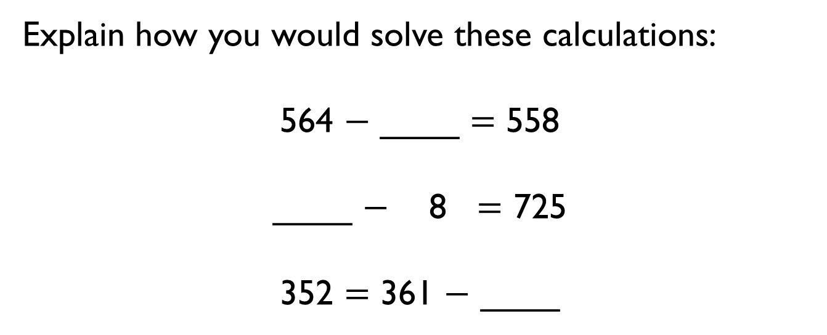
Explain how you would solve these calculations:
564 $−$ ____ $=$ 558
____ $−$ 8 $=$ 725
352 $=$ 361 $−$ ____

Slide 13

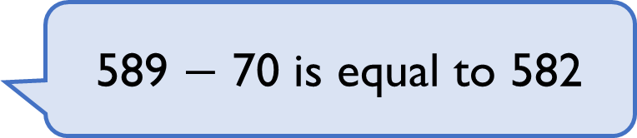
Spot the Mistake
Amir
What should the answer be?
589 $−$ 70 is equal to 582

Slide 14
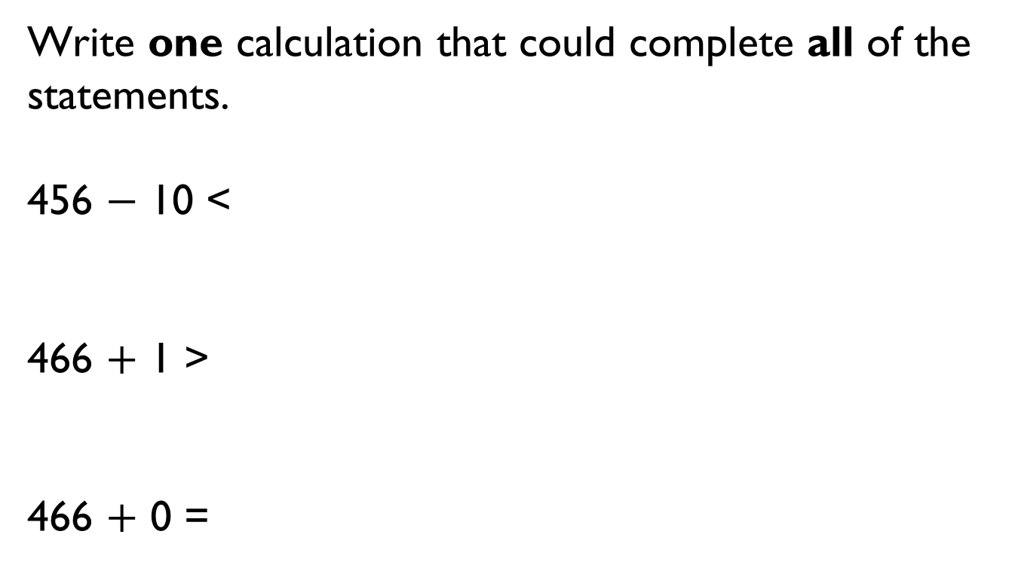
Write one calculation that could complete all of the statements.
456 $−$ 10 <
466 $+$ 1 >
466 $+$ 0 =

Slide 15

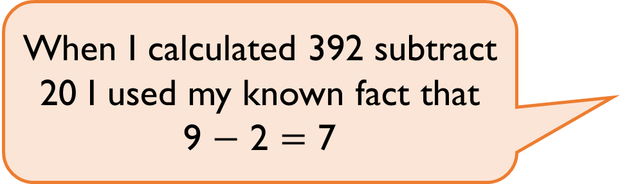
Rosie
Explain Rosie’s method.
When I calculated 392 subtract 20 I used my known fact that
9 $−$ 2 $=$ 7

Slide 16

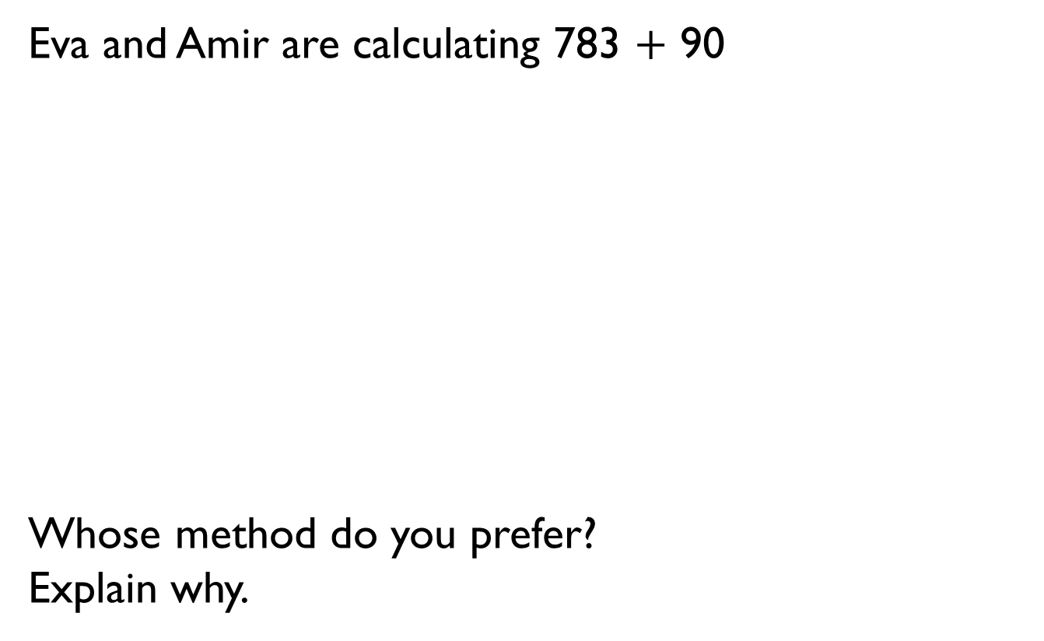
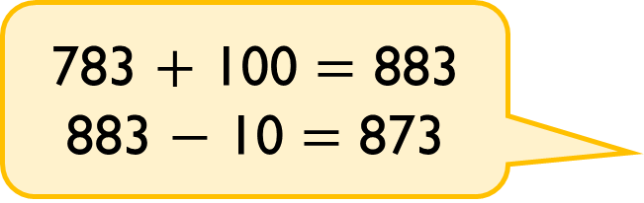
Eva and Amir are calculating 783 $+$ 90
Whose method do you prefer?
Explain why.
793, 803, 813, 823, 833, 843, 853, 863, 873
783 $+$ 100 $=$ 883
883 $−$ 10 $=$ 873

Slide 17
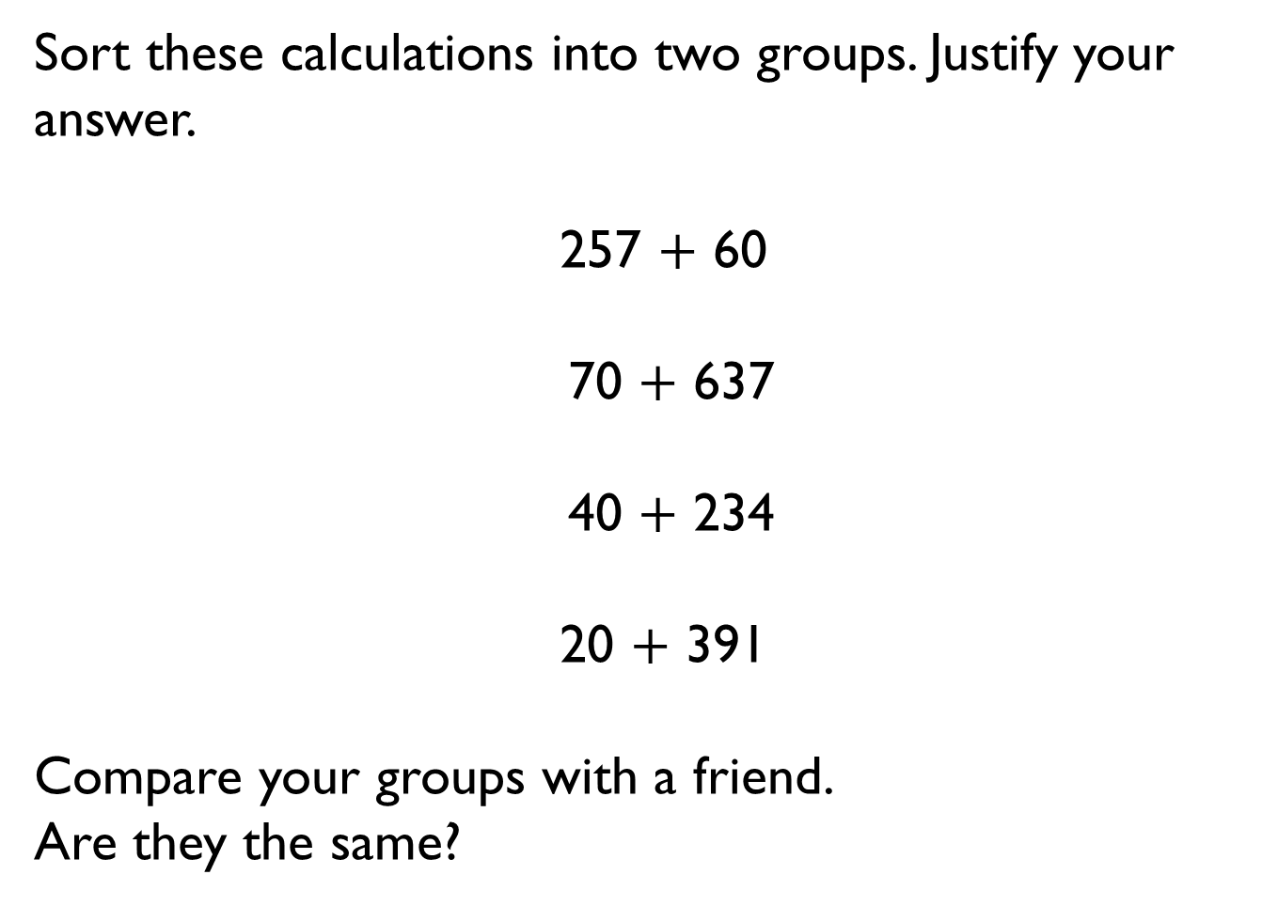
Sort these calculations into two groups. Justify your answer.
257 $+$ 60
70 $+$ 637
40 $+$ 234
20 $+$ 391
Compare your groups with a friend.
Are they the same?

Slide 18
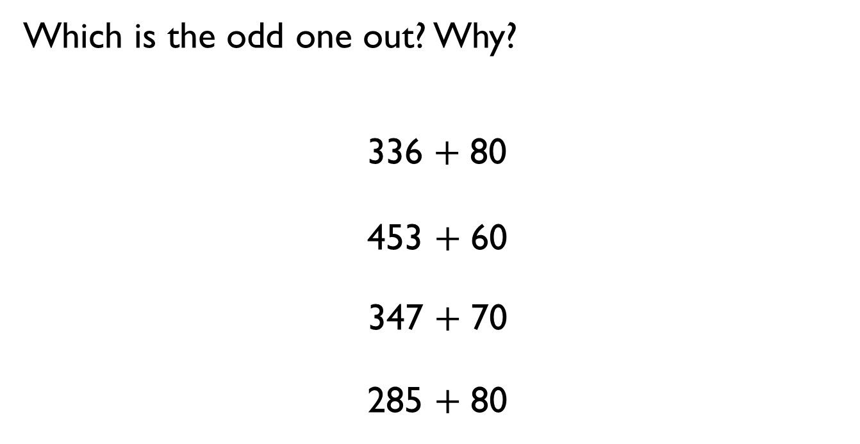
Which is the odd one out? Why?
336 $+$ 80
453 $+$ 60
347 $+$ 70
285 $+$ 80

Slide 19
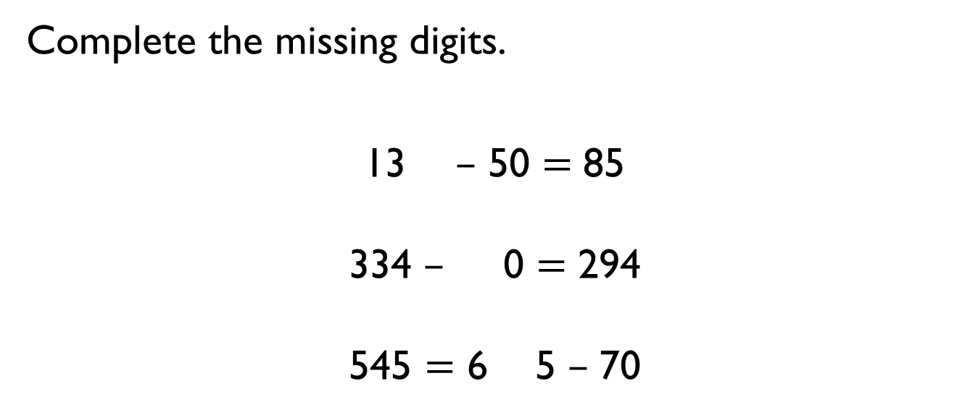
Complete the missing digits.
13 $–$ 50 $=$ 85
334 $–$ 0 $=$ 294
545 $=$ 6 5 $–$ 70

Slide 20
Whitney thinks the rule for the function machine is subtract 60
Is she correct? Explain why.
Input Rule Output
567 ? 497

Slide 21
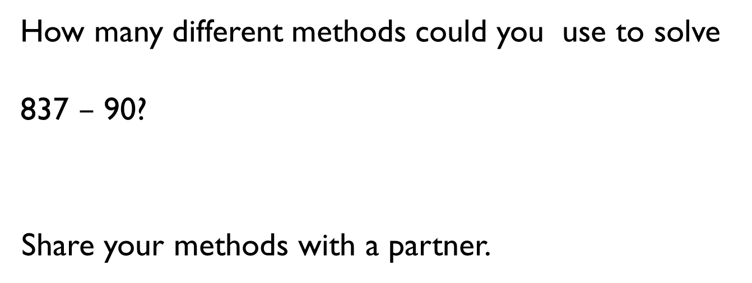
How many different methods could you use to solve
837 $–$ 90?
Share your methods with a partner.

Slide 22

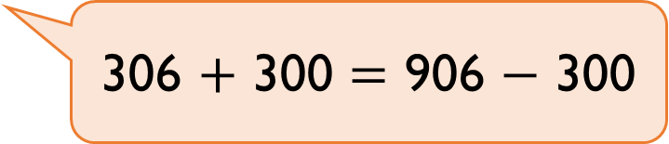
Alex
Is she correct?
Explain how you know.
306 $+$ 300 $=$ 906 $−$ 300

Slide 23
Teddy starts with the number 356
He adds a multiple of 100
His new number is greater than 500 but less than 800
Complete the table.
Numbers he couldn’t have added | Numbers he could have added

Slide 24
Complete the scenarios so they match the bar model.
Ron has ____ altogether.
He spends ______ and has £476 pounds left.
Jack has _______
Eva has £200
They have _____ altogether.
Amir has £200 more than Rosie.
Amir has _______
Rosie has _______
Draw your own bar model where one of the parts is a multiple of 100
Write scenarios to match the bar model.
476 | 200
676

Slide 25
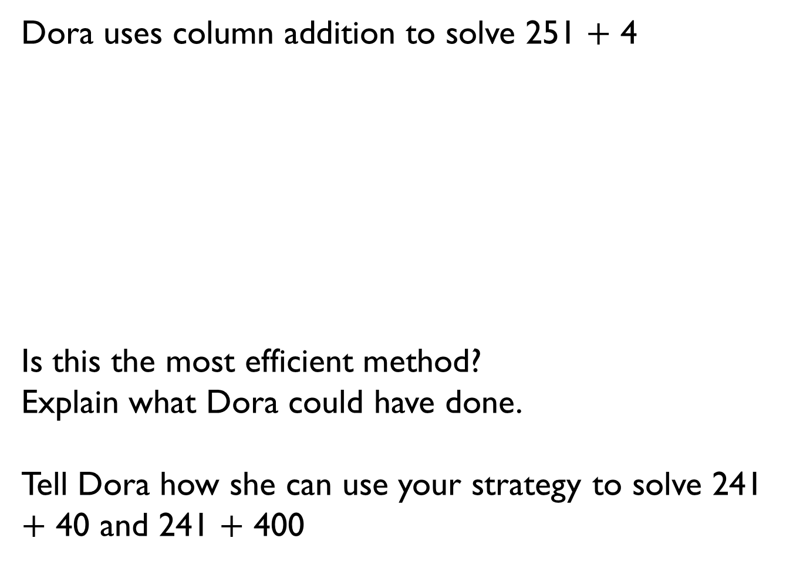
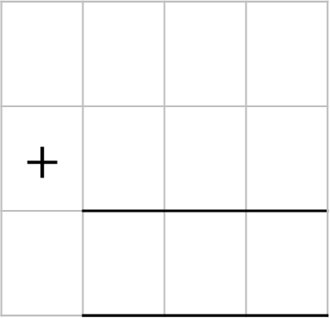
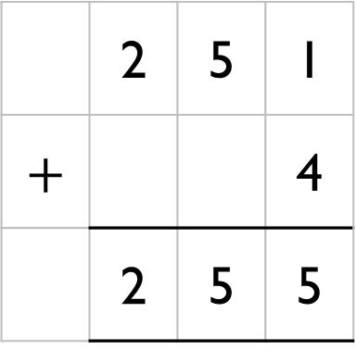
Dora uses column addition to solve 251 $+$ 4
Is this the most efficient method?
Explain what Dora could have done.
Tell Dora how she can use your strategy to solve 241 $+$ 40 and 241 $+$ 400
 | 2 | 5 | 1
$$+$$ |  |  | 4
 | 2 | 5 | 5
$$+$$

Slide 26
Investigate
Does adding and subtracting ones to a 3-digit number only affect the ones column?
Does adding and subtracting tens to a 3-digit number only affect the tens column?

Slide 27
Eva has 169 sweets in a jar.
She gives 37 sweets to Mo.
Which model represents this problem?
169
132
37 | 169
132
37
132
169
37 | 132
37
169

Slide 28
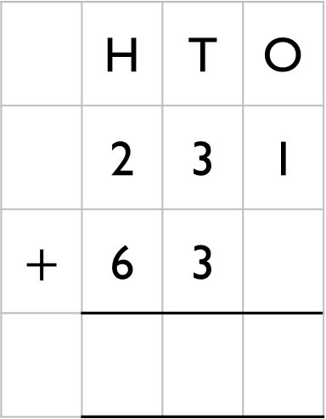
Explain the mistake Jack has made.
 | H | T | O
 | 2 | 3 | 1
$$+$$ | 6 | 3

Slide 29
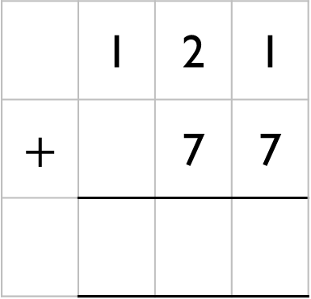
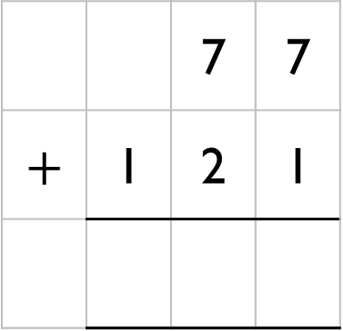
Rosie has 77 sweets.
Mo has 121 sweets.
Which addition will find how many sweets they have altogether?
Explain your answer.
 |  | 7 | 7
$$+$$ | 1 | 2 | 1
 | 1 | 2 | 1
$$+$$ |  | 7 | 7

Slide 30

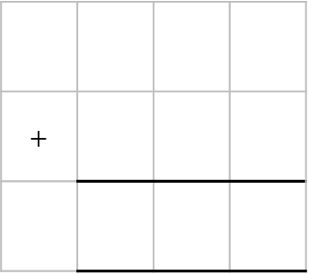
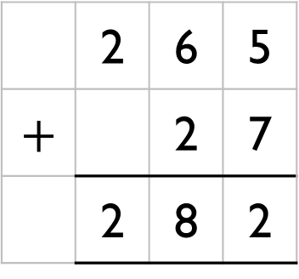
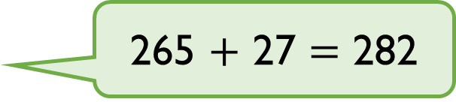
Eva
Here is her working out:
Is she correct? Explain why.
265 $+$ 27 $=$ 282
 | 2 | 6 | 5
$$+$$ |  | 2 | 7
 | 2 | 8 | 2
$$+$$

Slide 31
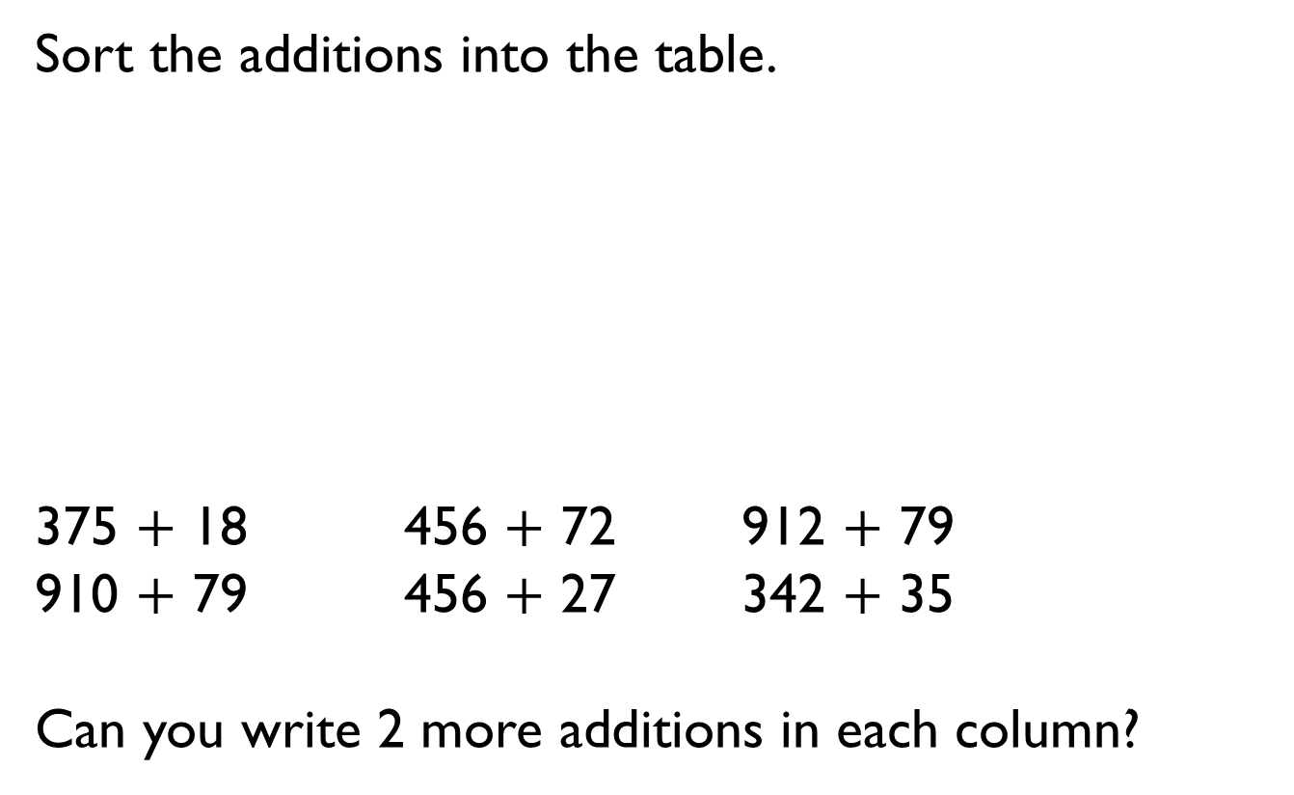
Sort the additions into the table.
375 $+$ 18 456 $+$ 72 912 $+$ 79
910 $+$ 79 456 $+$ 27 342 $+$ 35
Can you write 2 more additions in each column?
No exchange | Exchange 10 ones | Exchange 10 tens

Slide 32
Choose one 2-digit and one 3-digit number.
Write additions that have an exchange in the ones and the tens columns.
23
35
756
767
81
56
487
619

Slide 33
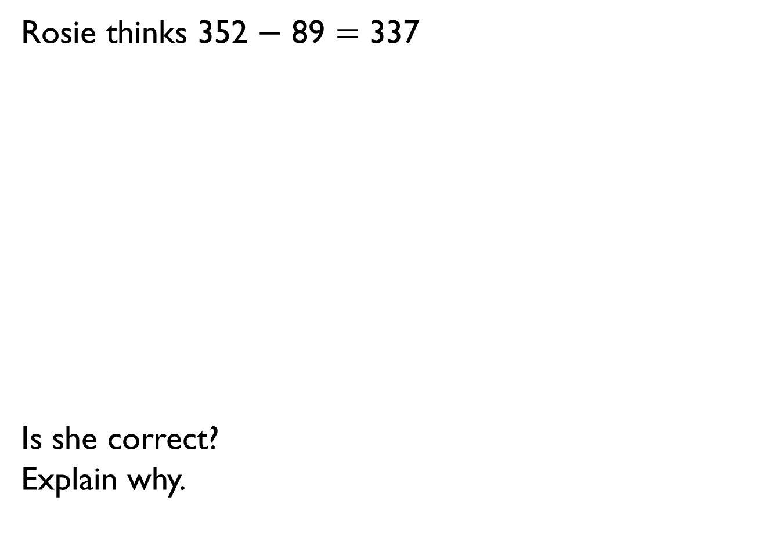
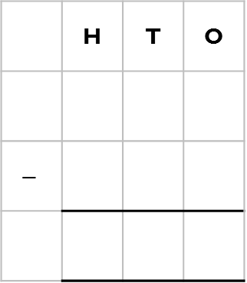
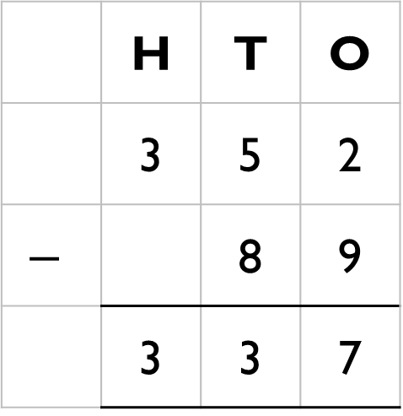
Rosie thinks 352 $−$ 89 $=$ 337
Is she correct?
Explain why.
 | H | T | O
 | 3 | 5 | 2
$$−$$ |  | 8 | 9
 | 3 | 3 | 7
 | H | T | O
$$−$$

Slide 34
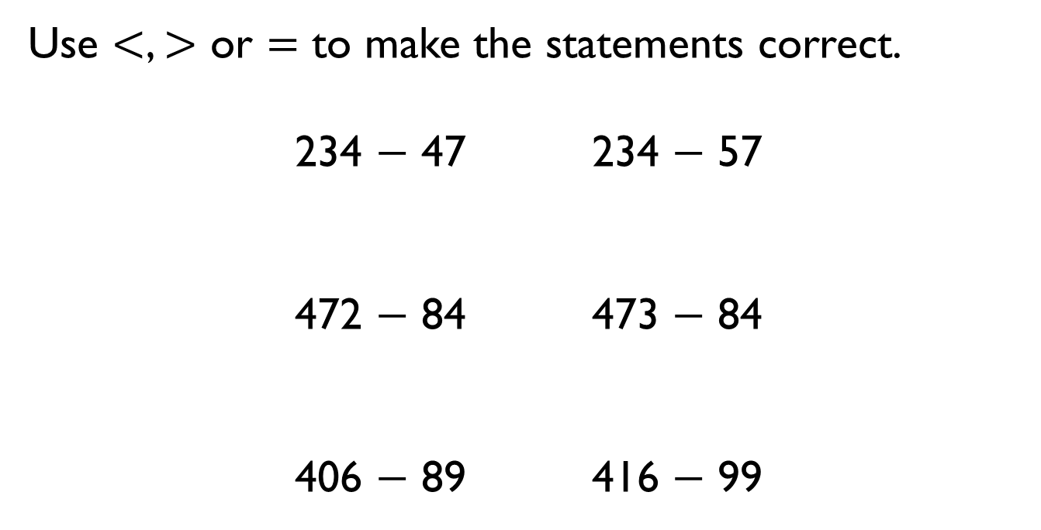
Use $<$, $>$ or $=$ to make the statements correct.
234 $−$ 47 234 $−$ 57
472 $−$ 84 473 $−$ 84
406 $−$ 89 416 $−$ 99

Slide 35



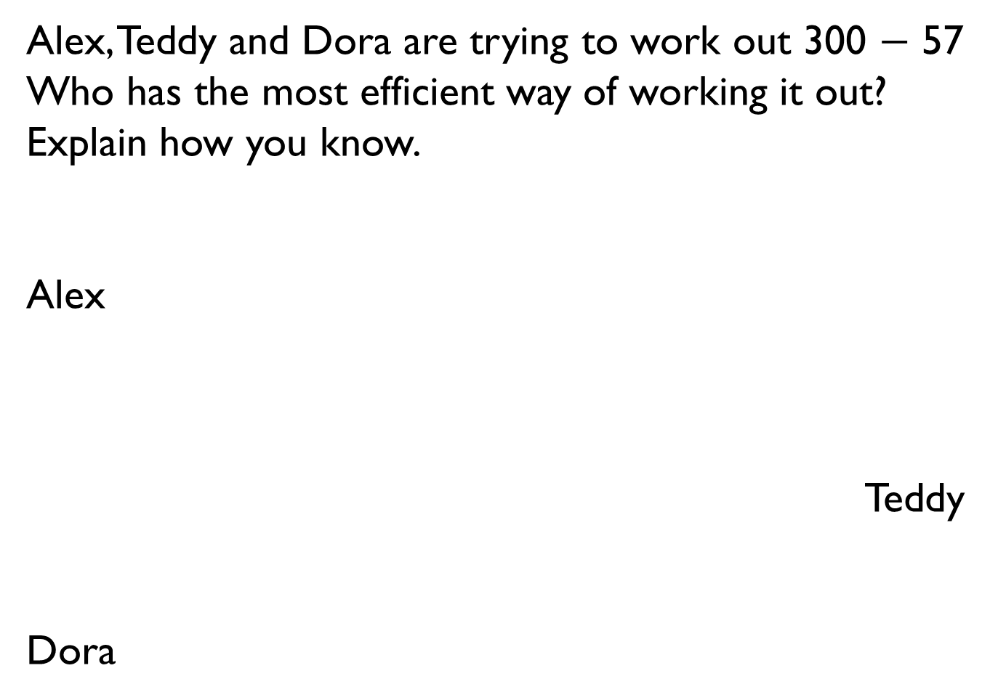
Alex, Teddy and Dora are trying to work out 300 $−$ 57
Who has the most efficient way of working it out?
Explain how you know.
Alex
Teddy
Dora
I know that take away means difference, so I can do 299 take away 56 and get the right answer.
I can count on from 57 to 100, and then count on to 300
I can use the column method to work it out and exchange when I need to.

Slide 36
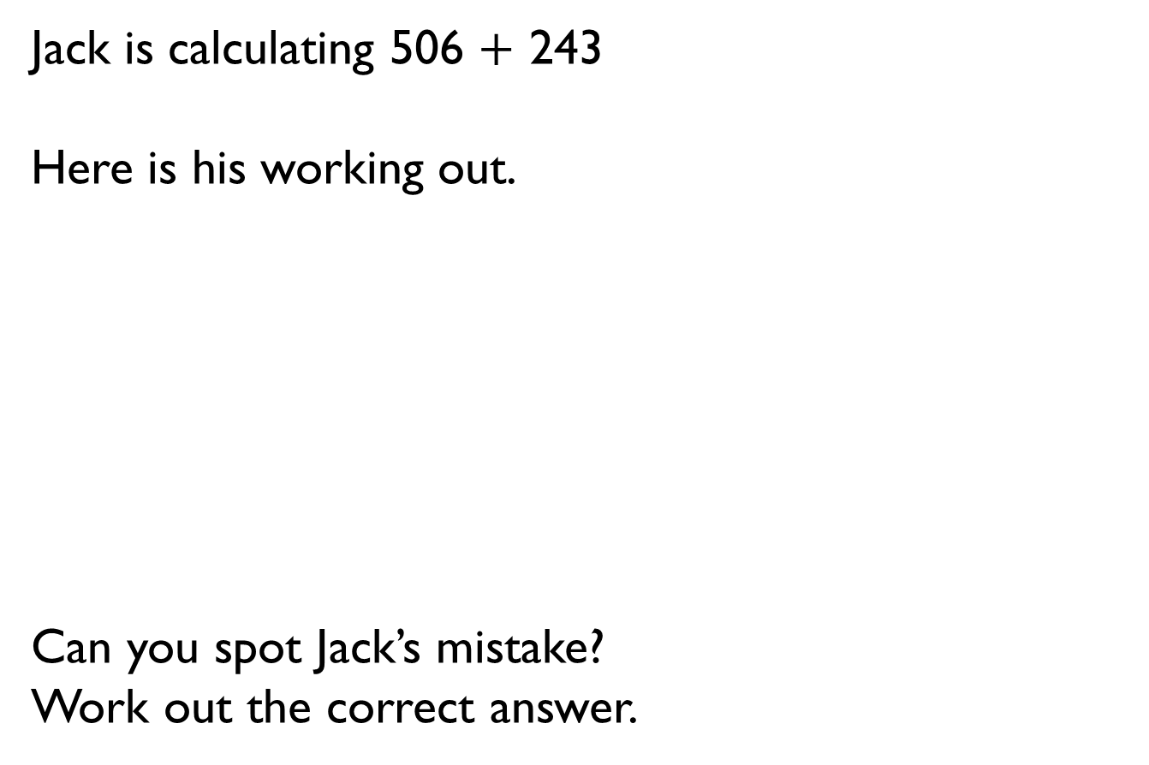
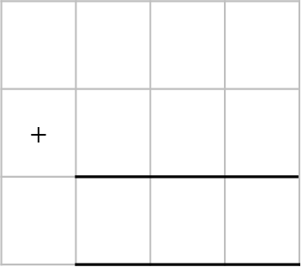
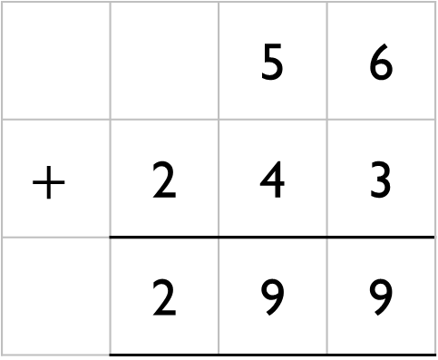
Jack is calculating 506 $+$ 243
Here is his working out.
Can you spot Jack’s mistake?
Work out the correct answer.
 |  | 5 | 6
$$+$$ | 2 | 4 | 3
 | 2 | 9 | 9
$$+$$

Slide 37
Here are three digit cards.
Alex and Teddy are making 3-digit numbers using each card once.
Alex
Teddy
Work out the total of their two numbers.
2
3
4
I have made the greatest possible number.
I have made the smallest possible number.

Slide 38







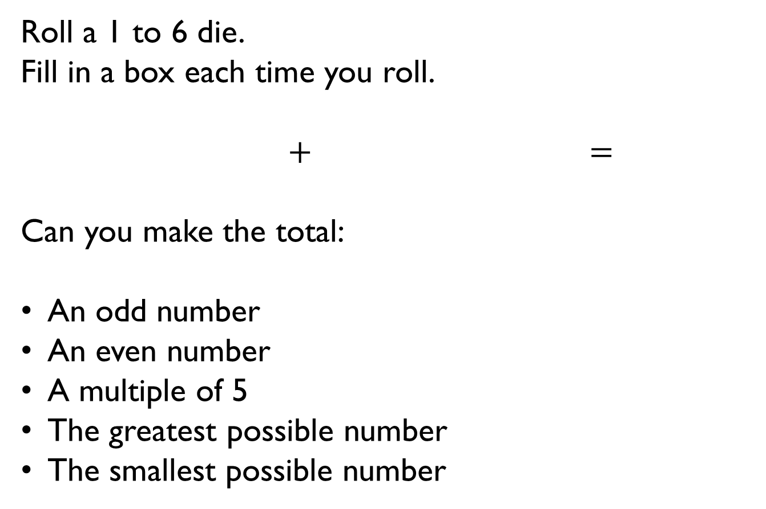
Roll a 1 to 6 die.
Fill in a box each time you roll.
$+$ $=$
Can you make the total:
An odd number
An even number
A multiple of 5
The greatest possible number
The smallest possible number

Slide 39
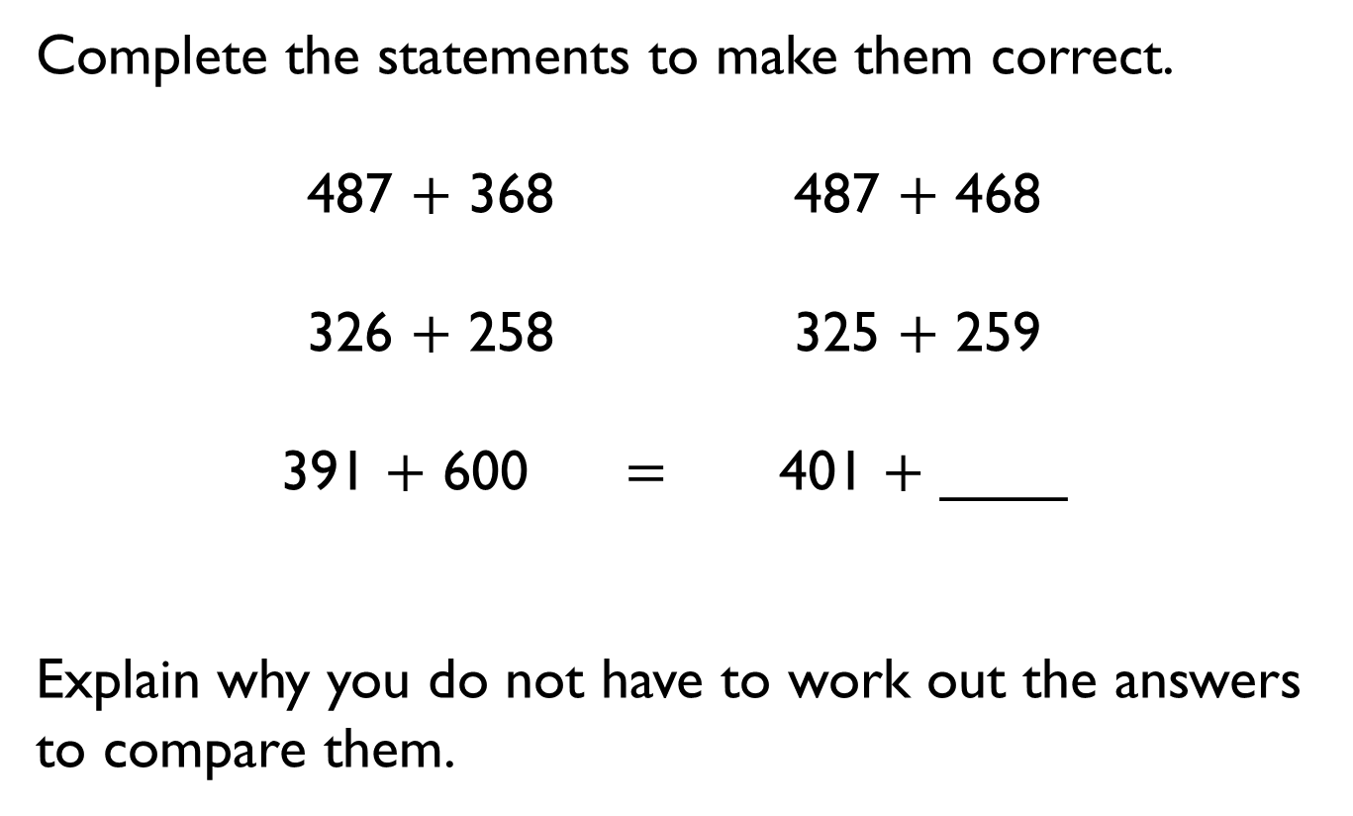
Complete the statements to make them correct.
487 $+$ 368 487 $+$ 468
326 $+$ 258 325 $+$ 259
391 $+$ 600 $=$ 401 $+$ ____
Explain why you do not have to work out the answers to compare them.

Slide 40
Start with the number 888
Roll a 1-6 die three times, to make a 3-digit number.
Subtract the number from 888
What number have you got now?
What’s the smallest possible difference?
What’s the largest possible difference?
What if all the digits have to be different?
Will you ever find a difference that is a multiple of 10? Why?
Do you have more odd or even differences?

Slide 41
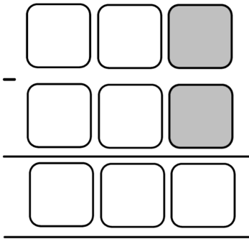
Use the digit cards to complete the calculation.
The digits in the shaded boxes are odd.
Is there more than one answer?
0
3
4
4
6
7
7
8
9

Slide 42
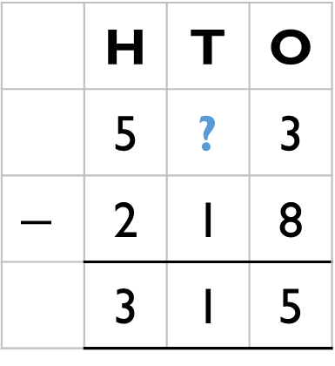
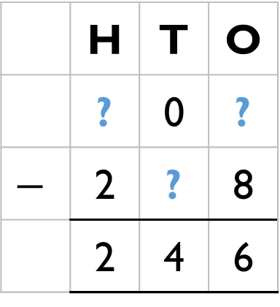
Work out the missing digits.
 | H | T | O
 | 5 | ? | 3
$$−$$ | 2 | 1 | 8
 | 3 | 1 | 5
 | H | T | O
 | ? | 0 | ?
$$−$$ | 2 | ? | 8
 | 2 | 4 | 6

Slide 43
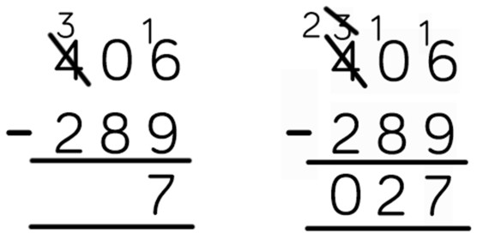
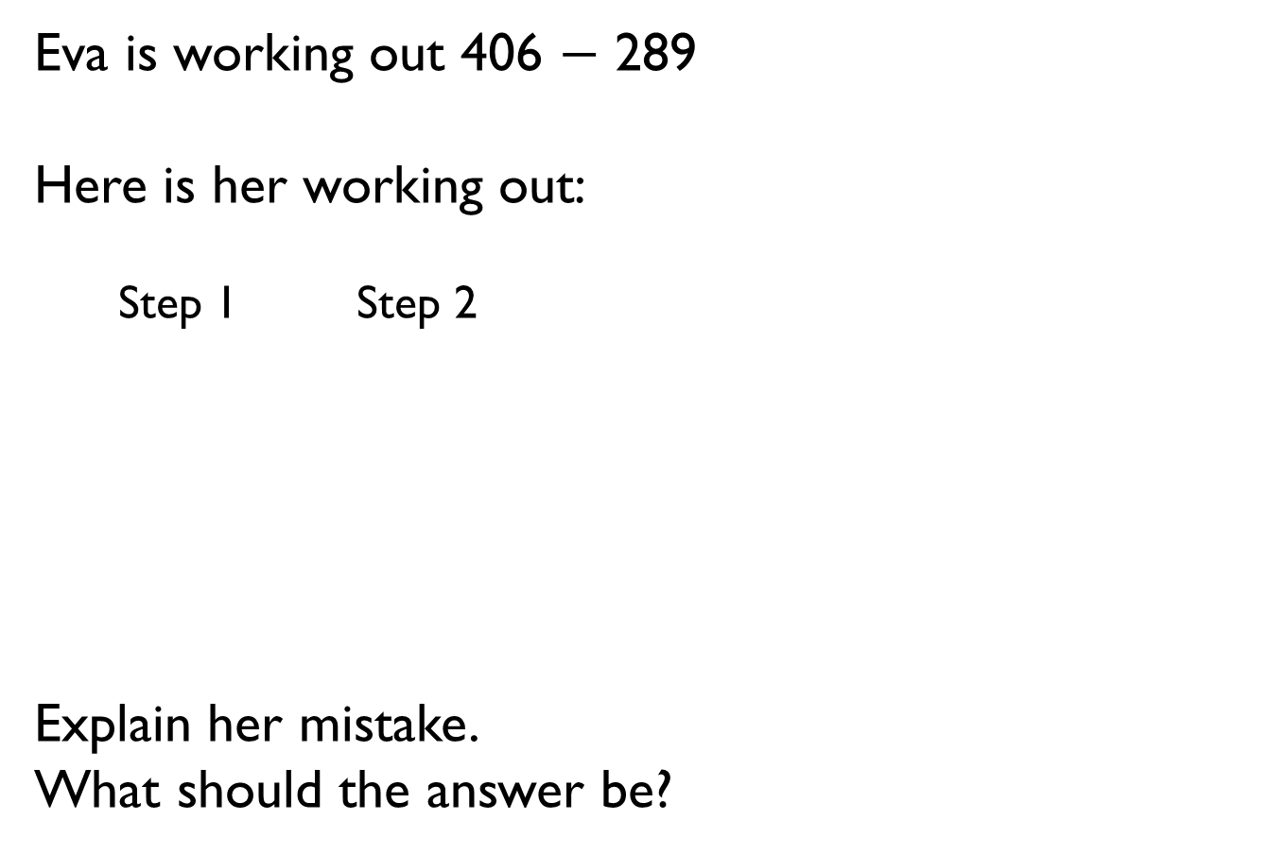
Eva is working out 406 $−$ 289
Here is her working out:
Step 1 Step 2
Explain her mistake.
What should the answer be?

Slide 44

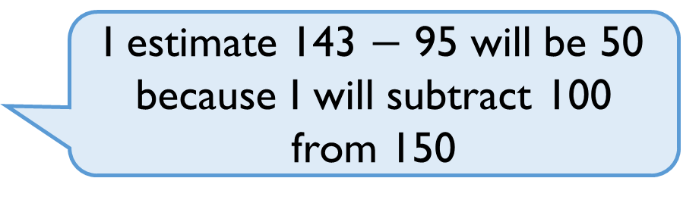
Tommy
Is this a good estimate? Why?
Are there any other ways he could have estimated?
I estimate 143 $−$ 95 will be 50 because I will subtract 100 from 150

Slide 45
Use the number cards to make different calculations with an estimated answer of 70
121
33
48
41
398
328
255

Slide 46

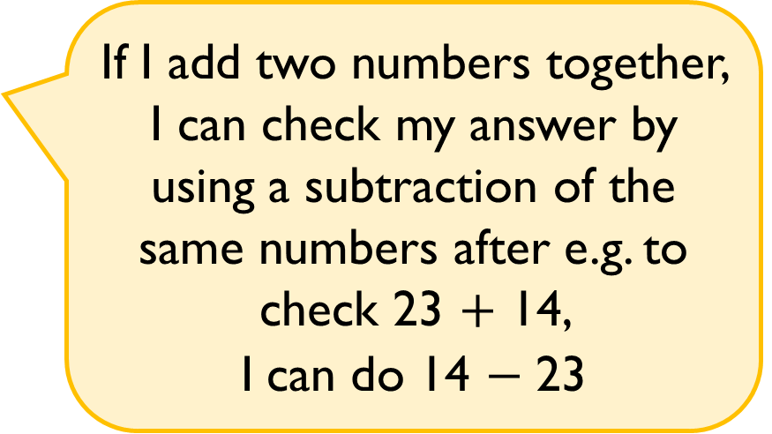
Mo
Do you agree? Explain why.
If I add two numbers together, I can check my answer by using a subtraction of the same numbers after e.g. to check 23 $+$ 14,
I can do 14 $−$ 23

Slide 47
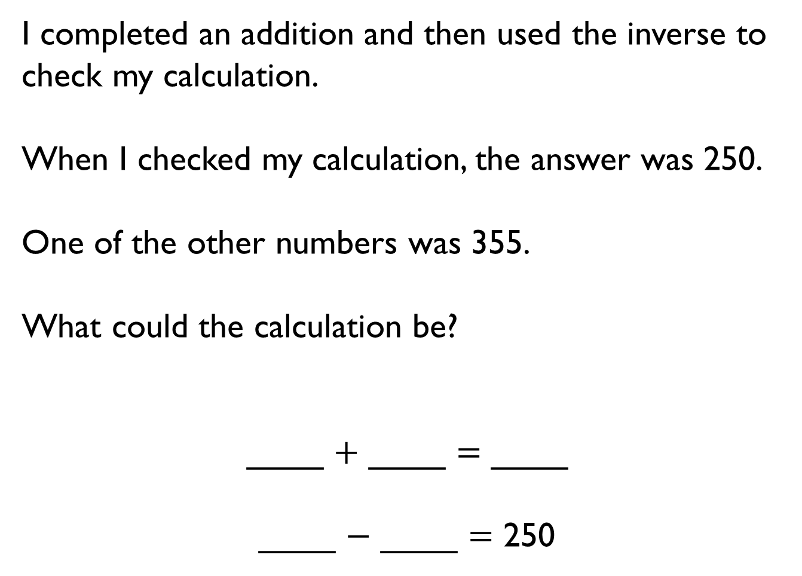
I completed an addition and then used the inverse to check my calculation.
When I checked my calculation, the answer was 250.
One of the other numbers was 355.
What could the calculation be?
____ $+$ ____ $=$ ____
____ $−$ ____ $=$ 250

