Slide 1




Year 2- Autumn - Block 1
Place Value

Slide 2





Jack says he has 61
Is he correct?
Explain your reasoning.

Slide 3


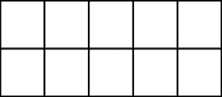
Here are two sets of objects.
Which are easier to count?
Explain your answer.

Slide 4


Each jar contains 10 cookies.
How many cookies are there altogether?
Write your answer in numerals and words.
What strategy did you use?
Did your partner use a different method?
What is the best strategy to use?
10
10
10
10

Slide 5
Where would 36 go on each of the number lines?
0
100
0
40
30
40

Slide 6








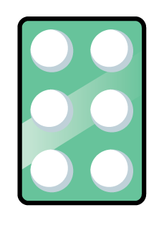



One of these images does not show 23
Can you explain the mistake?
A
B
C

Slide 7



How many two digit numbers can you
make using the digit cards?
What is the largest number?
Prove it by using concrete resources.
What is the smallest number?
Prove it by using concrete resources.
Why can’t the 0 be used as a tens number?
7
0
2

Slide 8
Complete each part-whole model in a different way.
6 tens
and
4 ones
64
64

Slide 9
Complete the extended part-whole model.
76
?
?
30
10

Slide 10

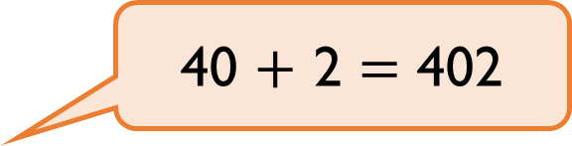
Teddy thinks that,
Explain the mistake he has made.
Can you show the correct answer using
concrete resources?
40 $+$ 2 $=$ 402

Slide 11
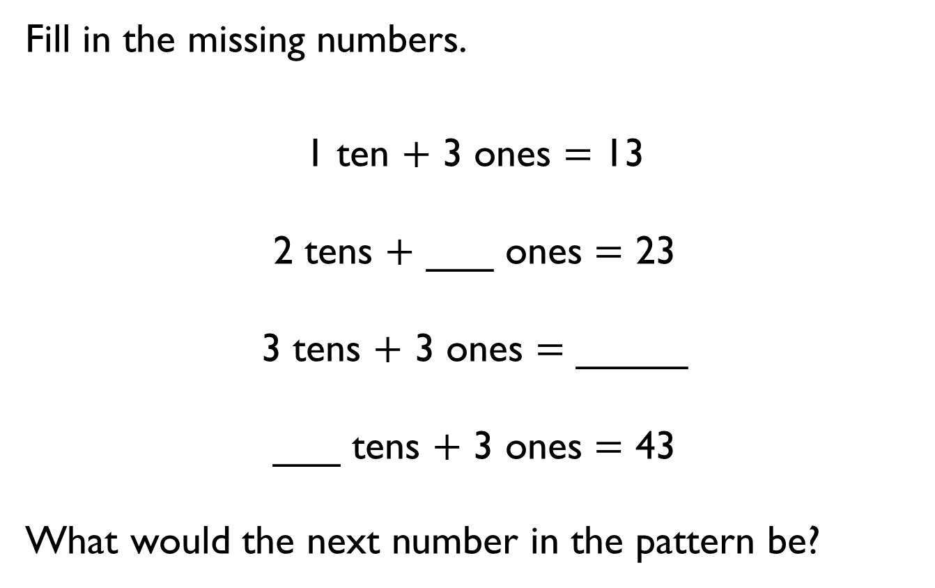
Fill in the missing numbers.
1 ten $+$ 3 ones $=$ 13
2 tens $+$ ___ ones $=$ 23
3 tens $+$ 3 ones $=$ _____
___ tens $+$ 3 ones $=$ 43
What would the next number in the pattern be?

Slide 12
How many two digit numbers can you make that have the same number of tens and ones?
Show each one on a place value chart.
Tens | Ones

Slide 13
Do both place value charts show the same value?
What is the same?
What is different?
A
Tens | Ones
B
Tens | Ones

Slide 14

Rosie and Amir are comparing numbers they have made.
Is Rosie correct?
Explain your answer.
My number is greater because I have more objects.

Slide 15


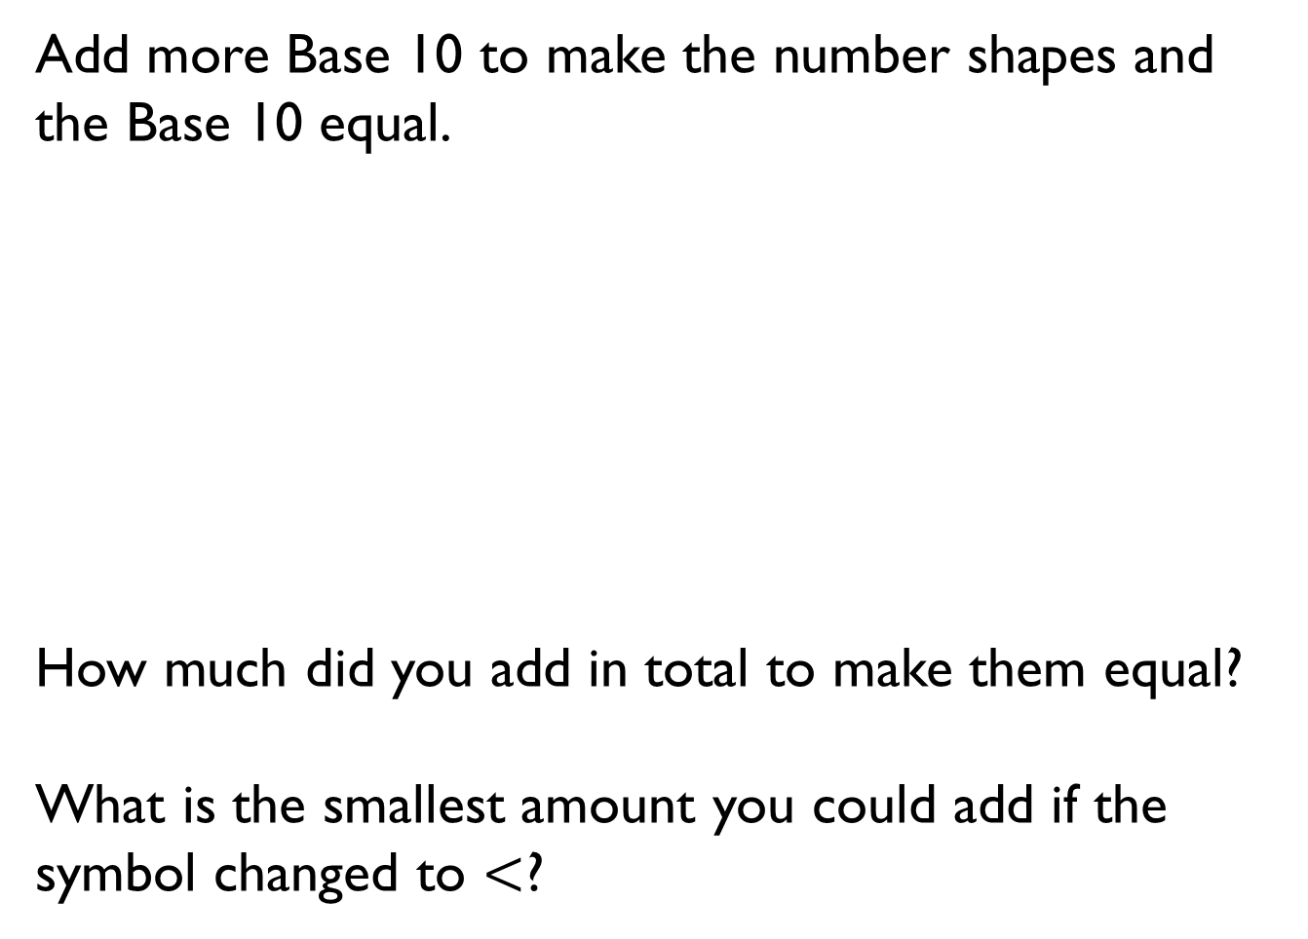
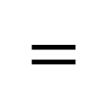
Add more Base 10 to make the number shapes and the Base 10 equal.
How much did you add in total to make them equal?
What is the smallest amount you could add if the symbol changed to $<$?
$$=$$

Slide 16
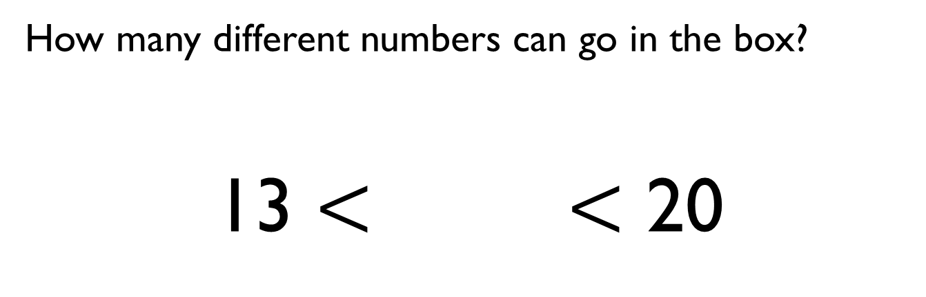
How many different numbers can go in the box?
13 $<$ $<$ 20

Slide 17
True or False?
One ten and twelve ones is bigger than 2 tens.
Explain how you know.

Slide 18

Eva says,
Do you agree?
Give some examples to support your answer.
When comparing numbers, the number with the highest number of ones is always the bigger number.

Slide 19
Order the numbers below.
Which would be the fourth number?
Explain how you ordered them.
33
53
37
29
34
43

Slide 20

Mo has written a list of 2-digit numbers.
Can you find all the numbers Mo could have written?
Write the numbers in order from smallest to largest.
What strategy did you use?
The digits of each number add up to five.
None of the digits are zero.

Slide 21
Eva says,
Do you agree with Eva?
Prove it.
If you count in 5s from any number in the five times table, your numbers will end in 5 or 0

Slide 22
Always, Sometimes, Never
When counting in 2s from zero the numbers are even.
When counting in 5s from zero the numbers are even.
When counting in 10s from zero the numbers are even.

Slide 23

True or False?
Explain your answer.
I start at 0 and count in 3s
I say the number 14

Slide 24
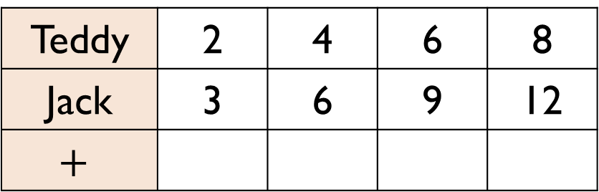
Teddy is counting in 2s and Jack is counting in 3s.
Teddy says,
What pattern do they make?
What happens if both Teddy and Jack count in 5s and they add them together to make a new pattern?
Teddy | 2 | 4 | 6 | 8
Jack | 3 | 6 | 9 | 12
$$+$$
If we add our numbers together as we count we can make a new number pattern.

