Slide 1




Year 2 - Autumn - Block 2
Addition & Subtraction

Slide 2


Here is an incomplete bar model.
The total is greater than 10 but less than 20
What could the missing numbers be?
How many different combinations can you find?
4

Slide 3
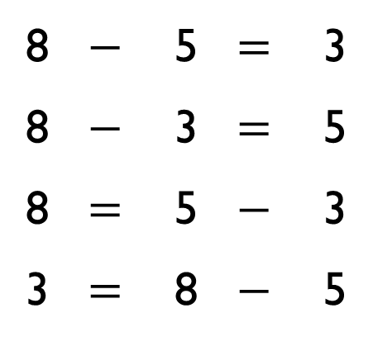

Rosie says,
Ron disagrees.
Who is correct? Can you prove it?
8 | $$−$$ | 5 | $$=$$ | 3
8 | $$−$$ | 3 | $$=$$ | 5
8 | $$=$$ | 5 | $$−$$ | 3
3 | $$=$$ | 8 | $$−$$ | 5
I think that all of these facts are correct because the numbers are related

Slide 4
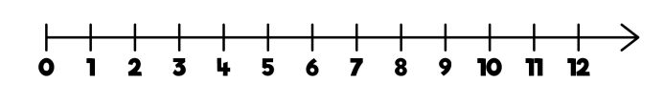
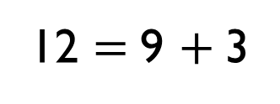
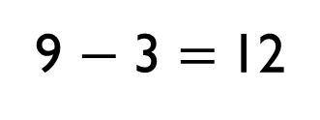
Which of the representations are equivalent to the bar model?
12
3 | 9
12 $=$ 9 $+$ 3
There are 9 cars in a car park, 3 cars leave.
9 − 3 $=$ 12
− 3

Slide 5
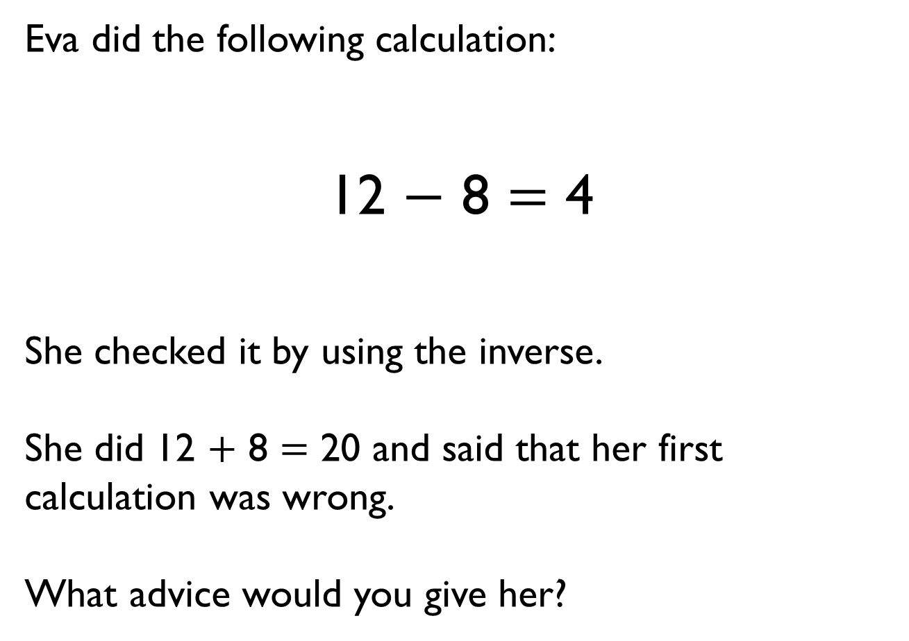
Eva did the following calculation:
12 $−$ 8 $=$ 4
She checked it by using the inverse.
She did 12 $+$ 8 $=$ 20 and said that her first calculation was wrong.
What advice would you give her?

Slide 6

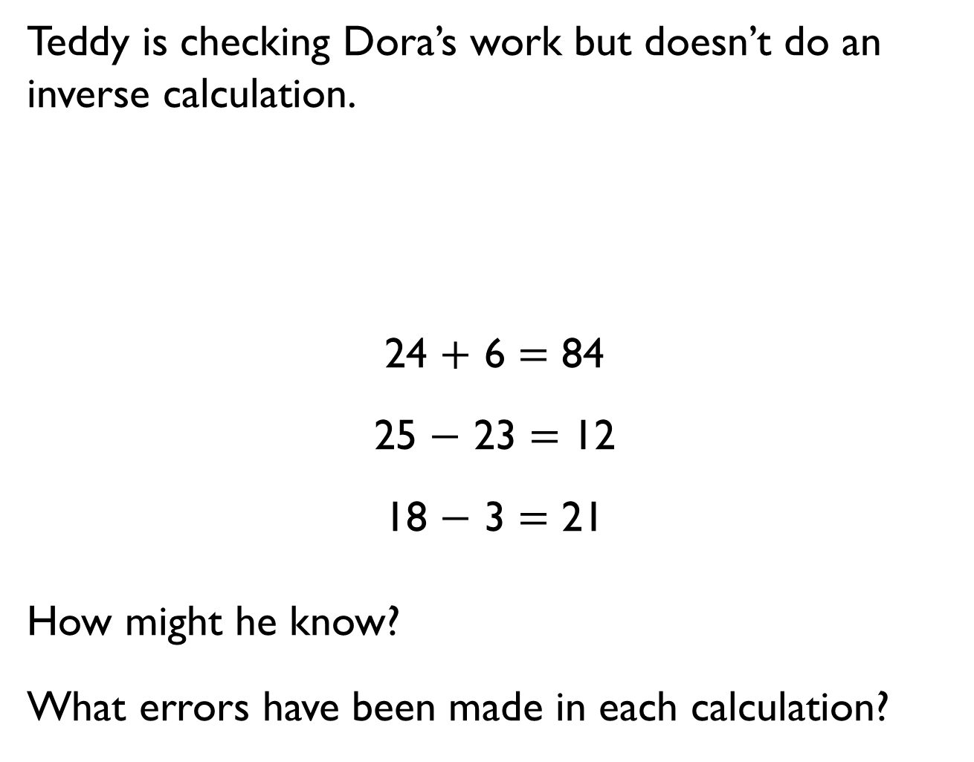
Teddy is checking Dora’s work but doesn’t do an inverse calculation.
24 $+$ 6 $=$ 84
25 $−$ 23 $=$ 12
18 $−$ 3 $=$ 21
How might he know?
What errors have been made in each calculation?
These calculations can’t be right.

Slide 7
Rosie thinks she knows the missing number without calculating the answer.
Can you explain how this could be possible?
15
17
8
7
8
?

Slide 8
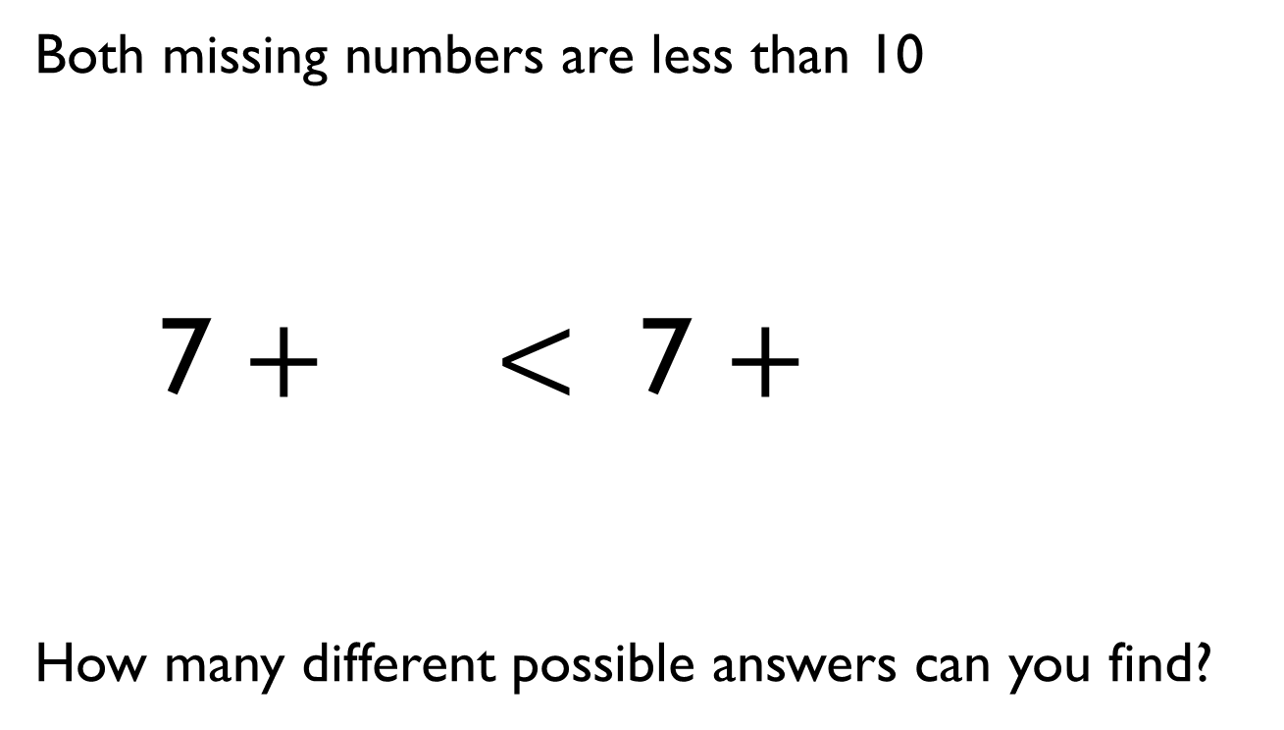
Both missing numbers are less than 10
7 $+$ $<$ 7 $+$
How many different possible answers can you find?

Slide 9
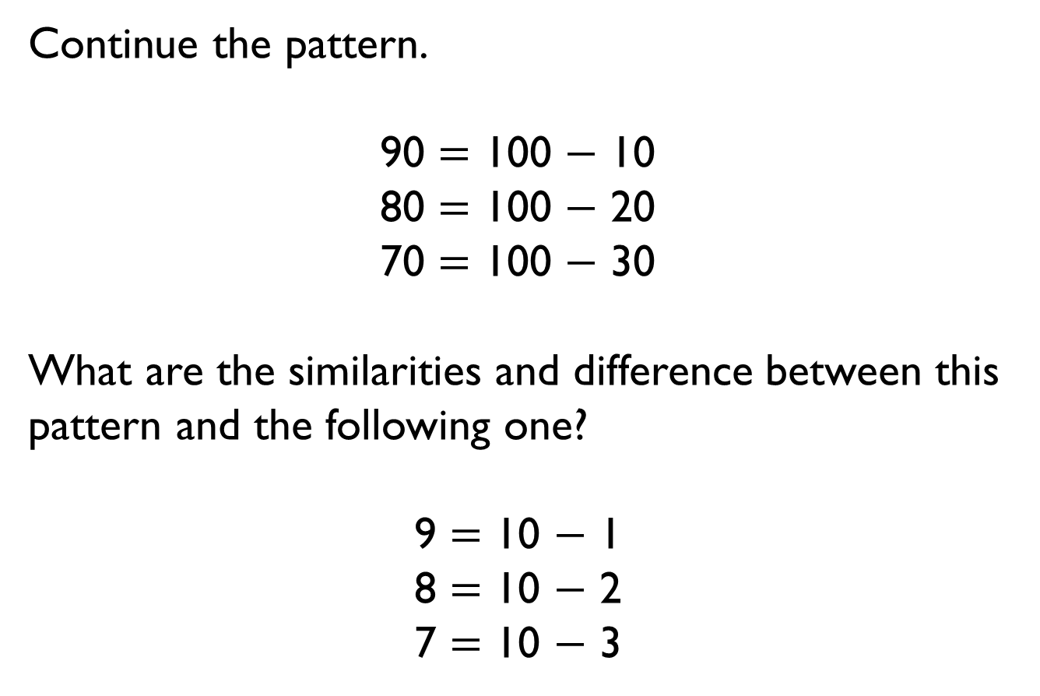
Continue the pattern.
90 $=$ 100 $−$ 10
80 $=$ 100 $−$ 20
70 $=$ 100 $−$ 30
What are the similarities and difference between this pattern and the following one?
9 $=$ 10 $−$ 1
8 $=$ 10 $−$ 2
7 $=$ 10 $−$ 3

Slide 10

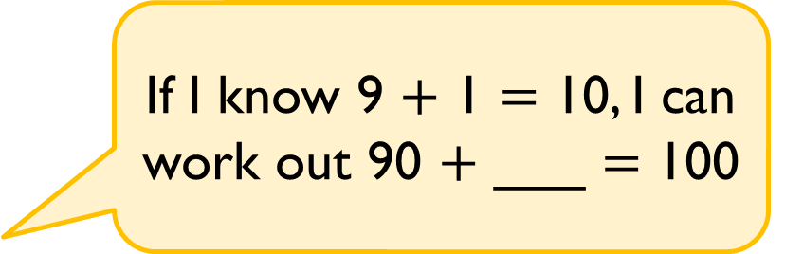
Alex says,
Find the missing number and explain how Alex knows.
If I know 9 $+$ 1 $=$ 10, I can work out 90 $+$ ___ $=$ 100

Slide 11
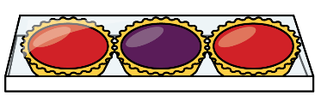
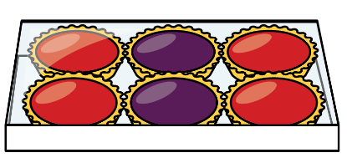
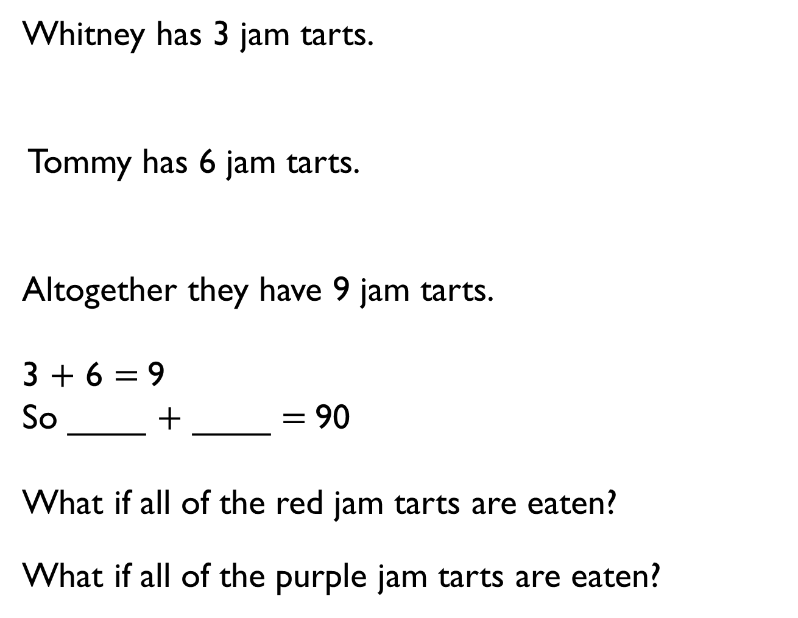
Whitney has 3 jam tarts.
Tommy has 6 jam tarts.
Altogether they have 9 jam tarts.
3 $+$ 6 $=$9
So ____ $+$ ____ $=$90
What if all of the red jam tarts are eaten?
What if all of the purple jam tarts are eaten?

Slide 12


Eva thinks,
Amir thinks,
Who is correct?
Can you help the person who is wrong to understand their mistake?
There are 10 different number bonds to 90 using multiples of 10
There are only 5

Slide 13
Using multiples of 10, how many number bonds are there for the following numbers?
20 30 40 50
What do you notice about the amount of bonds for each number?
If 80 has 5 bonds, predict how many 90 would have.

Slide 14
Squares are worth 10
Triangles are worth 20
Circles are worth 30
Can you complete the grid above so that all horizontal and vertical lines equal 60?
Can you create another pattern on an empty grid where each line equals 60?
How many possible ways are there to solve this?

Slide 15
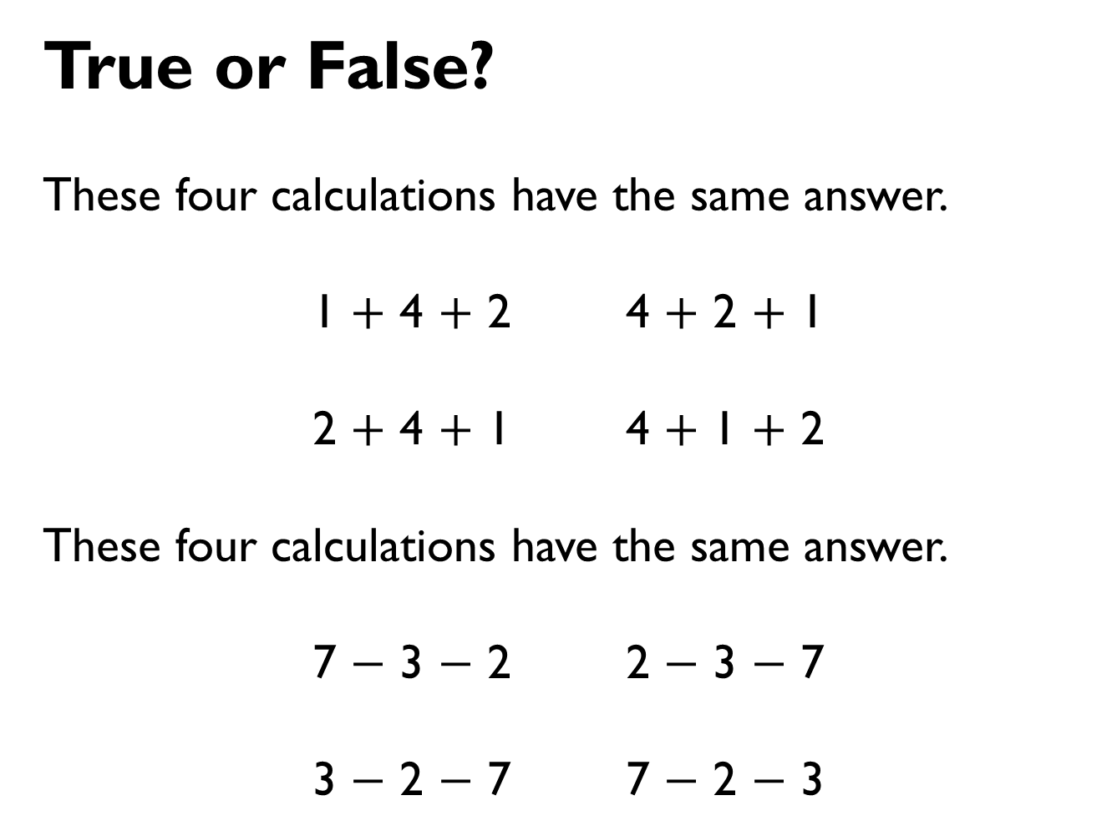
True or False?
These four calculations have the same answer.
1 $+$ 4 $+$ 2 4 $+$ 2 $+$ 1
2 $+$ 4 $+$ 1 4 $+$ 1 $+$ 2
These four calculations have the same answer.
7 $−$ 3 $−$ 2 2 $−$ 3 $−$ 7
3 $−$ 2 $−$ 7 7 $−$ 2 $−$ 3

Slide 16

Jack lives 5 km from school.
Annie lives 4 km from school in the same direction.
What is the distance between Jack and Annie’s houses?
After travelling to and from school, Jack thinks that he will walk 1 km more than Annie. Is he correct?
Explain your answer.
What will be the
difference in distance
walked after 2 school
days?
Jack’s house
Annie’s house

Slide 17










SALE
The cost of each piece of fruit is reduced by 10 p.
What are the new prices?
35 p
22 p
68 p
15 p

Slide 18

Mo says,
Is he correct?
Explain your reasoning.
I know that 10 more than 72 is 82 because I only have to look at the tens digit.

Slide 19
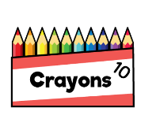

Class 3 gives one of their full packets of crayons away.
How many crayons do they have left?
Explain your reasoning.

Slide 20

Rosie is counting backwards in 10s.
She says,
and then stops.
What numbers comes next and why?
Forty-nine, thirty-nine, twenty-nine

Slide 21
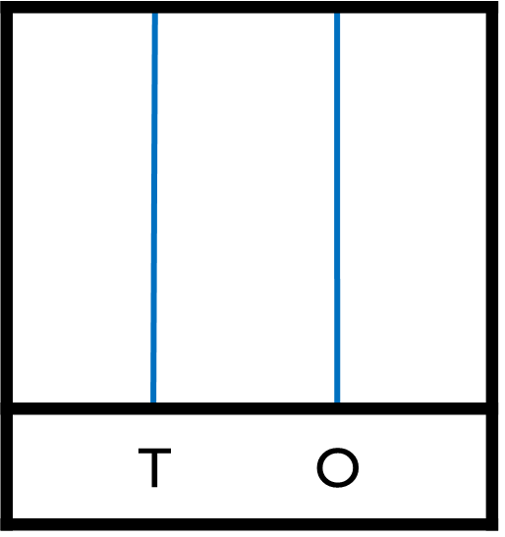
Tommy has three spare red beads.
What numbers could he make?
Explain your answer.

Slide 22
Here are Class 2’s crayons.
They are given a new box of 10 each day for a week.
How many crayons do they have at the end of the week?

Slide 23
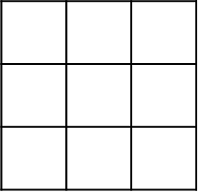
Circles represent 20
Triangles represent 10
Squares represent 50
What is the value of each row and column?

Slide 24
Always, Sometimes, Never
Explain your answer.
I am thinking of a two- digit number, if I add ones to it, I will only need to change the ones digit.

Slide 25
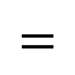

Here are three digit cards.
Place the digit cards in the number sentence.
How many different totals can you find?
What is the smallest total?
What is the largest total?
8
6
7
$$+$$
$$=$$

Slide 26

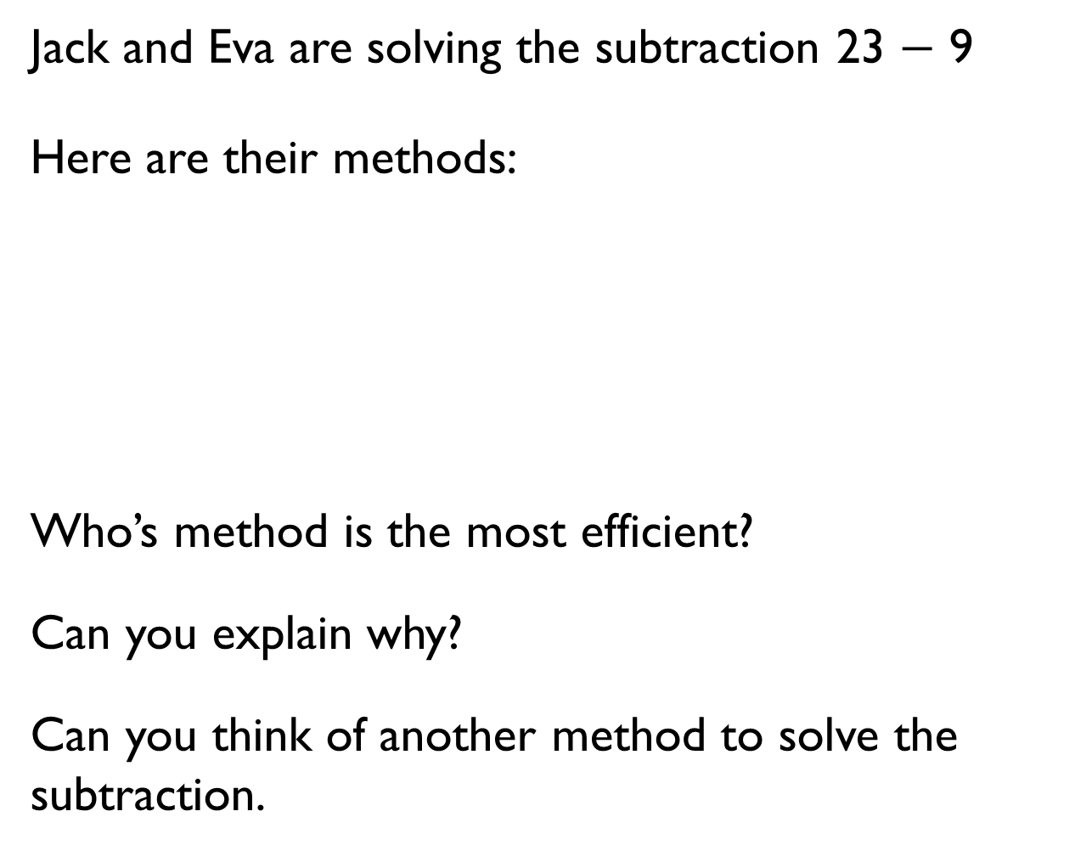
Jack and Eva are solving the subtraction 23 $−$ 9
Here are their methods:
Who’s method is the most efficient?
Can you explain why?
Can you think of another method to solve the subtraction.
I put 9 in my head and counted on to 23
I put 23 in my head and counted back 9

Slide 27
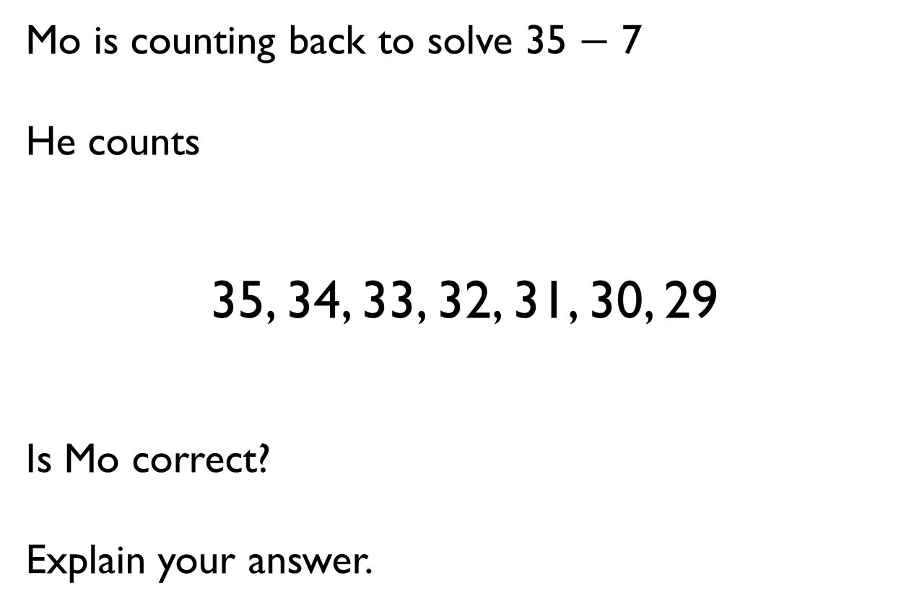
Mo is counting back to solve 35 $−$ 7
He counts
35, 34, 33, 32, 31, 30, 29
Is Mo correct?
Explain your answer.

Slide 28
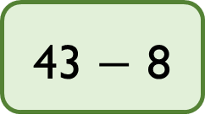
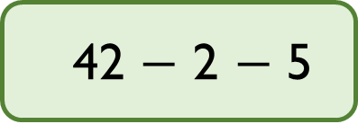
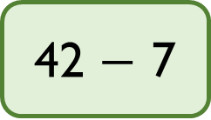
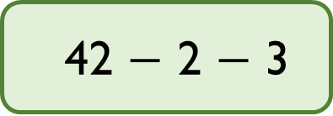
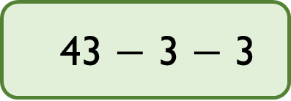
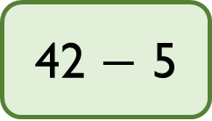
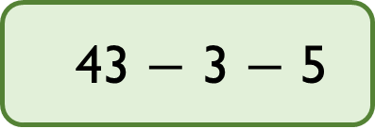
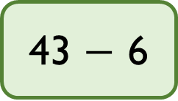
Match the number sentences to the number bonds that make the method more efficient.
42 $−$ 5
42 $−$ 2 $−$ 3
42 $−$ 7
43 $−$ 3 $−$ 3
43 $−$ 8
43 $−$ 3 $−$ 5
43 $−$ 6
42 $−$ 2 $−$ 5

Slide 29

Annie has 12 marbles.
Ron has 13 marbles more than Annie.
How many marbles do they have altogether?

Slide 30

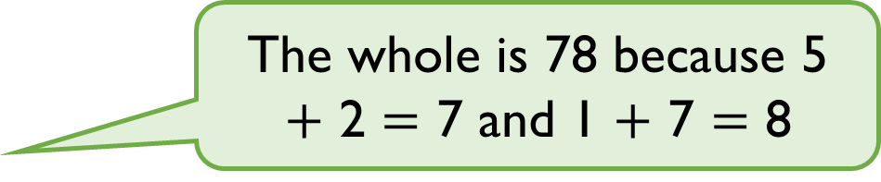
Amir has been asked to complete the bar model.
Explain to Amir what he has done wrong. How could you help him work out the correct total?
?
52 | 17
The whole is 78 because 5 $+$ 2 $=$ 7 and 1 $+$ 7 $=$ 8

Slide 31
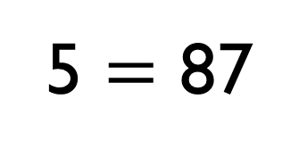
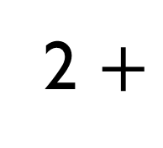
What digits could go in the boxes?
2 $+$
5 $=$ 87
8
2
3
5
7
6
4
1
9

Slide 32
Can you create a calculation where there will be an exchange in the ones and your answer will have two ones and be less than 100?

Slide 33
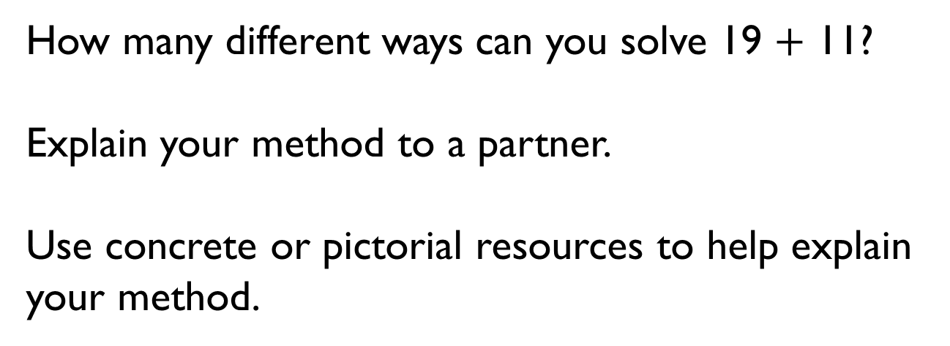
How many different ways can you solve 19 $+$ 11?
Explain your method to a partner.
Use concrete or pictorial resources to help explain your method.

Slide 34
Find all the possible pairs of numbers that can complete the addition.
How do you know you have found all the pairs?
What is the same about all the pairs of numbers?
1
2
4
2
1

Slide 35
Annie has 33 stickers.
Dexter has 54 stickers.
How many more stickers does Dexter have?
What method did you use to solve the problem?

Slide 36
Find the missing numbers.
Is this the only possible solution? Explain your answer.
Make the numbers using Base 10 to help you find your answer.
6
2
4
2

Slide 37

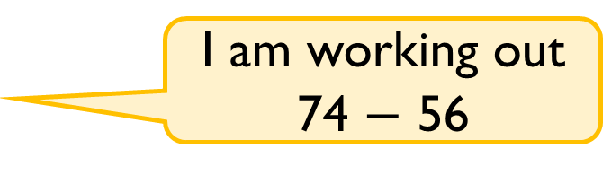
Eva and Whitney are working out some subtractions.
Whitney’s answer is double Eva’s answer.
What could Eva’s subtraction be?
One of my numbers in my question is 15
Eva
Whitney
I am working out
74 $−$ 56

Slide 38
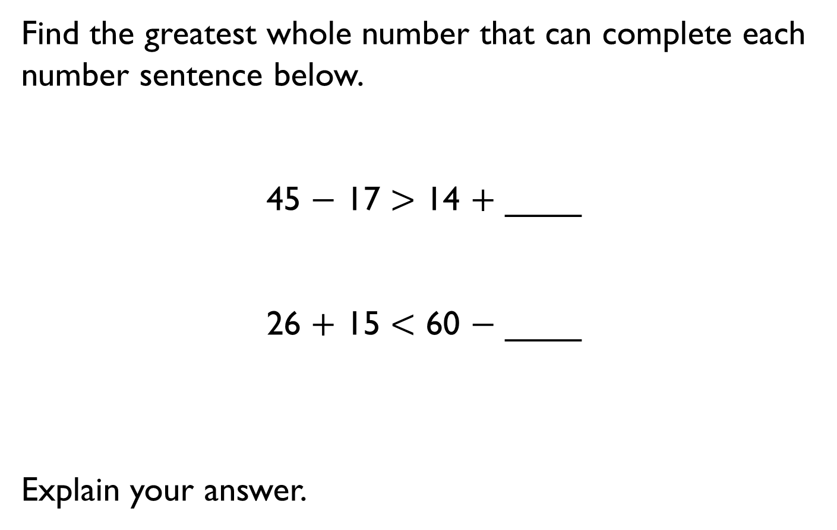
Find the greatest whole number that can complete each number sentence below.
45 $−$ 17 $>$ 14 $+$ ____
26 $+$ 15 $<$ 60 $−$ ____
Explain your answer.

Slide 39
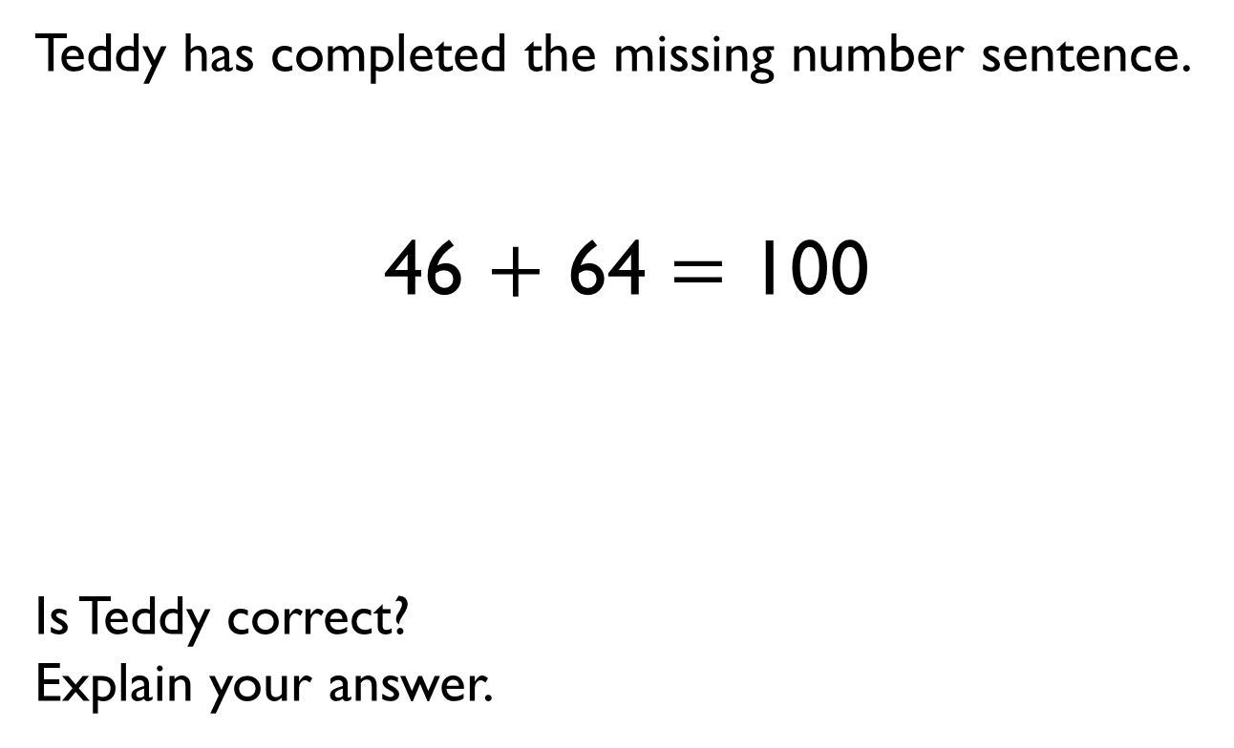
Teddy has completed the missing number sentence.
46 $+$ 64 $=$ 100
Is Teddy correct?
Explain your answer.

Slide 40
Each row and column adds up to 100.
Complete the grid.
45
45
35
15
65

Slide 41
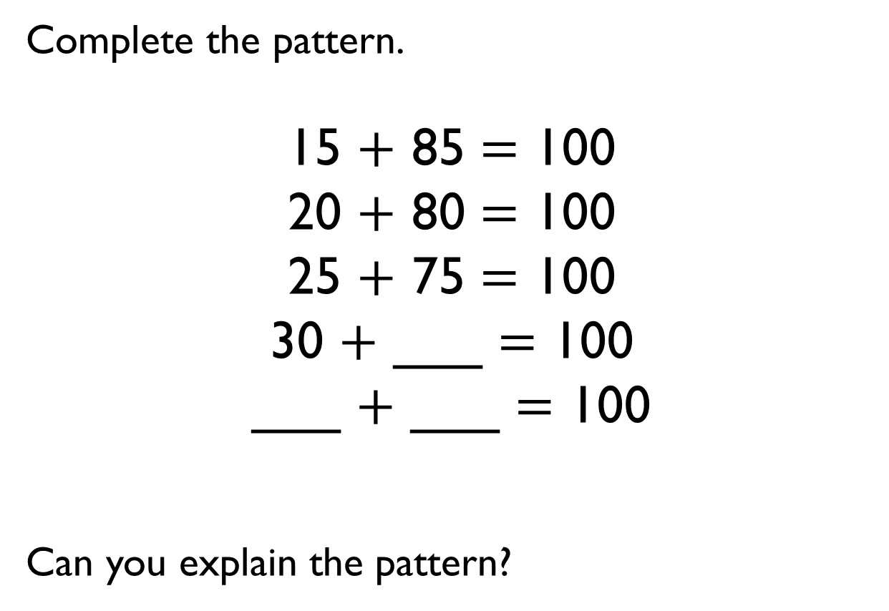
Complete the pattern.
15 $+$ 85 $=$ 100
20 $+$ 80 $=$ 100
25 $+$ 75 $=$ 100
30 $+$ ___ $=$ 100
___ $+$ ___ $=$ 100
Can you explain the pattern?

Slide 42










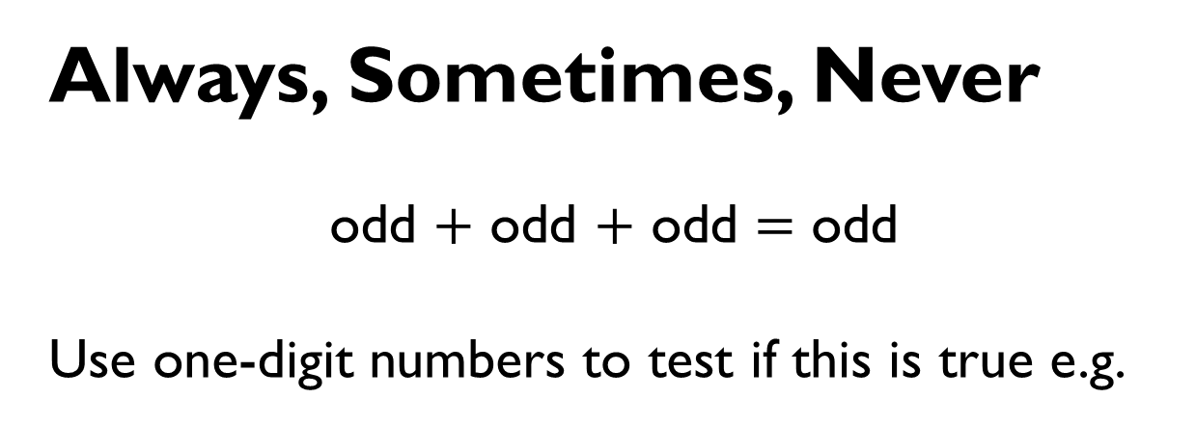

Always, Sometimes, Never
odd $+$ odd $+$ odd $=$ odd
Use one-digit numbers to test if this is true e.g.
3 $+$ 5 $+$ 7

Slide 43
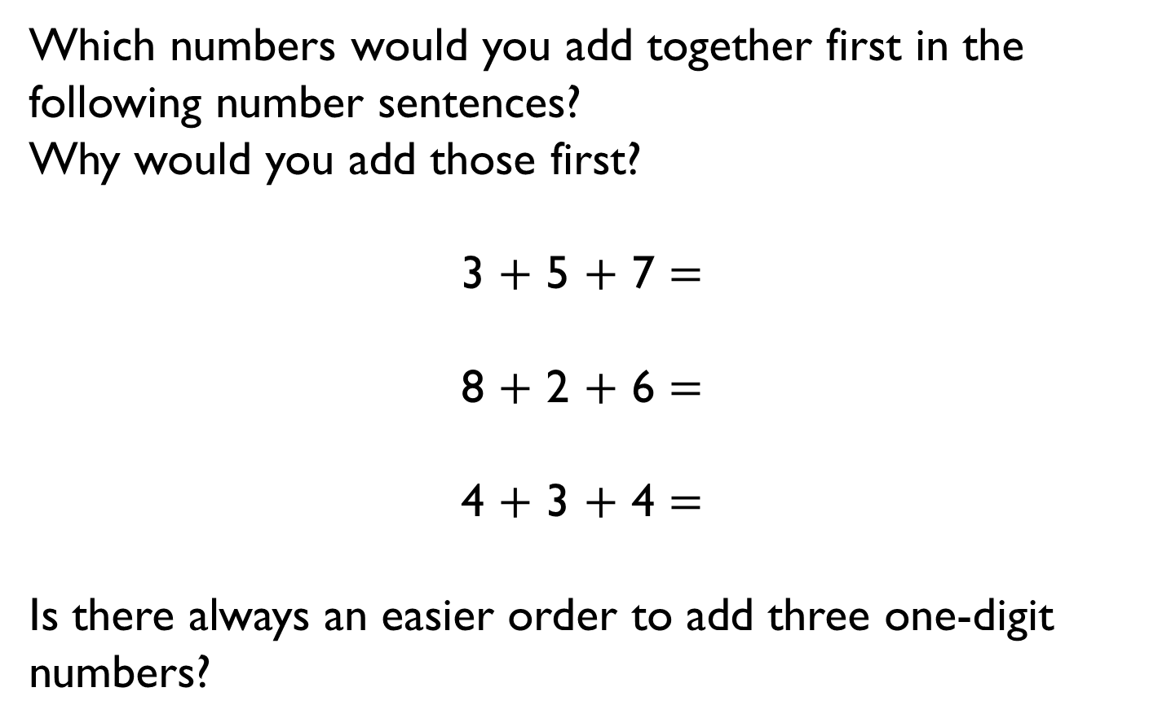
Which numbers would you add together first in the following number sentences?
Why would you add those first?
3 $+$ 5 $+$ 7 $=$
8 $+$ 2 $+$ 6 $=$
4 $+$ 3 $+$ 4 $=$
Is there always an easier order to add three one-digit numbers?

Slide 44
Take 3 consecutive one-digit numbers, e.g. 4, 5 and 6.
Add them together.
What do you notice?
Choose different groups of 3 consecutive one-digit numbers and see if there is a pattern.
8
2
3
5
7
6
4
1
9

