Slide 1




Year 2 - Autumn - Block 4
Multiplication & Division

Slide 2









Which group of money is the odd one out?
Explain why.

Slide 3
Sort into equal and unequal groups.
Create your own picture to go in each column.
Equal Groups | Unequal Groups

Slide 4


Spot the mistake.
Alex says, “There are 10 equal groups with 2 in each group. There are ten 2s.”

Slide 5



Has Eva shown the equal groups correctly?
Draw or use cubes to show what Eva should have done.

Slide 6
How can you make the groups equal?

Slide 7











Match the equal groups.
Three 5s
Two 10s
Two 3s

Slide 8



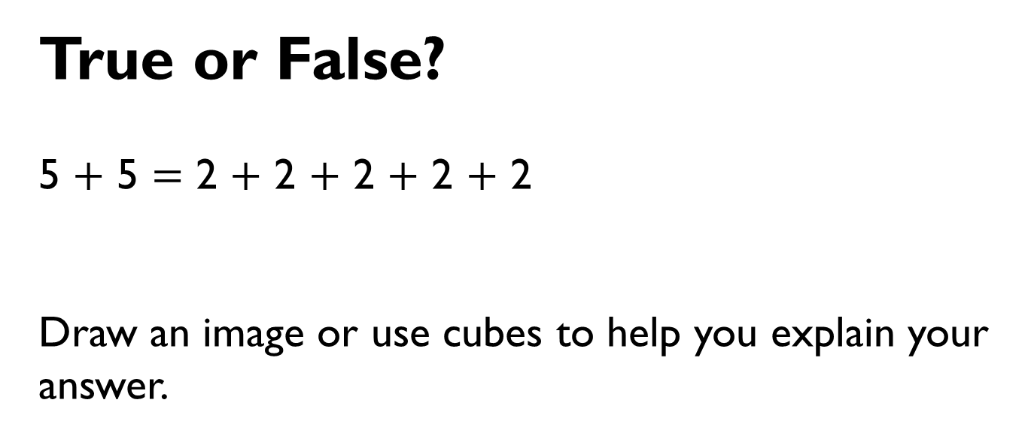
True or False?
5 $+$ 5 $=$ 2 $+$ 2 $+$ 2 $+$ 2 $+$ 2
Draw an image or use cubes to help you explain your answer.

Slide 9


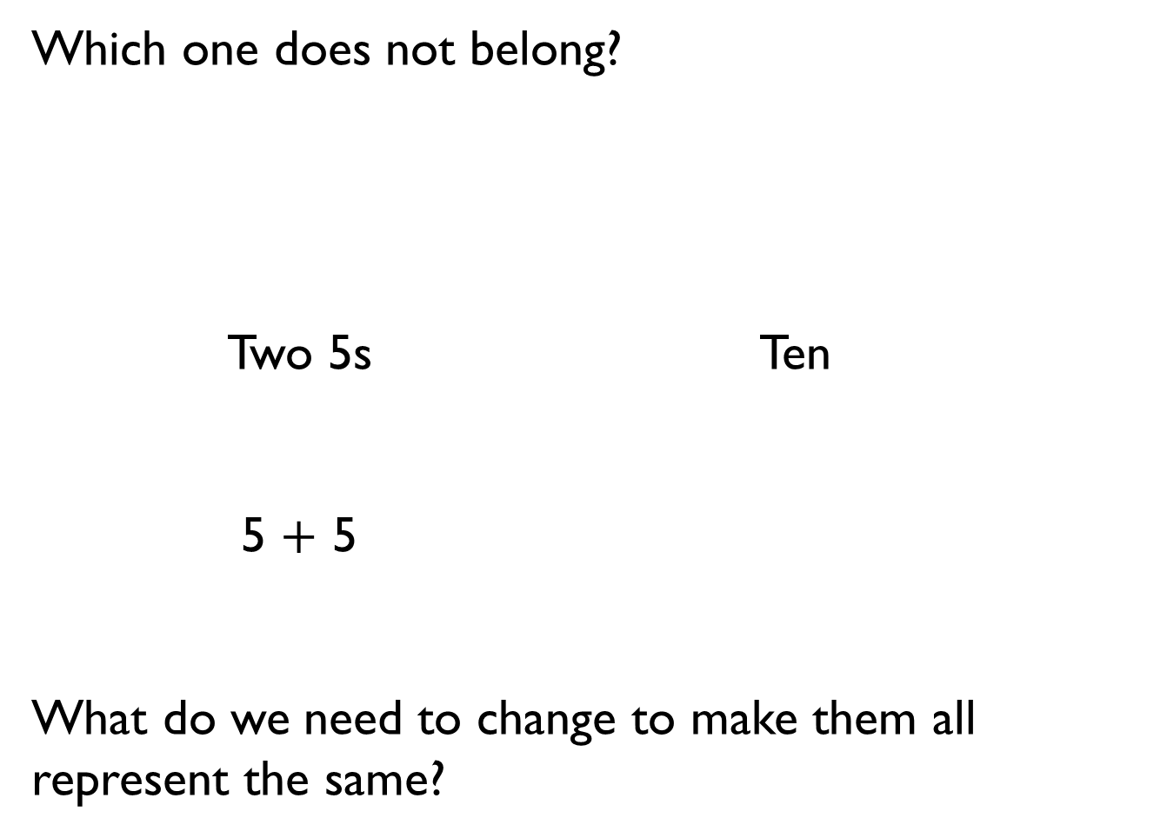
Which one does not belong?
Two 5s Ten
5 $+$ 5
What do we need to change to make them all represent the same?

Slide 10

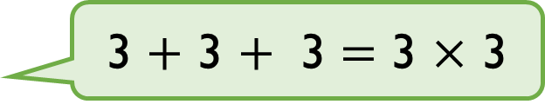
Is Mo correct? Explain why.
Draw an image to help you.
Mo
3 $+$ 3 $+$ 3 $=$ 3 $×$ 3

Slide 11



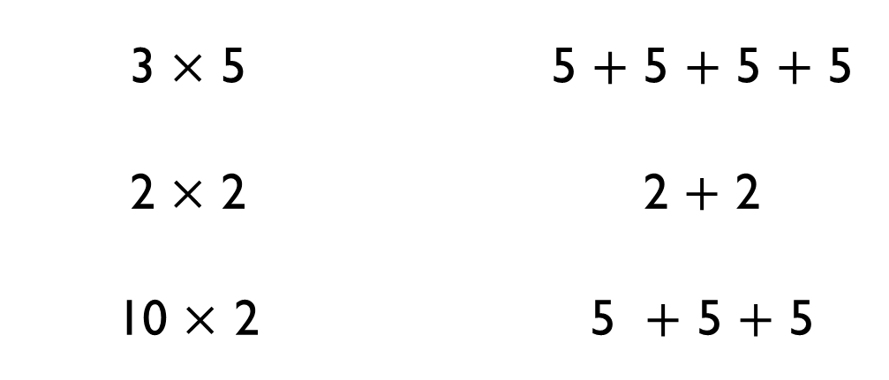
Use $<$, $>$ or $=$ to make the statements correct.
3 $×$ 5 |  | 5 $+$ 5 $+$ 5 $+$ 5
2 $×$ 2 |  | 2 $+$ 2
10 $×$ 2 |  | 5 $+$ 5 $+$ 5
$$=$$
$$<$$
$$>$$

Slide 12

Think of a multiplication to complete:
6 $+$ 6 $+$ 6 $>$ ___ $×$ ___

Slide 13
The total is 12, what could the addition and multiplication be?

Slide 14
There are four baskets.
There are three dolls in each basket.
How many dolls are there altogether?
Draw an image and write a calculation to represent the problem.

Slide 15
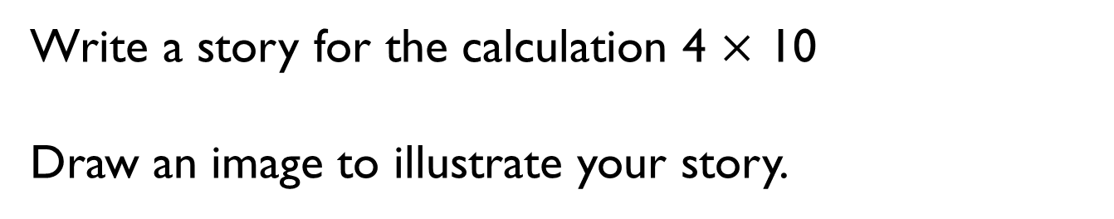
Write a story for the calculation 4 $×$ 10
Draw an image to illustrate your story.

Slide 16
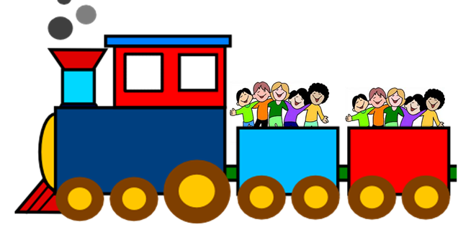

Each calculation could explain the image.
Explain why.
2 $×$ 5
5 $+$ 5
5 $×$ 2

Slide 17

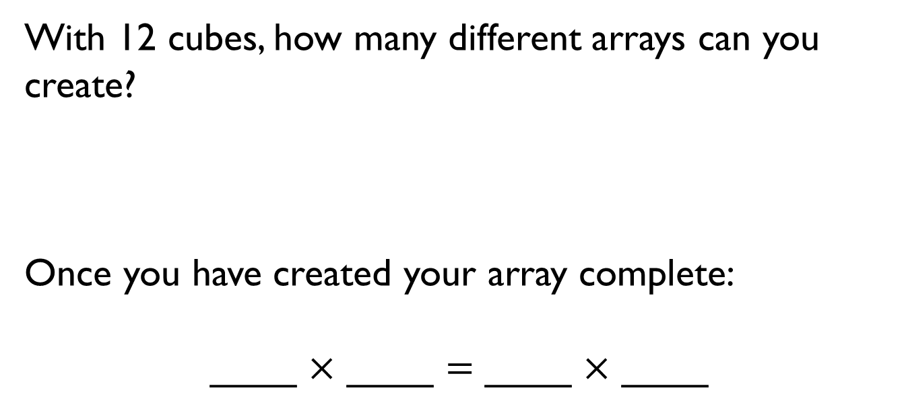
With 12 cubes, how many different arrays can you create?
Once you have created your array complete:
____ $×$ ____ $=$ ____ $×$ ____

Slide 18
Find different ways to solve six lots of three.

Slide 19
Part of this array is hidden.
The total is less than 16
What could the array be?

Slide 20
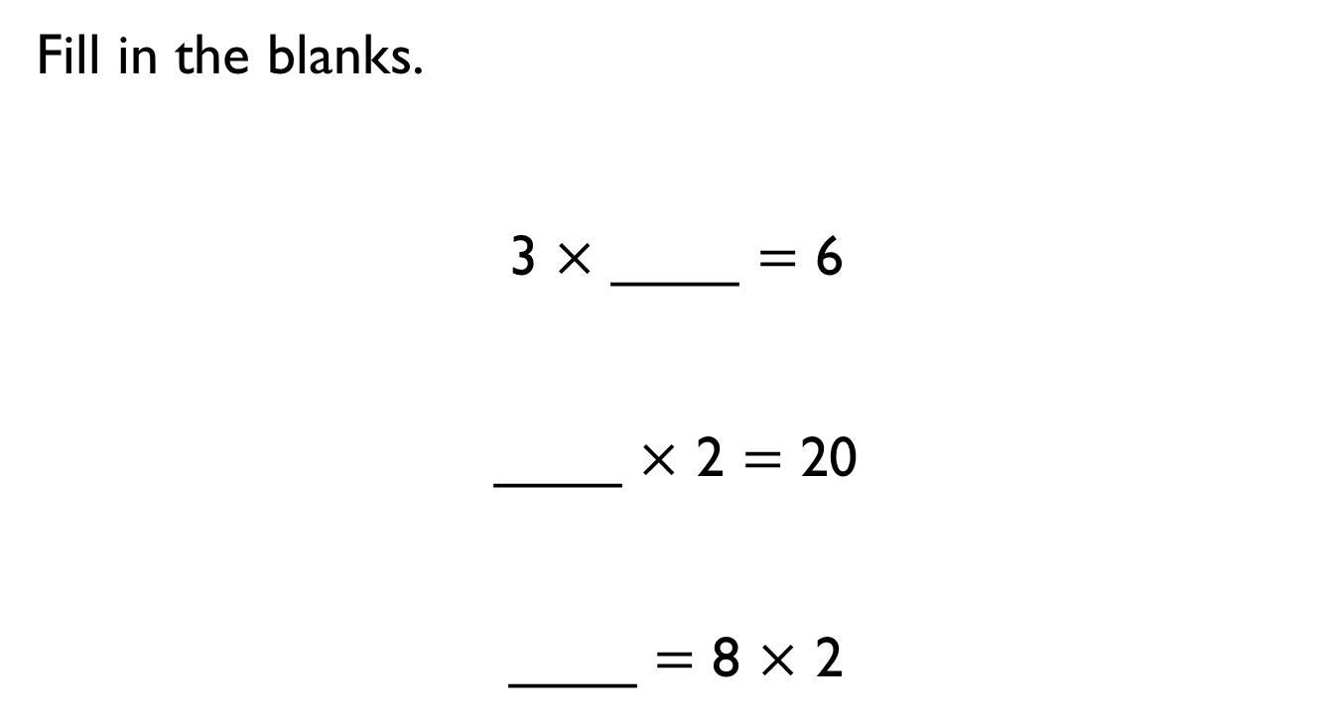
Fill in the blanks.
3 $×$ ____ $=$ 6
____ $×$ 2 $=$ 20
____ $=$ 8 $×$ 2

Slide 21
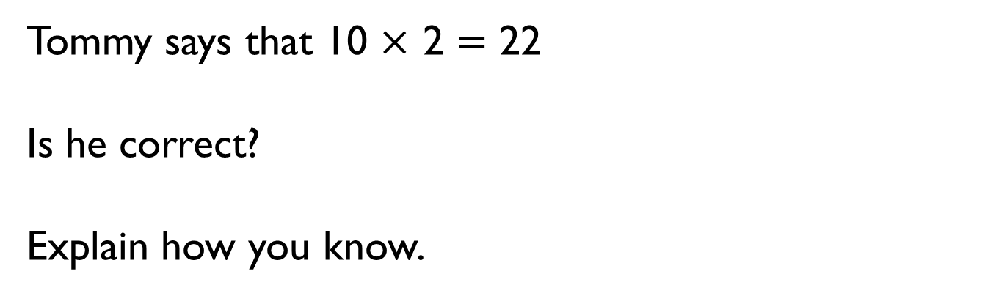
Tommy says that 10 $×$ 2 $=$ 22
Is he correct?
Explain how you know.

Slide 22

Eva says,
Is she correct? Explain your answer.
Eva
Every number in the 2 times-table is even.

Slide 23

Is Mo correct?
Explain your answer.
Mo
Every number in the 5 times-table is odd.

Slide 24
Tubes of tennis balls come in packs of 2 and 5
Whitney has 22 tubes of balls.
How many of each pack could she have?
How many ways can you do it?

Slide 25


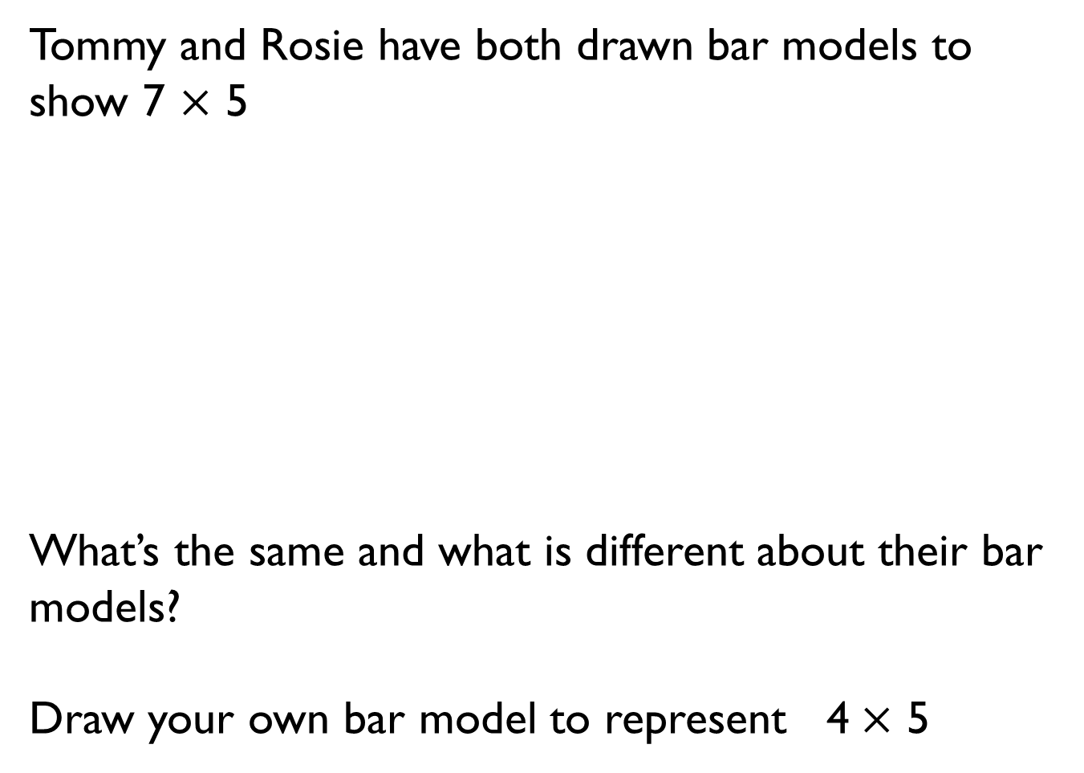
Tommy and Rosie have both drawn bar models to show 7 $×$ 5
What’s the same and what is different about their bar models?
Draw your own bar model to represent 4 $×$ 5
Tommy
Rosie
35
5 | 5 | 5 | 5 | 5 | 5 | 5
35
7 | 7 | 7 | 7 | 7

Slide 26

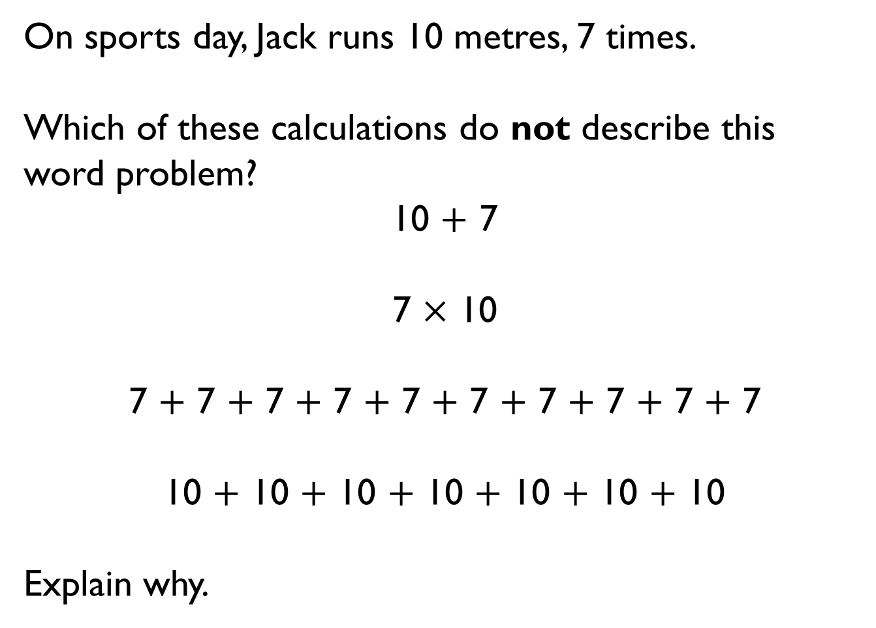
On sports day, Jack runs 10 metres, 7 times.
Which of these calculations do not describe this word problem?
10 $+$ 7
7 $×$ 10
7 $+$ 7 $+$ 7 $+$ 7 $+$ 7 $+$ 7 $+$ 7 $+$ 7 $+$ 7 $+$ 7
10 $+$ 10 $+$ 10 $+$ 10 $+$ 10 $+$ 10 $+$ 10
Explain why.

Slide 27

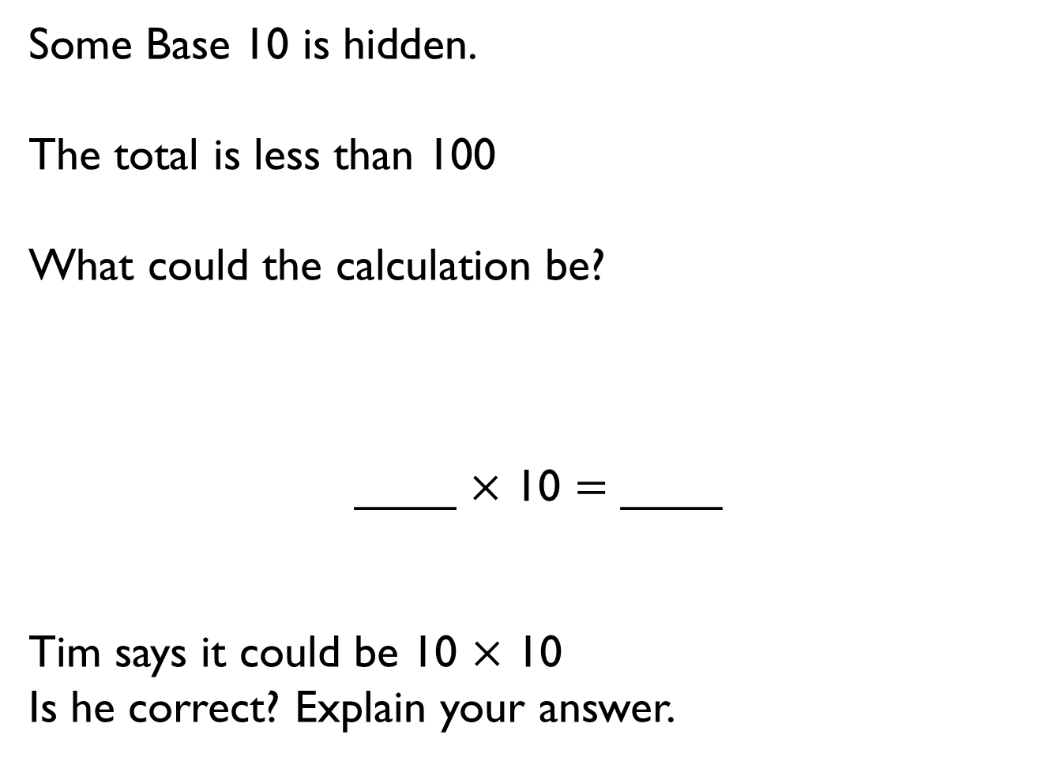
Some Base 10 is hidden.
The total is less than 100
What could the calculation be?
____ $×$ 10 $=$ ____
Tim says it could be 10 $×$ 10
Is he correct? Explain your answer.

