Slide 1




Year 1 - Autumn - Block 3
Shape

Slide 2


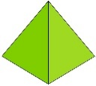




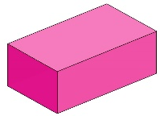

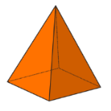
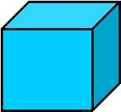
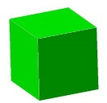
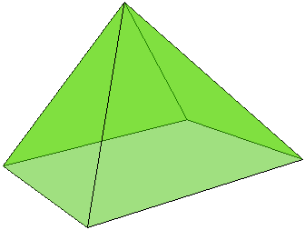
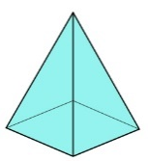

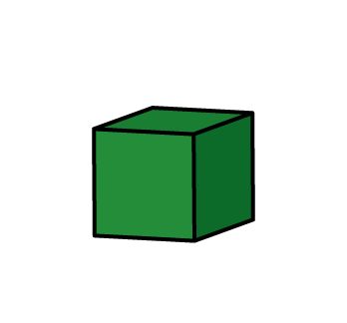

Put a selection of 3-D shapes in a feely bag.
Choose a shape. What do you think it is?
Explain how you know.

Slide 3
Use 3-D shapes to build a tower.
Which shapes are the best for the bottom of the tower?
Which shapes can only go on the top of the tower?
Can you use any of the shapes only in one orientation?

Slide 4
The bottom of a 3-D shape is hidden.
What shape could it be?
Explain how you know.

Slide 5




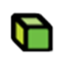
Some 3-D shapes have been sorted.
Have the shapes been sorted correctly?
Explain how you know.
How else could the shapes be sorted?

Slide 6
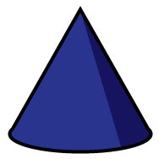
How many ways can you sort the shapes into groups?

Slide 7

Part of a shape is hidden.
What shape could it be?
Is there more than one possibility?
Explain your thinking.

Slide 8

Here is part of a shape.
How many different ways can you complete the shape using one or more straight lines?
Compare your shape with a partner.
What is the same and what is different?

Slide 9
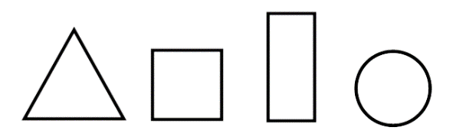
Use a selection of triangles, rectangles, squares and circles.
Put your shapes into groups.
Ask a partner to label your groups.
How many different groups can you create?

Slide 10
Tommy says that all shapes with 4 sides are squares.
Is Tommy correct?
Prove it.

Slide 11
Eva has sorted some shapes.
Squares Not Squares
Has she sorted them correctly?
Explain how you know.

Slide 12
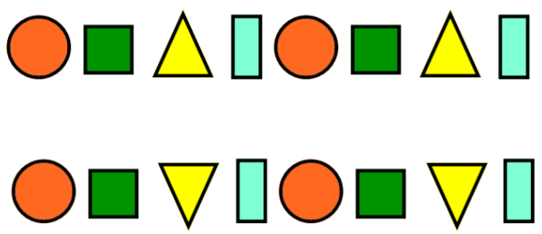


Amir and Eva are making patterns.
Eva -
Amir -
Who do you agree with?
Explain your answer.
Our patterns are exactly the same.
Our patterns are different.

Slide 13



Whitney is making a pattern in a circle.
Is Whitney’s pattern correct?
Explain why.
Can you make your own circular pattern using 3-D shapes?

